Slide 1
Drone based Face Recognition System
Presented by :
Deepjyoti Sarmah (Leader)
1181200068
Arunabha Dutta
1181200053
Tama Roy
1181200068
Under the guidance of :
Dr W.N. Singh

Slide 2
INTRODUCTION
Emerging technologies have increased the demand of products having more features. Nowadays combination of various techniques is the most essential criteria. Increasing demand of drones used for surveillance has given rise to the idea of face recognition drone where the drone recognizes the person next to it. The most challenging part in computer vision is Face detection and addition of this part to small drones. Proper utilization of power to get a better flight time was an essential part of designing.

Slide 3
Motivation
Drone surveillance has higher mobility and large surveillance scope in contrast to fixed cameras. There is a high demand for intelligent drones in real-world applications. However, face recognition in drone is different from traditional face recognition . The size varies in aerial photos from face instances. Not only because of spatial sensor resolutions but also because of the size differences within the same type of faces. Many times the faces are in motion. Faces in aerial photographs also appear in arbitrary directions. Hence, this work aims to discuss the state-of-the-art approaches in face recognition in drone and explore its real-time applications.

Slide 4
Drone and it’s categories
Different types of UAVs have different characteristics :
Single rotor UAV can carry heavy payloads but it has mechanical complexity which leads to high cost.
Multirotor UAV is a common type as its usage applies to both professionals and common people. It can hover or move along the given target.
Fixed-wing UAVs are high in flying speed and can carry heavy payloads but it needs a runway to takeoff and landing.
Hybrid UAV is an improved version of the fixed-wing but it is still under development.

Slide 5
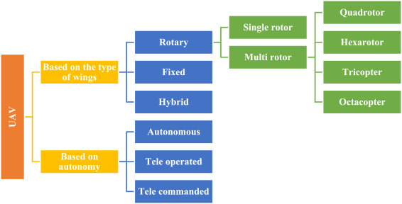

Slide 6
WHAT is a DRONE and its COMPONENTS:
Definition:
Essentially, a drone is a flying robot that can be remotely controlled or fly autonomously using software-controlled flight plans in its embedded systems, that work in conjunction with onboard sensors and a global positioning system (GPS).

Slide 7
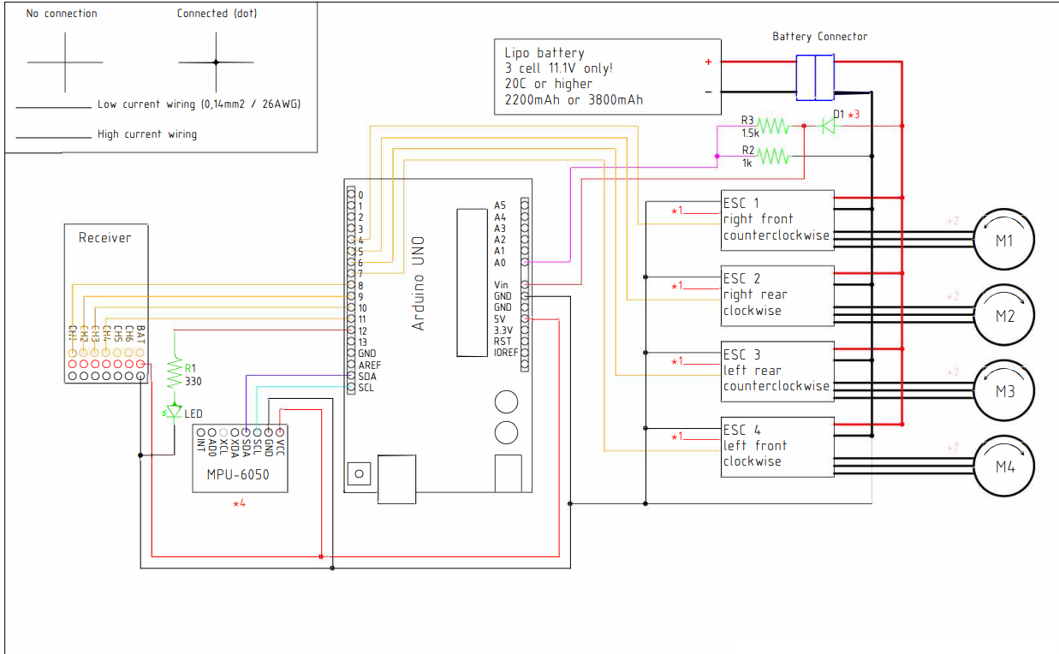
Drone Schematics:

Slide 8
Components:
Drone Flight Controller:
The flight controller is basically the motherboard of the drone. It is responsible for all the commands that are issued to the drone by the pilot. It interprets input from the receiver, the GPS Module, the battery monitor and the onboard sensors. The flight controller is also responsible for the regulation of the motor speeds through the ESC and for the steering of the drone. Any commands such as triggering of the camera, controlling the autopilot mode and other autonomous functions are controlled by the flight controller. Users will most likely not be required to make any alterations to the flight controller as this may often affect the performance of the drone.

Slide 9
Electronic Speed Controller(ESC):
An electronic speed controller (ESC) is an electric circuit whose main responsibility is to monitor and vary the speed of the drone during flight. It is also responsible for the direction of flight and variations in brakes of the drone. The ESC is also responsible for the conversion of DC battery power to AC power to propel the brushless motors. Modern drones depend entirely on the ESC for all their flight needs and for performance. More and more companies are coming up with better performing ESC that reduce power needs and increase performance, the latest one being the DJI Inspire 1 ESC. The ESC is mainly located inside the mainframe of the drone. It is unlikely that you will need to do anything or make any change on the ESC but in case you need to make any changes, you can locate it inside the mainframe of the drone.

Slide 10
Challenges in Drone based Face Recognition
In drone videos, the camera is placed at a higher altitude and the scene contains more contextual information.
However, changes in viewpoint, and changes in scale make the face detection task in drones more challenging than traditional face detection.
In a traffic surveillance scenario, drones record traffic from a bird's eye view. The advantage of this to 100 m in height to record vehicle traffic.

Slide 11
Face detection from a bird's eye perspective is more challenging than the front-parallel view for the following aspects,
The dynamic transition of moving objects.
Changes in aspect ratio and image scale.
Abrupt camera motion.
Severe perspective distortion.
Motion blur.
The high density of objects.
Complex background.

Slide 12
What is a facial recognition algorithm?
The facial recognition algorithm is a method of building a biometric face model for further analysis and the face recognition process.
The algorithms perform three main tasks:
detect faces in an image, video, or real-time stream; calculate a mathematical model of a face; compare models to training sets or databases to identify or verify a person.

Slide 13
Face Recognition Methods:-
There are different methods for face recognition, some of which are as follows-
Principal Component Analysis Method (PCA)
Linear Discriminant Analysis Method (LDA)
Fisherface Method

Slide 14
Principal Component Analysis (PCA)
Principal Component Analysis (PCA) is a mathematical procedure that uses an square matrix with real values to convert a set of values of possiblily correlated M face images into a set of values of K uncorrelated variables called Eigenface
The number of Eigenfaces is always less than or equal to the number of original face images i.e., K < M

Slide 15
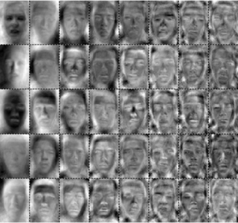
This transformation is defined in such a way that the first Eigenfaces shows the most dominant “direction/features” of the dataset and each succeeding component in turn shows the next most possible dominant “direction/features”, under the constraints that it be uncorrelated to the preceding components

Slide 16
To reduce the calculations needed for finding these eigenfaces, the dimensionality of the original dataset is reduced before they are calculated

Slide 17
Since Principal components shows the “directions” of data and each preceding components shows less “directions” and more “noise”, only few first eigenfaces are selected whereas the rest are discarded.
These K eigenfaces can safely represent the whole original dataset because they depict the majority of the “features”/”directions” that make up the data set

Slide 18
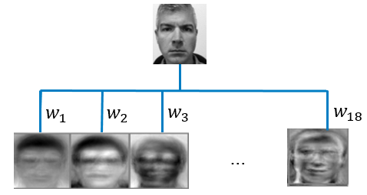
Therefore , each variable in the original dataset can be represented in terms of these K principal components

Slide 19
Representing a data point this way (as a combination of K principal components) reduces the number of values (from M to K) needed to recognize it
This makes the recognition process faster and more free of “error caused by noise “
The result of PCA are usually discussed in terms of
Component score (i.e., data point is made up of “how much” of each of K principal components.
And loading (the weight by which each standardized original variable should be multiplied to get the component score)

Slide 20
Merits and Demerits
Merits
Reduces dimensionality of Image
Simple , Fast and Robust
Image without disturbance are recognized fast
Demerits
Poor discriminating power
Insensitive to variation in face position, facial expression

Slide 21
Linear Discriminant Analysis(LDA):
A general statement of the problem of machine recognition faces can be formulated as follows: given still or video images of a scene, identify or verify one or more persons in the scene using a stored database.
Recognition of human faces is a very complex problem: lighting conditions, facial expressions vary from time to time; faces may appear at different scales, positions and orientations, facial hair.
So it presents difficulties like interclass similarity and intraclass variability due to head pose, illumination conditions, and expressions as shown in figure.

Slide 22
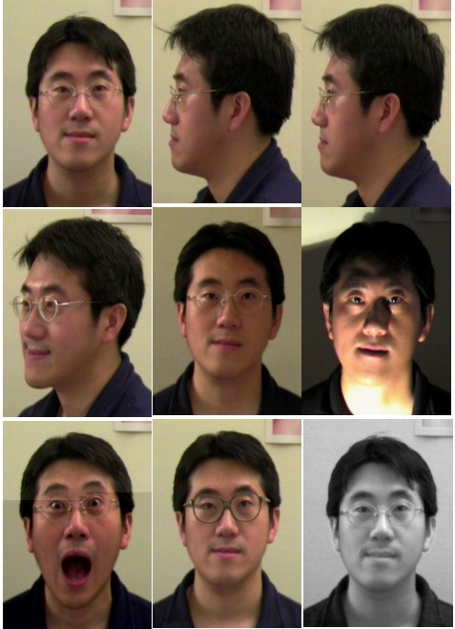

Slide 23
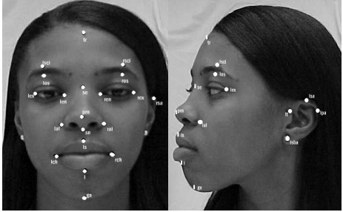
Methods that were proposed for face recognition:
Local feature matching method.
Holistic Matching method.
Hybrid methods.

Slide 24
Objective Focus:
We focus on the second based-appearance methods LDA: this approach includes two phases: training and classification. In the training phase, a fisher space is established from the training samples and the training faces are projected onto the same subspace. The optimal projection (transformation) can be readily computed by applying the Eigen decomposition on the scatter matrices.[4]
In the classification phase, an input face is projected into the fisher space and classified using the Euclidean distance as a similarity measure.[4]

Slide 25
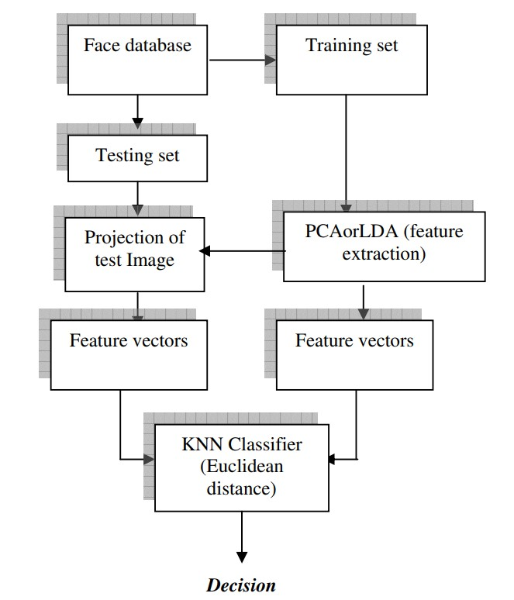

Slide 26


Algorithm used in Linear Discriminant Analysis:
Step 1:
We need a training set composed of a relatively large group of subjects with diverse facial characteristics. The appropriate selection of the training set directly determines the validity of the final results. The database should contain several examples of face images for each subject in the training set and at least one example in the test set.[3]
It is assumed that all images are already normalized to m × n arrays and that they contain only the face regions and not much of the subjects’ bodies.[3]
For appearance-based face recognition, a 2Dface image is viewed as a vector with length N in the high dimensional image space. The training set contains M samples belonging to C individual classes

Slide 27
Step 2:
For each image and sub image, starting with the two dimensional m × n array of intensity values I(x, y), we construct the vector expansion Φ R m× n. This vector corresponds to the initial representation of the face. Thus the set of all faces in the feature space is treated as a high-dimensional vector space.[3]
Step 3:
By defining all instances of the same person’s face as being in one class and the faces of different subjects as being in different classes for all subjects in the training set, we establish a framework for performing a cluster separation analysis in the feature space. Also, having labeled all instances in the training set and having defined all the classes, we compute the within-class and between-class scatter matrices. [3]

Slide 28
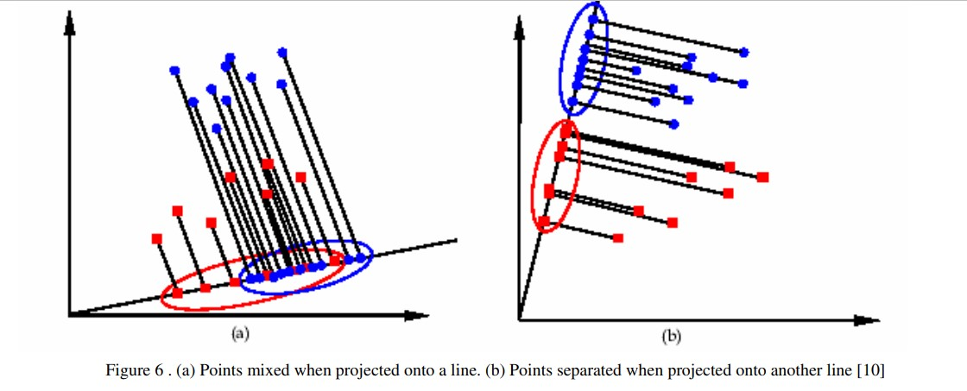

Slide 29
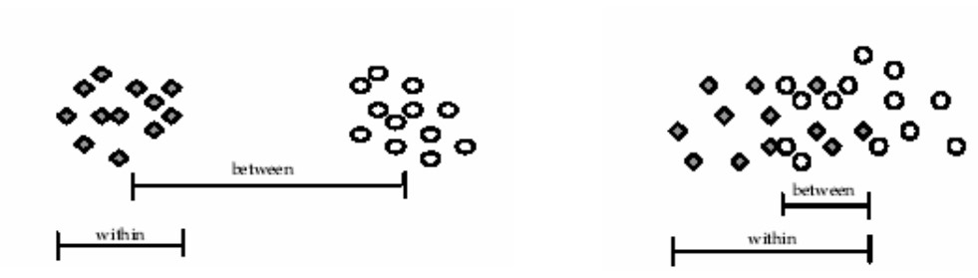

Slide 30
Conclusion Of Linear Discriminant Analysis:
Linear Discriminant Analysis method has been successfully applied to face recognition which is based on a linear projection from the image space to a low dimensional space. But the major drawback of applying LDA is that it may encounter the small sample size problem. When the small sample size problem occurs, the within-class scatter matrix becomes singular. Since the within-class scatter of all the samples is zero in the null space of Sw, the projection vector that can satisfy the objective of an LDA process is the one that can maximize the between-class scatter.
LDA is supervised method, while it is performed to solve a linear solution, we need also to propose a nonlinear solution like kernel method, the local linear embedding, the Isomap , the laplacianfaces that aims to preserve the local information while the unwanted variation can be eliminated or reduced. Support vector machine using kernel function aims to project the input data onto a high dimension feature space and then constructs an optimal separating hyperplane in that space.

Slide 31
Merits and Demerits
Merits
Face recognize of image without disturbance
Overcome the limitation of PCA
Demerits
Encounters small sample problem
Fails when scatter matrices are singular called as singularity problem

Slide 32
System Design
Structure of Quad:
-the basic principle used for drone is to make it produce an optimum amount of thrust which will help the drone to raise.
-comprises of object having 3 axes,at the center we have the main process going on.
-the small sized frames helps the drone to attain stability.
-separate space for battery is available which helps to manage components.
-the head consists of a small opening for camera.
Eg: The Glass fibre mini FPV Quadcopter frame.

Slide 33
The Glass fibre mini FPV Quadcopter frame.
The thickness- 1.5 mm,which can guarantee the flying ability of the quadcopter and effectively reduces the shake.
Length of wheelbase is 250mm,weight of the complete frame is 170g.
The fuselage is integrated by the aluminium alloy pillar for its intensity.
Fiberglass can be used to make the frame.

Slide 34
Flight controller
Can be said as a tiny intelligent pilot sitting inside the drone and navigates the drone through any difficult situation.
To achieve such results,the flight controller needs a lot of signals from various sensors.
The Ardupilot APM 2.8 is a professional quality IMU autopilot,with a mixture of varied sensors and modules.
It can support 8 RC channel with 4 serial ports which are useful to attach different type of receiver and sensors.

Slide 35
The power of a drone-battery
A drone is powered by batteries,which is the major drawback.
Because it gets exhausted after 15 mins of flight,causing a decrease drone on the ground.
Various kinds of batteries are: zinc-carbon, zinc-mercury,silver-zinc,lithium etc.
The lithium-polymer batteries are majorly used.
So we are going to use LIPO 3S battery. These batteries provide higher specific energy as compared to other lithium battery types.

Slide 36
Radio controller
Radio control is the use of control signals transmitted by radio to remotely control a device.
The transmitter enables control through radio waves and the receiver activates the motors
Fly sky fsi6X is the most impressive and advanced receiver transmitter pair.
Works in the bandwidth of 2.4 Ghz.
Its provides very less interference between other devices,also consumes less power with high reliable receiver.

Slide 37
Raspberry PI camera
The PI camera can be used in a face recognition drone because of its very small size and negligible weight,having high definition capturing capability.
The camera can be placed at the front of the drone to get the front view.
It can be directly attached to the raspberry PI.

Slide 38
Raspberry Pi module
It is an electronic device that works like a CPU,having several ports:a ethernet port and input port for micro SD card and output ports.
It has 64-bit ARM Cortex processor with 256 MB of RAM.
High efficiency
Supports linux,ARM, Mac operating system.
The operating system is first loaded in the micro SD card and installed in the PI.
PI is used to load the videos captured by camera and detect the face of person
GPIO pins are connected to other electronic devices to get the output.

Slide 39
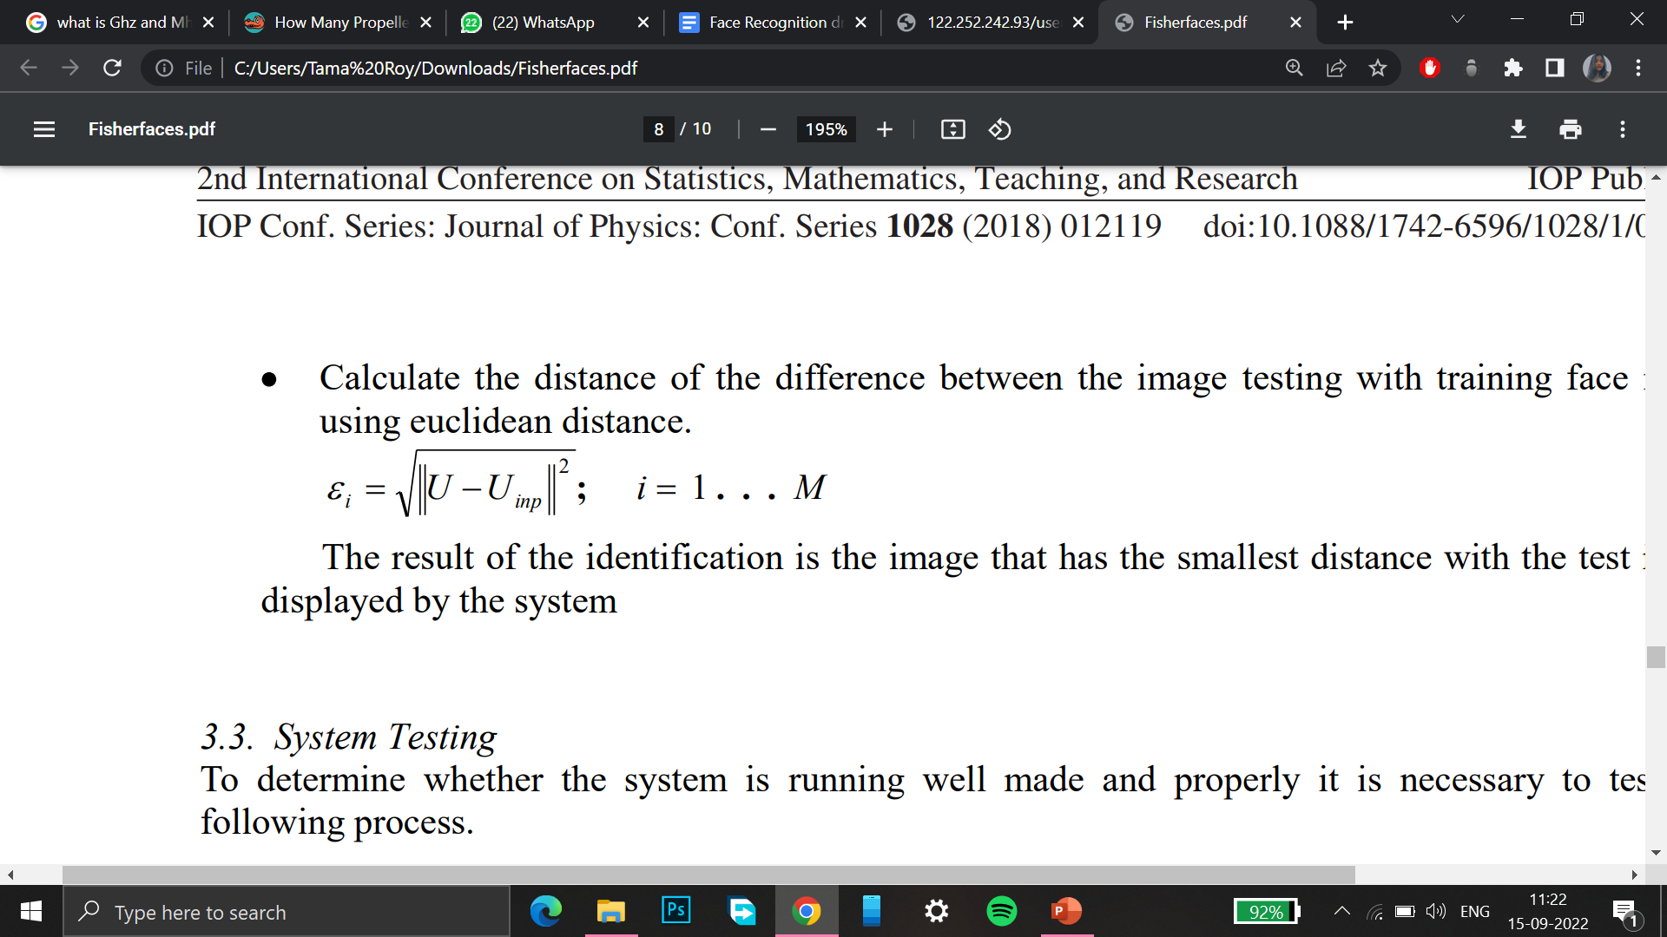
Fisherface method for face recognition
In 1997, Belheumeur has introduced the fisherface method for face recognition. It is designed to recognize the face image by matching the results of feature extraction.
The weakness of this method is that when the PCA reduces the dimensions,it causes some loss of discriminant information in the LDA process.
But in its development, face recognition with fisher method has still got some problems that is the computational problem and the condition of the face image into input that will be used as image testing.
The problem with computational is that it is way too complex process and the problem with with condition of the face is due to the light variations of the face image,the attributes of the face and the variation of the position of the image.
Feature generation process with Fisherface method is done by Euclidean distance formula

Slide 40
Merits and Demerits
Merits
Efficient in memory usage
High recognition success rate
Time efficient
Demerits
Difficult to compute covariance matrix

Slide 41
Conclusion
COMPARISON
Technique | Memory usage | Recognition Rate | Data Representation
LDA | Moderate | Better Than PCA. | Powerful than PCA.
PCA | High | Better Than Eigen and Fisherface. | Powerful Data Representation.
Fisherface | Most Efficient | Highest Recognition Rate. | Efficient Data Representation.

Slide 42
The project is made keeping the idea of surveillance in remote areas. It is difficult to run an operation in remote areas where an army’s life is always in danger and such technology can be used for better operation in such areas. It will help to prevent life of soldiers.
For future prospective we can use this drone for taking attendance purpose by just flying the drone throughout the room and it will detect and record the faces and make the attendance sheet without taking time and with zero effort .

