Slide 1
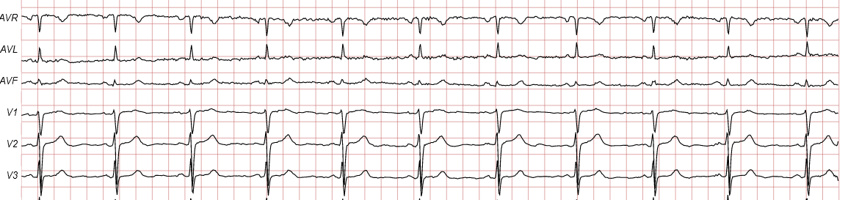
Transfer Learning for ECG Classification using PTB-XL
Project Presentation
Presented By Date
Deepkamal K. Gill 02/02/2022
Notes:
Add ecg image

Slide 2
Agenda
Introduction
Transfer Learning
Related Work
Data Summary and Methodology
Experiments and Results
Conclusion
Limitations and Future scope

Slide 3
Introduction
Cardiovascular diseases account for the death of every 1 in 4 persons in the US¹
An ECG (electrocardiography) records the electrical activity of heart at rest
Provides information about
heart rate and rhythm
enlargement of the heart due to high blood pressure (hypertension)
evidence of a previous heart attack (myocardial infarction)
Automated classification of ECG signals can aid in
Early diagnosis of heart diseases
¹https://www.cdc.gov/heartdisease/facts.htm

Slide 4
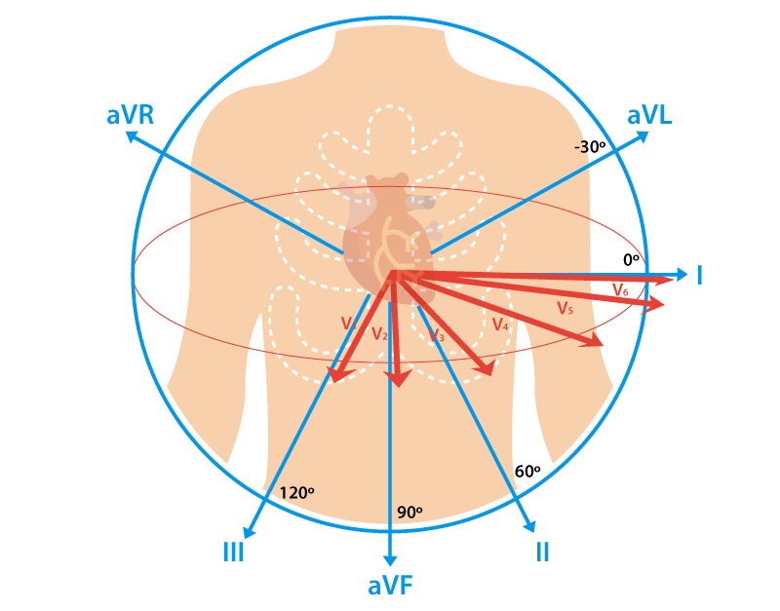
Challenges with ECG Data
Limited labeled data
Datasets recorded at different configurations
Signal frequency
Time duration
Diagnostic code formats
Only specific leads available
A 12-lead ECG paints a complete picture of the heart's electrical activity by recording information through 12 different perspectives.
Data Augmentation
Solution?
Semi-supervised Learning
Transfer Learning
Notes:
Read about other solutions for challenges

Slide 5
What is Transfer Learning?
Make use of knowledge gained while solving one problem and apply it to a related problem

Slide 6

What is Transfer Learning?
Make use of knowledge gained while solving one problem and apply it to a related problem

Slide 7
What is Transfer Learning?
Make use of knowledge gained while solving one problem and apply it to a related problem
A model trained on one task/dataset is re-purposed for a second related task/ dataset

Slide 8
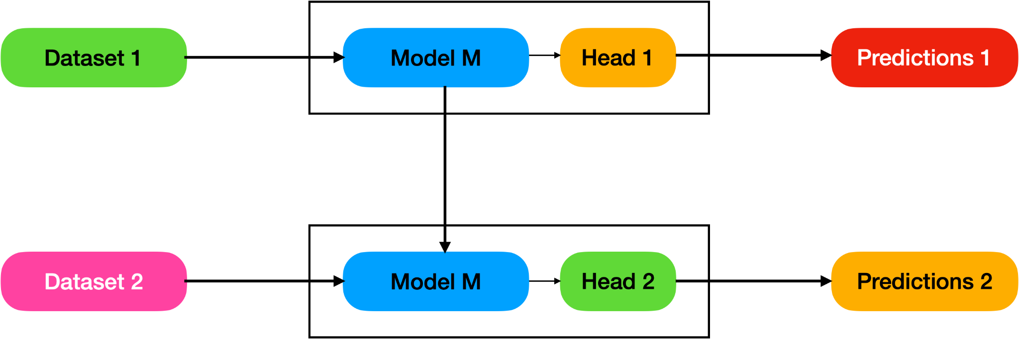
What is Transfer Learning?
A model trained on one task/dataset is re-purposed for a second related task/ dataset

Slide 9
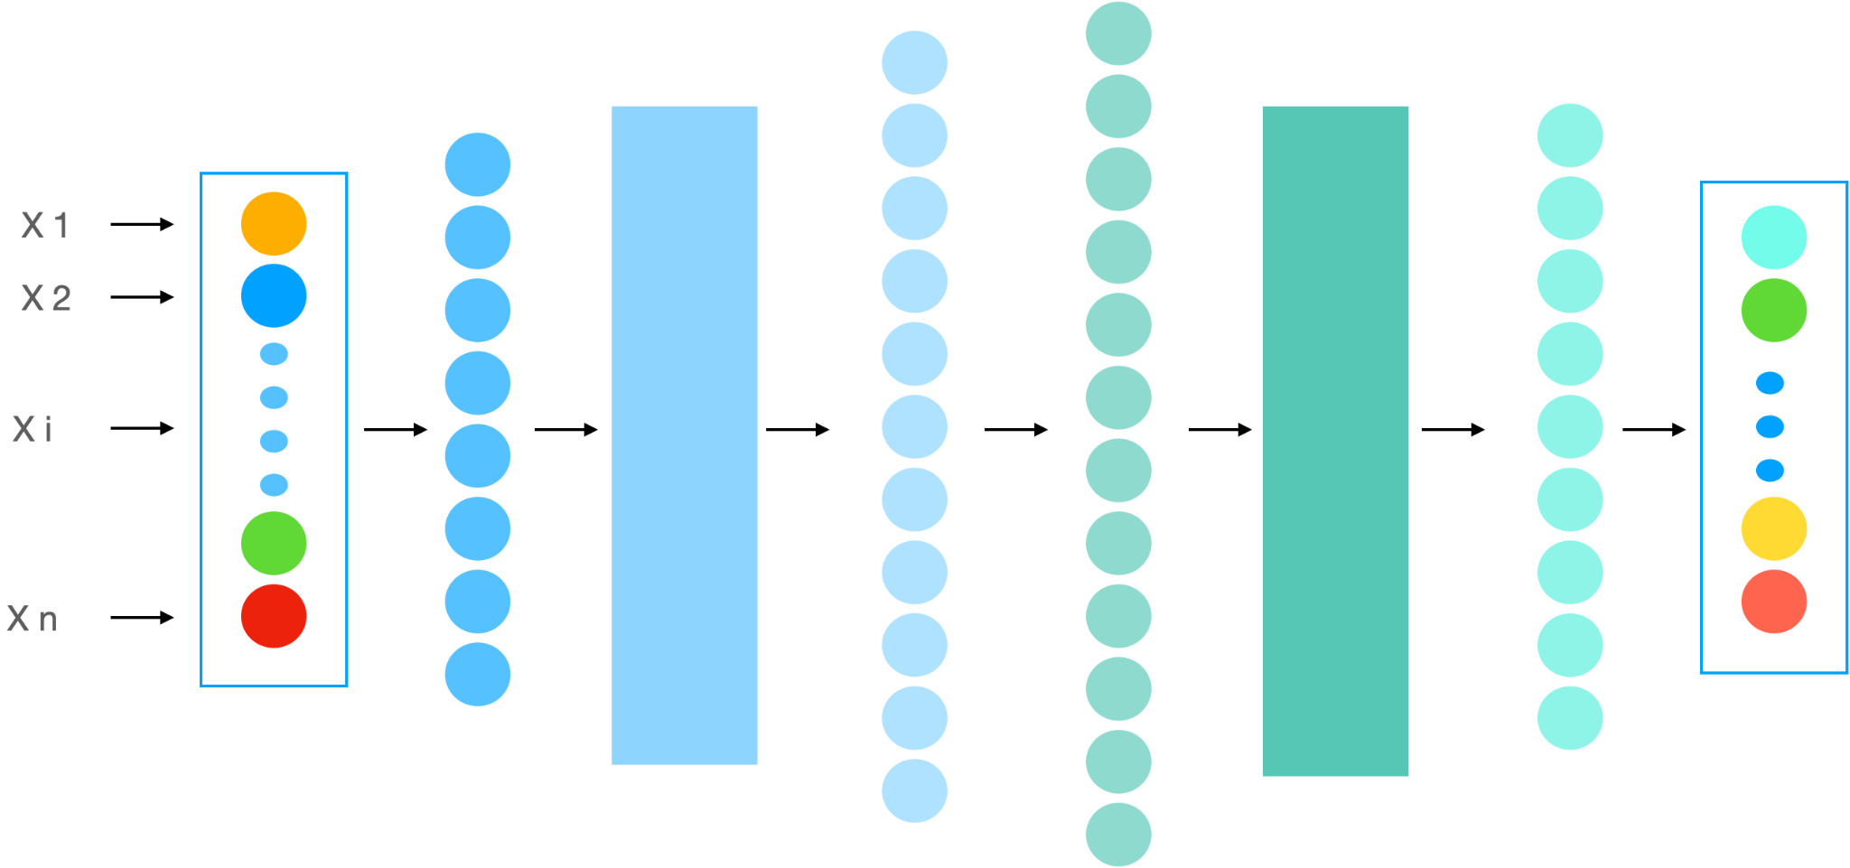
Gradual Unfreezing

Slide 10
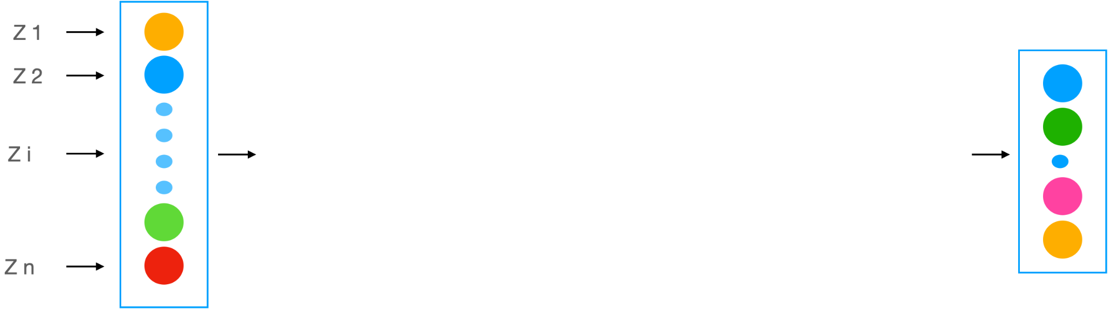
Gradual Unfreezing

Slide 11
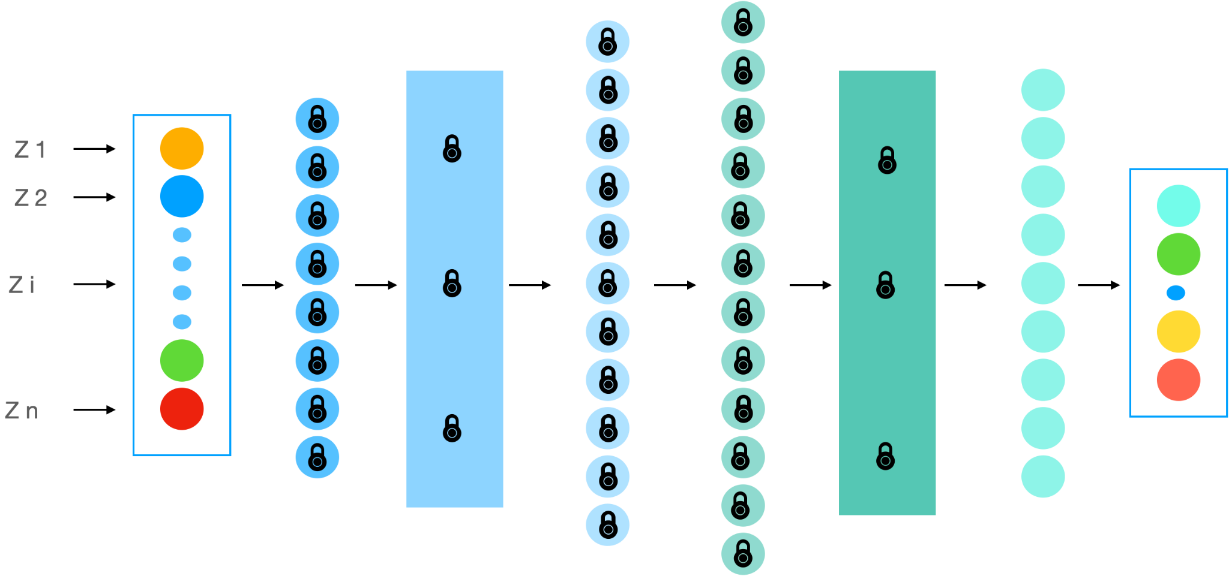
Gradual Unfreezing

Slide 12
Gradual Unfreezing
Freezing a layer prevents its weights from being modified.

Slide 13
Related Work
Most current research focuses on transfer learning for classification of specific heart abnormalities
Weimann et al. "Transfer learning for ECG classification." Scientific reports (2021)
This paper hypothesized that PTB-XL, largest 12-lead ECG dataset released recently, could serve as a prospective base dataset for transfer learning
Strodthoff, Nils, et al. "Deep learning for ECG analysis: Benchmarks and insights from PTB-XL." IEEE Journal of Biomedical and Health Informatics (2020)
Evaluation on data subsets to verify the potential of transfer learning
Jang, Jong-Hwan et al. "Effectiveness of Transfer Learning for Deep Learning-Based Electrocardiogram Analysis." Healthcare informatics (2021)
Notes:
The paper about transfer learning for ECG classification was one paper that motivated us to pursue this particular area. The paper used two ECG datasets to test transfer learning for <disease> classification. But this paper focussed on diagnosis of only one disease. A lot of other papers also focussed on diagnosis of just one disease. We have tried to go beyond that in our project.
The second paper published a dataset called PTB-XL that was the largest 12-lead available data till date. The authors conducted several benchmark experiments to evaluate the usability of the dataset. This is the paper that we built upon.
The third paper also performed transfer learning on ECG datasets <elaborate a bit more>. But they considered subsets of the data and evaluated their performance, which formed the basis for some our experiments.

Slide 14
Main Idea
Goal: Test whether PTB-XL is a good dataset for transfer learning for ECG classification
 | PTB-XL¹ (Base Dataset) | G12EC² (Evaluation Dataset)
No. of Records | 21,837 | 10,344
No. of Leads | 12
Frequency | 500 Hz
Time Duration | 10 seconds
Key Contributions:
Pre-train ECG classification model using PTB-XL
Finetune and evaluate performance on G12EC
Compare with the best standalone model trained on G12EC
¹https://physionet.org/content/ptb-xl/1.0.1/
²https://www.kaggle.com/bjoernjostein/georgia-12lead-ecg-challenge-database

Slide 15
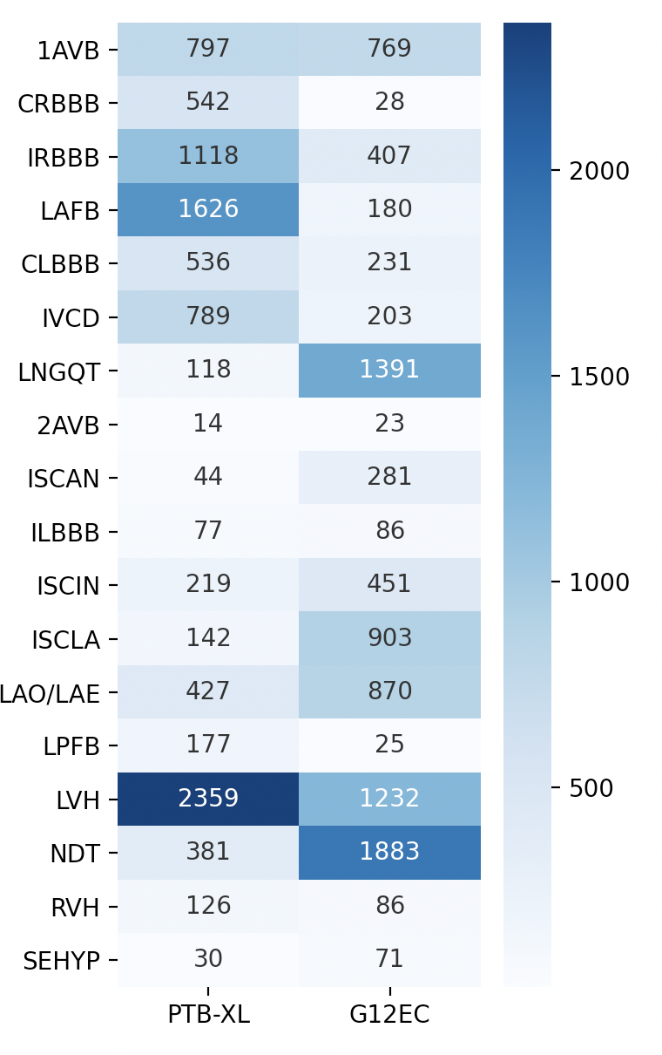
Data Summary
PTB-XL has 5 diagnostic superclasses and 44 subclasses
PTB-XL (44)
G12EC (24)
18
Label distribution for both datasets is quite different
Will transfer learning still work?
Notes:
We used only common labels and discarded labels with count<10
Why does transfer learning work and how does the difference in label distribution affect the result

Slide 16
Methodology
Notes:
why x-resnet 1d?

Slide 17
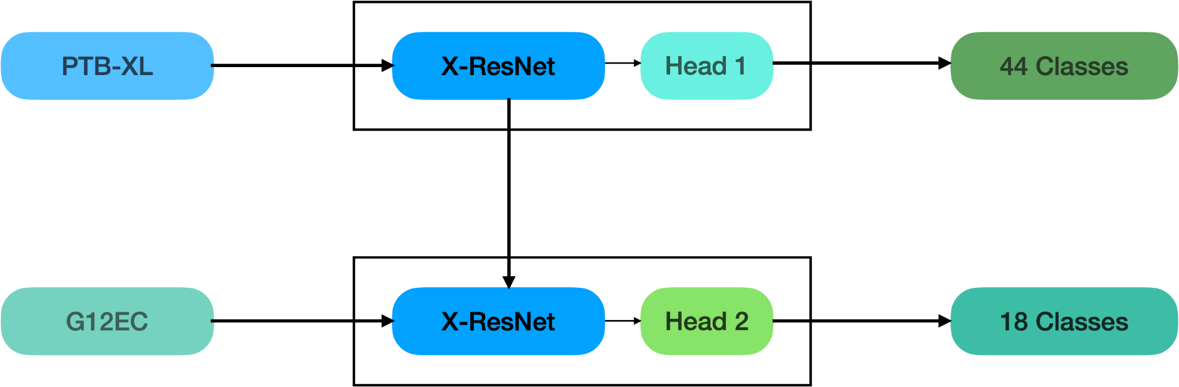
Methodology
*
*

Slide 18
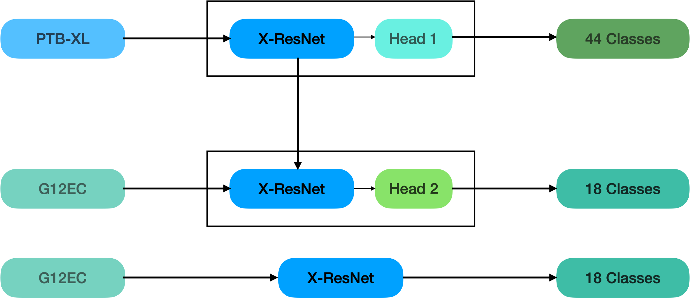
Methodology
*
*

Slide 19
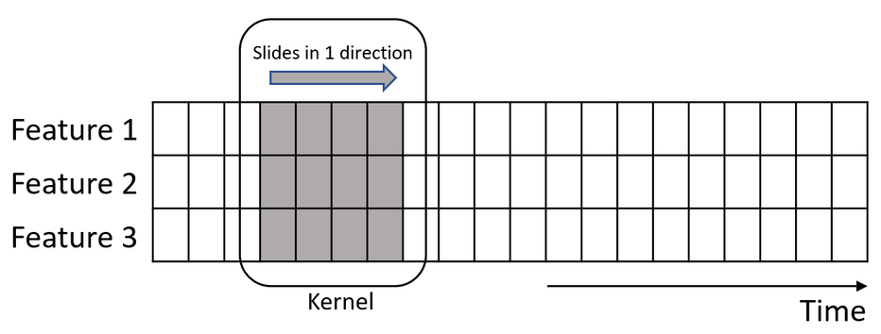
Why CNN for time-series data?
CNNs’s convolutions are popularly known to work on spatial or 2D data
Convolutions for 1D data can be used in general data types including texts and time series data
Use 1D convolutions to extract information along the time dimension

Slide 20
Why prefer CNNs?
CNNs are computationally cheaper than RNNs
CNNs don’t assume that history is complete
Sliding window approach used for this study
More active research in CNN

Slide 21
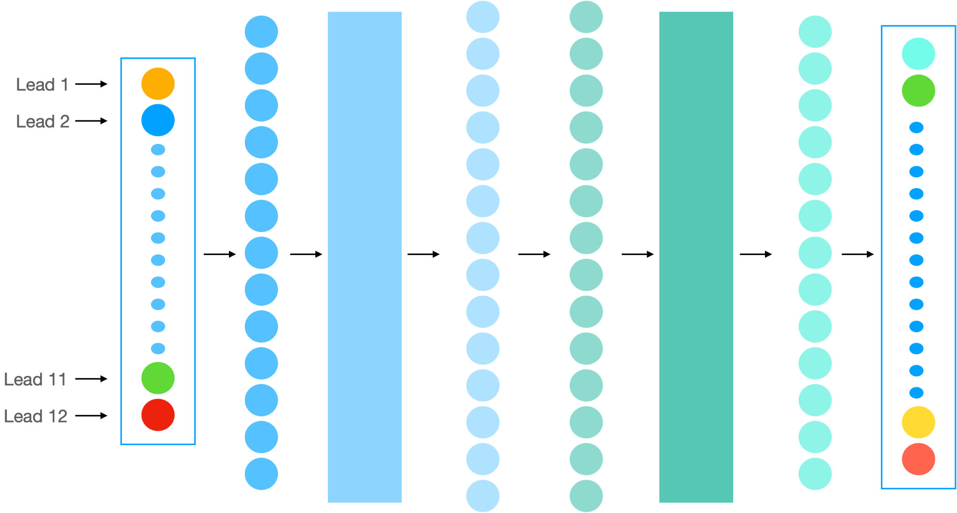
Methodology - Pre-training on PTB-XL
PTB-XL
44 Diagnostic
classes

Slide 22
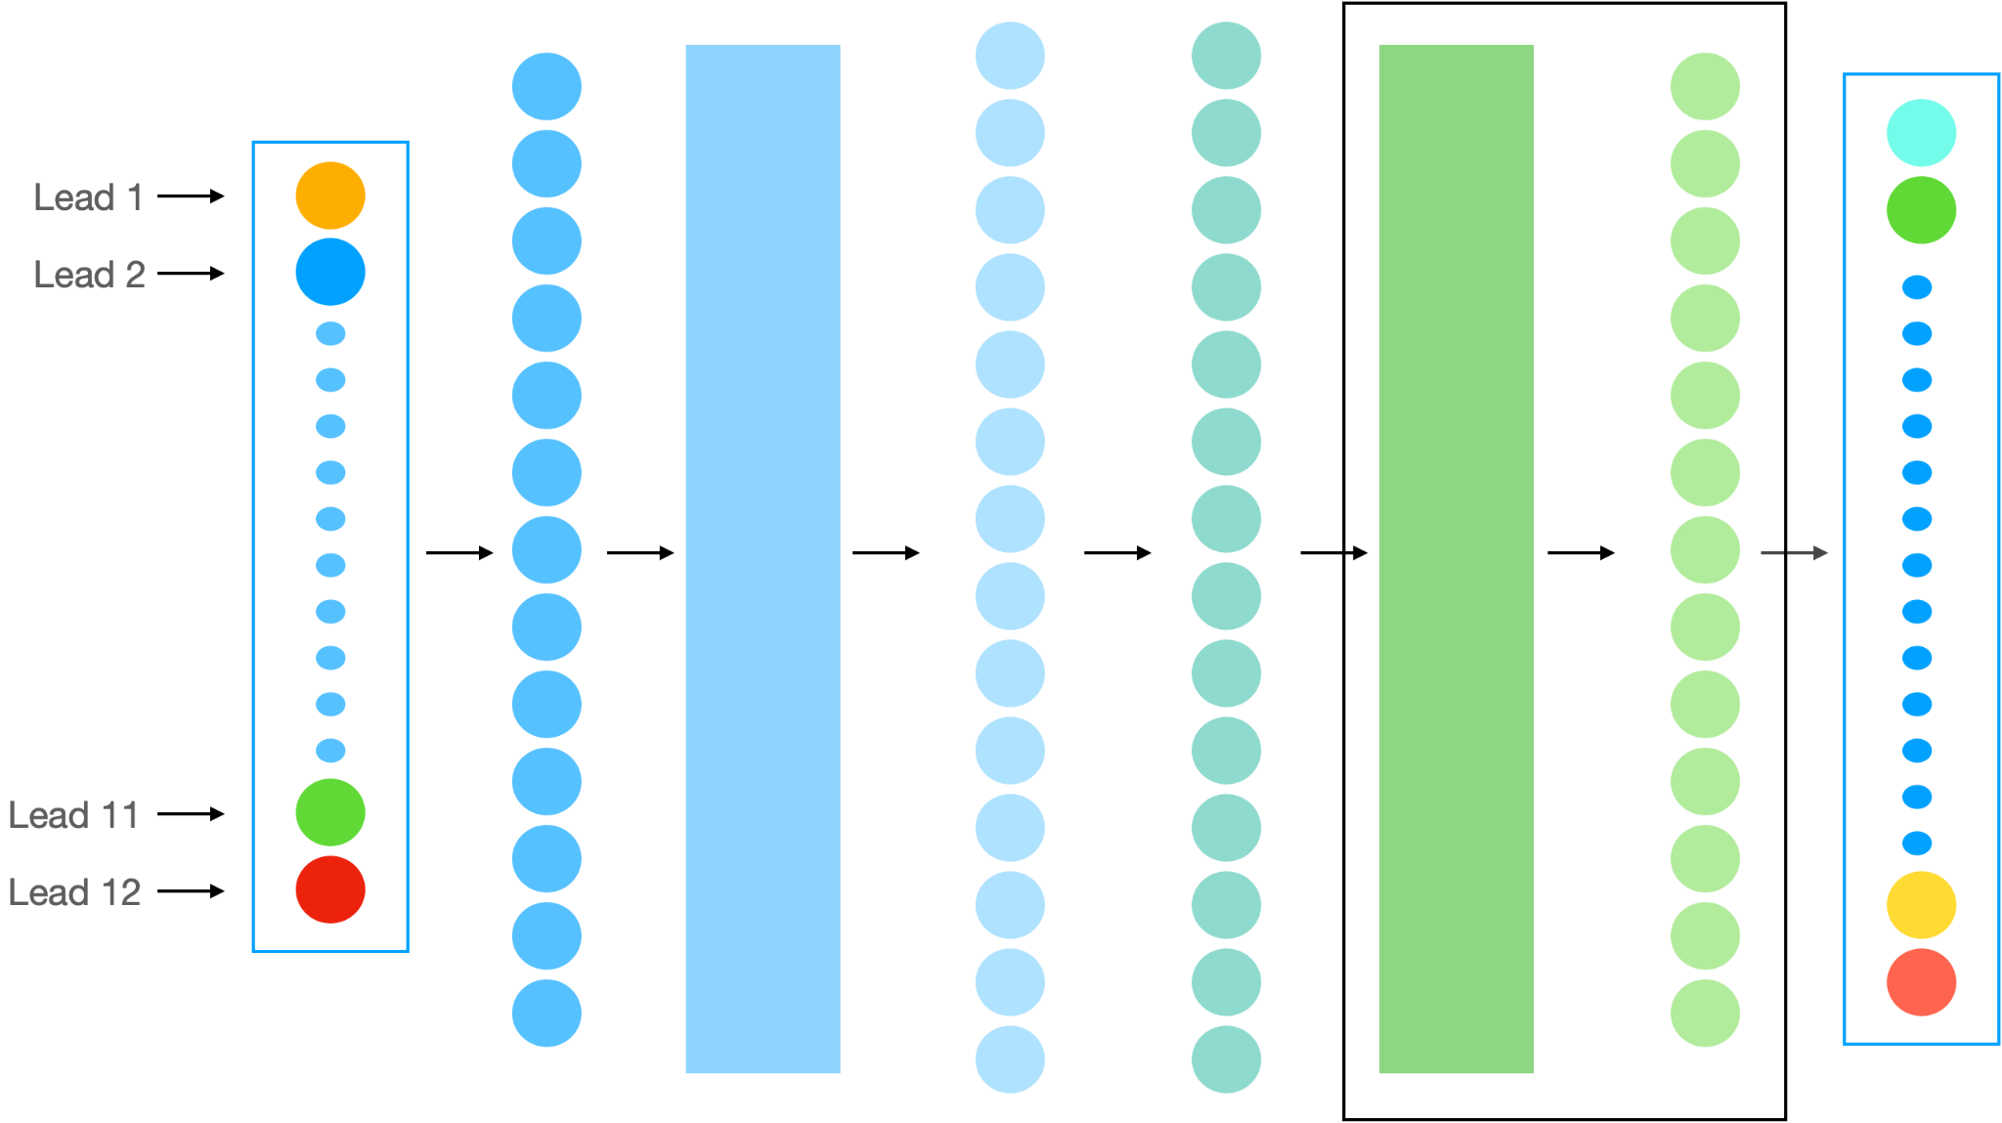
Methodology - Fine-tuning on G12EC
G12EC
18 Diagnostic
classes

Slide 23
Results
Performance of different models trained only on G12EC dataset (independent)
Model | Macro AUC
XResNet | 0.843
ResNet | 0.785
InceptionNet | 0.685
Performance of G12EC fine-tuned using model pre-trained on PTB-XL
Task | Macro AUC
PTB-XL Pre-training | 0.947
G12EC Fine-tuning | 0.919 (+0.076)
Notes:
Mention percentage improvement

Slide 24
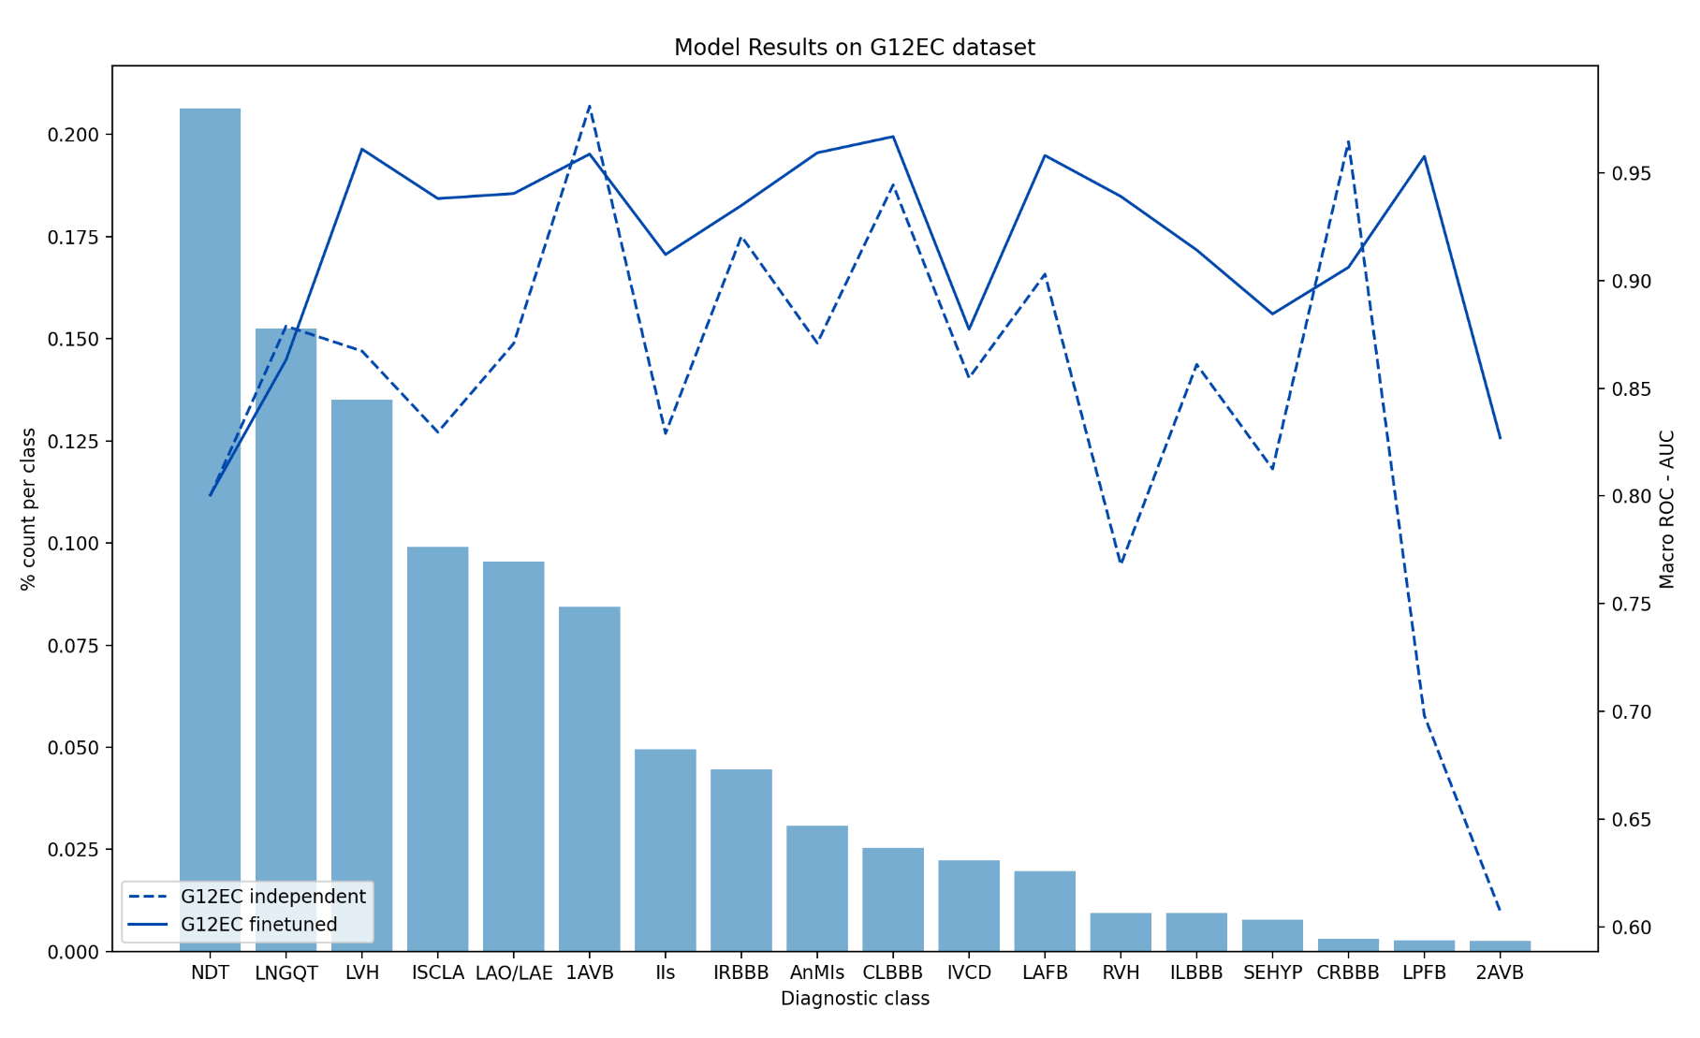
Results: Class-wise performance
Notes:
Fine tuned model performs better on 15 of 18 labels
LNGQT
1AVB
CRBB
Label support for these classes is significantly higher in G12EC than PTB-XL

Slide 25
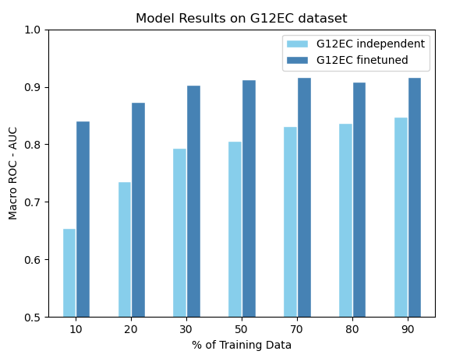
Experiment 1: Performance using G12EC subsets
Fine-tuned model performs consistently better than independent model
Gap increases as training data for fine-tuning is reduced
Test AUC of fine-tuned model only drops by ~0.07 when the training data is reduced to 10%
Notes:
Add plot for g12ec finetune and model comparison (over 7 subsets for train)
Explain gap
Explain evidence for validating the hypothesis

Slide 26
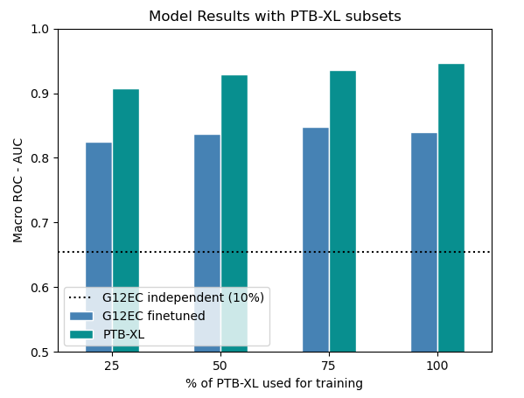
Experiment 2: Performance by PTB-XL subsets
Used 10% of G12EC for a fair comparison
As expected model performance drops with decrease in data used for pre-training
Performance of fine-tuned model is better even after pre-training on 25% PTB-XL data
Notes:
Test what fraction of PTB-XL is required to beat performance of G12EC

Slide 27
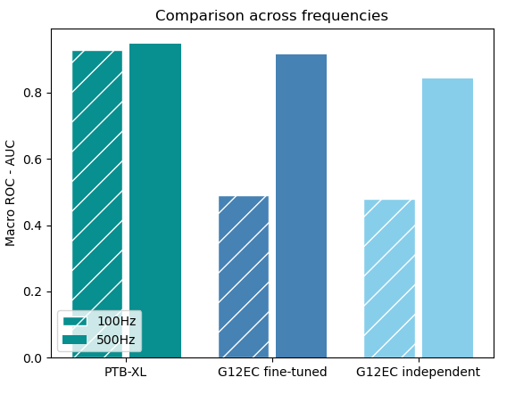
Experiment 3: Frequency downsampling
PTB-XL performance remained almost same on lower frequency
G12EC performance dropped significantly
G12EC loses significant information at lower frequencies

Slide 28
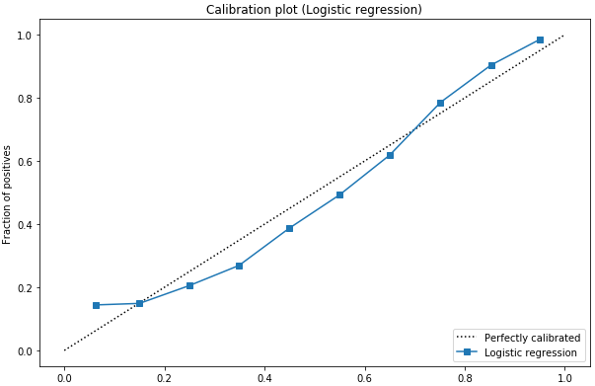
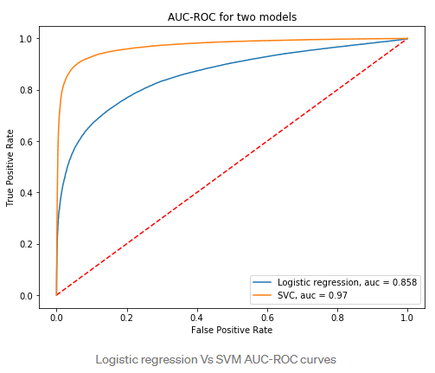
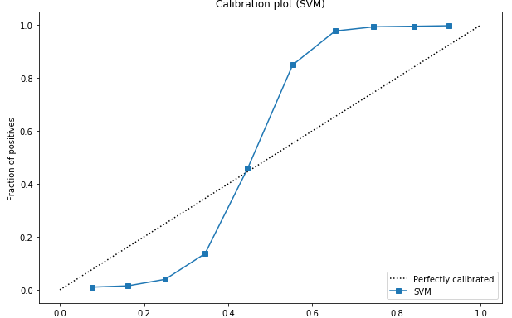
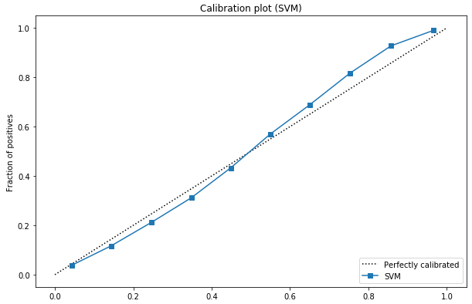
Experiment 4: Calibration
What is calibration?
A model is perfectly calibrated if, for any probability value p, a prediction of a class with confidence p is correct 100*p per cent of the time
Platt’s Scaling

Slide 29
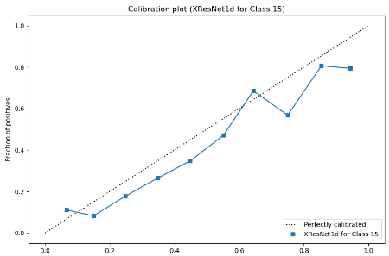
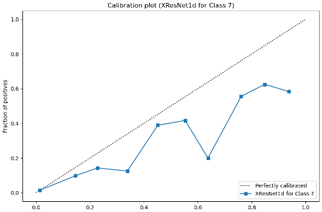
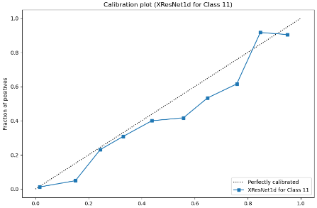
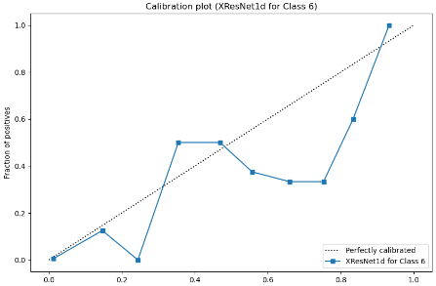
Experiment 4: Calibration

Slide 30
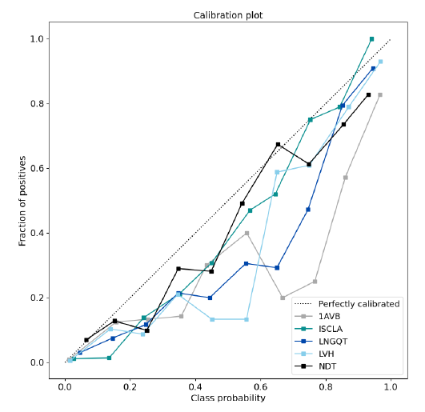
Experiment 4: Calibration
Calibration curves plotted for 10% of G12EC as test data
Classes with high label support - NDT (194), ISCLA (90) mostly well calibrated
1AVB (77), LNGQT (139), LVH (120) required further calibration
Classes with very low label support ignored

Slide 31
Experiment 5: Frequency Domain Analysis
Macro AUC on PTB-XL model drops significantly
This effect on performance propagates to the fine-tuned model on G12EC
Further work is required to understand the reasons behind the drop in model performance
Component | PTB-XL | G12EC Fine-tuned
Absolute | 0.668 | 0.555
Real | 0.664 | 0.508
Imaginary | 0.614 | 0.506

Slide 32
Conclusion
PTB-XL is a good dataset for transfer learning: fine-tuning achieves ~8% increase in performance over independently trained model
Even with different label distributions the transfer learning performed well
Existing literature focuses on a single or a certain class of diagnosis
Implication: milestone for classification on thousands of smaller datasets currently available

Slide 33
Limitations / Future Work
Model might not perform well in cases when labels for both datasets are different
Use techniques to match label distribution which could potentially improve finetune performance
Performance drops significantly on lower frequency data
Find techniques to preserve most useful information in lower frequencies
Current datasets were quite similar, can test the technique on diverse datasets
Test if information from one lead or a particular waveform contributes more to the performance
Improve the underlying architecture that can
Learn from periodic patterns in ECG signals
Demonstrate invariance to frequency changes
Notes:
point 1 - what if the label mapping is not available and its not one-to-one

Slide 34
Thank You
Questions?

