Slide 1
EDUVANTAGE AI / CAPSTONE PRESENTATION
Eduvantage AI
Student Success Intelligence
Capstone project | advisor-facing evidence and support workflow
Eduvantage AI · 01 / 11

Slide 2
EDUVANTAGE AI / CAPSTONE PRESENTATION
Problem and business need
Assessment, registration, and learning-activity signals are spread across records.
Advisors need a reviewable way to prioritize follow-up and understand the evidence behind a concern.
Eduvantage AI · 02 / 11

Slide 3
EDUVANTAGE AI / CAPSTONE PRESENTATION
Solution overview
One workspace for cohort analytics, student profiles, historical search, recommendations, plans, and feedback.
The system organizes evidence; advisors retain decision authority.
Eduvantage AI · 03 / 11

Slide 4
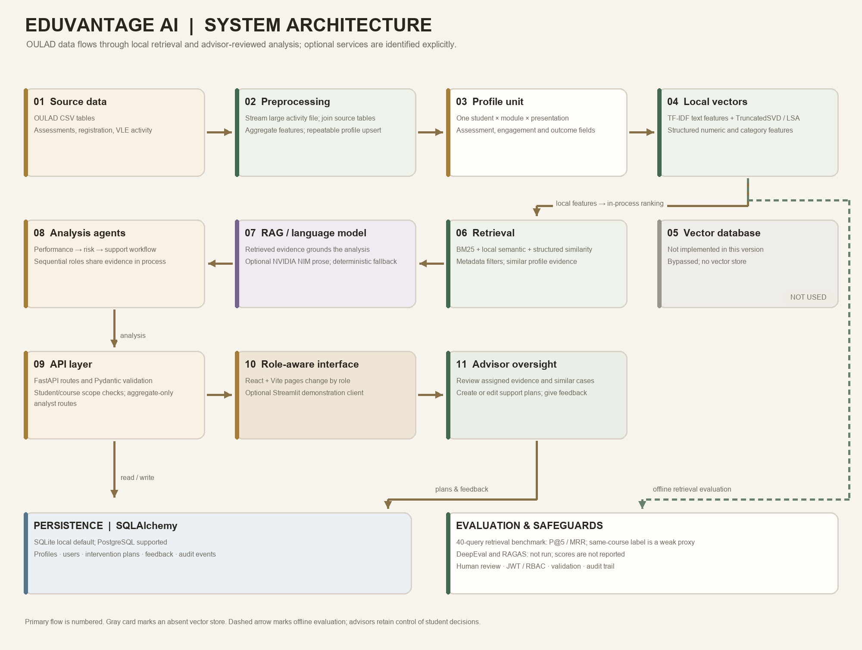
EDUVANTAGE AI / CAPSTONE PRESENTATION
Architecture
OULAD -> streaming preprocessing -> profiles -> local TF-IDF/LSA -> in-process retriever
FastAPI orchestrates analysis; React/Vite presents it. No pretrained embedding service or vector DB is used.
Eduvantage AI · 04 / 11

Slide 5
EDUVANTAGE AI / CAPSTONE PRESENTATION
Data flow
CSV -> joins and aggregation -> student-course-presentation profile -> filtered retrieval -> advisor UI
The VLE event file is streamed; local import contains 32,593 aggregated profiles.
Eduvantage AI · 05 / 11

Slide 6
EDUVANTAGE AI / CAPSTONE PRESENTATION
Technology stack
Python / FastAPI / Pydantic / SQLAlchemy / scikit-learn / React / Vite / Streamlit
SQLite default; PostgreSQL supported. Optional NVIDIA NIM uses a server-side key.
Eduvantage AI · 06 / 11

Slide 7
EDUVANTAGE AI / CAPSTONE PRESENTATION
Role-based access
Admin manages accounts and grants; faculty scope is by course; advisor scope is by student.
Analysts see aggregate reports only. Roles and grants persist in the database and are enforced by the API.
Eduvantage AI · 07 / 11

Slide 8
EDUVANTAGE AI / CAPSTONE PRESENTATION
Agent workflow
Performance analysis -> risk assessment -> support recommendation
Sequential in-process roles share evidence through the API orchestrator; an advisor reviews suggested actions.
Eduvantage AI · 08 / 11

Slide 9
EDUVANTAGE AI / CAPSTONE PRESENTATION
Demo walkthrough
Sign in -> filter cohort -> inspect a profile -> ask assistant -> create/edit a plan
Use React at 127.0.0.1:5173 or Streamlit at localhost:8501; API docs at 127.0.0.1:8000/docs.
Eduvantage AI · 09 / 11

Slide 10
EDUVANTAGE AI / CAPSTONE PRESENTATION
Evaluation results
40-query retrieval: hybrid P@5 0.450 / MRR 0.681; keyword P@5 0.475 / MRR 0.729
Same-course relevance is a weak proxy. DeepEval aggregate report is pending; do not claim unrun metrics.
Eduvantage AI · 10 / 11

Slide 11
EDUVANTAGE AI / CAPSTONE PRESENTATION
Challenges and learnings
Local retrieval improves deployment simplicity but has no indexed vector store or pretrained semantic encoder.
Need advisor-labeled retrieval judgments, model calibration/fairness review, and institutional privacy review before operational use.
Eduvantage AI · 11 / 11

