Slide 1
Welcome
A Data Science Project by Deepkumar Pawar

Slide 2
COVID-19 Vaccination Priority by Age
Can we determine who receives the COVID-19 vaccine first after its development, and if so, who?

Slide 3
Why this Topic?
Relevant
Interesting
Vast

Slide 4
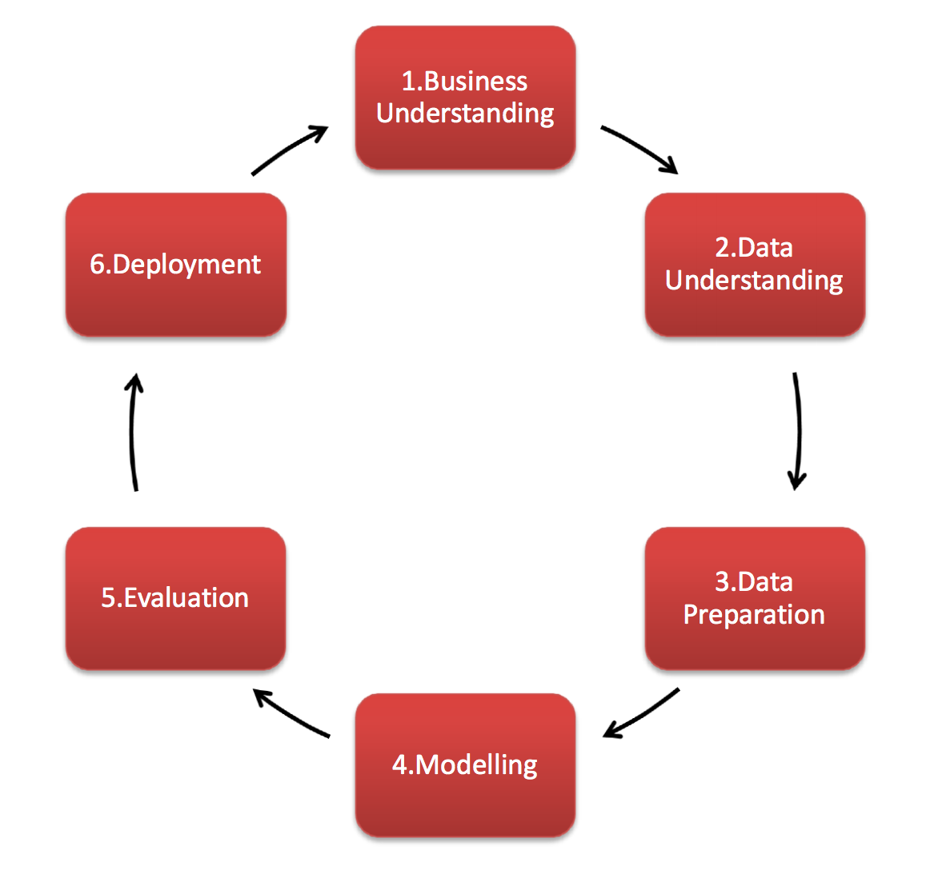
Before We Begin – Data Science Project Lifecycle
Cross Industry Standard Process for Data Mining
or CRISP-DM

Slide 5
Sources and Tools
Tools
Python and Google Colaboratory – online runtime environment
Trello – planning
Excel – to better examine the datasets
Sources:
Datasets: Primary Research
Our World in Data COVID dataset for case demographics
Kaggle UNCOVER COVID-19 Challenge datasets – Canada Individual Cases and Deaths
Worldometer Coronavirus Age Sex Demographics
Research
Colaboratory and python libraries documentation for pandas and seaborn: Primary Research
Deep Learning, a book by Aaron Courville, Ian Goodfellow, and Yoshua Bengio: Secondary Research
Web articles: Secondary Research
Each reference is documented properly in the dissertation and diary

Slide 6
Aims and Objectives Overview
Analyze datasets available for COVID-19 and use statistical tools and techniques to draw conclusions and gain a better understanding

Slide 7
Aims and Objectives in Detail / What I Did
Decide and discover which of the various available data sources pertaining to the COVID-19 pandemic are relevant and document them
Import data in Colab
Clean data where necessary and group data into relevant parts; this is dependent on the context of this data
Research: Various useful and relevant statistical and analytical tools and techniques to apply on the data as described above
Apply statistical and analytical tools and techniques to draw relevant conclusions from the data
Document and describe drawn conclusions
If relevant or useful conclusions cannot be drawn that can contribute to the project, document and describe that as well
Summarize

Slide 8
Let’s take a Field Trip
https://colab.research.google.com/drive/1EKiwXdLCKzcQoP60KxP_L0Sn5jqCAOoJ?usp=sharing
https://colab.research.google.com/drive/1hLnxYYbjdMS2qutF1McJcx6spDOBqFsM?usp=sharing

Slide 9
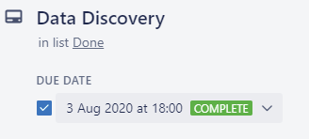
Challenges Faced and Changes / Improvements made
Problem: Dimensionality Reduction Problem in the first dataset (COVID-19 Case Demographics)
Solution: Discovered and learnt about an algorithm called Principal Component Analysis which helped with this
Problem: Tight Time Constraints
Solution: Planned project well using resources such as Trello

Slide 10
Strengths & Weaknesses of the Project
Strengths:
Planning: Effective planning led to the project being finished smoothly despite time constraints
Produced interesting graphs and drew conclusions for both arguments that contributed towards the research question
Weaknesses:
Omission of select parts of data in analysis due to lack of sufficient statistical expertise may result in inaccuracies in the inferences
Cannot develop a final conclusion because due to time constraints, could not explore further datasets available
Could not receive access to a very valuable COVID-19 dataset held by the NHS

Slide 11
New Skills Learnt
Project Skills:
Independently planning and managing a long term project
Researching effectively to find the information I need
Harvard Referencing
Setting deadlines for myself and sticking to them
Documenting each step of the project in detail
Technical Skills:
Using python and Google Colaboratory for data science projects
Manipulating a dataset and preparing it for conversion to a graph or other use
Drawing valuable inferences from a graph
Learnt about algorithms such as PCA and how it works

Slide 12
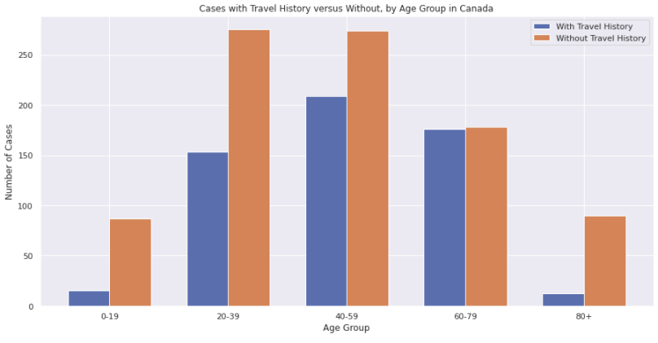
Conclusions

Slide 13
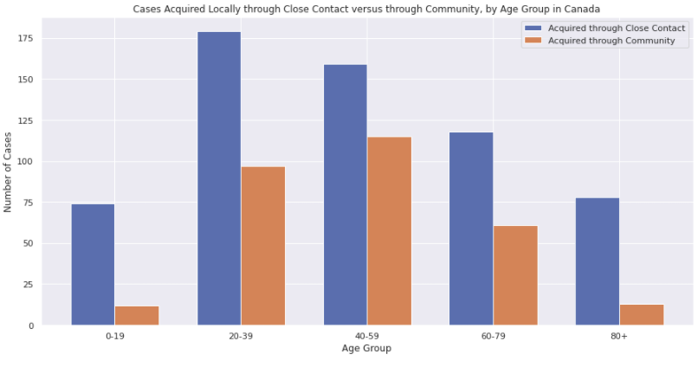

Slide 14
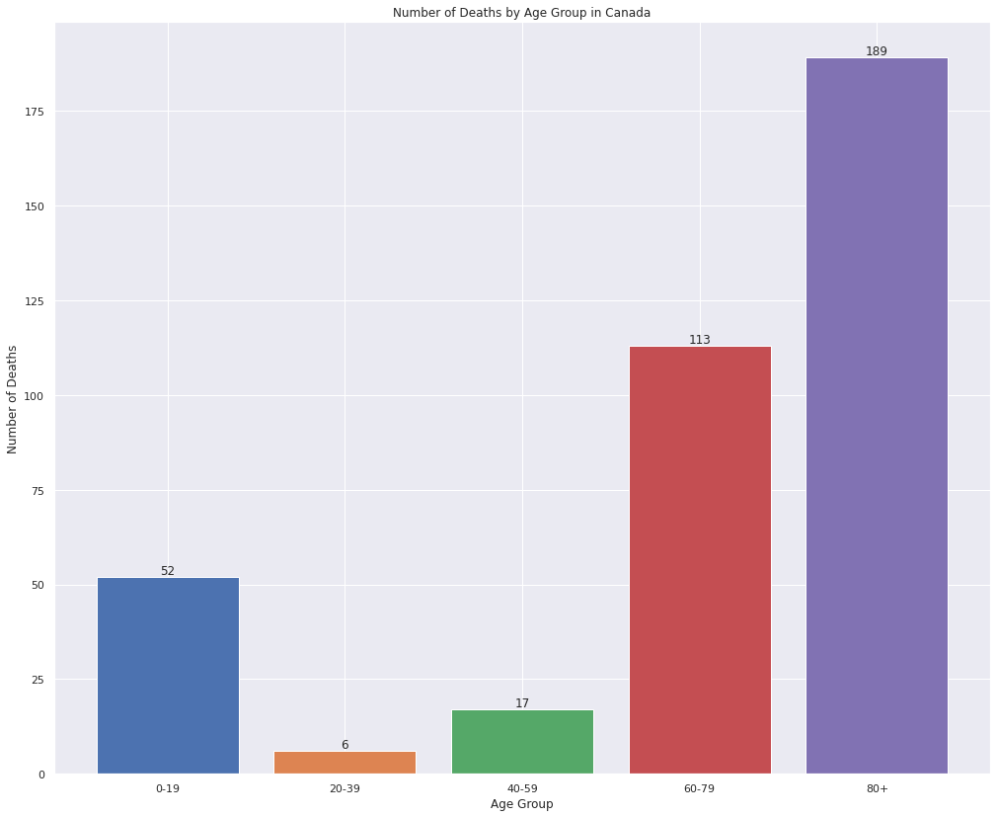

Slide 15
Completion of Aims and Objectives
Analyze datasets available for COVID-19 and use statistical tools and techniques to draw conclusions and gain a better understanding
Can we determine who receives the COVID-19 vaccine first after its development, and if so, who?

Slide 16
Thank you!

