Slide 1
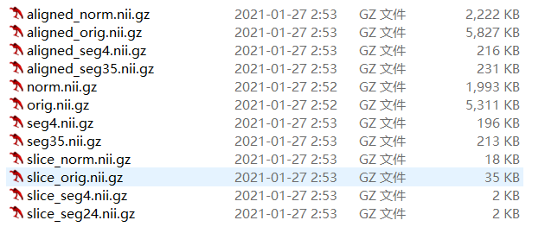
数据
共计414个患者信息
Aligned_norm图像大小为160*192*224

Slide 2
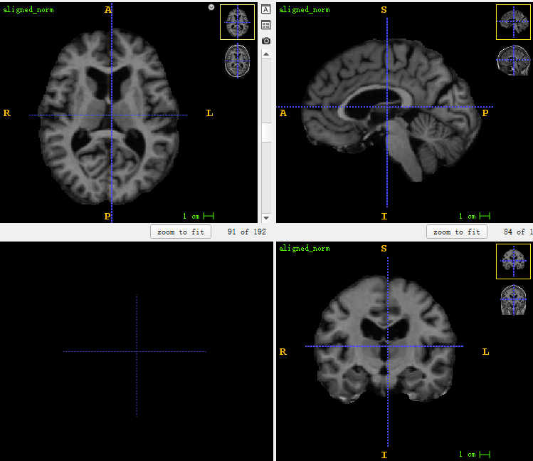
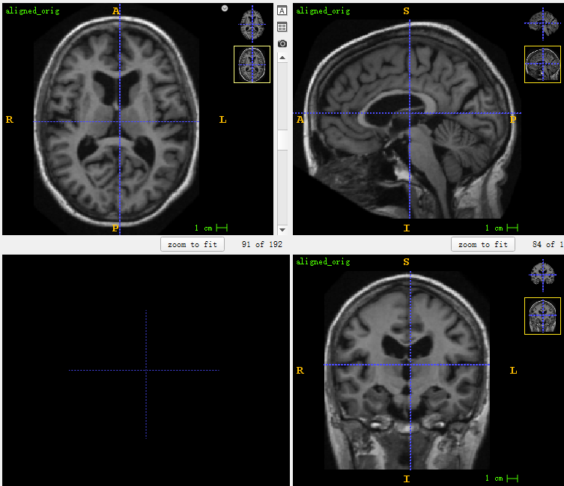
数据
aligned-norm
aligned-orig

Slide 3
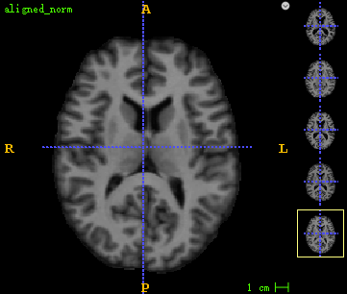
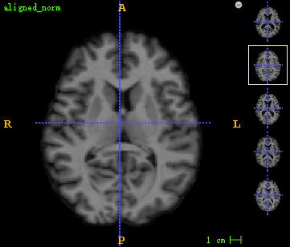
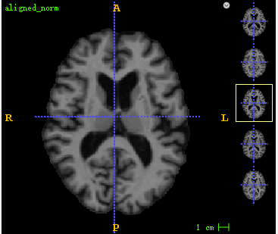
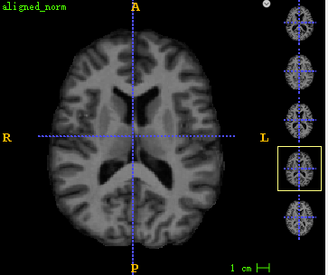
数据预处理

Slide 4
数据增强
建议采用：
RandomIntensityChange
RandomGammaCorrection
MinMax_norm
Noise
不建议采用：
RandCrop3D
CenterCropBySize
RandomFlip
code：./Baseline_registration_models/CycleMorph/data/trans.py

Slide 5
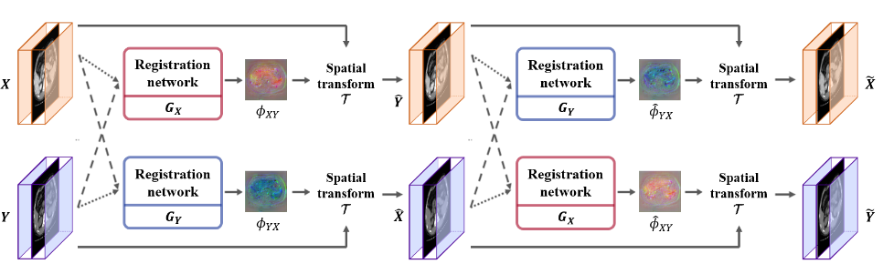
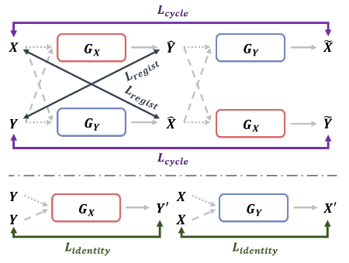
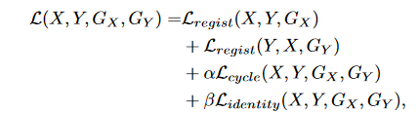
CycleMorph
code:https://github.com/boahK/MEDIA_CycleMorph

Slide 6
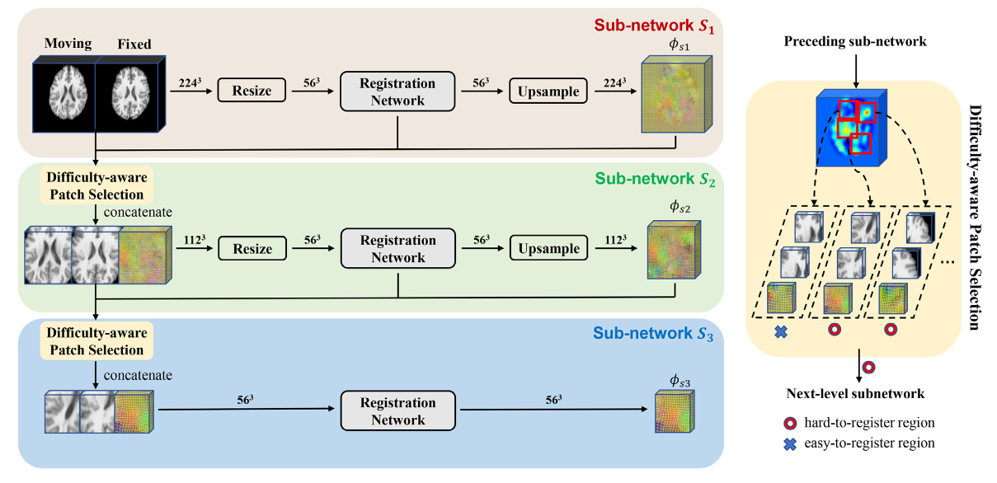
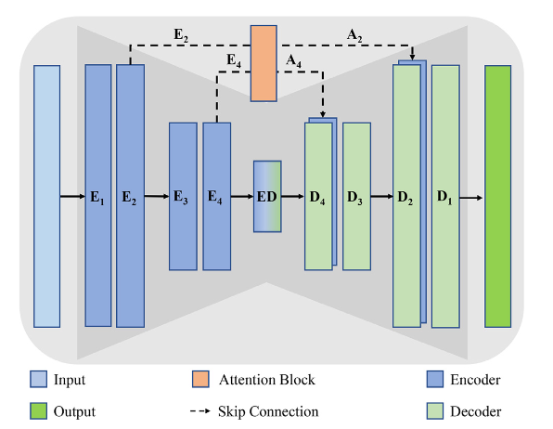
Difficulty-aware hierarchical convolutional neural networks

Slide 7
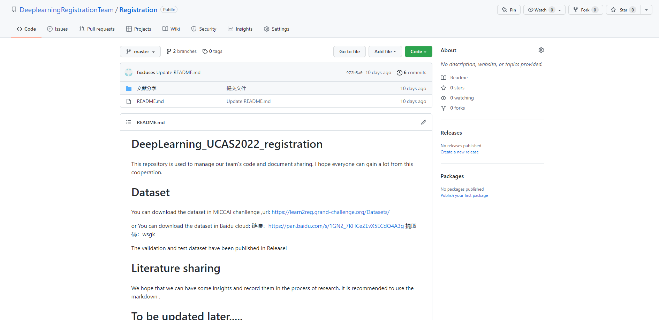
Github

