Slide 1
Backorder Prediction
Deepmala Mehra

Slide 2
Statement of the Problem
Part backorders is a common supply chain problem, wherein a customer places an order for a product that is temporarily out of stock. The percentage of items backordered and the number of backorder days are important measures of the quality of a company's customer service and the effectiveness of its inventory management.
A company can manage its inventory more efficiently using a prediction on the backorder risk for the products. Goal here is to use the past data and metadata around the backorders, and provide a prediction on the potential products for backorders.
.

Slide 3
Project Overview
Client
Sigma Retails Ltd is a leading online store providing products ranging from clothing, home improvements to grocery. Recently, client has been finding it difficult to manage the backorders, resulting into increasing customer issues and a decline in customer satisfaction.
Client is looking for ways to improve backorders handling. With the help of this analysis, a reasonable prediction on the products that can go on backorder is expected. Such a prediction could immensely help client to plan for a more effective stocking and backorder handling.
Dataset
Dataset consists of the historical data around the backorders. It has 23 features and ~ 160000 observations.
Dataset can be found at: https://www.kaggle.com/tiredgeek/predict-bo-trial

Slide 4
Data Wrangling
Tasks performed:
Handling inconsistent column names and datatype
Missing Data handling
Removal of duplicate rows
Handling columns with repetitive values
Handling the outliers
Write the clean data into a new file for further steps

Slide 5
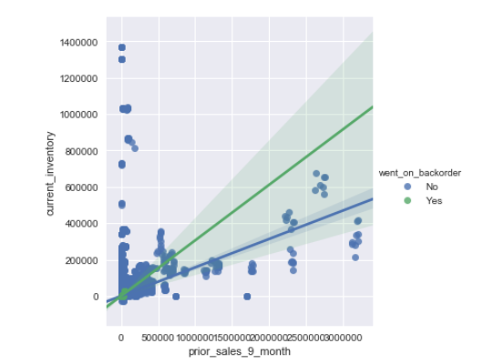
EDA and Data storytelling
Tasks performed:
Handling of multicollinearity
Relationship of categorical variables
Inferential statistics
Some interesting data facts
Current inventory for some products found to be as high as 1.4 million even when there is no sale in prior 9 months

Slide 6
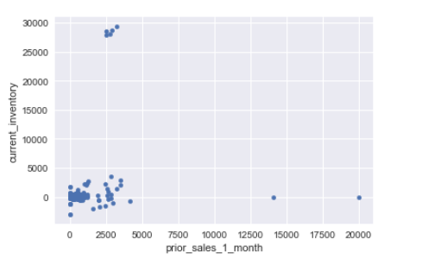
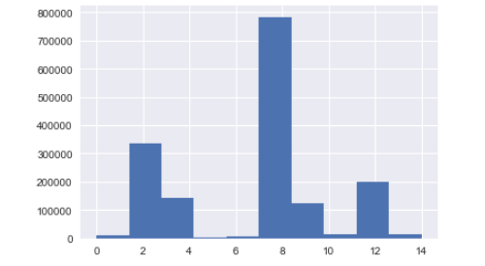
Something unexpected - current inventory is zero for some products even the prior 1 months shows sale as high as 200,000
Good trend for transit duration for the client. Most of the products have a short duration on transit.

Slide 7
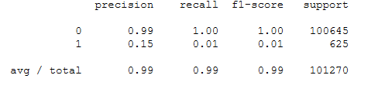
Data Modeling
Dataset is highly imbalanced. We have only 0.6% data as ‘Yes’ to back order, so accuracy cannot be a validation criteria here. Client is looking forward for ‘Precision’ as validation criteria because it is important that as many of the records predicted are correct as possible so that time is not wasted working on false positives.
KNN : Since Dataset is very large, KNN model cannot be trained with the entire training dataset. I used 20% sample data to train the Model. Scaling is applied on the features. Since Target class is highly imbalance precision for this model was 0.15 only.

Slide 8
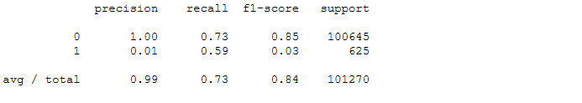
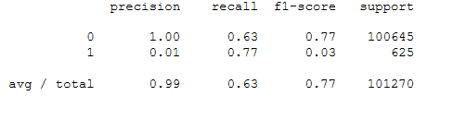
LinearSVM: I trained the LinearSVM with 20% sample of the data. class_weight = 'balanced‘ is used with default features. Precession for the model was 0.01 only.
SupportVectorMachine(svm.SVC): . class_weight = 'balanced‘ is used with default features. This Precession for the model also had 0.01 only.

Slide 9
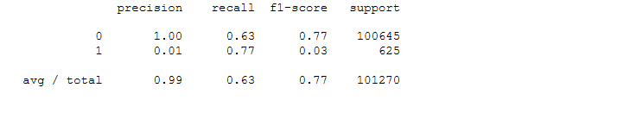
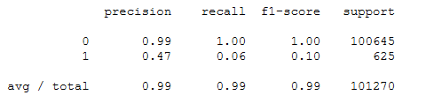
LogisticRegression: class_weight = 'balanced‘ is used with default features. This precession for the model also had 0.01 only.
RandomForestClassifier: RandomForestClassifier had good precision score compared to all other classifiers . Using class_weight = 'balanced‘ increased recall score but decreased precision score . So I decide to drop class weight from default RandomForestClassifier

Slide 10
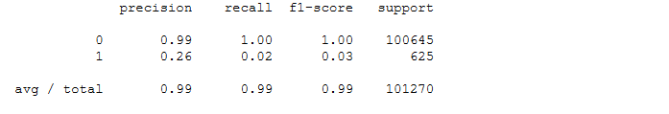
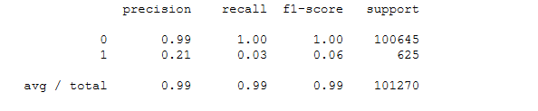
GradientBoostingClassifier : This model also had better precision score. I chose this model to tune further to see if precision can be increased.
AdaBoostClassifier: . Similarly, this model also had better precision score. I decided to tune further to see if precision can be increased.

Slide 11
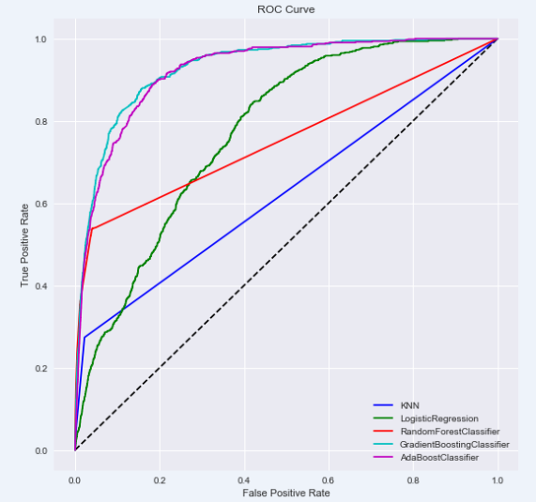
ROC Curve
.

Slide 12
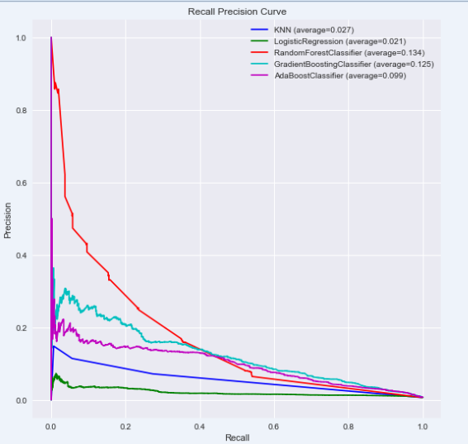
Recall Precision Curve
As we can see here, RandomForestClassifier, GradientBoostingClassifier, AdaBoostClassifier has better precision value, I decided to tune and validate these models.

Slide 13
Model tuning and cross validation
I chose to tune and validate RandomForestClassifier, GradientBoostingClassifier, AdaBoostClassifier as they had better precision value. For tuning the parameters of the model, I used a mix of cross-validation and randomize search.
Models are trained on 70% train data and validated on 30% test data . Cross validation is done on 10 folds . After the training and testing the data on 10 folds, below are the precision scores.
Estimator | Precision Score
RandomForestClassifier | 0.80864198
GradientBoostingClassifier | 0.567225189671
AdaBoostClassifier(randomForestClassifier) | 0.812655571276

Slide 14
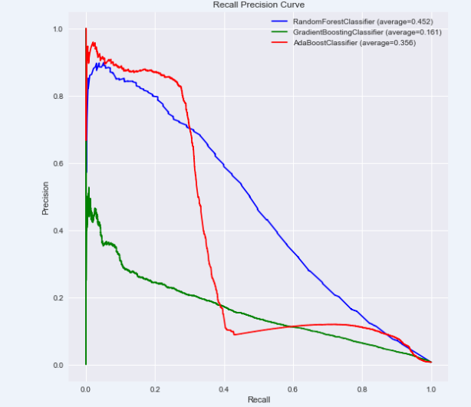
Recall Precision Curve for Tuned Classifiers

Slide 15
Conclusion
Based on the performances of all the predictive models, I found tuned AdaBoostClassifier with base classifier as tuned RandomForestClassifier as the most suitable predictive model to choose here.
I will recommend this model to client as it has precision score of .81.
Please check-out below link for detailed report:
https://github.com/DeepmalaMehraGH/CapstoneProject1/blob/master/Backorder%20dataset_report.pdf

