Slide 1
C++ Memory Model Study with CppMem
David Fang

Slide 2
Case 1

Slide 3
int main() {
atomic_int x = 0;
atomic_int y = 0;
{{{
{
x.store(1, memory_order_seq_cst); y.load(memory_order_seq_cst);
}
|||
{
y.store(1, memory_order_seq_cst); x.load(memory_order_seq_cst);
}
}}};
return 0; }
The result “y=0,x=0” is impossible

Slide 4
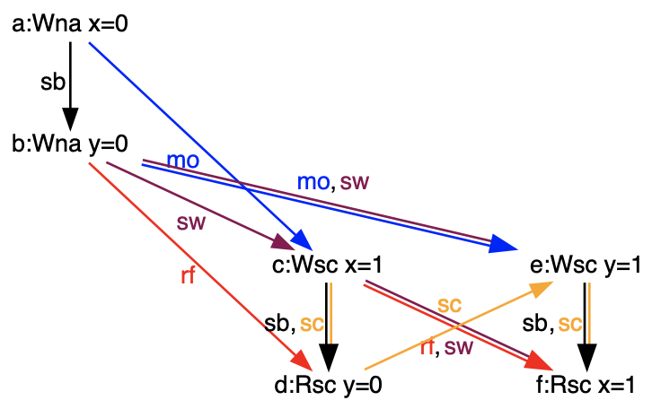
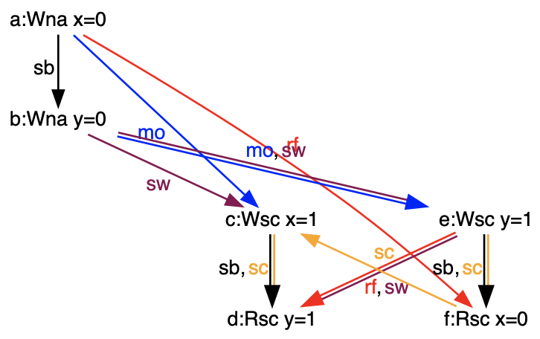
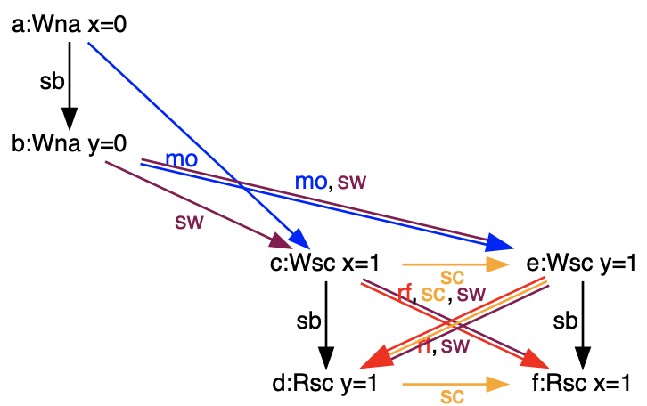
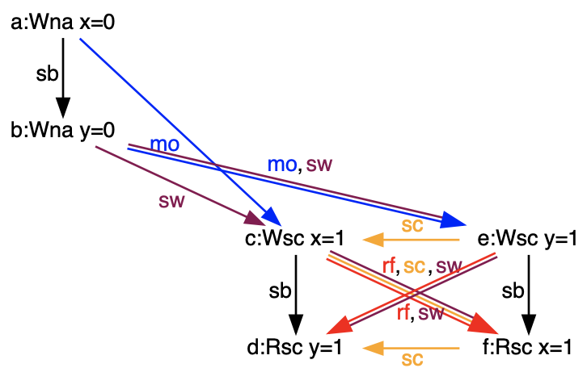
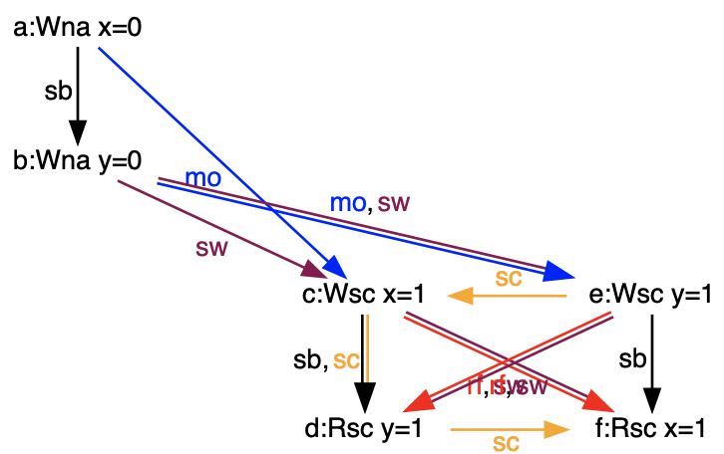
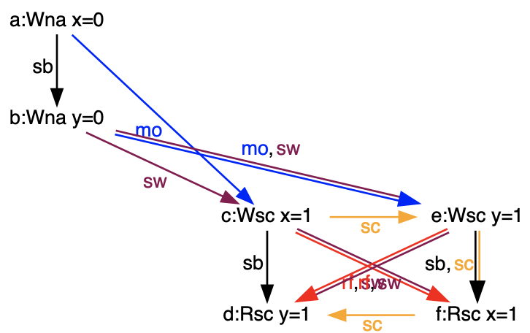
x.store(1,seq_cst) y.load(seq_cst) y.store(1,seq_cst) x.load(seq_cst)
y.store(1,seq_cst)
x.load(seq_cst)
x.store(1,seq_cst)
y.load(seq_cst)
x.store(1,seq_cst)
y.store(1,seq_cst)
y.load(seq_cst) x.load(seq_cst)
y.store(1,seq_cst)
x.store(1,seq_cst)
x.load(seq_cst)
y.load(seq_cst)
y.store(1,seq_cst)
x.store(1,seq_cst)
y.load(seq_cst)
x.load(seq_cst)
x.store(1,seq_cst)
y.store(1,seq_cst)
x.load(seq_cst)
y.load(seq_cst)
All seq cst operations on either same or different atomic variables in the same thread must follow their source code order,
so there is a global order of interleaved operations on all threads with source code order.

Slide 5
int main() {
atomic_int x = 0;
atomic_int y = 0;
{{{
{
x.store(1, memory_order_relaxed); y.load(memory_order_acquire);
}
|||
{
y.store(1, memory_order_release); x.load(memory_order_relaxed);
}
}}};
return 0; }

Slide 6
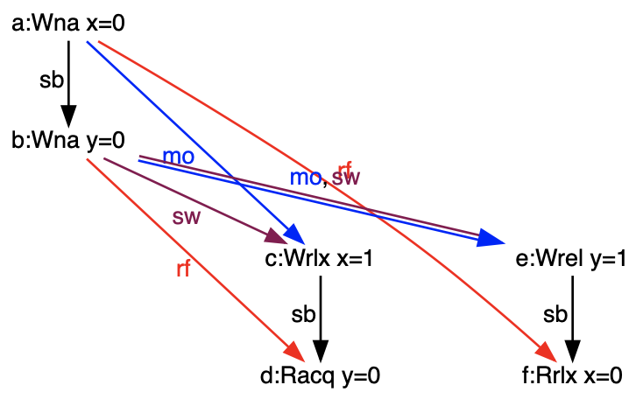
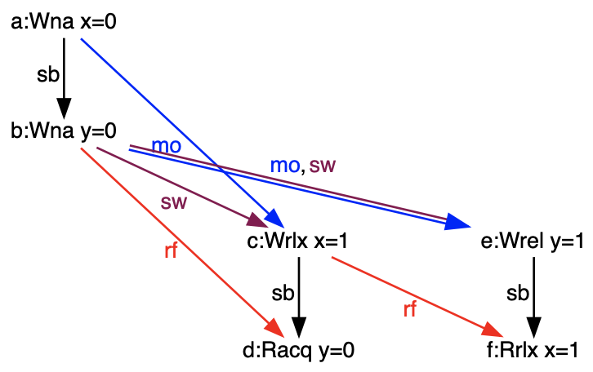
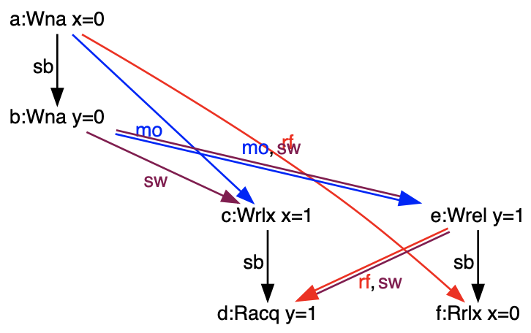
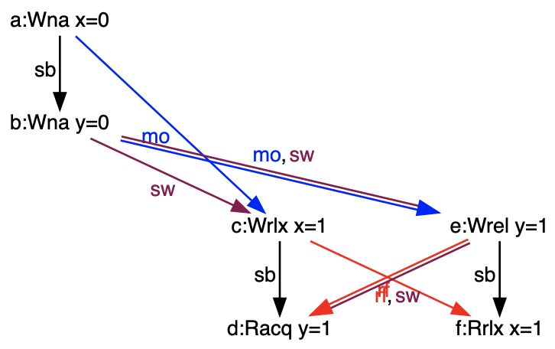
The top 2 case: y.load(acq) is NOT synchronized with (reads from) y.store(1,rel) BECAUSE
both cases’ y.load(acq) reads from Wna(write-non-atomic),
so there is no order constraint between “x.store(1,rlx) and x.load(rlx)”
The bottom 2 cases: y.load(acq) is synchronized with (reads from) y.store(1,rel), BUT
x.store(1,rlx) is NOT sequenced after y.load(acq) and
x.load(rlx) is NOT sequenced before y.store(1,rel),
so there is no order constraint between “x.store(1,rlx) and x.load(rlx)”

Slide 7
int main() {
atomic_int x = 0;
atomic_int y = 0;
{{{
{
x.store(1, memory_order_seq_cst); y.load(memory_order_acquire);
}
|||
{
y.store(1, memory_order_release); x.load(memory_order_seq_cst);
}
}}};
return 0; }

Slide 8
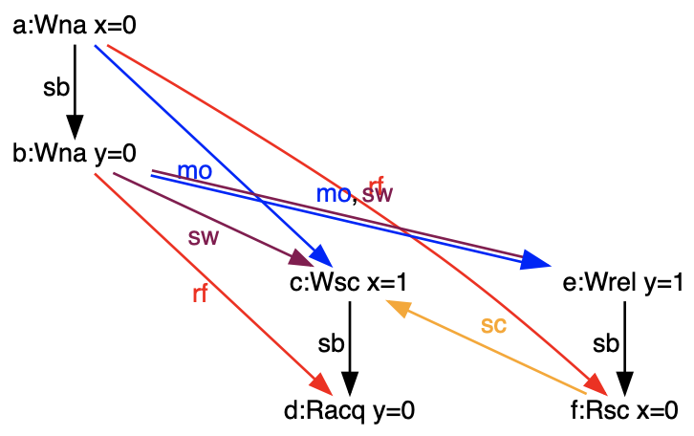
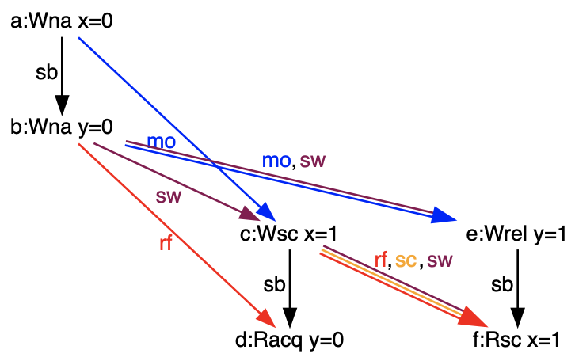
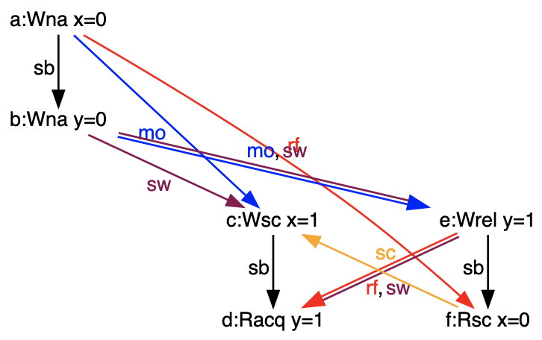
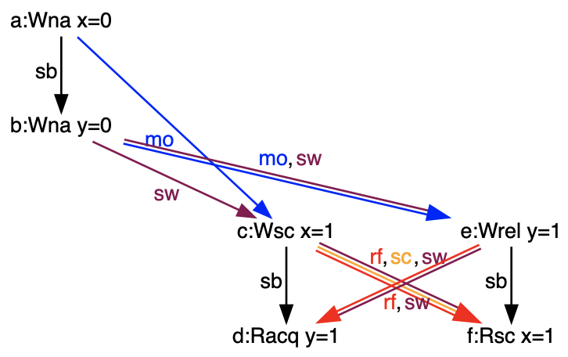
The top 2 case: y.load(acq) is NOT synchronized with (reads from) y.store(1,rel) BECAUSE
both cases’ y.load(acq) reads from Wna(write-non-atomic),
so there is no order constraint between “x.store(1,seq_cst) and x.load(seq_cst)”
The bottom 2 cases: y.load(acq) is synchronized with (reads from) y.store(1,rel), BUT
x.store(1,seq_cst) is NOT sequenced after y.load(acq) and
x.load(seq_cst) is NOT sequenced before y.store(1,rel),
so there is no order constraint between “x.store(1,seq_cst) and x.load(seq_cst)”

Slide 9
int main() {
atomic_int x = 0;
atomic_int y = 0;
{{{
{
x.store(1, memory_order_relaxed); y.load(memory_order_relaxed);
}
|||
{
y.store(1, memory_order_relaxed); x.load(memory_order_relaxed);
}
}}};
return 0; }

Slide 10

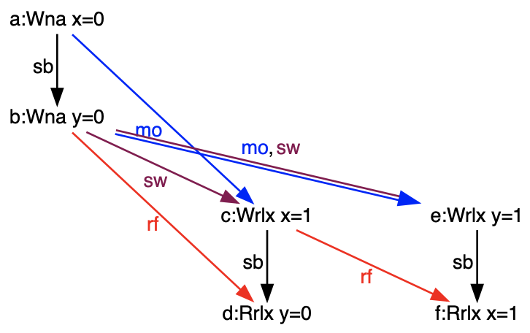
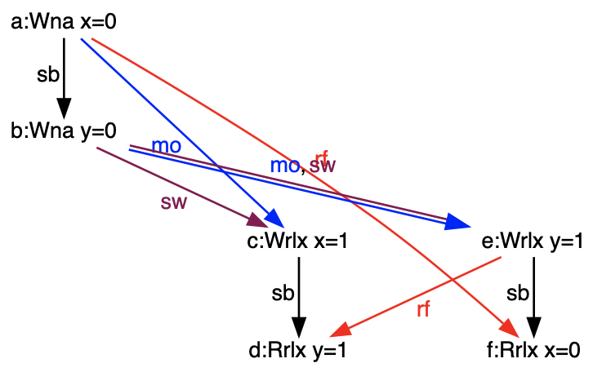
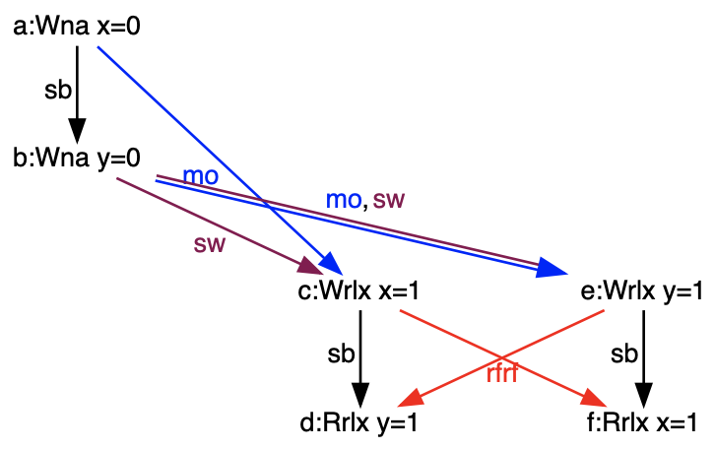
All rlx operations on the same atomic variable in the same thread cannot be reordered,
BUT all rlx operations on different atomic variables in the same thread can be reordered,
so there is no order constraint for this case,
which means there can be all possible permutations 4*3*2*1=24 ways of global order.

Slide 11
Case 2

Slide 12
int main() {
atomic_int x = 0;
atomic_int y = 0;
{{{
{
x.store(1, memory_order_seq_cst); y.store(1, memory_order_seq_cst);
}
|||
{
y.load(memory_order_seq_cst); x.load(memory_order_seq_cst);
}
}}};
return 0; }
The result “y=1,x=0” is impossible

Slide 13
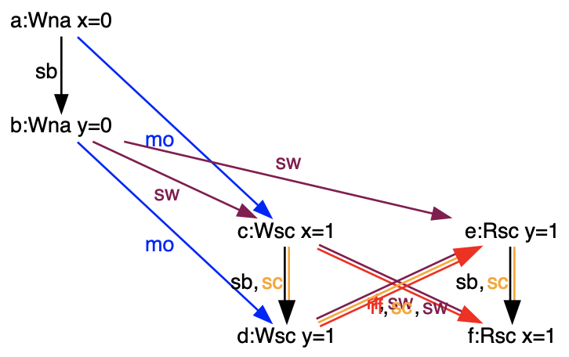
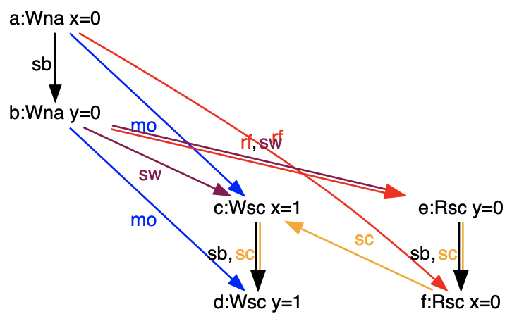
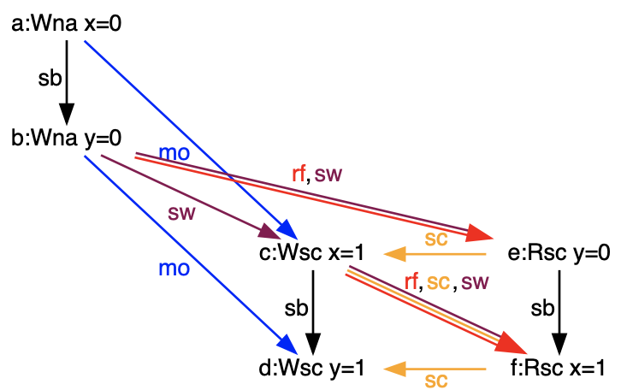
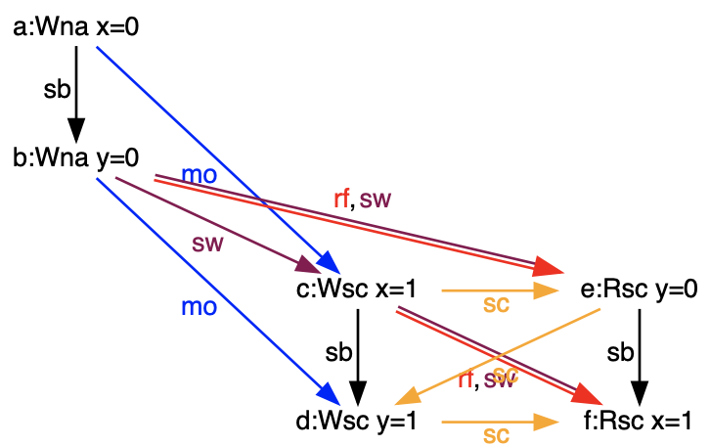
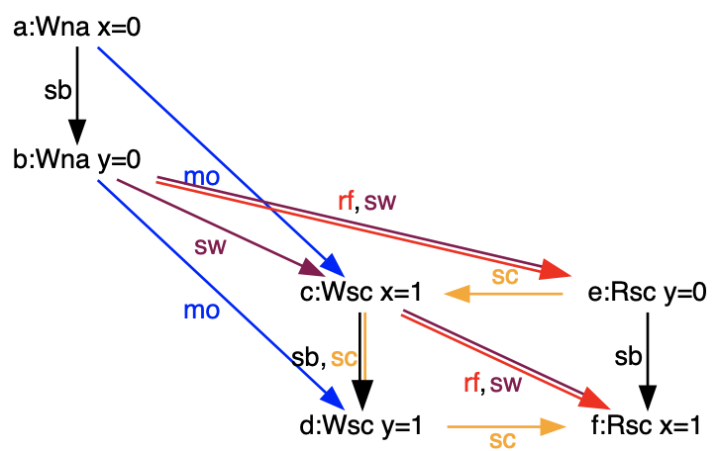
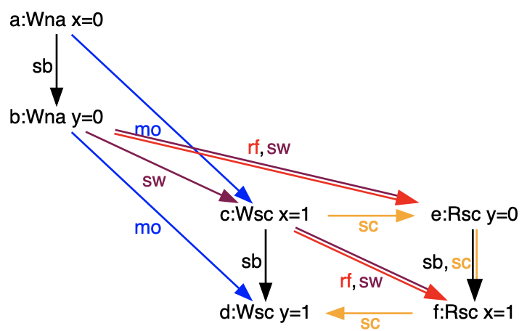
x.store(1,seq_cst)
y.store(1,seq_cst) y.load(seq_cst)
x.load(seq_cst)
y.load(seq_cst)
x.load(seq_cst)
x.store(1,seq_cst)
y.store(1,seq_cst)
y.load(seq_cst)
x.store(1,seq_cst)
x.load(seq_cst)
y.store(1,seq_cst)
x.store(1,seq_cst)
y.load(seq_cst)
y.store(1,seq_cst)
x.load(seq_cst)
y.load(seq_cst)
x.store(1,seq_cst)
y.store(1,seq_cst)
x.load(seq_cst)
x.store(1,seq_cst)
y.load(seq_cst)
x.load(seq_cst)
y.store(1,seq_cst)
All seq cst operations on either same or different atomic variables in the same thread must follow their source code order,
so there is a global order of interleaved operations on all threads with source code order.

Slide 14
int main() {
atomic_int x = 0;
atomic_int y = 0;
{{{
{
x.store(1, memory_order_relaxed); y.store(1, memory_order_release);
}
|||
{
y.load(memory_order_acquire); x.load(memory_order_relaxed);
}
}}};
return 0; }
The result “y=1,x=0” is impossible

Slide 15
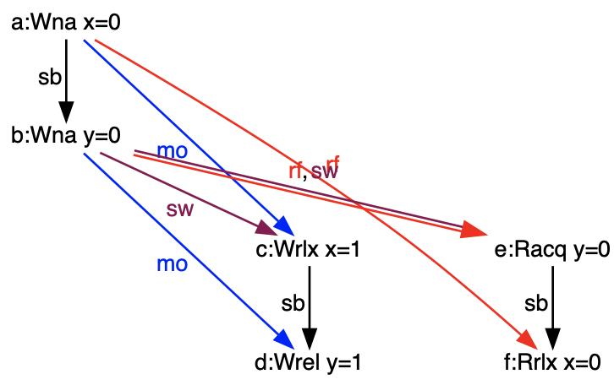
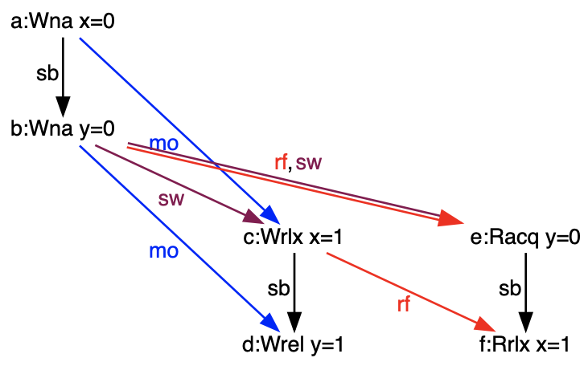
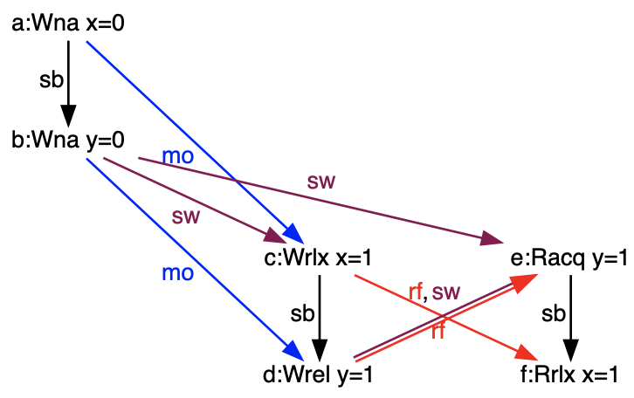
The top 2 case: y.load(acq) is NOT synchronized with (reads from) y.store(1,rel) BECAUSE
both cases’ y.load(acq) reads from Wna(write-non-atomic),
so there is no order constraint between “x.store(1,rlx) and x.load(rlx)”
The bottom case: y.load(acq) is synchronized with (reads from) y.store(1,rel), AND
x.store(1,rlx) is sequenced before y.store(1,rel) and
x.load(rlx) is sequenced after y.load(acq),
so there is an order constraint between “x.store(1,rlx) and x.load(rlx)”

Slide 16
int main() {
atomic_int x = 0;
atomic_int y = 0;
{{{
{
x.store(1, memory_order_seq_cst); y.store(1, memory_order_release);
}
|||
{
y.load(memory_order_acquire); x.load(memory_order_seq_cst);
}
}}};
return 0; }

Slide 17
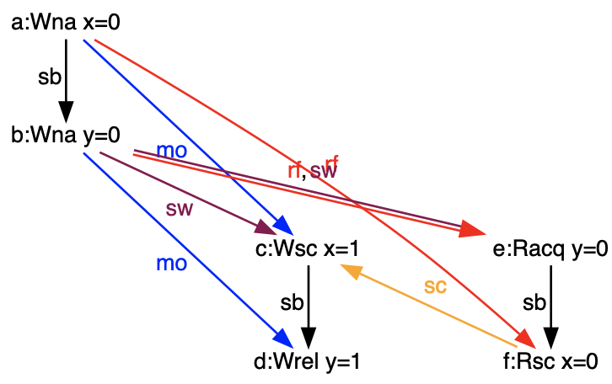
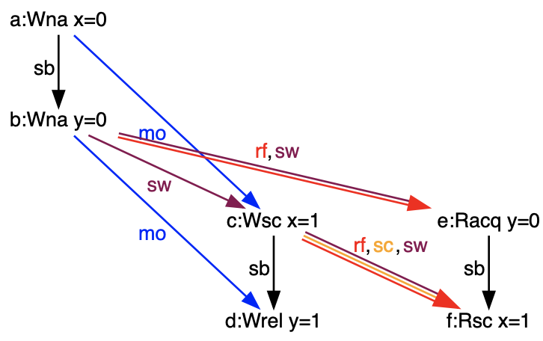
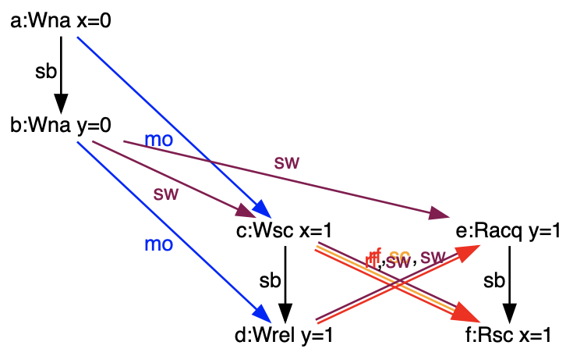
The top 2 case: y.load(acq) is NOT synchronized with (reads from) y.store(1,rel) BECAUSE
both cases’ y.load(acq) reads from Wna(write-non-atomic),
so there is no order constraint between “x.store(1,seq_cst) and x.load(seq_cst)”
The bottom case: y.load(acq) is synchronized with (reads from) y.store(1,rel), AND
x.store(1,seq_cst) is sequenced before y.store(1,rel) and
x.load(seq_cst) is sequenced after y.load(acq),
so there is an order constraint between “x.store(1,seq_cst) and x.load(seq_cst)”

Slide 18
int main() {
atomic_int x = 0;
atomic_int y = 0;
{{{
{
x.store(1, memory_order_relaxed); y.store(1, memory_order_relaxed);
}
|||
{
y.load(memory_order_relaxed); x.load(memory_order_relaxed);
}
}}};
return 0; }

Slide 19
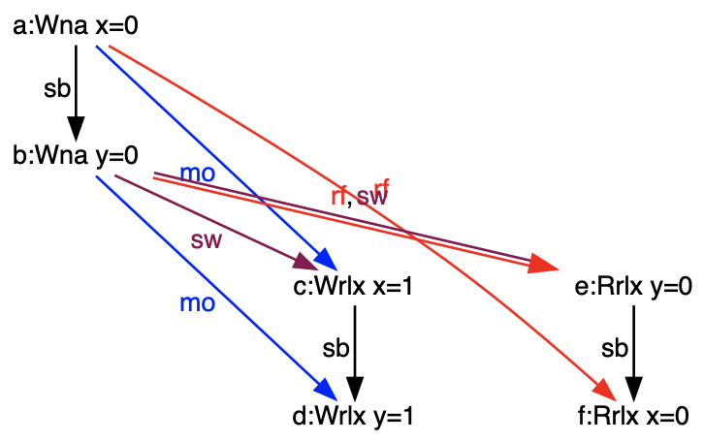
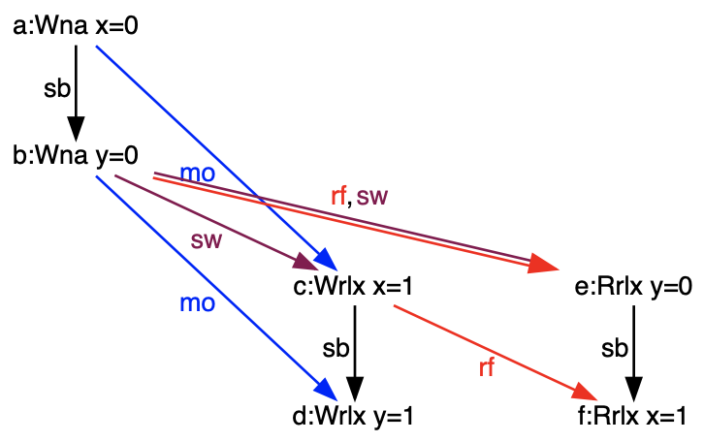
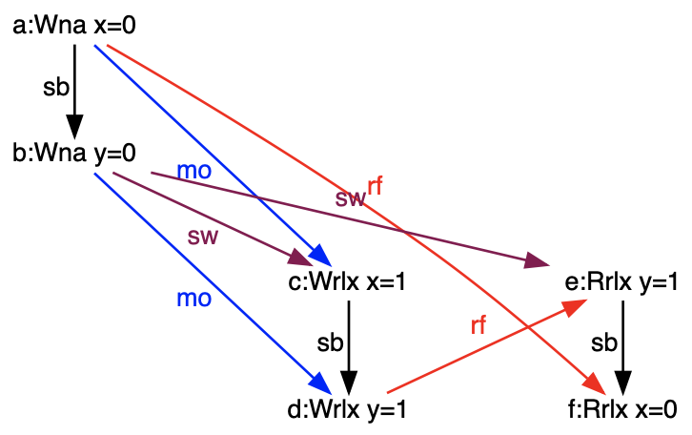
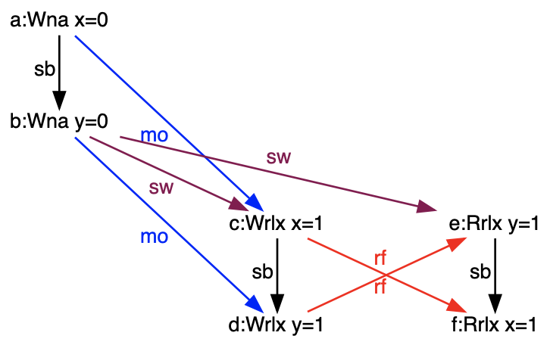
All rlx operations on the same atomic variable in the same thread cannot be reordered,
BUT all rlx operations on different atomic variables in the same thread can be reordered,
so there is no order constraint for this case,
which means there can be all possible permutations 4*3*2*1=24 ways of global order.

