Slide 1
Project Volta
Improving file transfer speeds onto different devices

Slide 2

The problem
The normal transfer of files can take up a lot of time
Normally single threaded
Under utilizing the resources

Slide 3
Related Work & Their Problems
Robocopy
Windows only
Not a lot of people use it because it has no UI
Hasn’t been updated in over 5 years
Teracopy
Windows only
Lack of kernel integration

Slide 4


Technologies
Rust
Safe and blazingly fast
If it compiles it will run
Tauri
An alternative electron
Lightweight and secure by default

Slide 5
Approaches
People normally carry flash drive two main reasons:
Transfer files between computers
Storing files as backup
Neither of these case require the file in its original format
Using in async I/O to speed up the process
Using compression to reduce the overall file size
This is an implementation of smarter compression
Parallely operating multiple file
Somehow allow for multiple logical cursors

Slide 6
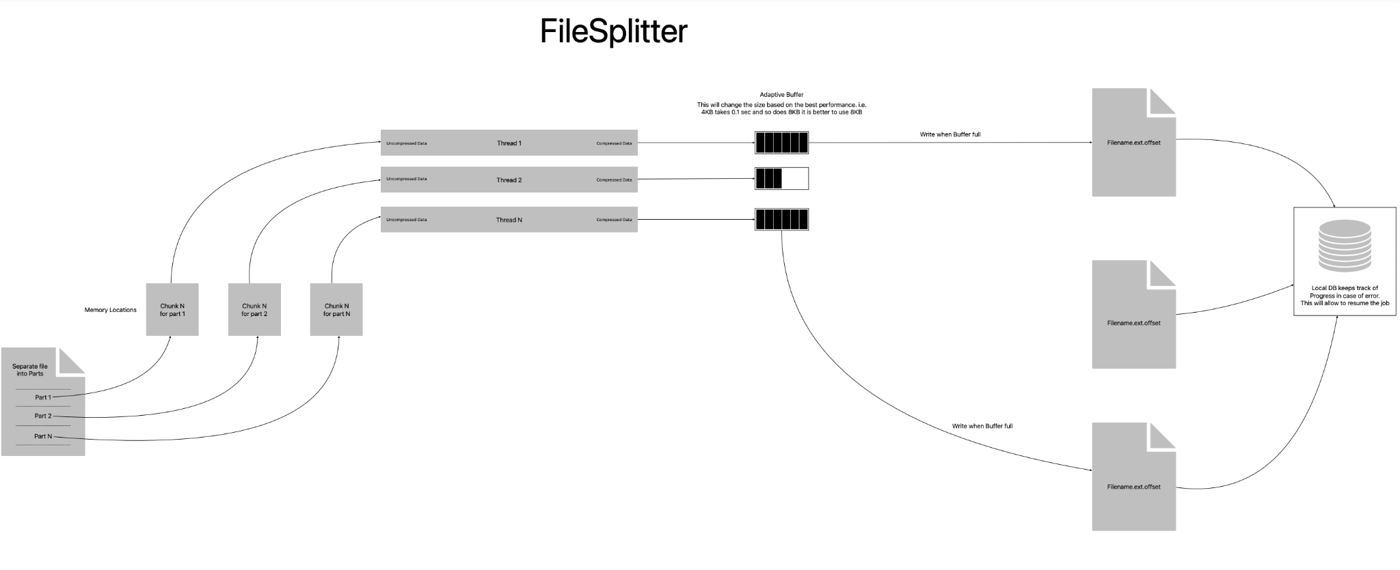
“Innovative Idea”

Slide 7
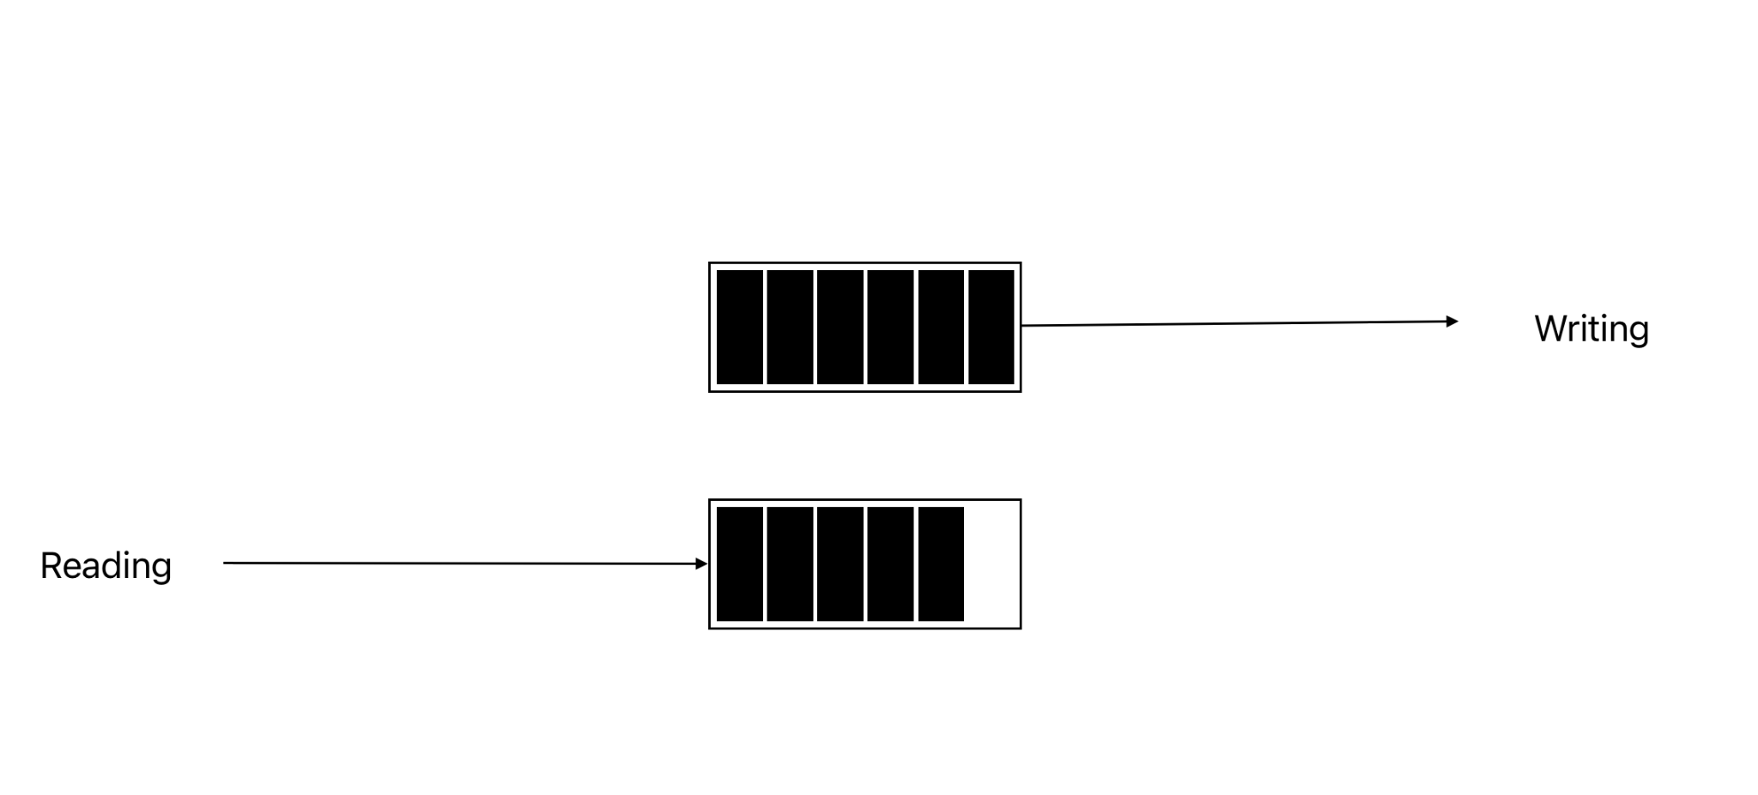
New Idea

Slide 8
New Idea

Slide 9
Issues
Context Switching too often - very expensive process
Constantly competing for resources
CPU spent more time fighting for resources and than actually working
Compression is slower than anticipated. Comparing to a simple copy/ paste function, compression took 25% more time. On the bright side, the compression, decreased the size of file significantly
Tauri is not mature enough. There are limitation on the state manager which causes problems with UI.

Slide 10
Things to know for Future Work
Better Design
Wisely choosing the input variables and numbers. Noticed a performance boost when the number of threads were fewer.
Explore better compression algorithms such as 7z.
Adaptive Buffered Writer - internal buffer size changes on demand observation

Slide 11
Questions?

Slide 12
Thank You
Deep Patel

