Slide 1



auction management system
Individual Project

Slide 2

Table of content
Purpose Of The Project
System Design Diagram
ER Diagram
Use Case Diagram
Functionalities
Used Data Structure And Class
Merits & Demerits
Tools Used
Future Scope

Slide 3

Purpose of project
An auction management system helps with the entire auction process by enabling the creation, management, and execution of auctions.
It provides a platform where sellers can list items for bidding and buyers can place bids in a secure and transparent environment.
It also includes tools for monitoring auctions , View Auction status, and automatically determining winners at the auction's close.
The system facilitates user registration, real-time bidding, and fair competition among participants.

Slide 4
System Design diagram
Start
"Select your role: (1) Auctioneer, (2) Seller, (3) Buyer“
If 1, then go to step 6; otherwise, go to step 2.
If 2, then go to step 17; otherwise, go to step 2.
If 3, then go to step 24; otherwise, go to step 2.
**Auctioneer Options**: - a) Create Auction - b) Start Bidding - c) View Auction - d) Close Auction - e) Exit
If a, then go to step 11; otherwise, go to step 6.
If b, then go to step 12; otherwise, go to step 6.
If c, then go to step 13; otherwise, go to step 6.
If d, then go to step 14; otherwise, go to step 6.
Enter auction details and create auction, then go to step 28.
Select an auction and start bidding, then go to step 28.
Display auction details and go to step 28.
Select an auction and close it, then go to step 28.

Slide 5
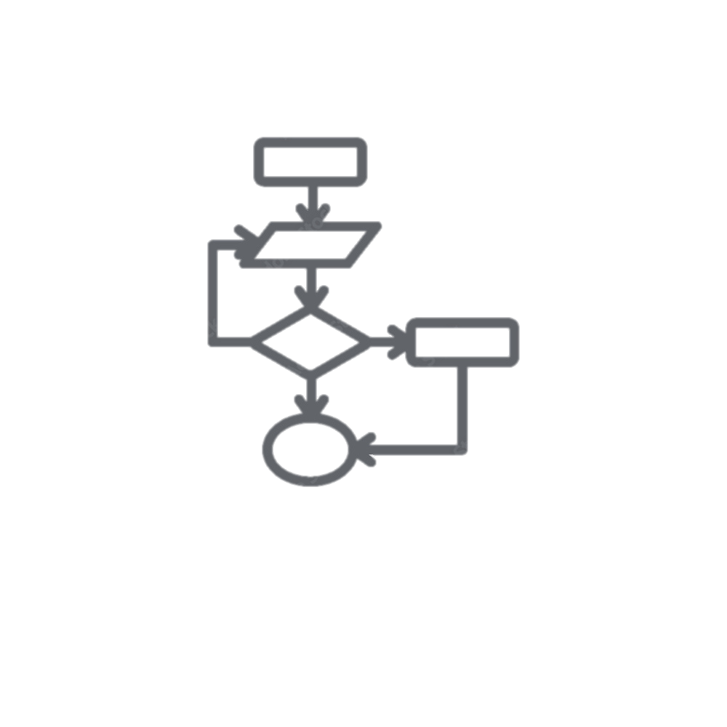
15. If e, then go to step 2.
16. **Seller Options**: - a) Register as Seller - b) Add Item in Auction - c) Update Item in Auction - d) Exit
17. If a, then go to step 21; otherwise, go to step 16.
18. If b, then go to step 22; otherwise, go to step 16.
19. If c, then go to step 23; otherwise, go to step 16.
20. If d, then go to step 2.
21. Enter seller details and register, then go to step 28.
22. Enter item details and add the item to the auction, then go to step 28.
23. Select an item and update details, then go to step 28.
24. **Buyer Options**: - a) View Ongoing Auctions - b) Register in Auction - c) Exit
25. If a, display ongoing auctions and go to step 28.
26. If b, register in the auction and go to step 28.
27. If c, then go to step 2.
28. **End**

Slide 6
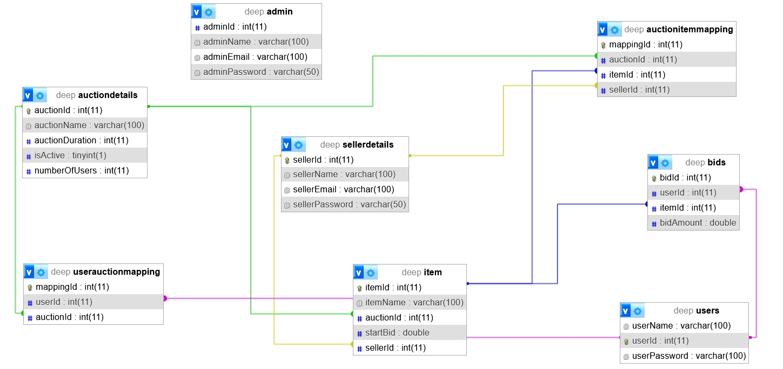
Er diagram

Slide 7
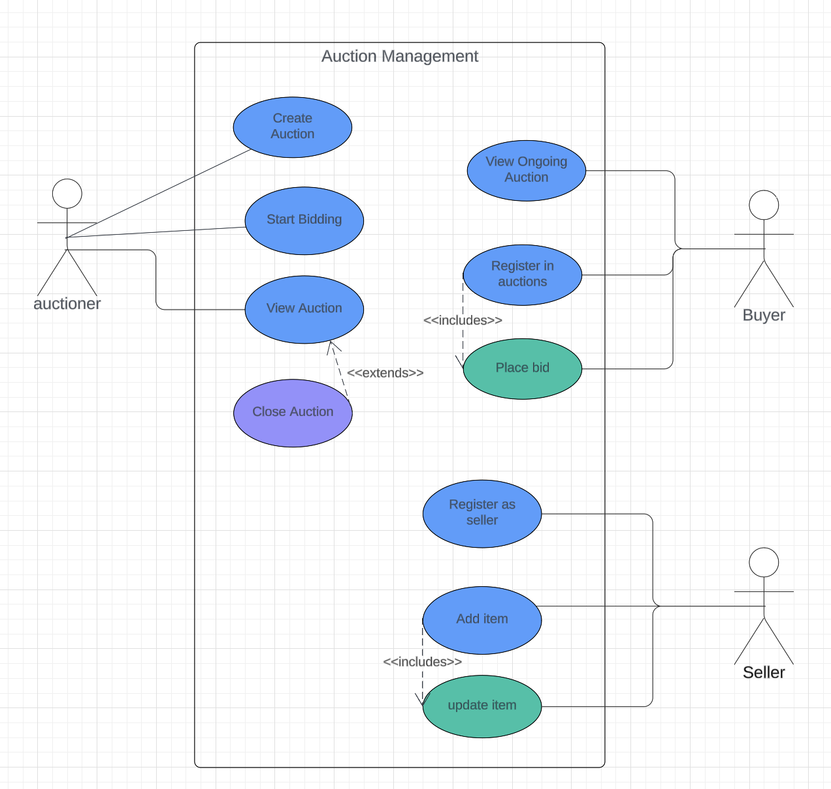
Use case diagram

Slide 8
Functionalities
Data Structure Using Java | Java-II | Database Management
List: Used to store and manage multiple auctions, allowing easy iteration and access to auction details. | Admin (Auctioneer): Manages the auction process, including creating, starting, viewing, and closing auctions. | auctionDetails table: Stores auction IDs, names, durations, and statuses for tracking auctions.
HashMap: Used to map auction IDs to their names, enabling quick retrieval of auction information. | Seller: Registers and adds items to auctions, with the ability to update item details. | item table: Holds item IDs, names, starting bids, auction IDs, for auction items.
Array of Objects: Used to store user and bid information, ensuring organized and efficient handling of bids. | User (Buyer): Participates in auctions by registering, viewing ongoing auctions, and placing bids on items. | sellerDetails table: Contains seller IDs, names, and contact details for managing sellers.
 | JDBC for establishing connection. It also prevents accidental deletion. PreparedStatement, CallableStatement are also used. | Other Tables users, bids, auctionItemMapping, userAuctionMapping tables

Slide 9

Merits & Demerits
Merits:
Secure
Reliable
Handle invalid input
Data loss is reduced
User Friendly
Demerits:
No Gui used
Requires careful handling of sensitive data

Slide 10
Tools used
XAMPP
JDBC
VS CODE
LUCID CHART

Slide 11

Future scope
We can develop a mobile app and improve user interfaces for better accessibility and convenience.
We can provide sellers with advanced analytics and recommendations to optimize their auction strategies.
We can add real-time bidding and notifications to enhance user engagement during live auctions.
We can enhance security with fraud detection mechanisms to safeguard against unauthorized activities.

Slide 12

thank you

