Slide 1

Food and nutrition analysis
By
Deep Patel:-18CP204

Slide 2

Introduction
Food and nutrition are the way that we get fuel, providing energy for our bodies. We need to replace nutrients in our bodies with a new supply every day.
Water is an important component of nutrition. Fats, proteins, and carbohydrates are all required.
Maintaining key vitamins and minerals are also important to maintaining good health.
For pregnant women and adults over 50, vitamins such as vitamin D and minerals such as calcium and iron are important to consider when choosing foods to eat, as well as possible dietary supplements

Slide 3
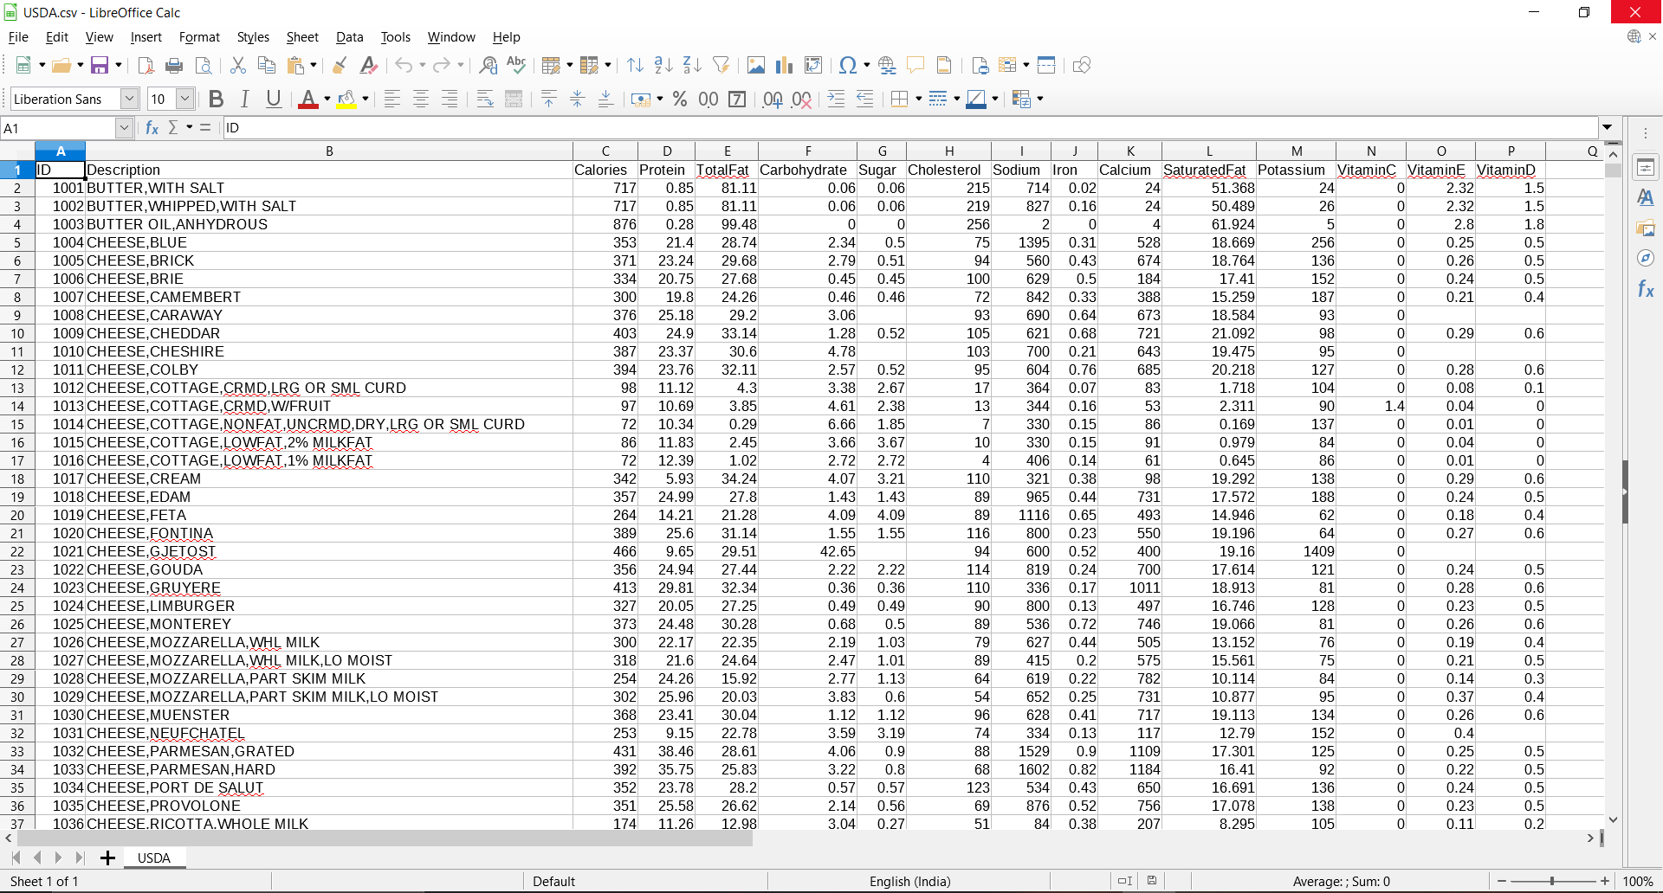
DATASET
This Dataset consist of foods with nutrients available in that food
Such as
Fats
Carbohydrates
Vitamins
Proteins
Calories
Et al

Slide 4



Calories
Items containing high number of calories
We know that some nutrients contain a large amount of calories
Such as fats and carbohydrates are responsible for higher calories.
Proteins and vitamins contains less amount
Of calories
Summary of calories found in items

Slide 5
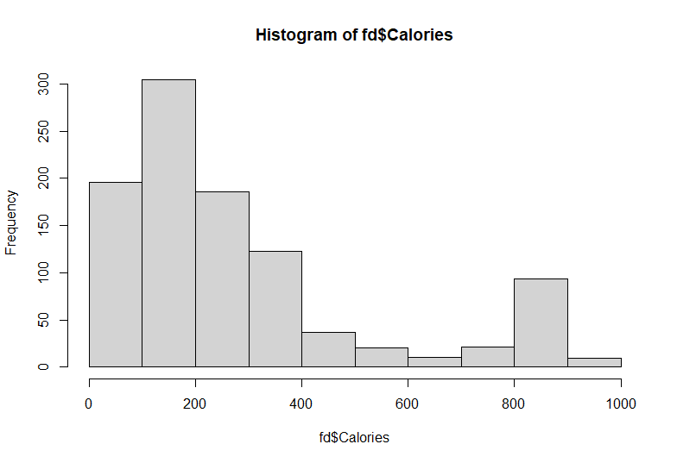
Representation
This is the representation of frequency distribution of items containing calories

Slide 6


Proteins
Protein is an important part of a healthy diet.
Proteins are made up of chemical 'building blocks' called amino acids.
Your body uses amino acids to build and repair muscles and bones and to make hormones and enzymes. They can also be used as an energy source.

Slide 7


Stats about protein
Items containing high amount of proteins
Summary of proteins

Slide 8

Fats
Fats in food come in several forms, including saturated, monounsaturated, and polyunsaturated.
Too much fat or too much of the wrong type of fat can be unhealthy.
Some examples of foods that contain fats are butter, oil, nuts, meat, fish, and some dairy products.

Slide 9


Stats about Fats
Items containing minimum and maximum fats
Summary of fats

Slide 10
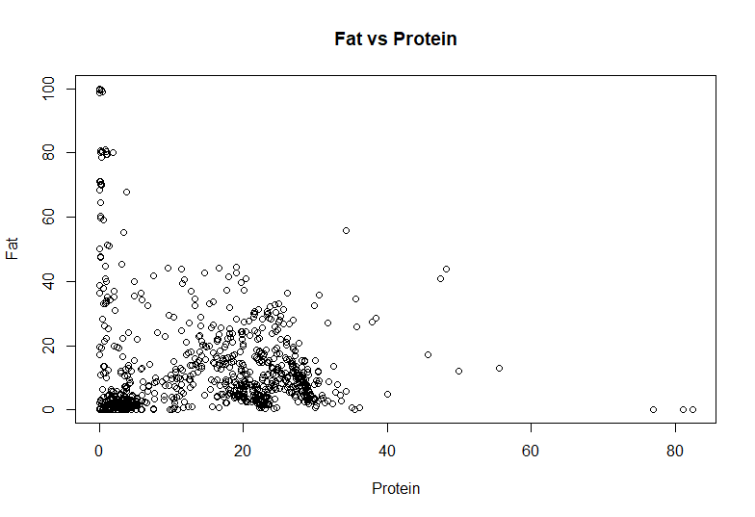
Fats vs Proteins
X = Proteins
Y = Fats

Slide 11

Carbohydrates
Carbohydrates are found in a wide array of both healthy and unhealthy foods—bread, beans, milk, popcorn, potatoes, cookies, spaghetti, soft drinks, corn, and cherry pie.
They also come in a variety of forms.
The most common and abundant forms are sugars, fibers, and starches.

Slide 12


Stats about Carbohydrates
Items containing high carbohydrates
Summary of carbohydrates

Slide 13

Sugar
Sugar is a simple carbohydrate that belongs to a class of chemically related sweet-tasting substances.
It is available in many different forms.
The three main types of sugar are sucrose, lactose, and fructose.
Even though cells need glucose to survive, consuming too much can cause health problems.

Slide 14


Stats about Sugar
Items containing sugar
Summary of sugar

Slide 15
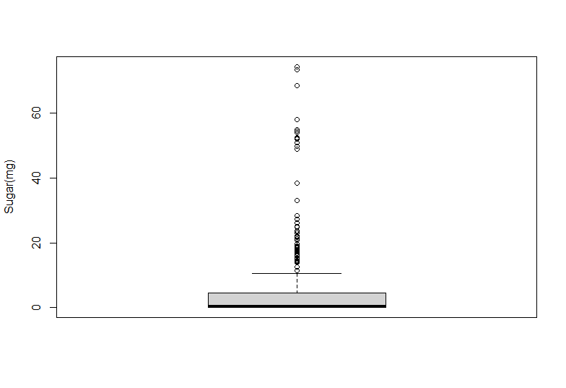
BOXPLOT graph of sugar

Slide 16
Cholesterol
Cholesterol is a waxy, fat-like substance that's found in all the cells in your body.
Your body needs some cholesterol to make hormones, vitamin D, and substances that help you digest foods.
Your body makes all the cholesterol it needs.

Slide 17


Stats about Cholesterol
Items containing Cholesterol
Summary of Cholesterol

Slide 18
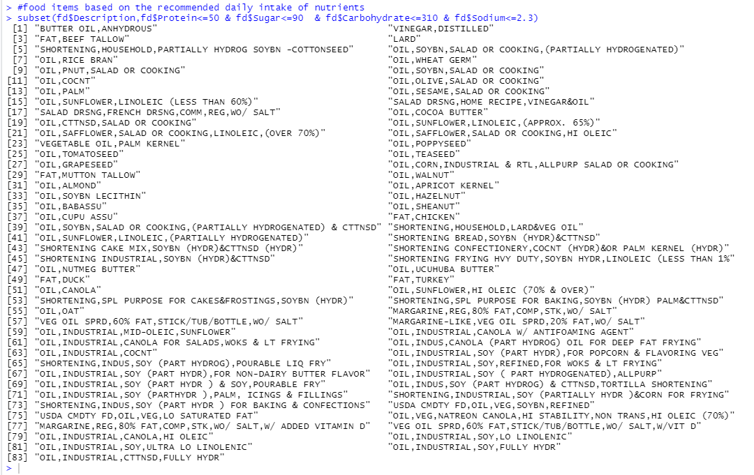
ITEMS TO BE RECOMMENDED FOR NUTRIENTS

Slide 19

Thank you

