Slide 1

Routine Checker
Course: 4CP50 – Python Programming
Group Members:
Deep Patel (18CP204)
Nawaaz Basha (18CP205)

Slide 2

Introduction
Database application with GUI
Store regular routine data like daily expenditure, studied or not, did exercise or not, etc

Slide 3

Tools and Technologies
Library: Tkinter
Database: Sqlite
IDE: Pycharm

Slide 4
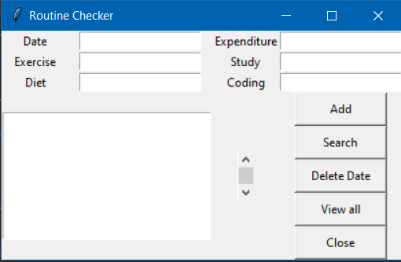
User Interface

Slide 5

Required files
Frontend.py
Backend.py
Routine.db

Slide 6

Thank you

