Slide 1

Student Data Analysis and Visualization
Course: - 4CP02 – Data Analytics and Visualization
Group Members:
Yash Dholariya (18CP019)
Jemish Mangukiya (18CP044)
Deep Patel (18CP204)

Slide 2
Introduction
Data on the results in national assessments for secondary and university education in engineering students
Data contains academic, social, economic information for 12,411 students
Observe the influence of social variables and the evolution of students' learning skills

Slide 3
Python Libraries
Pandas
Matplotlib
Seaborn

Slide 4
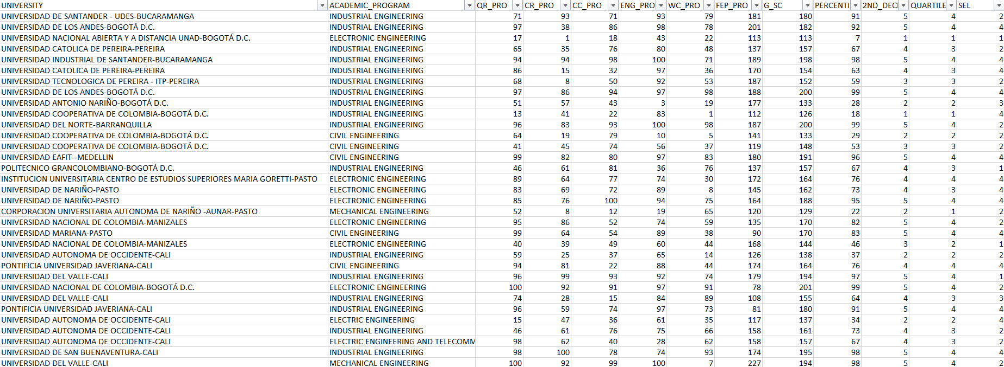
Dataset
https://data.mendeley.com/datasets/83tcx8psxv/1

Slide 5
Dataset
Column | Description
EDU_FATHER | Father's education
EDU_MOTHER | Mother's education
OCC_FATHER | Father's occupation
OCC_MOTHER | Mother's occupation
STRATUM | Stratum
MAT_S11 | Mathematics
QR_PRO | Quantitative Reasoning - ability to understand and manipulate quantitative data
CR_PRO | Critical Reading - assesses the ability to understand a text and the critical approach to it
CC_PRO | Citizen Competencies - assesses the concept of citizenship
ENG_PRO | Competence to communicate effectively in English
WC_PRO | Written Communication - assesses the ability to transmit in writing own ideas related to a topic
FEP_PRO | Formulation of Engineering Projects
G_SC | Global Score
SEL | Socioeconomic Level

Slide 6

Thank you

