Slide 1
CHALMERS UNIVERSITY OF TECHNOLOGY • MMS236 AIRCRAFT DESIGN
Aircraft design, DT1
EXAELIA — 80m Liquid Hydrogen Blended Wing Body Transport
Johan Persson, Sai Srinivasa Manideep Jakka, Tobias Hilltorp, William Gustavsson
Group 13
430 Passengers | 12,500 km Range | Mach 0.85 at FL350 | 80.0 m Wingspan (ICAO Code F)

Slide 2
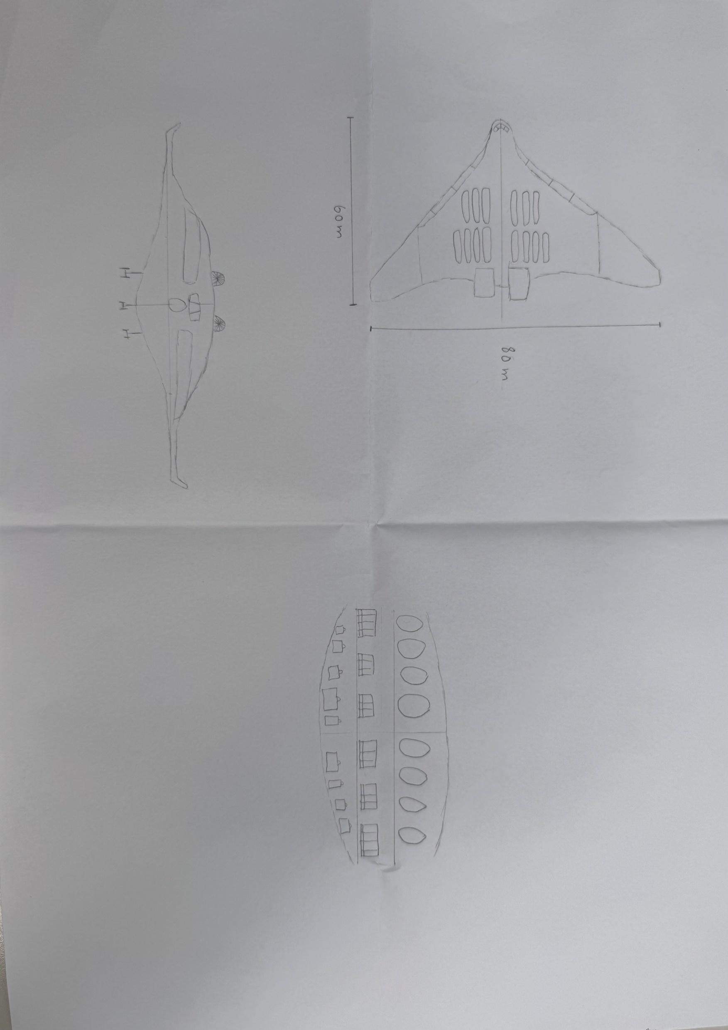
CONCEPT ORIGIN
Blended wing body
Initial hand-drawn configuration sketch • 80 m wingspan blended wing body planform

Slide 3
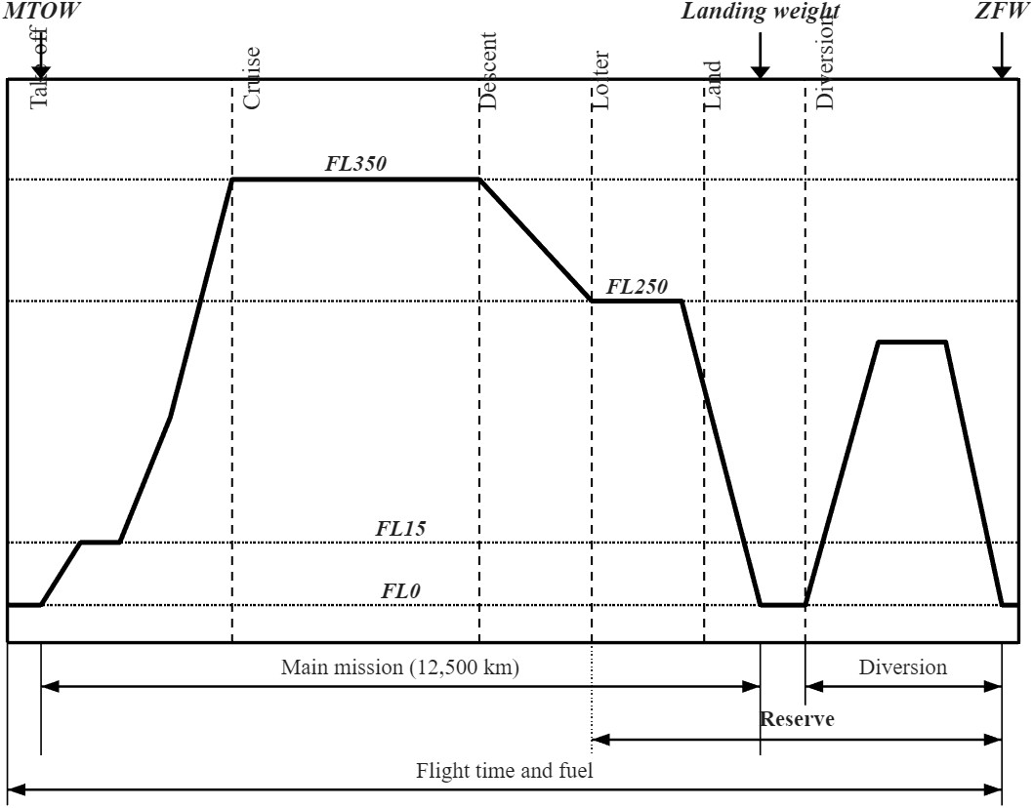
MISSION PROFILE
Sizing mission
Design Range: 12,500 km at FL350 (M0.85) • 200 nm Diversion • 30 min Loiter + 3% Contingency

Slide 4
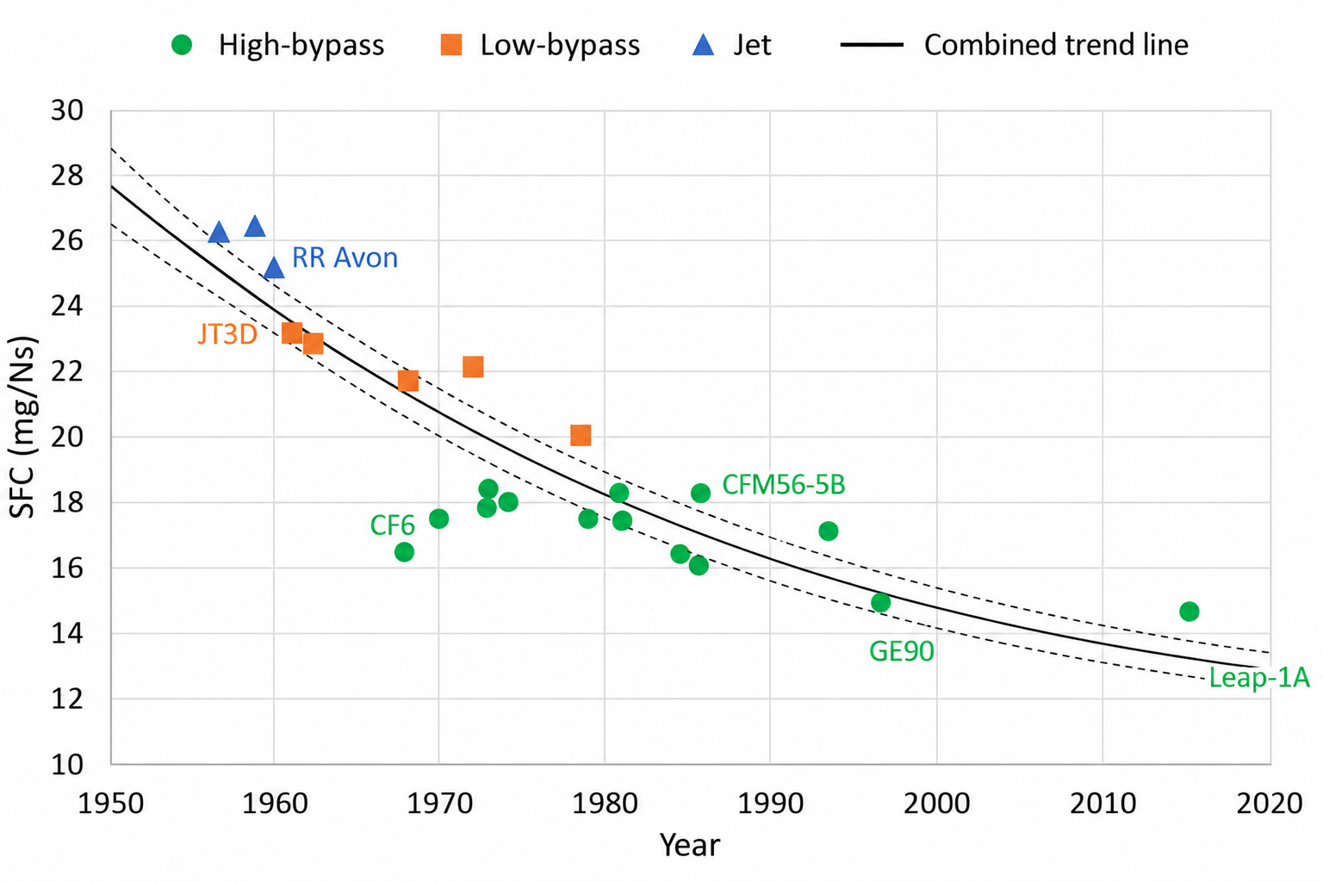
PROPULSION MODELING
Engine performance
FOLLOWING TREND LINE
2050 SFC ~ 12.4 mg/Ns
Baseline turbofan historical efficiency extrapolation
HYDROGEN FUEL CONVERSION
SFC ~ 5.0 mg/Ns
Adjusted for liquid hydrogen (120 MJ/kg vs 42.8 MJ/kg)

Slide 5
AERODYNAMIC EFFICIENCY
Aerodynamics
ASPECT RATIO
5.0
Full planform geometric ratio (b² / S_ref)
SWET / SREF
2.4
High volumetric packaging efficiency
L/D MAX
24.5
Maximum loiter & holding efficiency
L/D CRUISE
21.2
Optimal Mach 0.85 long-range condition
Holding & Loiter Aerodynamic Efficiency: (L/D) Loiter = 24.5 (Jet Engine Loiter Maximum)

Slide 6
MASS SIZING
MTOW
ASSUMPTION
Aircraft design
book
Raymer statistical empty weight
buildup method
Raymer Methodology
EMPTY WEIGHT FRACTION
0.56
We / W0 = 155,600 / 275,460 kg
MTOW = 275,460 kg (~275.5 t)
TANK MASS
35,400 kg
6 tanks × 5,900 kg
Gravimetric index Gi = 0.50

Slide 7
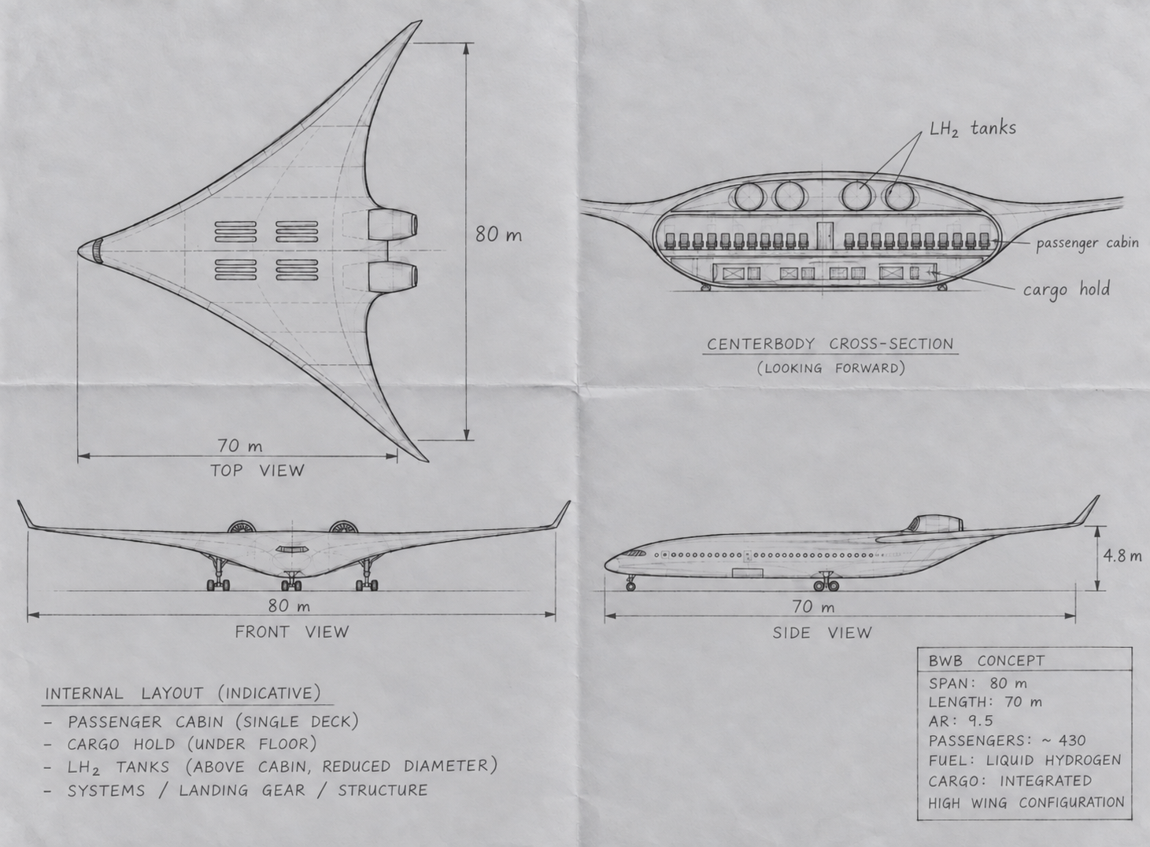
CONFIGURATION
The concept
(AI ENHANCED SKETCH)
EXAELIA 80m Hydrogen BWB • 430 Pax Single-Deck Theater Cabin • 610 m³ Cryogenic Storage

Slide 8
BIBLIOGRAPHY
References
NASA Technical Reports Server (NTRS)
Aerodynamic Design and Performance Analysis of Advanced Blended-Wing-Body Transports
https://ntrs.nasa.gov/api/citations/20120001452/downloads/20120001452.pdf
International Journal of Hydrogen Energy (ScienceDirect)
Civil Liquid Hydrogen Aircraft Design, Sizing and Cryogenic Storage Integration
https://www.sciencedirect.com/science/article/pii/S036031992404535X#bib87

