Slide 1
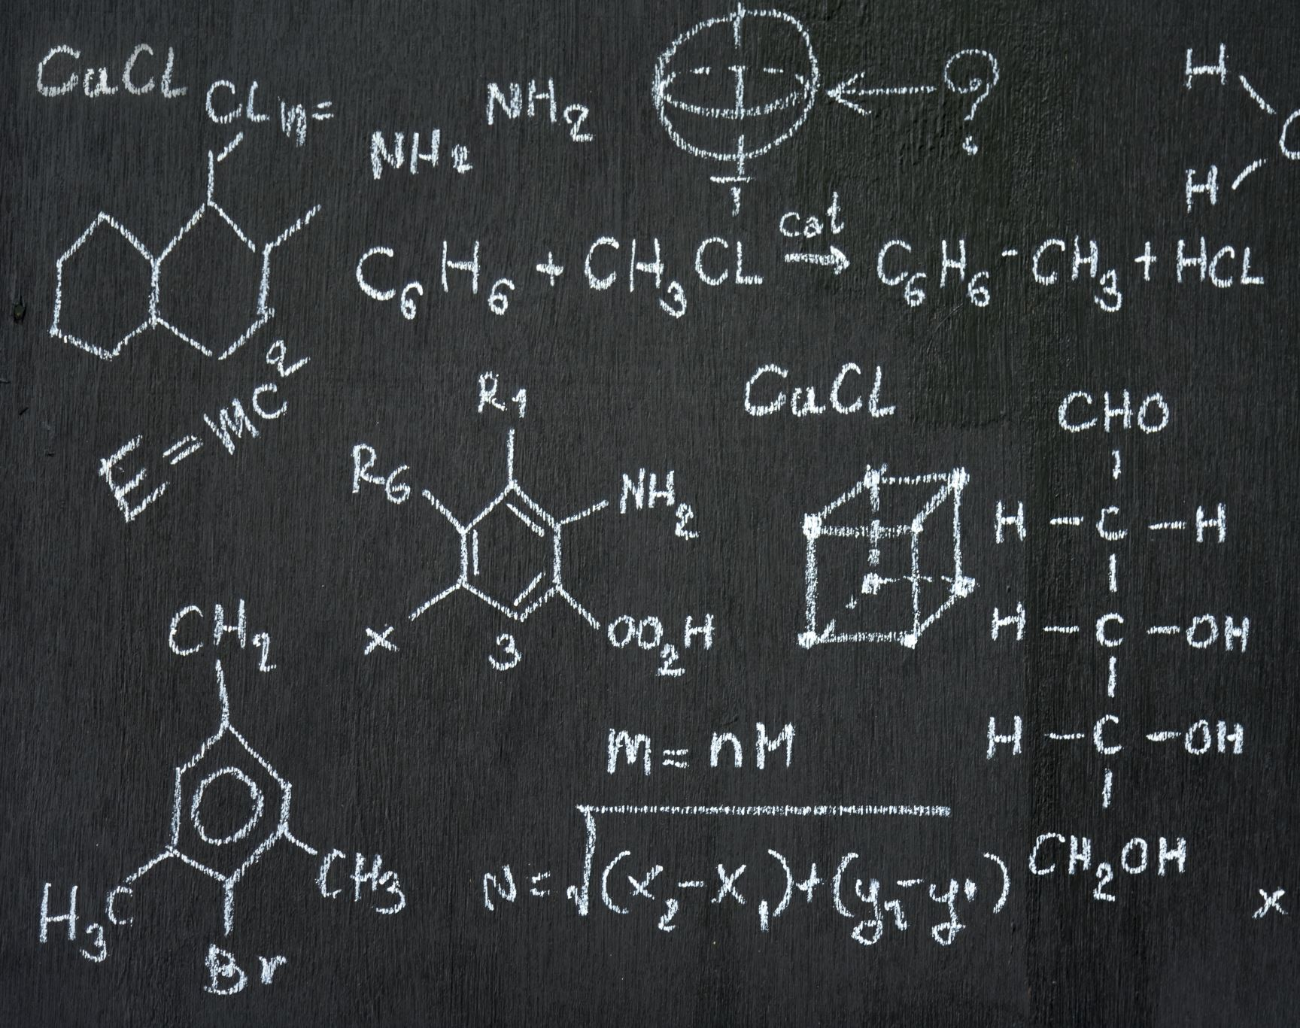
Presentation: Physics-Informed Deep Learning for Fire Dynamics
From Multi-Camera Video Feeds

Slide 2
High-Level Pipeline (The "Big Picture")
Phase 1: Data Factory: Generating synthetic "perfect" fire data using Fire Dynamics Simulator (FDS).
Phase 2: The "Eyes" (Vision): Using DeepLab-B0 / U-Net to segment fire from background (based on Swedish thesis findings).
Phase 3: The "Brain" (Prediction): Using ConvLSTM to remember the past and predict the next frame.
Phase 4: The "Laws" (Physics): Constraining the AI with a Physics-Informed Loss Function (e.g., Conservation of Mass).

Slide 3
Step 1 - Data Generation (FDS CLI)
Objective: Create a massive dataset of fire behavior without needing dangerous real-world fires.
Tool: Fire Dynamics Simulator (FDS) via Command Line Interface (CLI).
Workflow:
  Scripting: Python script generates randomized .fds input files (varying burner size, fuel type, ventilation).
  Simulation: CLI executes FDS in batch mode (fds_local.bat job_name.fds).
  Extraction: Export 2D "Slice Files" (frames) of temperature and heat release rate at 30 FPS.
Outcome: 10,000+ labeled frames of "ground truth" fire behavior.

Slide 4
Step 2 - Data Processing (The Vision Layer)
Objective: Teach the computer to "see" the fire before it tries to predict it.
Reference: Based on the Examensarbete thesis (Schelin & Holappa).
Preprocessing:
  Gyroflow: Stabilize real-world footage (for the lab experiment phase).
  HSV Masking: Create binary masks (black/white) to define "Fire" vs "Not Fire".
Segmentation Model:
  Architecture: DeepLab-B0 (Selected for highest accuracy) or Fast-SCNN (for speed).
  Task: Input Raw Frame >> Output Segmentation Mask (Fire Shape).

Slide 5

Step 3 - The "Brain" (Spatiotemporal Modeling)
Objective: Predict the next frame based on the history of the fire.
Architecture: ConvLSTM (Convolutional Long Short-Term Memory).
  Why? Standard CNNs see space (shape). Standard RNNs see time (history). ConvLSTM sees both.
Input: Sequence of 5 frames ($t_{−4},t_{−3},$ $t_{−2},$ $t_{−1},$ $t_{0},$).
Output: Prediction of the next frame ($t_{+1}$).
Innovation: The model learns the "velocity" of the flame edges.

Slide 6

Step 4 - Physics Integration (The "Thesis" Core)
Objective: Stop the AI from hallucinating physically impossible fires.
Problem: Pure AI might predict a fire suddenly disappearing or teleporting.
Solution: Physics-Informed Loss Function.
  Standard Loss: "Did the pixels match?" (MSE).
  Physics Loss: "Did the total mass/heat conserve?"
Implementation:
$$Loss_{\left\{total\right\}} = Loss_{\left\{image\right\}} +λ⋅ Loss_{\left\{physics\right\}}$$
(Where $"λ$” penalizes the model if it violates conservation laws).

Slide 7
Step 5 - Validation & Benchmarking
Objective: Prove it works.
Metric 1: Intersection over Union (IoU): Does the predicted shape match the real shape?
Metric 2: Heat Release Rate (HRR) Correlation: Does the predicted visual intensity match the actual heat output?
The Test: Run the AI prediction against a brand new FDS simulation it has never seen before.

