Slide 1
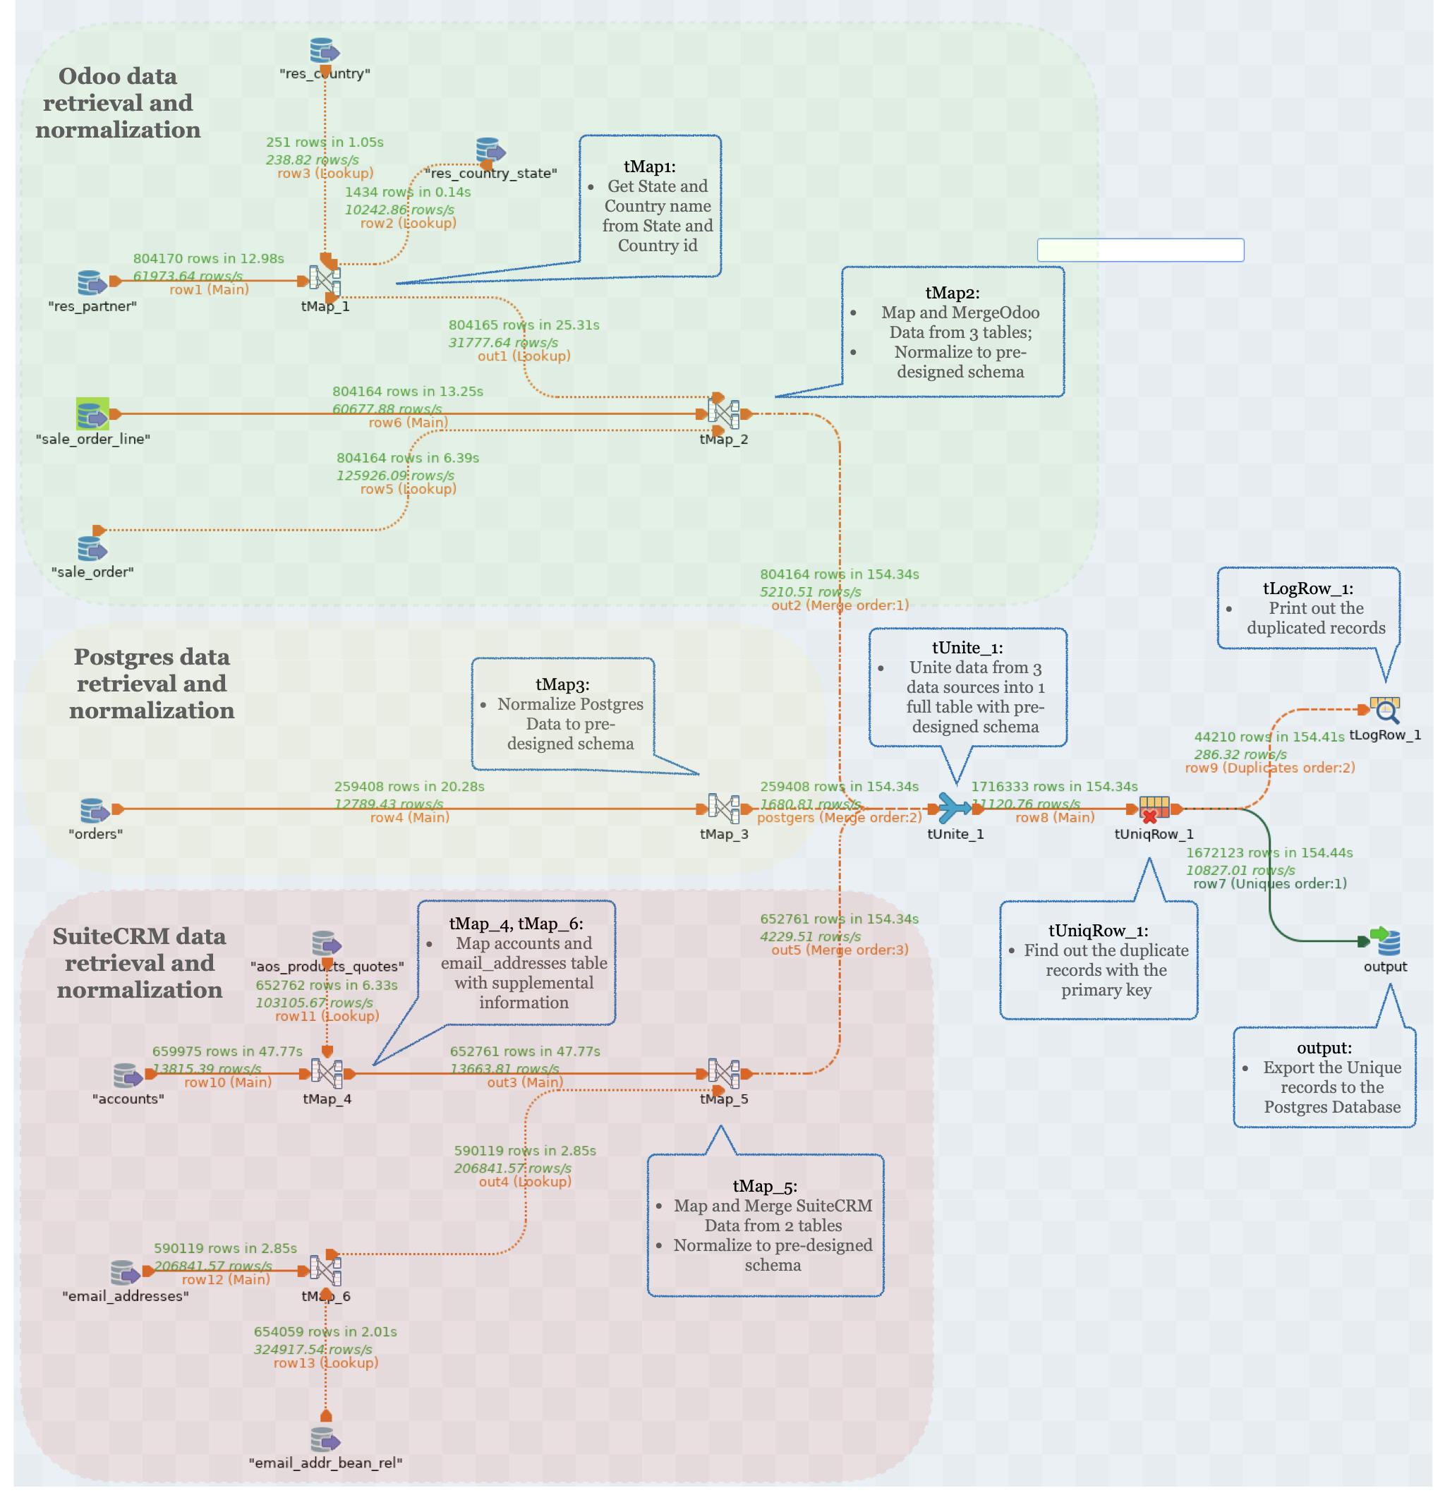
Talend Pipeline

Slide 2
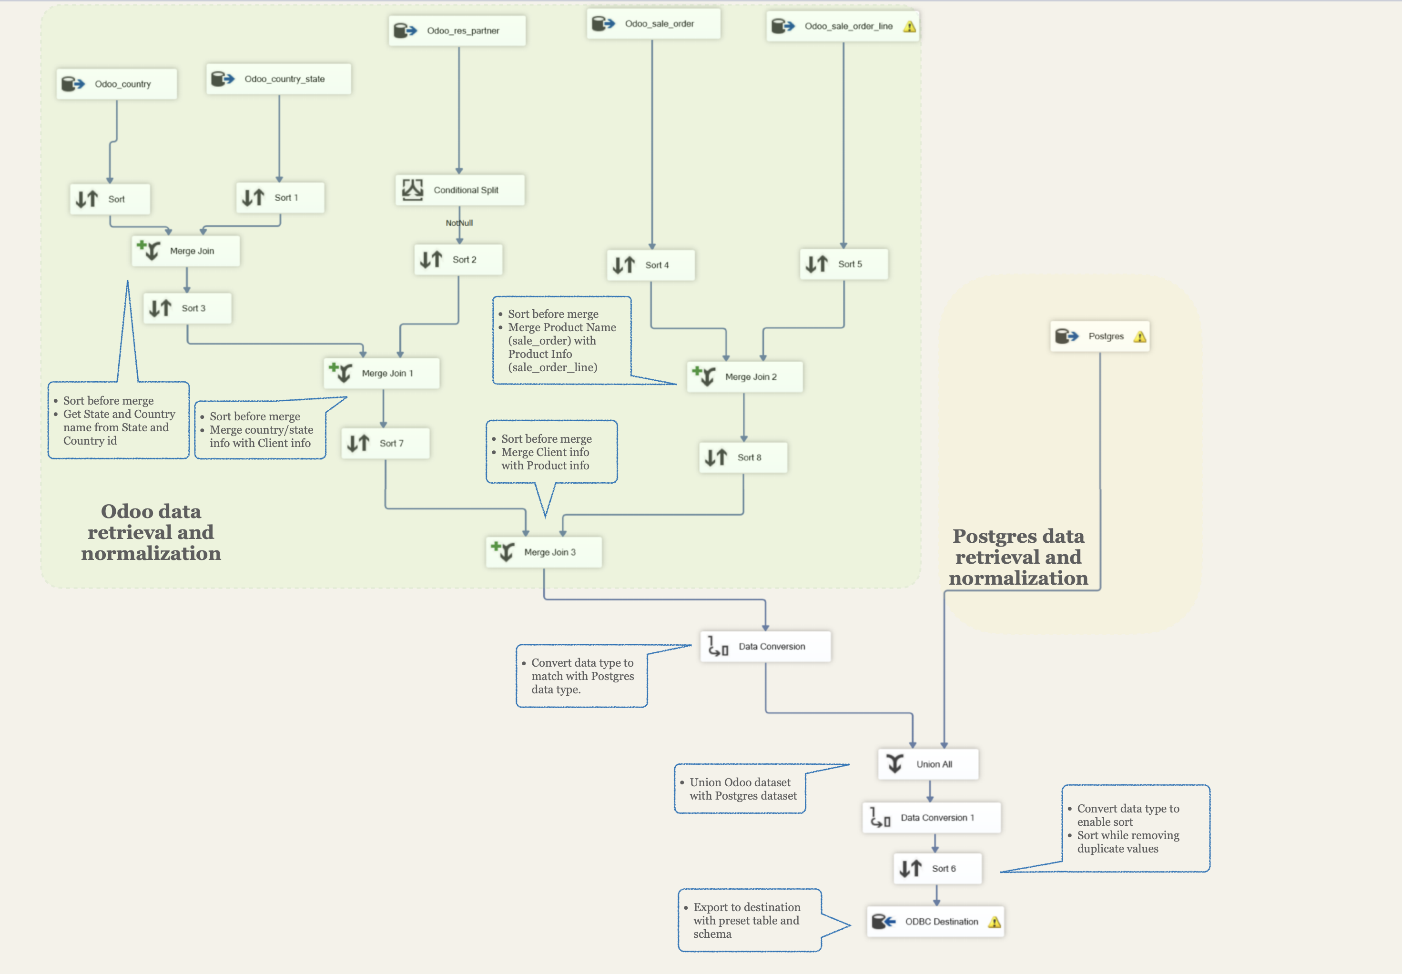
SSIS Pipeline

Slide 3
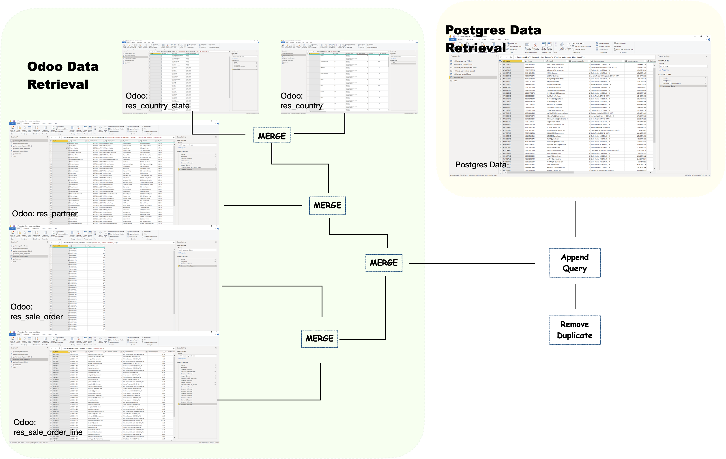
Power Query Pipeline

Slide 4
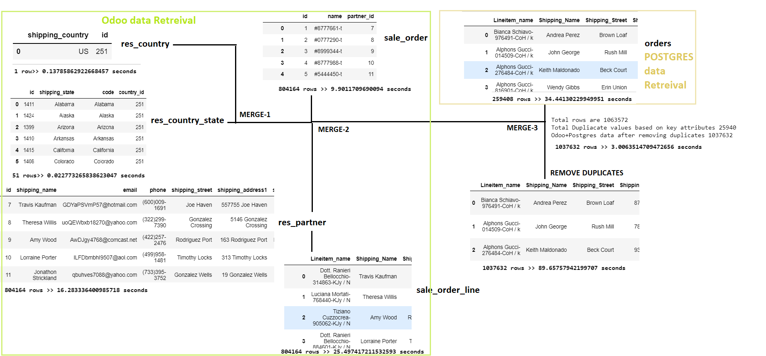
Python Pipeline

