Slide 1
Clustering
BY: DEEPSHIKHA JAIN

Slide 2
Problem statement Description: HELP International is an international humanitarian NGO that is committed to fighting poverty and providing the people of backward countries with basic amenities and relief during the time of disasters and natural calamities. Now the CEO of the NGO needs to decide how to use this money strategically and effectively. The significant issues that come while making this decision are mostly related to choosing the countries that are in the direst need of aid.

Slide 3
In this case study we performed the following steps:
Data Quality Check
EDA
Outlier Detection
Hopkin's Test
Scaling
Find the best value of k using SSD Elbow, Silhoutte Score
Using the final value of k, perform the kMeans analysis
Visualize it using boxplot
9.Hierarchial Clustering: By Complete Linkage
10. Visualize it using boxplot
11. Conclusion

Slide 4
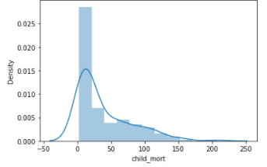
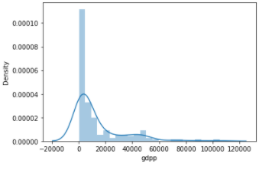
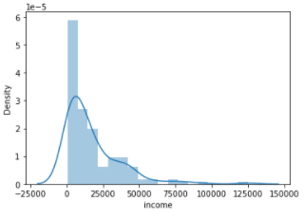
EDA
Child mortality, Income and GDPP are normally distributed which means that there are lesser chances for any internal grouping.

Slide 5
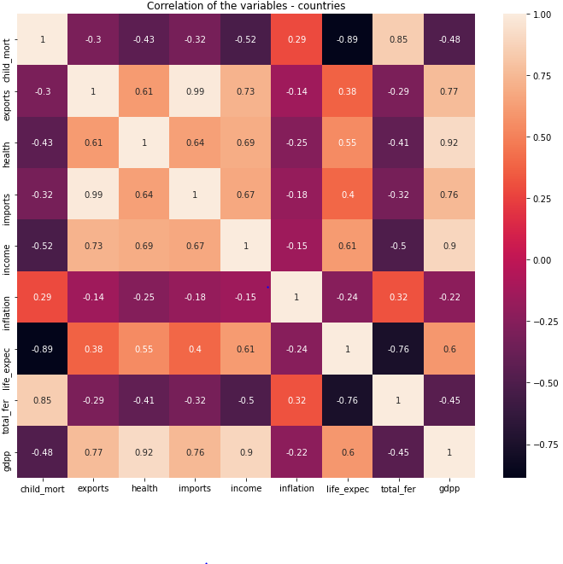
Correlation of the variables of dataset
From the heatmap it is conclude that –
Some variables having high correlations like GDPP with life_expect, income, imports, health, exports.
Some variables having negative correlations like child mortality rate with life_expect, income, health.

Slide 6
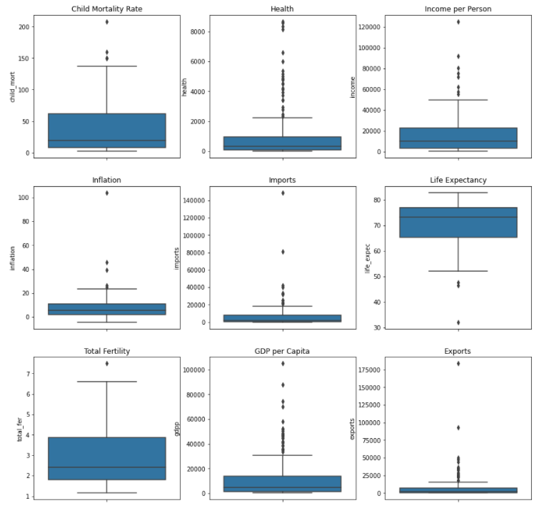
Visualization of Outliers Using Boxplot
From Boxplot it is conclude that:
All variables contains outliers.
Health, GDPP and income has more more outliers as compare to others.
Only life Expectancy as outliers on the bottom of the box plot.
Import and Export has very thin size of quartile.

Slide 7
Hopkins statistic & Scaling
Hopkins statistics gives idea about how different our date is from the randomly scattered data.
It is good to scale the data set as some values are large and some are small so better to scaled them all

Slide 8
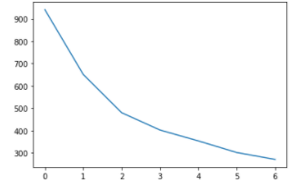
K-Means Clustering
K-means Clustering is the most popular unsupervised machine learning algorithm. It is a centroid-based or distance-based algorithm. The working of the algorithms is as follows:
First we initialize k points called means randomly. Then we categorize each item to its closest mean and we update the mean's coordinates, which are the averages of the items categorized in the mean so far. Then We repeat the process for a given number of iterations and at the end.

Slide 9
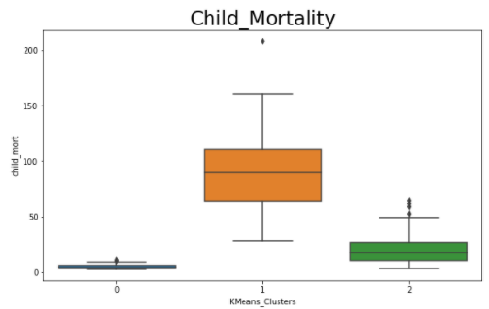
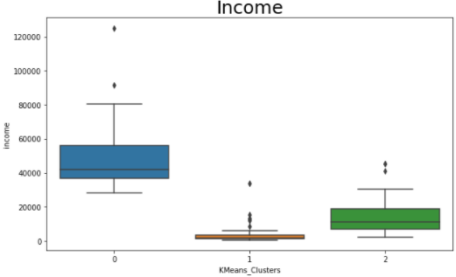
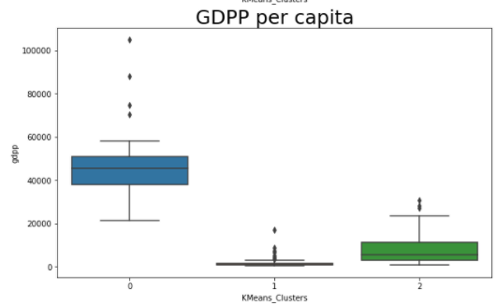
Visualization of clusters
Cluster 0 has GDPP and Income quiet high than cluster 1 and 2 where as has child mortality low.
Cluster 1 has high child mortality rate as compare to 0 and 2.
Cluster 2 has all values comparable.

Slide 10
Insights (K-Means with outliers)
There are total 48 countries from the dataset need urgent help/aid as they are having lowest income, high child mortality and low GDPP.
Top five Countries that need immediate Aid are Congo, Dem. Rep., Liberia, Burundi, Niger, Central African Republic.

Slide 11
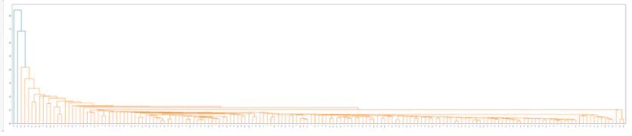
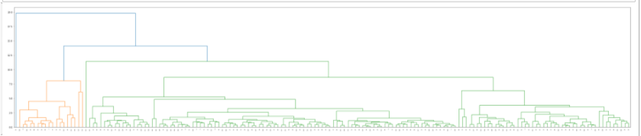
Hierarchical clustering(Single linkage, Complete Linkage)
This is another method to find our low development countries using single linkage.
As we can see in first graph, it is not quite visible and doesn’t not suits properly with the dataset because we can cut the tree in a threshold value, we will use complete linkage for hierarchical clustering.
Second graph shows proper way to decide number of clusters needs to be used by cutting at threshold value.

Slide 12
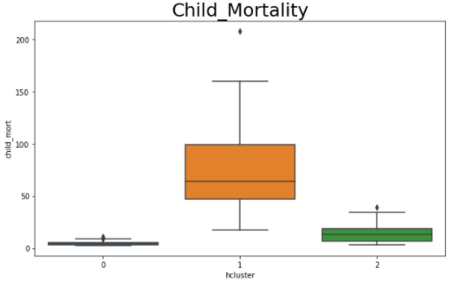
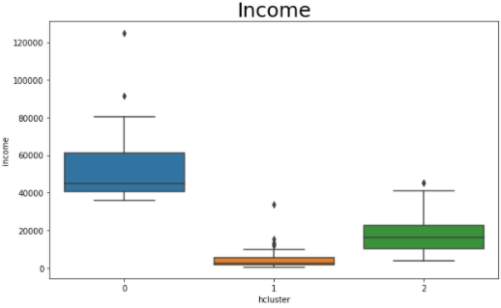
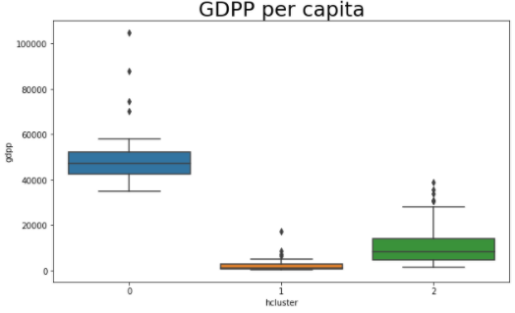
Visualization of Hierarchical clusters
Cluster 0 has GDPP and Income quiet high than cluster 1 and 2 where as has child mortality low.
Cluster 1 has high child mortality rate as compare to 0 and 2.
Cluster 2 has all values comparable.

Slide 13
Insights (Hierarchical with outliers)
There are total 70 countries from the dataset need urgent help/aid as they are having lowest income, high child mortality and low GDPP.
Top five that need that need immediate Aid are Congo, Dem. Rep., Liberia, Burundi, Niger, Central African Republic.

Slide 14
Conclusion::
K-means clustering :
Countries that need direst need of aid: 48 countries.
Hierarchical clustering :
Countries that are direst need of aid: 70 countries.
It is observed that from both clustering, hierarchical clustering gives precise information so it is better to good with countries from hierarchical clustering.
Top five Countries that need immediate Aid are Congo, Dem. Rep., Liberia, Burundi, Niger, Central African Republic.
List of countries that need Aid are:: 'Afghanistan', 'Angola', 'Bangladesh', 'Benin', 'Bhutan', 'Bolivia', 'Botswana', 'Burkina Faso', 'Burundi', 'Cambodia', 'Cameroon', 'Central African Republic', 'Chad', 'Comoros', 'Congo, Dem. Rep.', 'Congo, Rep.', "Cote d'Ivoire", 'Egypt', 'Equatorial Guinea', 'Eritrea', 'Fiji', 'Gabon', 'Gambia', 'Ghana', 'Guatemala', 'Guinea', 'Guinea-Bissau', 'Guyana', 'Haiti', 'India', 'Indonesia', 'Iraq', 'Jordan', 'Kenya', 'Kiribati', 'Kyrgyz Republic', 'Lao', 'Lesotho', 'Liberia', 'Madagascar', 'Malawi', 'Mali', 'Mauritania', 'Micronesia, Fed. Sts.', 'Mozambique', 'Myanmar', 'Namibia', 'Nepal', 'Niger', 'Nigeria', 'Pakistan', 'Philippines', 'Rwanda', 'Samoa', 'Senegal', 'Sierra Leone', 'Solomon Islands', 'South Africa', 'Sudan', 'Tajikistan', 'Tanzania', 'Timor-Leste', 'Togo', 'Tonga', 'Turkmenistan', 'Uganda', 'Uzbekistan', 'Vanuatu', 'Yemen', 'Zambia'

Slide 15
Thank You

