Slide 1


Slide 2

Machine Learning – I Lead Scoring Case Study Assignment
Deepshikha Jain &
08-FEB-2021

Slide 3
OBJECTIVE
To help X education to select the most promising leads known as ‘hot leads’ who are most likely to convert into paid customers.

Slide 4
PROBLEM STATEMENT:
To help X education to select the most promising leads known as ‘hot leads’ who are most likely to convert into paid customers.
Build a logistic regression model to assign a lead score between 0 and 100 to each of the leads where the leads with higher lead score have a higher conversion chance and the leads with lower lead score have a lower conversion chance.
Identify the driver variables and understand their significance which are strong indicators of lead conversion.
Identify the outliers, if any, in the dataset and justify the same.
Consider both technical and business aspects while building the model.
Summarize the conversion predictions by using evaluation metrics like accuracy, sensitivity, specificity and precision.

Slide 5
ANALYSIS APPROACH
DATA COLLECTION AND DATA CLEANING:
Leads.csv :
• Following columns contain more than 30% null values initially:
Tags
Lead Quality
Asymmetrique Activity Index
Asymmetrique Profile Index
Asymmetrique Activity Score
Asymmetrique Profile Score
• So, we remove all the NULL values with some relevant text and dropped the columns who has values Null values more than 30%

Slide 6
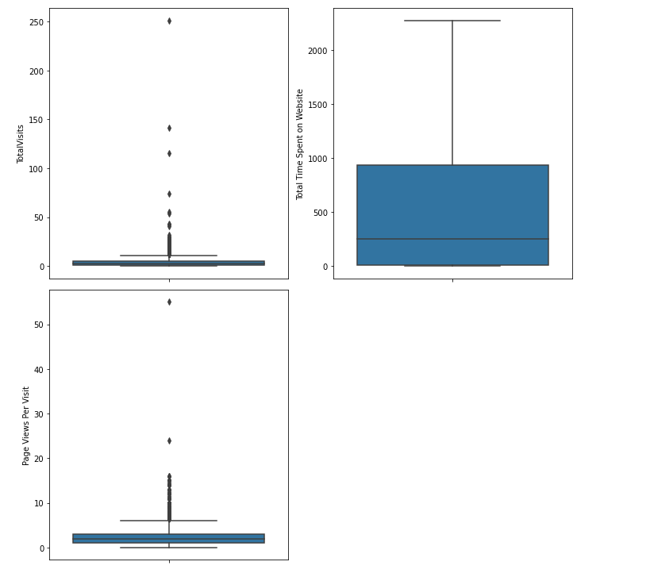
VISUALISING DATA
Univariate Analysis – Outliers
Univariate analysis revealed data distribution and outliers in ‘Leads’ data. Key columns where outliers were identified are:- 1)TotalVisits
2) Page Views Per Visit
Inter Quantile Range (IQR) method has been used to treat outliers in the data.
We decided to remove the outliers

Slide 7
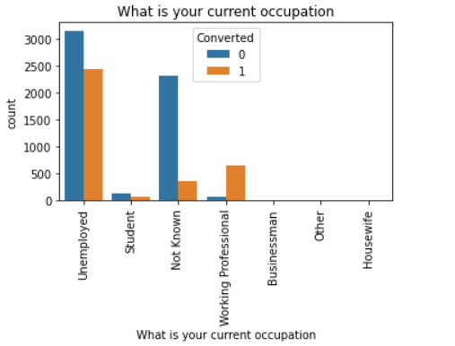
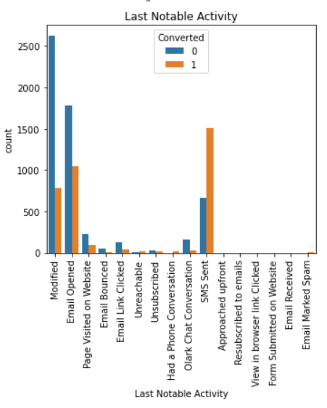
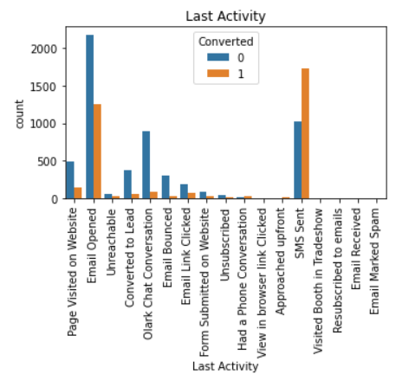
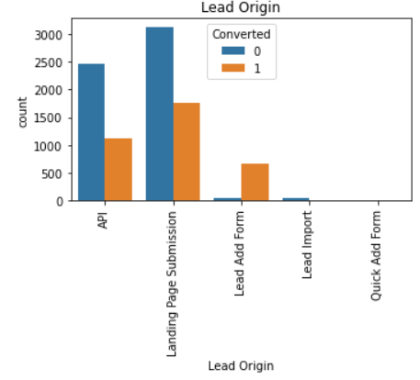
Bivariate Analysis: Categorical variables
‘Converted’ column has been chosen as target variable. So, bivariate analysis of important variables has been performed with respect to the target variable.
Unemployed showing interest so, on next batch have higher chances of getting converted.
Lead originated through “Landing Page Submission” and “API” has high possibility of getting converted.
Lead belongs to Email Opened, SMS Sent converts more than any other sources.

Slide 8
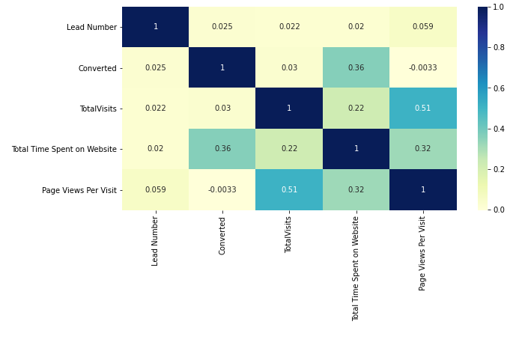
CORRELATION OF THE VARIABLES
Points to be concluded from the graph on the right :
From the heatmap, we can see that there are some variables having very high correlation with respect to positive and negative.

Slide 9
Data Preparation for Modeling:
Create Dummy Variables:
Independent variables as dummy variables allows easy interpretation and calculation of the odds ratios, which increases the stability and significance of the coefficients.
• Dummy variables have been created for following columns:
Lead Origin
Lead Source
Last Activity
Specialization
What is your current occupation
Do Not Email
A free copy of Mastering The Interview

Slide 10
Data Preparation for Modelling:
Binary Variables Encoding:
• Variables which have binary (Yes/No) values have been encoding with 1 and 0. • 1 denotes Yes whereas 0 denotes No.
Train – Test Split:
• The modified ‘Leads’ dataset has been split into Train and test dataset in the ratio 70:30.
• Train dataset has been used to train the model whereas Test dataset has been used to evaluate the model
Feature Scaling:
• It is important to have all variables on the same scale in order to avoid the dominance of variables with high magnitude in the model.
• “MinMaxScaler” function has been used to scale the data for modeling which brings all the data points into a standard.

Slide 11
Model Building: Using logistic Regression:
Generalized Linear Model (GLM) from StatsModels library has been used to build the Logistic Regression Model.
Initially, the model was built using 82 features present in X_train dataset.
Most of the features were found to be insignificant. So, we needed to perform feature selection technique.
Feature Selection using Recursive Feature Elimination (RFE):
RFE is an optimization technique for finding the best performing subset of features. It is based on the idea of repeatedly constructing a model and choosing either the best (based on coefficients), setting the feature aside and then repeating the process with the rest of the features. This process is applied until all the features in the dataset are exhausted. Features are then ranked according to when they were eliminated.
We ran RFE to identify top 15 features for further model building process.
Insignificant features were dropped one by one after checking the P-value and Variance Inflation Factor (VIF).
Accepted P-value should be kept below 0.05 and VIF should be less than 5.

Slide 12
Final Model and Interpretation:
Final model contains 13 most important features which satisfy all the selection criteria.
Lead score having conversion probability greater than 0.35 are being predicted as “Converted”.
Using this probability threshold value (0.35), the leads from the test dataset have been predicted whether they would get converted or not.
Confusion matrix with cut-off 0.35 has been created to calculate evaluation metrics.
Confusion matrix: [[3109 773]
[ 442 1943]]
Evaluation metrics:
Accuracy: 81% approx.
Sensitivity: 81% approx.
Specificity: 80% approx.
Precision: 77% approx.

Slide 13
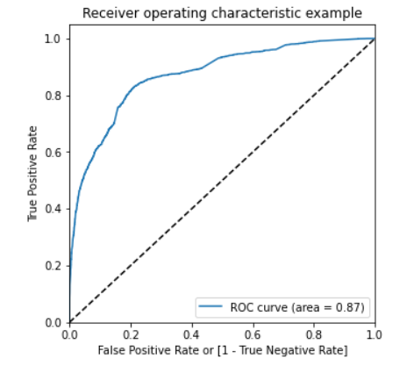
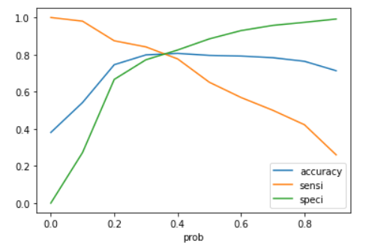
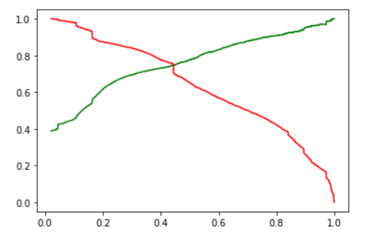
Evaluation Metrics:
Receiver Operating Characteristics (ROC) Curve:
By determining the Area Under the Curve(AUC) of the ROC curve, the goodness of the model is determined.
Since the ROC curve is close to the upper left part of the graph, it means this model is a very good model.
The value of AUC for our model is 0.87.
Plot accuracy sensitivity and specificity:
Tradeoff between sensitivity and accuracy can be observed (cutoff = 0.35).
Precision and Recall plot:
Ideal cutoff of 0.43 is observed from recall and precision plot.
We will use both the cutoff and evaluate results for further predictions.

Slide 14
Conclusion and Recommendations:
Followings are top features that contribute to decision which mean the conversion probability of a lead increases with increase in values of these features:
Lead Origin
Last Notable Activity
Last Activity
What is your current occupation
Top three categories that contribute to decision
Lead Origin ==> Lead Add Form
Total Time Spent on Website
Lead Source_Direct Traffic
This model will help to identify the hot leads which would enhance speed-to-lead and the response rate.

Slide 15

THANK YOU

