Slide 1


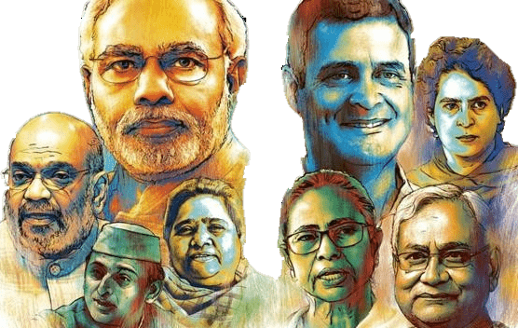

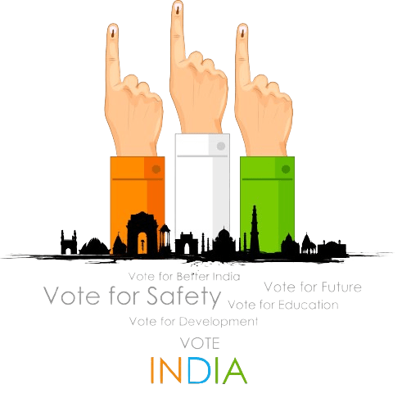
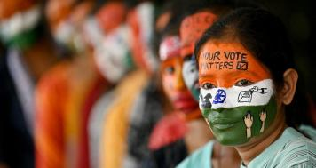
ATLIQ MEDIA
RESUME PROJECT CHALLENGE #11

Slide 2

CODEBASICS RESUME PROJECT CHALLENGE #11
Provide insights from Lok Sabha elections data to a media company.

Slide 3

PROBLEM STATEMENT
BACKGROUND
PROJECT OVERVIEW
PRIMARY QUESTIONS
SECONDARY QUESTIONS
DASHBOARD SHOWCASE
INSIGHTS
RECOMMENDATIONS
Agenda :

Slide 4


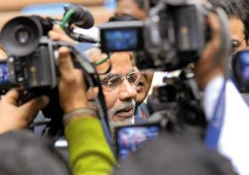
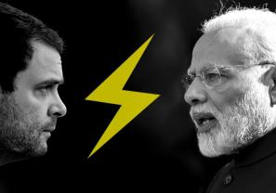
PROBLEM STATEMENT
ATLIQ MEDIA
AtliQ Media, a private media company, aims to telecast an insightful show on the Lok Sabha elections 2024 in India, focusing on unbiased analysis rather than predicting the winners. As a data analyst, I will take on the role of Peter Pandey to examine data from the 2014 and 2019 elections to uncover significant insights and explore themes like voter turnout percentages. Guided by primary and secondary questions from my manager, Tony Sharma, I will use various analytical tools to craft a compelling and concise presentation for chief editor Bruce Haryali, who values strong storytelling.
This Photo by Unknown Author is licensed under CC BY-NC-ND
This Photo by Unknown Author is licensed under CC BY-SA-NC

Slide 5
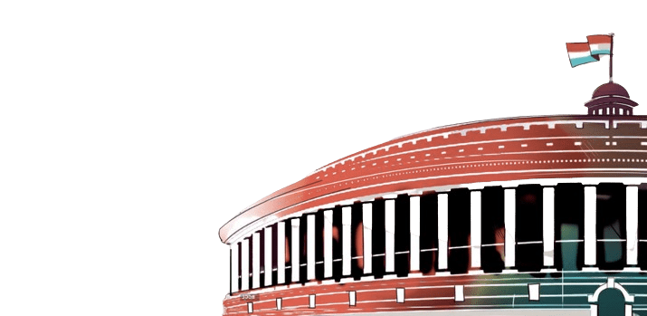
BACKGROUND
The Lok Sabha election, held every five years in India, is a significant event where citizens vote to elect representatives to the lower house of Parliament. This election decides the makeup of the 543-member Lok Sabha, which is essential for shaping the country's laws and forming the government. It features dynamic political campaigns, active voter engagement, and showcases the democratic spirit of India's diverse population.
Key points about the Lok Sabha election:
Winning Requirement: A party or coalition needs at least 272 seats to form a majority in the 543-member Lok Sabha.
Coalition Governments: If no party achieves a majority, parties may form coalitions to create a government.
Role of the President: In case of a hung parliament, where no clear majority is achieved, the President of India may invite the largest party or coalition to prove its majority in the house.
Government Formation: The party or coalition with a majority forms the government, with the leader becoming the Prime Minister.
Impact: The election influences the country's legislative agenda and policy direction for the next five years.

Slide 6
Project overview
Objective: Conduct a comprehensive analysis of the datasets of 2014 and 2019 Lok Sabha election results.
Focus: Analyze constituency-wise results and state codes sourced from the Election Commission of India.
Datasets: Include detailed information on candidates, votes received, and party affiliations, providing valuable insights for the electoral study.
Data Correction:
Address spelling mistakes.
Standardize case formats.
Remove trailing spaces.
Data Completeness:
In the 2014 dataset, information on constituencies in Telangana was initially missing due to Andhra Pradesh's bifurcation. This data was later mapped using the 2019 dataset.
Details regarding constituencies in Odisha and Chhattisgarh are not available in the 2014 dataset.

Slide 7
PRIMARY QUESTIONS

Slide 8
Q1. LIST TOP 5 / BOTTTOM 5 CONSTITUENCIES OF 2014 AND 2019 IN TERMS OF VOTER TURNOUT RATIO?
TOP 5 CONSTITUENCIES IN 2014
TOP 5 CONSTITUENCIES IN 2019
State | Constituency | Voter Turnout Ratio %
Assam | Dhubri | 88.35%
Nagaland | Nagaland | 87.82%
West Bengal | Tamluk | 87.59%
West Bengal | Bishnupur | 86.72%
Lakshadweep | Lakshadweep | 86.61%
State | Constituency | Voter Turnout Ratio %
Assam | Dhubri | 90.66%
West Bengal | Bishnupur | 87.31%
Assam | Barpeta | 86.55%
West Bengal | Jalpaiguri | 86.49%
Arunachal Pradesh | Arunachal East | 86.46%

Slide 9
Q1. LIST TOP 5 / BOTTTOM 5 CONSTITUENCIES OF 2014 AND 2019 IN TERMS OF VOTER TURNOUT RATIO?
BOTTOM 5 CONSTITUENCIES IN 2014
BOTTOM 5 CONSTITUENCIES IN 2019
State | Constituency | Voter Turnout Ratio %
Jammu & Kashmir | Srinagar | 25.86%
Jammu & Kashmir | Anantnag | 28.84%
Jammu & Kashmir | Baramulla | 39.13%
Maharashtra | Kalyan | 42.88%
Bihar | Patna Sahib | 45.33%
State | Constituency | Voter Turnout Ratio %
Jammu & Kashmir | Anantnag | 8.94%
Jammu & Kashmir | Srinagar | 14.43%
Jammu & Kashmir | Baramulla | 34.57%
Telangana | Hyderabad | 44.84%
Maharashtra | Kalyan | 45.29%

Slide 10
Q2. LIST TOP 5/ BOTTOM 5 STATES OF 2014 AND 2019 IN TERMS OF VOTER TURNOUT RATIO?
TOP 5 STATES IN 2014
TOP 5 STATES IN 2019
State | Voter Turnout Ratio %
Nagaland | 87.82%
Lakshadweep | 86.61%
Tripura | 84.72%
Dadra & Nagar Haveli | 84.07%
Sikkim | 83.33%
State | Voter Turnout Ratio %
Lakshadweep | 85.18%
Nagaland | 82.91%
Manipur | 82.54%
Tripura | 82.35%
West Bengal | 81.72%

Slide 11
Q2. LIST TOP 5 / BOTTOM 5 STATES OF 2014 AND 2019 IN TERMS OF VOTER TURNOUT RATIO?
BOTTOM 5 STATES IN 2014
BOTTOM 5 STATES IN 2019
State | Voter Turnout Ratio %
Jammu & Kashmir | 49.66%
Bihar | 56.25%
Uttar Pradesh | 58.42%
Maharashtra | 60.29%
Madhya Pradesh | 61.59%
State | Voter Turnout Ratio %
Jammu & Kashmir | 44.84%
Bihar | 57.30%
Uttar Pradesh | 59.18%
NCT of Delhi | 60.58%
Maharashtra | 60.96%

Slide 12
Q3. WHICH CONSTITUENCIES HAVE ELECTED THE SAME PARTY FOR 2 CONSECUTIVE ELECTIONS, RANK THEM BY % OF VOTES TO THAT WINNING PARTY IN 2019.
State | Constituency | Party | Winner % Votes in 2019
Gujarat | Surat | BJP | 74.47%
Gujarat | Navsari | BJP | 74.37%
Gujarat | Vadodara | BJP | 72.30%
Himachal Pradesh | Kangra | BJP | 72.02%
Rajasthan | Bhilwara | BJP | 71.59%
In 2019, the top 5 winning parties by percentage of votes are listed, with a total of 336 constituencies re-electing the same party consecutively for the second time in the Lok Sabha elections.

Slide 13
Q4. WHICH CONSTITUENCIES HAVE VOTED FOR DIFFERENT PARTIES IN TWO ELECTIONS (LIST TOP 10 BASED ON THE DIFFERENCE (2019-2014) IN WINNER VOTE PERCENTAGE IN TWO ELECTIONS).
State | Constituency | Party 2014 | Party 2019 | Difference Winner Vote %
West Bengal | Alipurduars | AITC | BJP | 24.77%
Assam | Autonomous District | INC | BJP | 22.49%
Tamil Nadu | Kanyakumari | BJP | INC | 22.19%
Puducherry | Puducherry | AINRC | INC | 21.70%
Bihar | Bhagalpur | RJD | JD(U) | 21.56%
Uttar Pradesh | Sambhal | BJP | SP | 21.52%
Bihar | Jhanjharpur | BJP | JD(U) | 21.16%
Karnataka | Chikkballapur | INC | BJP | 20.15%
Uttar Pradesh | Ghazipur | BJP | BSP | 20.09%
Bihar | Supaul | INC | JD(U) | 19.48%
These are top 10 Constituencies by difference in winner vote %.
In total there are 175 constituencies which elected different party in 2019 Loksabha elections.
48 out of these 175 constituencies elected BJP candidate in 2019.

Slide 14
Q5. TOP 5 CANDIDATES BASED ON MARGIN DIFFERENCE WITH RUNNERS IN 2014 AND 2019.
TOP 5 CANDIDATES BY MARGIN IN 2014
TOP 5 CANDIDATES BY MARGIN IN 2019
State | Constituency | Candidate | Margin Difference
Gujarat | Vadodara | Narendra Modi | 570128
Uttar Pradesh | Ghaziabad | Vijay Kumar Singh | 567260
Gujarat | Navsari | C. R. Patil | 558116
Rajasthan | Jaipur | Ramcharan Bohra | 539345
Gujarat | Surat | Darshana Vikram Jardosh | 533190
State | Constituency | Candidate | Margin Difference
Gujarat | Navsari | C. R. Patil | 689668
Haryana | Karnal | Sanjay Bhatia | 656142
Haryana | Faridabad | Krishan Pal | 638239
Rajasthan | Bhilwara | Subhash Chandra Baheria | 612000
Gujarat | Vadodara | Ranjanben Bhatt | 589177

Slide 15
Q6. % SPLIT OF VOTES OF PARTIES BETWEEN 2014 VS 2019 AT NATIONAL LEVEL.
PARTY WISE VOTE % SPLIT 2014
PARTY WISE VOTE % SPLIT 2019
In both the 2014 and 2019 Lok Sabha elections, BJP secured the maximum vote share in India.
Following the BJP, the Indian National Congress (INC) also achieved a significant share of votes.
BJP and INC together account for nearly half of the total vote share.
This dominance underscores their status as the two major national parties in India.

Slide 16
Q7. % SPLIT OF VOTES OF PARTIES BETWEEN 2014 VS 2019 AT STATE LEVEL.
PARTY WISE VOTE % SPLIT 2014
UTTAR PRADESH
Constituencies: 80
MAHARASHTRA
Constituencies: 48
BIHAR
Constituencies: 40

Slide 17
Q7. % SPLIT OF VOTES OF PARTIES BETWEEN 2014 VS 2019 AT STATE LEVEL.
PARTY WISE VOTE % SPLIT 2019
UTTAR PRADESH
Constituencies: 80
MAHARASHTRA
Constituencies: 48
BIHAR
Constituencies: 40

Slide 18
Q8. LIST TOP 5 CONSTITUENCIES FOR TWO MAJOR NATIONAL PARTIES WHERE THEY HAVE GAINED VOTE SHARE IN 2019 AS COMPARED TO 2014.
BHARATIYA JANTA PARTY
INDIAN NATIONAL CONGRESS
State | Constituency | % Gain in Vote Share
Tripura | Tripura West | 46.67%
West Bengal | Purulia | 42.14%
Tripura | Tripura East | 39.74%
West Bengal | Ranaghat | 35.51%
West Bengal | Jhargram | 34.82%
State | Constituency | % Gain in Vote Share
Tamil Nadu | Karur | 60.15%
Tamil Nadu | Tiruchirapalli | 54.06%
Tamil Nadu | Arani | 51.48%
Tamil Nadu | Thiruvallur | 50.98%
Tamil Nadu | Krishnagiri | 49.00%
BJP has a strong and growing influence in West Bengal.
INC has a significant foothold in South India, especially in Tamil Nadu.

Slide 19
Q9. LIST TOP 5 CONSTITUENCIES FOR TWO MAJOR NATIONAL PARTIES WHERE THEY HAVE LOST VOTE SHARE IN 2019 AS COMPARED TO 2014.
BHARATIYA JANTA PARTY
INDIAN NATIONAL CONGRESS
State | Constituency | % Loss in Vote Share
Andhra Pradesh | Narsapuram | 48.56%
Andhra Pradesh | Visakhapatnam | 45.98%
Andhra Pradesh | Tirupati | 43.53%
Maharashtra | Sangli | 15.66%
Daman & Diu | Daman & Diu | 10.85%
State | Constituency | % Loss in Vote Share
Dadra & Nagar Haveli | Dadra & Nagar Haveli | 40.79%
Maharashtra | Ratnagiri Sindhudurg | 31.25%
Maharashtra | Aurangabad | 28.85%
Arunachal Pradesh | Arunachal West | 23.80
West Bengal | Raiganj | 21.95
BJP is experiencing a significant loss in vote share primarily in Andhra Pradesh constituencies.
INC is losing its vote share across various states, reflecting a broader challenge in maintaining its voter base nationwide.

Slide 20
Q10. WHICH CONSTITUENCY HAS VOTED THE MOST FOR NOTA?
Year | State | Constituency | No. of Votes | NOTA Vote Share % in Constituency
2014 | Tamil Nadu | Nilgiris | 46559 | 4.99%
2019 | Bihar | Gopalganj | 51660 | 5.04%

Slide 21
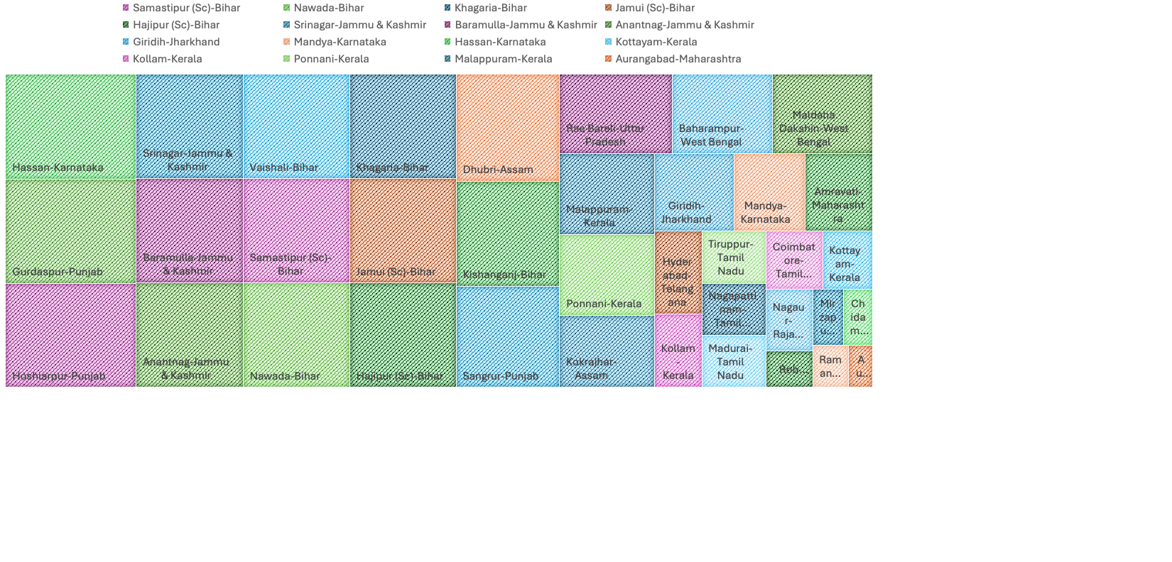
Q11. WHICH CONSTITUENCIES HAVE ELECTED CANDIDATES WHOSE PARTY HAS LESS THAN 10% VOTE SHARE AT STATE LEVEL IN 2019?

Slide 22
SECONDARY QUESTIONS

Slide 23
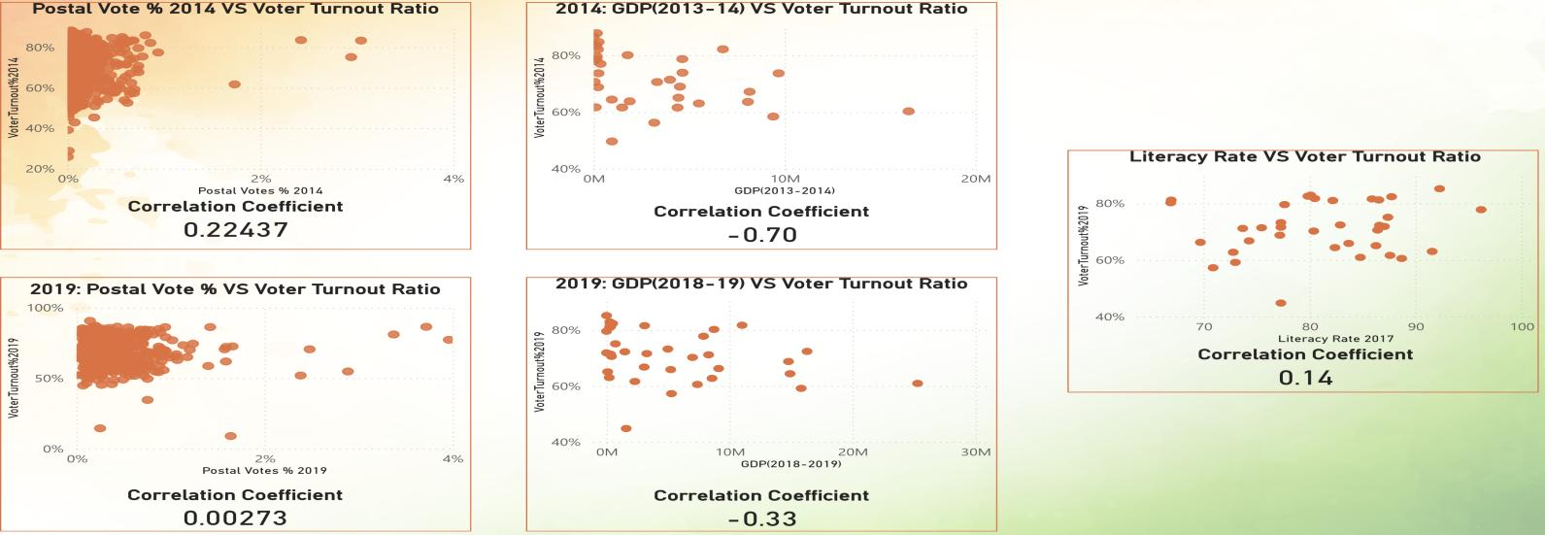
Q1. IS THERE A CORRELATION BETWEEN POSTAL VOTES % AND VOTER TURNOUT % ?
2014: Postal Vote % VS Voter Turnout %
2019: Postal Vote % VS Voter Turnout %
The correlation coefficient between Voter turnout % and Postal Vote % for the year 2014 and 2019 is 0.22437 and 0.00273 respectively. This means there's a weak positive relationship between the two. In simple terms, as the percentage of postal votes goes up, voter turnout tends to increase slightly. However, since the correlation is weak, many other factors likely influence voter turnout, and this relationship isn't very strong. This finding suggests that while postal voting might have some impact, we should look at other variables to understand voter turnout better.

Slide 24
Q2. IS THERE ANY CORRELATION BETWEEN GDP OF A STATE AND VOTER TURNOUT % ?
2014:
Correlation Coefficient: -0.70
Interpretation: Strong negative relationship between voter turnout percentage and state GDP.
Insight: States with higher GDP generally had lower voter turnout.
2019:
Correlation Coefficient: -0.33
Interpretation: Weaker negative relationship between voter turnout percentage and state GDP.
Insight: Although higher GDP still corresponds to lower voter turnout, the relationship is less strong than in 2014.
Overall Insight:
Economic factors might influence voter behaviour, but their impact has decreased over time.

Slide 25
Q3. IS THERE ANY CORRELATION BETWEEN LITERACY % OF A STATE AND VOTER TURNOUT % ?
Weak positive relationship between literacy rate and voter turnout ratio.
A higher literacy rate is slightly associated with higher voter turnout.
The relationship is weak, indicating that literacy rate alone is not a strong predictor of voter turnout.
Other factors likely play a more significant role in influencing voter turnout.

Slide 26
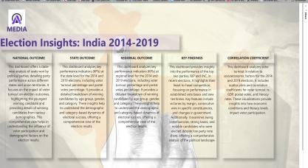
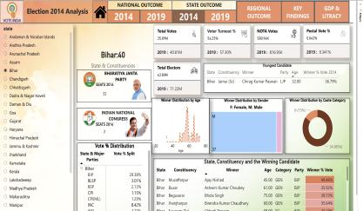
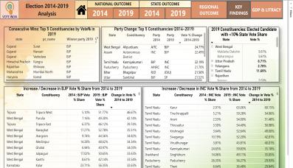
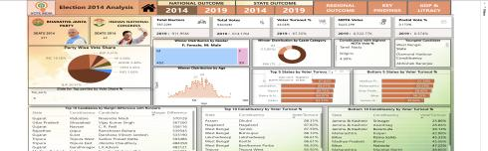
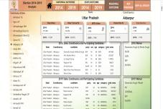
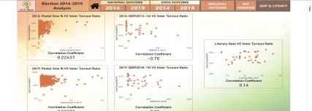
DASHBOARD OVERVIEW

Slide 27
INSIGHTS

Slide 28
Voter Turnout
2014: The voter turnout was approximately 66.06%, the highest ever recorded in the history of Indian general elections at that time.
2019: The voter turnout further increased to about 67.35%, showing a continued trend of growing electoral participation.
Gender Participation
2014: Women voters accounted for 65.63% of the total voter turnout.
2019: There was a notable increase in women's participation, with women voters accounting for 67.18% of the total voter turnout.

Slide 29
Youth Participation
2014: A significant portion of the electorate comprised first-time voters, with about 23 million new voters aged 18-19.
2019: The number of first-time voters increased to 45 million, reflecting the growing political engagement among youth.
Winning Margins
2014: Several constituencies had narrow winning margins, indicating highly competitive elections.
2019: The trend continued with close contests in many constituencies, but some saw increased winning margins due to stronger party influence.

Slide 30
Party Performance
2014: Bharatiya Janata Party (BJP) won 282 seats, securing a majority on its own. The Indian National Congress (INC) faced a significant defeat, winning only 44 seats.
2019: BJP further increased its tally to 303 seats, while INC improved slightly but remained far behind with 52 seats.
Regional Parties
2014: Regional parties like All India Trinamool Congress (AITC) and AIADMK performed well in their respective states.
2019: Regional parties continued to hold sway in various states, with AITC, YSR Congress, and DMK making significant gains in West Bengal, Andhra Pradesh, and Tamil Nadu, respectively.

Slide 31
Voter Turnout by State
2014: States like West Bengal, Kerala, and Tamil Nadu saw higher than average voter turnout.
2019: Similar patterns were observed, with these states maintaining high voter engagement, while states like Bihar and Uttar Pradesh saw improvements in voter turnout compared to previous elections.

Slide 32
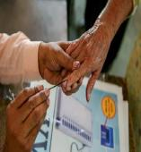
Q4. PROVIDE 3 RECOMMENDATIONS ON WHAT THE ELECTION COMMISSION/ GOVERNMENT CAN DO TO INCREASE THE VOTER TURNOUT % ?
Targeted Voter Education: Launch a targeted and engaging voter education campaign, utilizing social media influencers and celebrities to reach a broader audience. Focus on highlighting the importance of each vote and the impact it has on shaping the nation's future.
Convenience and Accessibility: Enhance convenience by increasing the number of polling stations, especially in densely populated areas, and introducing mobile polling booths to reach remote locations. Implement early voting options and explore the possibility of online voting for eligible citizens.
Community Engagement and Recognition: Encourage community leaders, schools, and local organizations to promote voter participation. Recognize and reward communities with high voter turnout through public acknowledgment and small incentives, fostering a culture of civic responsibility and pride.

Slide 33
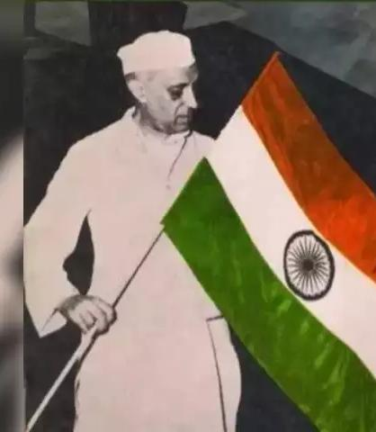
The first Lok Sabha election in 1951-52 was a historic event in Indian democracy, with several important insights:
Massive Participation: It marked the first time that Indian citizens exercised their democratic right to vote on such a large scale. Over 173 million people were eligible to vote, and the voter turnout was an impressive 45.7%.
Diverse Representation: The election saw a diverse range of candidates and parties, representing various regions, communities, and ideologies. This diversity reflected India's pluralistic society and democratic ethos.
Congress Dominance: The Indian National Congress (INC) emerged as the dominant party, winning 364 out of 489 seats. This landslide victory laid the foundation for Congress's long-standing dominance in Indian politics in the initial years after independence.
Role of States: While Congress performed well at the national level, regional parties and movements also gained prominence in some states, highlighting the importance of regional aspirations in Indian politics.
Constitutional Framework: The successful conduct of the election demonstrated the effective implementation of the constitutional framework for elections, establishing the Election Commission of India as a robust and independent electoral body.
Women's Participation: Although the participation of women voters was relatively low, the election marked the beginning of women's political empowerment in India, with several women candidates winning seats in the Lok Sabha.

Slide 34


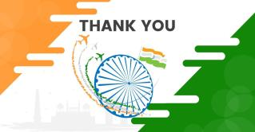

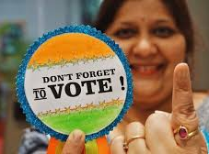
ATLIQ MEDIA
DEEPSHIKHA SINGH
DATA ANALYST

