Slide 1
INCOME PREDICTION
A MACHINE LEARNING MODEL

Slide 2
PROBLEM STATEMENT
The objective of this machine learning task is to construct a predictive model for classifying individuals based on whether their income exceeds a specified threshold of $50,000.

Slide 3
PROJECT FLOW
Importing the required libraries
Loading the dataset
Having a look at our dataset
Data Visualization
Data Pre-processing
Model Training
Model Evaluation

Slide 4
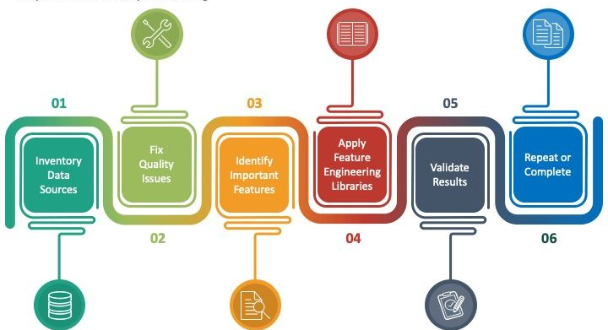
DATA PRE-PROCESSING
Data Pre-Processing is an important aspect for building a machine learning model. A good machine learning model highly rely on how much pre-processed the data is.

Slide 5
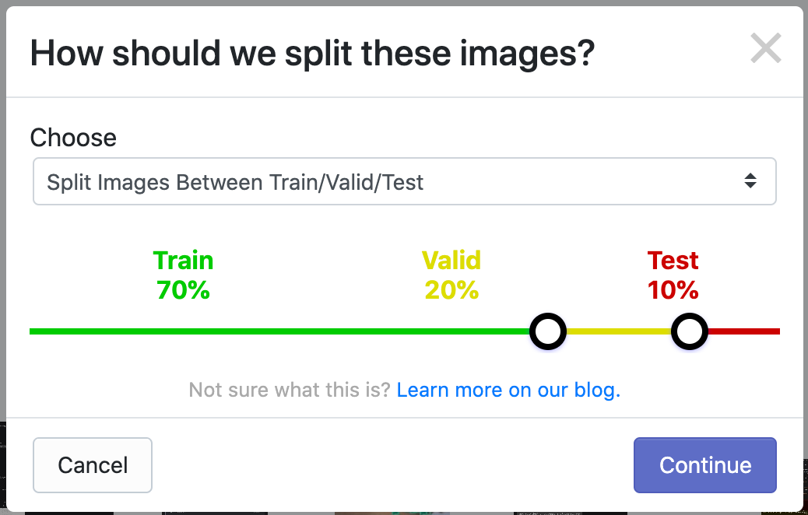
TRAIN TEST SPLIT

Slide 6
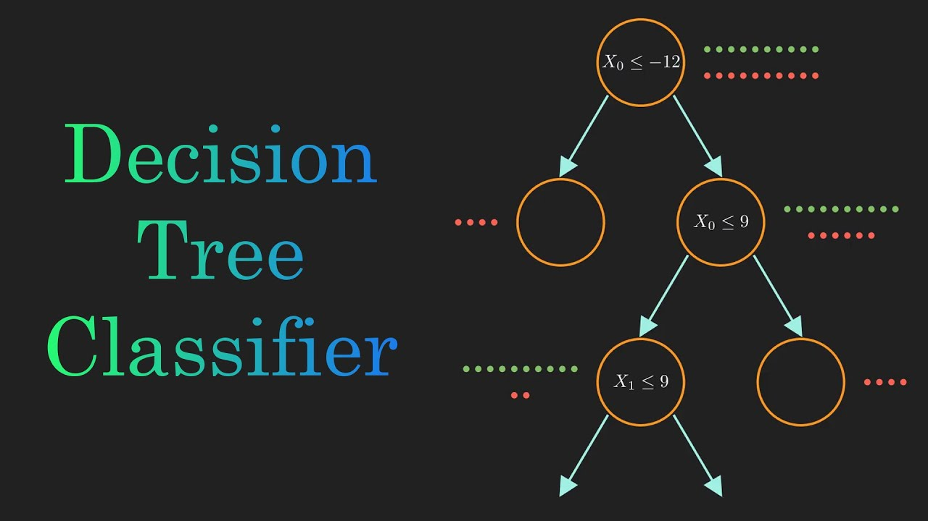
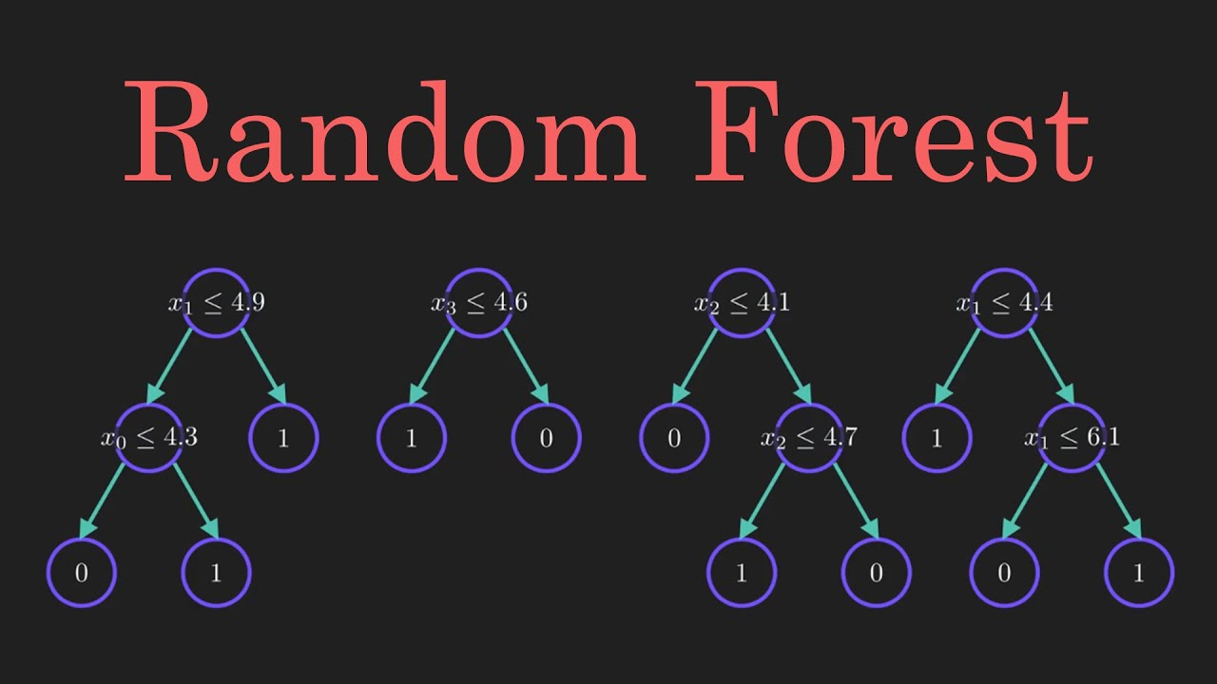
MODEL TRAINING

Slide 7
MODEL EVALUATION
DECISION TREE
RANDOM FOREST
TRAINING ACCURACY → 100%
TESTING ACCURACY → 95%
TRAINING ACCURACY → 99%
TESTING ACCURACY → 96%

Slide 8


