Slide 1
World bank development indicators
Data Incubator Project
Tim Zeiske
2016

Slide 2

World Development indicators
International financial institution
Provides loans to developing countries
Goal: Poverty reduction
>1000 metrics describing the development of a country/region
Examples:
  Arable land (hectares)
  Net trades (US$)
  Electricity from renewables (kWh)
  CO2 emission (kt)
  ...

Slide 3
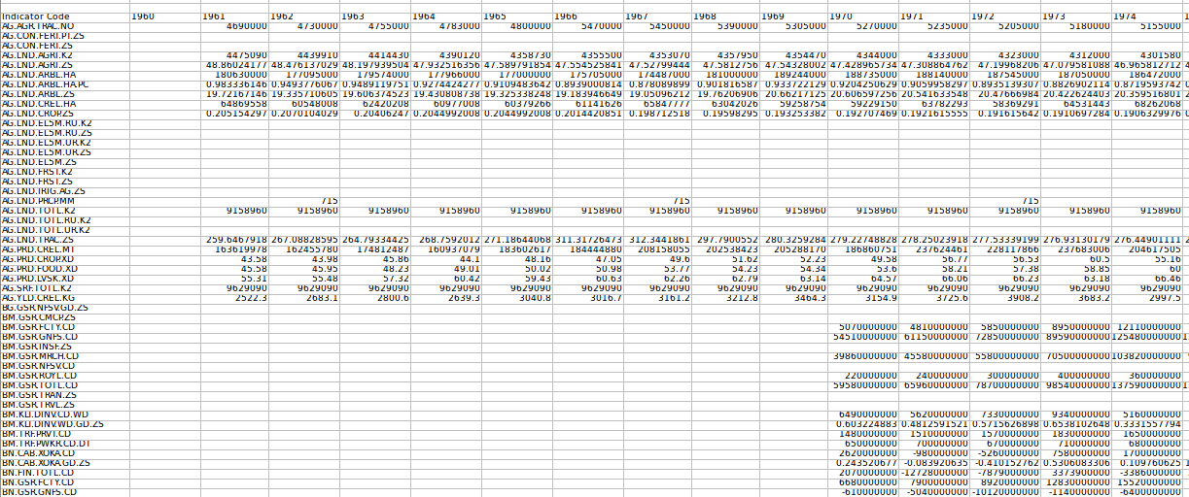
The data
CSV file for each country (US, GER)
Variety of units, scales
Ranging from 1960 to 2015, values on yearly basis
Missing datapoints: not all metrics have data for each year

Slide 4
Quality of the data
Data decently clean
Cleanup includes:
  Identification of data rows/columns, removal or empty ones
  Removal of missing data points without “shifting” data (data point for 1970 needs to stay assigned to 1970 even if years before are removed)
  Solution: keep missing data points around as 0.0 and remove only when necessary
When appropriate, data was scaled by subtracting average for that metric (over all years) and dividing by range (max-min) for that metric

Slide 5
Tools
Python
Numpy
Matplotlib
Scipy
Emacs

Slide 6
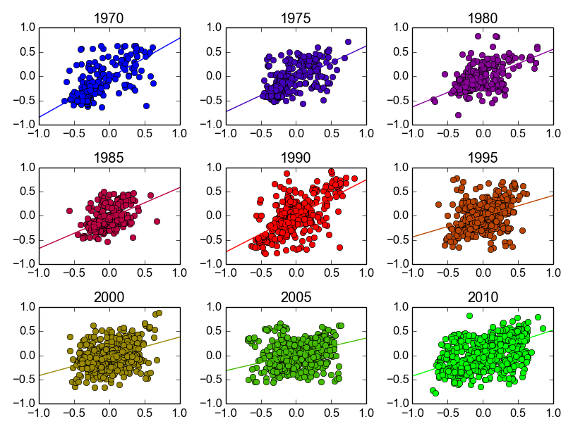
Correlation between USA & Germany
Normalized indicator value that year for GER
Each dot = one indicator pair (US vs. GER)
Normalized indicator value that year for US

Slide 7
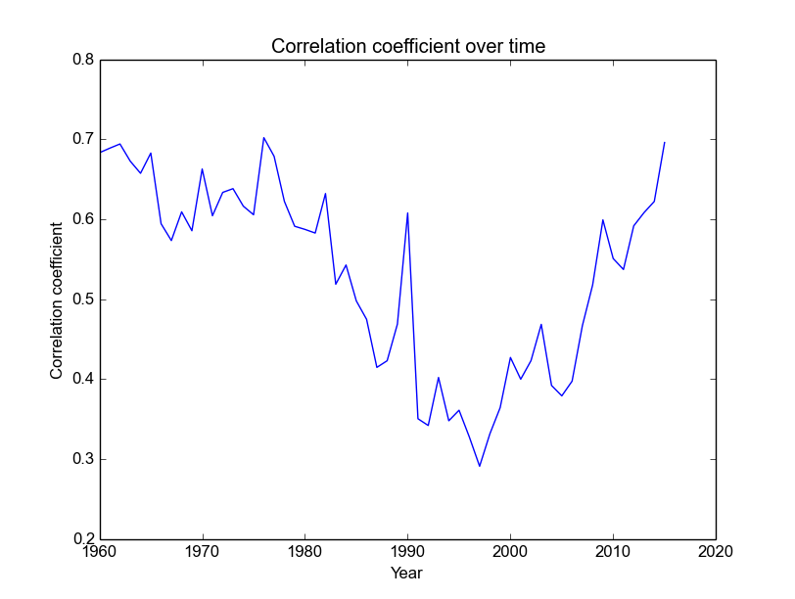
Correlation over time

Slide 8
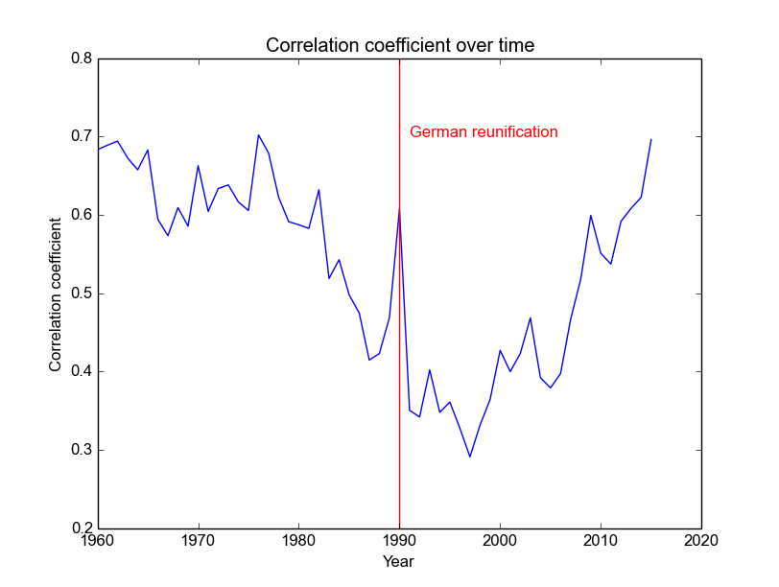
Historic event: German reunification (end of cold war)

Slide 9
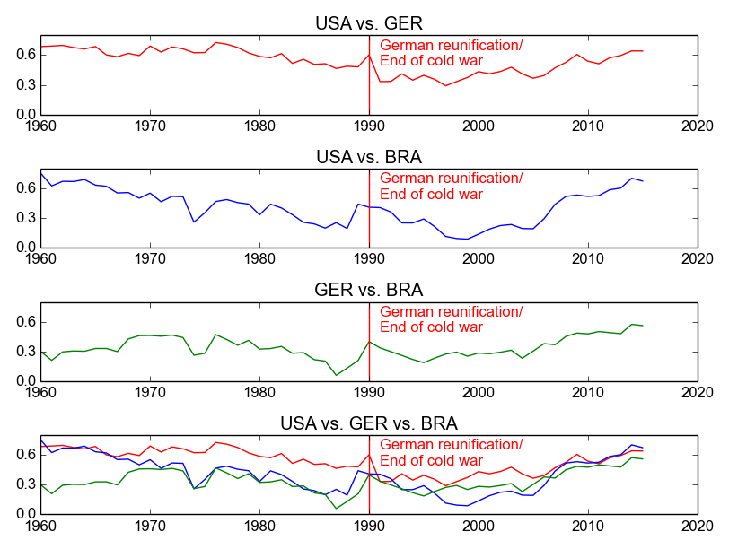
Third country: Brazil

Slide 10
Third country: Brazil
Germany and Brazil historically show strong correlation to USA but not to each other
All three countries have strongly increased their correlation since the end of the cold war

Slide 11
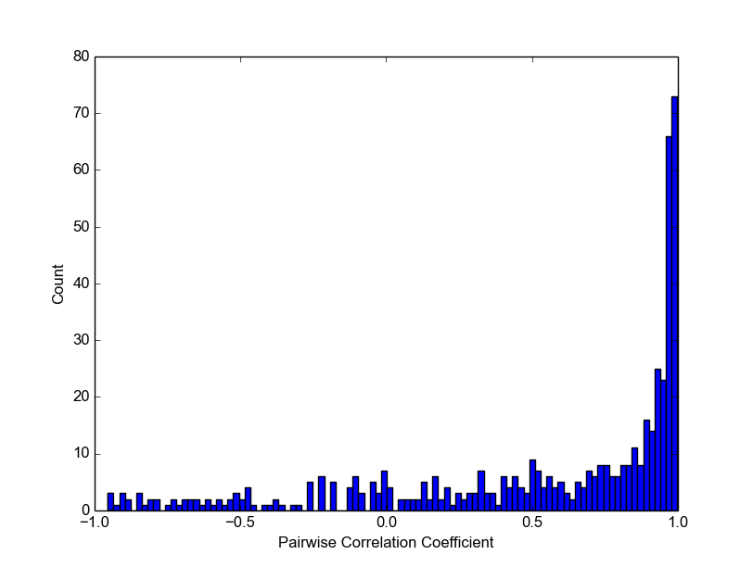
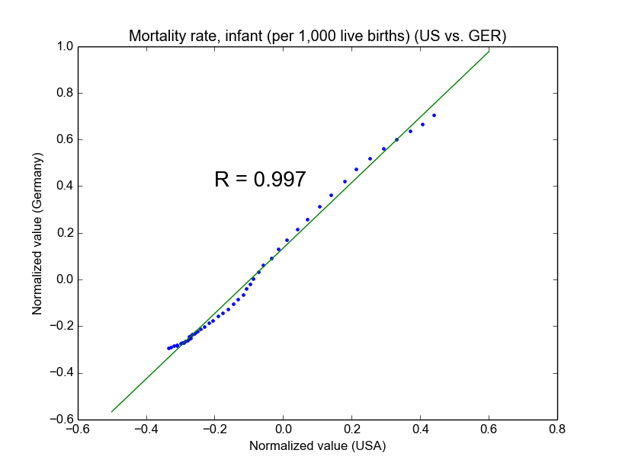
Correlation coefficients of each indicator between countries (over time)

Slide 12
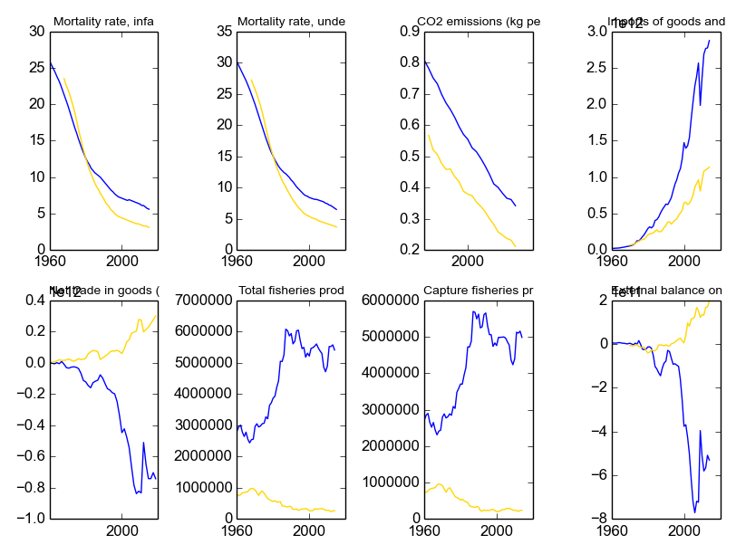
Positive and negative correlations

Slide 13
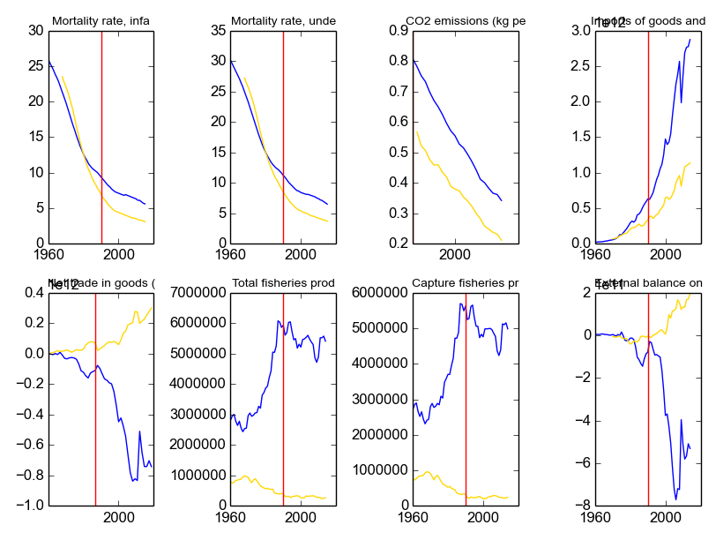
Influence of reunification

Slide 14
Future directions
Correlations between different (not same) indicators within a country/region or across countries?
Correlations between different indicators across countries and time periods?
→ potential predictive power, for example:
  Can arable land area in one decade predict CO2 emissions in the next decade?
  Will investment in fishery in Germany lead to increased trade balance of USA?

