Slide 1
Drug Discovery: Predicting Molecular Activity with Machine Learning
Kostantinos Morfesis

Slide 2
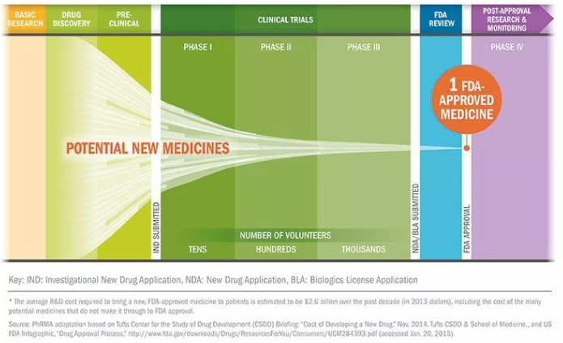
Background

Slide 3
Cost and simplification
Drug discovery is a costly process
$2.7 Billion bringing a drug to market
How can we expedite this?
ML to automate some of the process
Time till market is 10 years on average

Slide 4
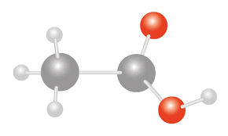

Where can we use machine learning?
Observe interaction (activity level)
Molecule
Biological target
Activity
Activity
Molecule
If given some information about each molecule can we predict these activity levels?

Slide 5
Outline
Data source
What data do we have to work with?
Exploratory analysis
How does the data look and how can we simplify it?
Model selection
What models will work best?
Model prediction and accuracy
How well can these models predict?
Results and further analysis
What conclusions can we draw from the analysis?

Slide 6

Data source: Merck Molecular Activity Kaggle challenge
Act_1
Molecule | Activity | D_1 | D_2
M_1 | 0.77 | 1 | 1
M_2 | 2.43 | 0 | 2
M_3 | 4.88 | 0 | 0
M_4 | 3.33 | 0 | 0
M_5 | 1.00 | 2 | 0
M_6 | 0.98 | 1 | 0
https://www.merck.com/index.html
15 different csv’s for 15 different targets
2 GB of training data
Columns – Molecule ID, Activity level, features (D_1, D_2, …, D_n)

Slide 7
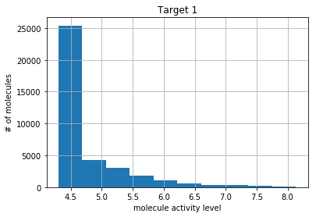
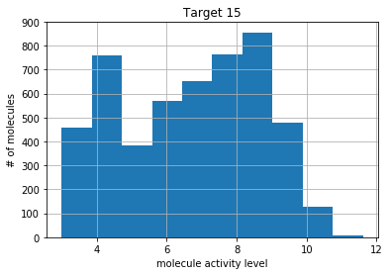
Exploratory analysis: data distributions
Large variety of data: different activity level ranges , variances, and large number of features

Slide 8
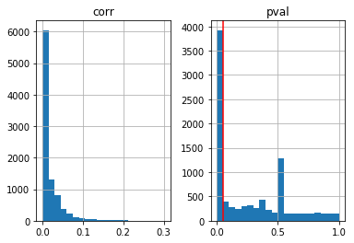
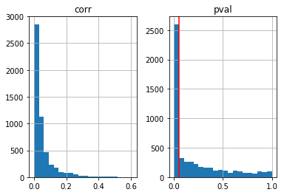
Exploratory analysis: correlations
Target 1
Target 15
Number of features
correlation
P-value
correlation
P-value
Let’s remove these statistically insignificant features (note: red line indicates p = .05)

Slide 9
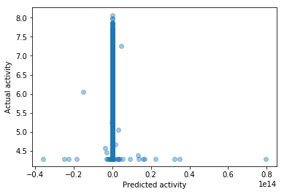
Model selection: Start simple OLS
R-squared = -4.08
Huge variance in predicted values
How can we prevent this and lower model flexibility?

Slide 10
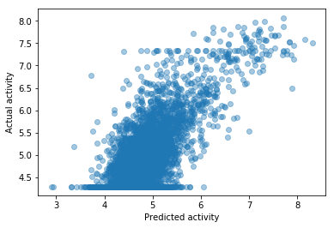
Second attempt: Ridge regression
R-squared = 0.56
Alpha = 1000
Greatly increased accuracy with large rigidity (alpha)
Slightly non-linear, can we account for this?

Slide 11
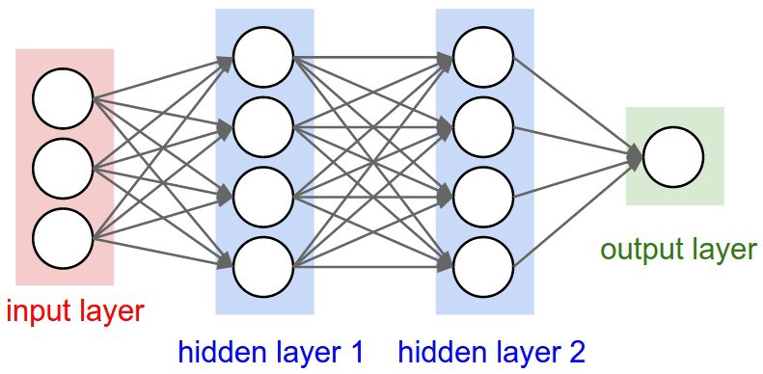
Accounting for non-linearity
Polynomial regression
Neural network
Dependent variable
Feature
Easy to perform and check
Similar R-squared compared to Ridge
Takes time to train
Greater parameter flexibility
https://medium.com/@rajatgupta310198/getting-started-with-neural-network-for-regression-and-tensorflow-58ad3bd75223

Slide 12
Final model choices
Ridge regression
Performed well in exploratory analysis
Neural network regression
Can handle overfitting
Can handle overfitting
Able to accommodate non-linear behavior
https://medium.com/@rajatgupta310198/getting-started-with-neural-network-for-regression-and-tensorflow-58ad3bd75223

Slide 13
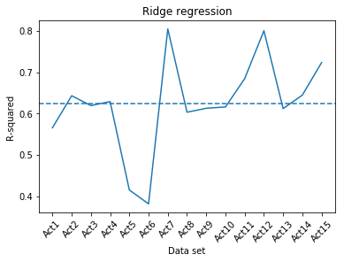
Ridge regression analysis
Avg. R-squared = 0.62
Alpha = 1000
Accuracy drop on Act’s 5 & 6

Slide 14
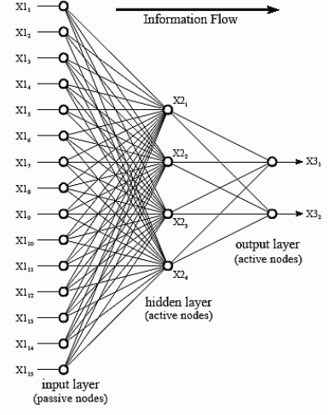
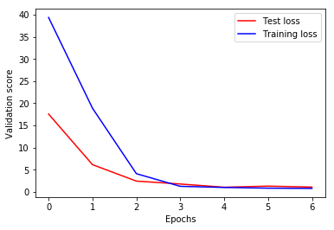
Neural network preprocessing
Number of epochs
Number of layers
Number of nodes
input
Hidden 1
Hidden 2
output
ReLU
ReLU
Optimal number was 8 epochs w/ full batch size
Optimal number of hidden layers was 2
100 nodes in hidden 1
50 nodes in hidden 2

Slide 15
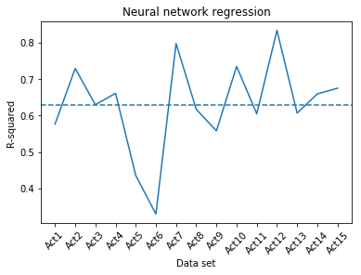
Neural network analysis
Avg. R-squared = 0.630
Accuracy drop on Act’s 5 & 6
Slightly increased accuracy from ridge (needs more parameter optimization)

Slide 16
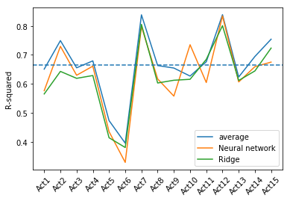
Ensemble analysis
Avg. R-squared = 0.651
Average prediction was obtained from (y_pred1 + y_pred2)/2
Models are overall complimentary (increased avg. R-squared)

Slide 17
Results and future analysis
Predictive ability
Model average R-squared = 0.665
Impactable insights
Can be used to segment molecules into those which have activity above or below a certain value
Future analysis
Inclusion of more models to increase ensemble average
Conduct binary classification for higher accuracy and greater usability

