Slide 1






ECDS
CareFlow
Team: QUADCORE

Slide 2
ECDS
Problem Statement
Hospitals often discover serious patient complaints too late, usually after public reviews are posted.
This delay breaks the feedback-to-resolution loop and causes reputation damage.
The challenge is to capture dissatisfaction in real time and trigger a fast, closed-loop service recovery process.
Target outcome: initiate complaint handling quickly with ticketing, manager alerts, and patient communication.

Slide 3
ECDS
Proposed Solution
Our system automates end-to-end service recovery after discharge/payment:
Patient billing status updated to Paid/Discharged.
WhatsApp survey message is auto-triggered.
Patient reply is analyzed using Gemini (with local fallback).
Sentiment, severity, complaint category, and summary are generated.
Negative feedback creates a ticket, notifies duty manager, and sends a personalized resolution message.
Positive feedback triggers a thank-you + review nudge.
Weekly analytics report summarizes trends and actions.

Slide 4
ECDS
INNOVATION
Closed-loop automation from patient reply to action, not just passive analytics.
Complaint intelligence + operations in one flow: sentiment -> ticket -> manager notification -> patient response.
Fallback AI logic ensures system continues even if Gemini quota/API is unavailable.
Pattern-based escalation: repeated category (>3/week/department) auto-escalates to department head.
Unified operations console: simulator, dashboard, feedback, tickets, heatmap, analytics, notifications.

Slide 5

ECDS
TECH STACK
Python
MongoDB
ReactJS
Twilio

Slide 6
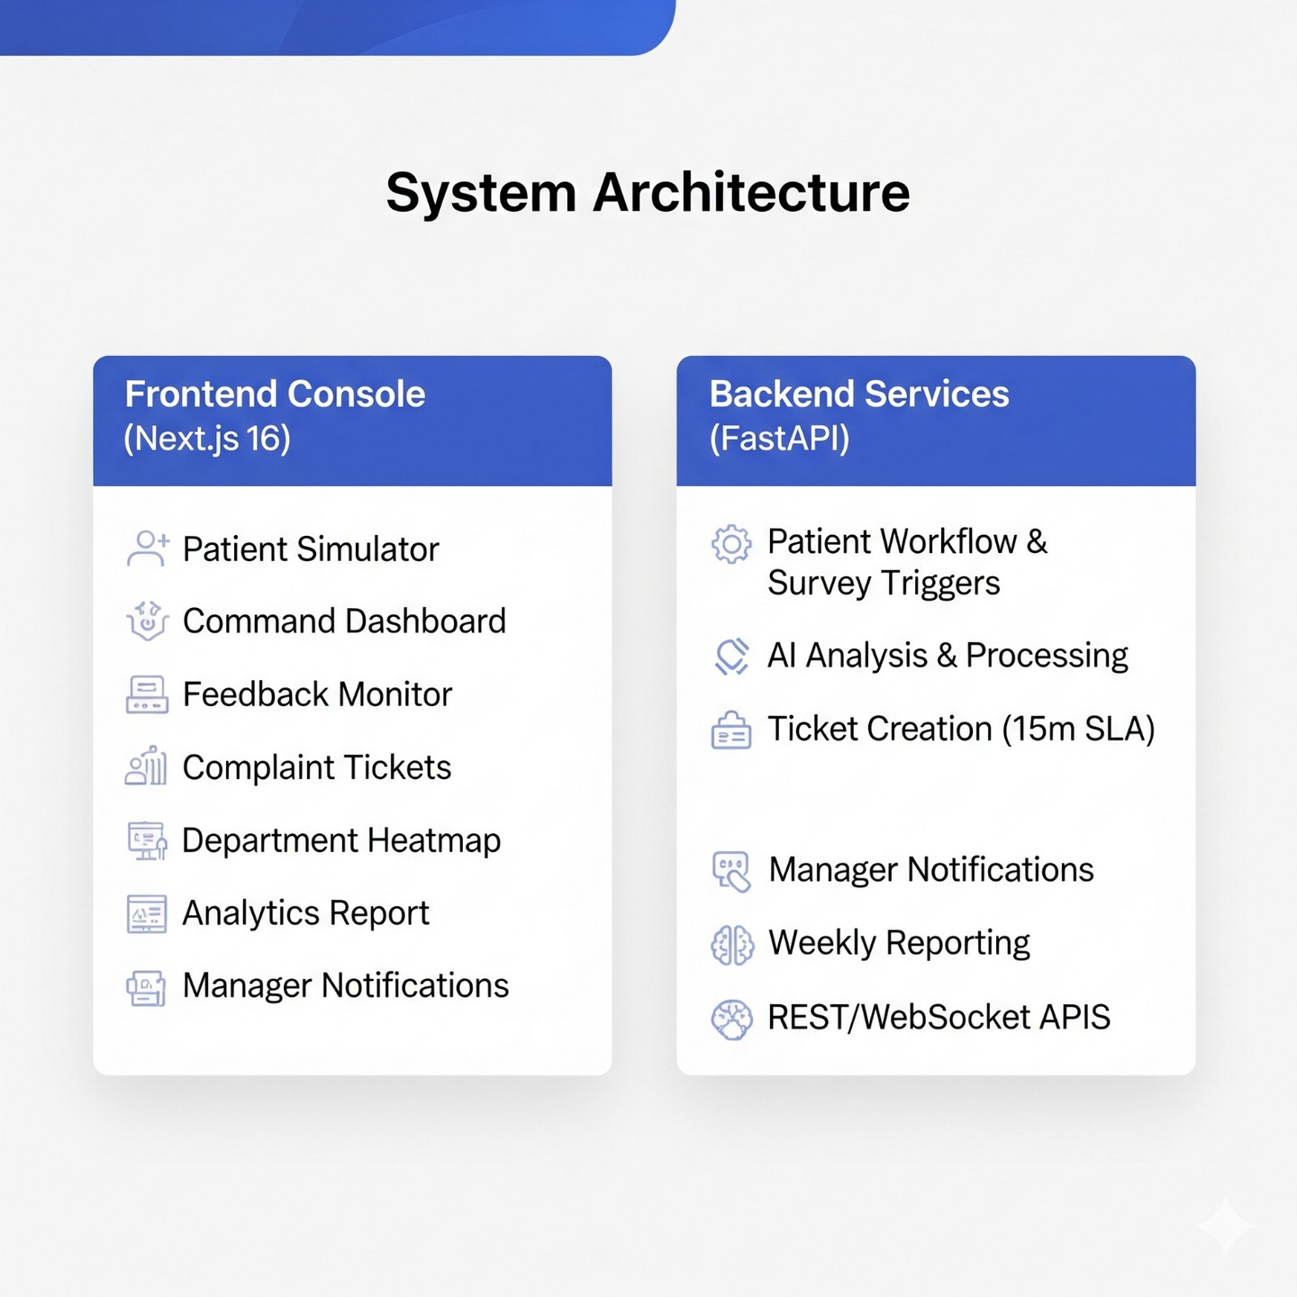
ECDS
SYSTEM ARCHITECTURE

Slide 7
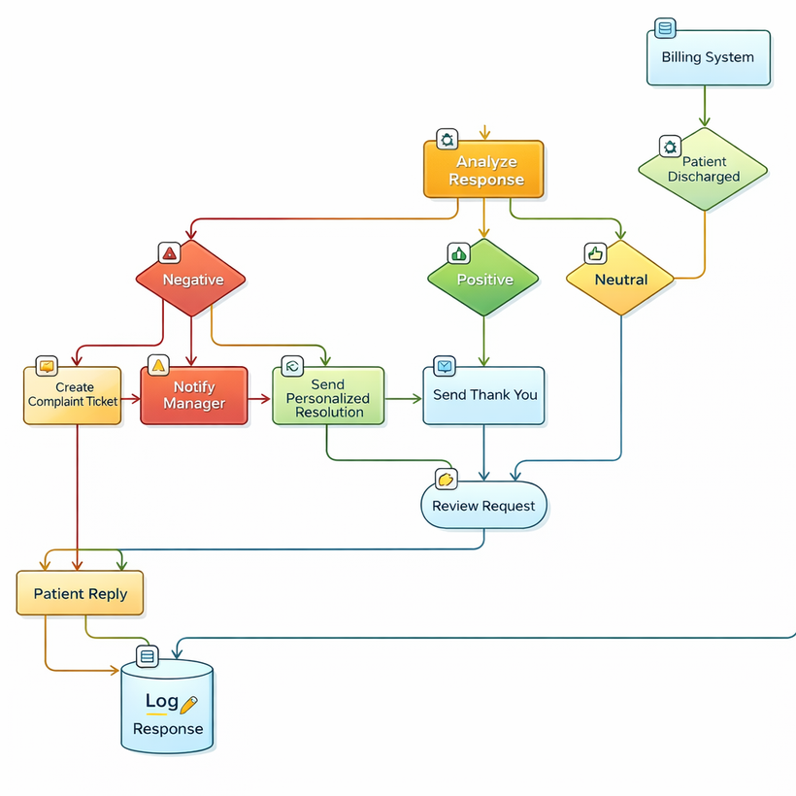
ECDS
System Flow
Select seeded patient in simulator.
Mark billing as Paid -> survey sent on WhatsApp channel.
Submit patient reply (negative/neutral/positive).
Show generated sentiment, severity, category, summary.
For negative case: show created ticket and manager alert.
Show personalized resolution message recorded in workflow.
Open dashboard/heatmap/analytics to show system-wide impact.

Slide 8
ECDS
Problem Requirements vs Features Implemented
Problem Requirement | Feature Implemented | Technical Implementation
Eliminate Feedback Lag | Auto-Trigger System | Backend triggers WhatsApp via Twilio on Paid/Discharged status.
Understand "Why" & "How Bad" | AI Analysis Engine | Gemini-powered category extraction and Severity Scoring (1-5).
Accountability & Tracking | CRM-Style Ticketing | Full-lifecycle ticket tracking with department-specific routing.
Proactive Management | Real-Time Heatmaps | Visualization of repeated patterns and high-risk department clusters.

Slide 9
ECDS
TEAM MEMBERS
Mahatva Agarwal – 25MCA1081
Aayush Raj – 25MCA1069
Deeptanu Dhar – 25MCA1021
Prince Kumar – 25MCA1018

Slide 10
ECDS
Thank You

