Slide 1
Team Details
a. Team name: [FILL IN]
b. Team leader name: [FILL IN]
c. Problem Statement: BFSI - Intelligent Risk, Fraud & Financial Experiences. Millions of people pay rent, bills and UPI on time but have no credit file, so lenders cannot see them and they get no explanation or path forward.
Notes:
Team name and leader are placeholders: the PDF template had them blank and I do not know them.

Slide 2
Brief about the idea
GhostScore turns everyday payment records (electricity bills, rent receipts, UPI screenshots) into an explainable credit-readiness band, then shows the applicant concrete steps to improve it.
Score it. Explain it. Show the way up.
Built entirely on Google Cloud. The working prototype runs on synthetic personas.
Notes:
Lead with Priya: pays on time every month, invisible to a bureau.

Slide 3
Opportunities
How is it different?
Most alternative-scoring ideas stop at a number. GhostScore closes the loop: score, plain-language explanation, then ranked next steps.
How does it solve the problem?
It makes reliable payers visible to lenders and tells applicants what would help, instead of a bare refusal.
USP
Every point change shown to the user is measured by re-scoring their profile. Gemini only phrases results and never computes a number.
Notes:
The USP is the what-if loop with a hard rule that the LLM never invents numbers.

Slide 4
List of features offered by the solution
• Document upload with extraction and a review step showing flags
• Credit-readiness band (300-850 scale) with a confidence note
• Plain-language explanation of the signals the model relies on
• Improvement plan with re-scored point estimates per action
• Loan options grounded in cited policy passages (a lender decides)
• Advisor chat for what-if and eligibility questions
• Score history and an audit log of every score
• English, Hindi and Marathi switcher (local mode uses a fixed translation table; wording not yet native-reviewed)
Notes:
Be careful on the last bullet: in local mode Hindi and Marathi come from a fixed translation table, not Gemini. Real translation is Gemini P7 in Google Cloud mode, which has not been run. The wording was drafted by an AI assistant and has not been reviewed by a native speaker.

Slide 5
Process flow: Priya's journey
1. Consent
Choose what to link
2. Upload
Bill, rent, UPI
3. Check
Extracted fields and flags
4. Score
Band, signals, confidence
5. Improve
Re-scored next steps
→
→
→
→
From the score screen: Loan options (cited policy passages) | Advisor chat | Score history | Audit log
Add more documents from the plan and the loop repeats: the score updates and the history records it.
Notes:
Walk the five boxes left to right.

Slide 6
Architecture diagram
Client: Stitch-designed web app (served by Cloud Run)
API: FastAPI on Cloud Run (9 endpoints)
Document AI
reads documents
Pub/Sub
score events
BigQuery
feature SQL and store
Vertex AI
score and what-if re-score
Gemini on Vertex AI
phrases explanations, plan, chat.
Numbers come only from Vertex AI.
Vertex AI Search
grounds loan options in policy passages
Cloud SQL / AlloyDB
app state, score history, audit log
Compliance review step checks the score explanation, improvement plan and loan options before display (chat is not yet covered)
Local mode replaces each Google service with a labelled stub plus a local model. The Google Cloud code paths are written but not yet run on a live project.
Notes:
Read top to bottom. Point out the amber compliance bar and the status note.

Slide 7
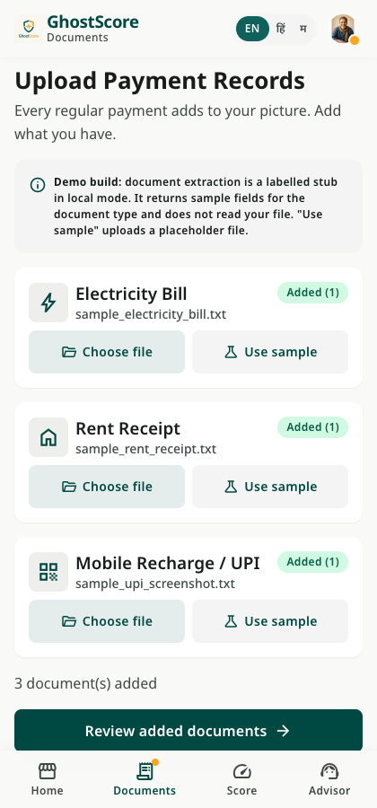
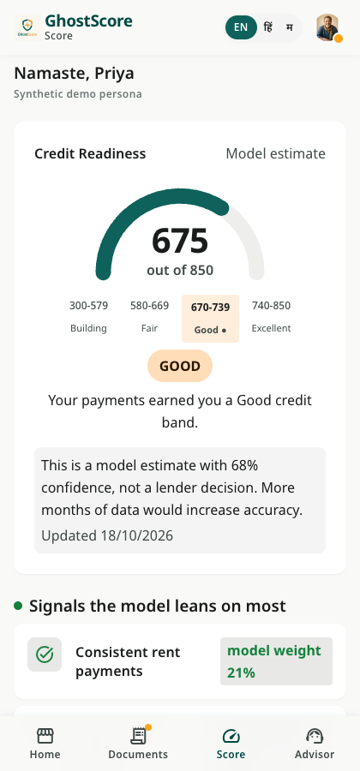
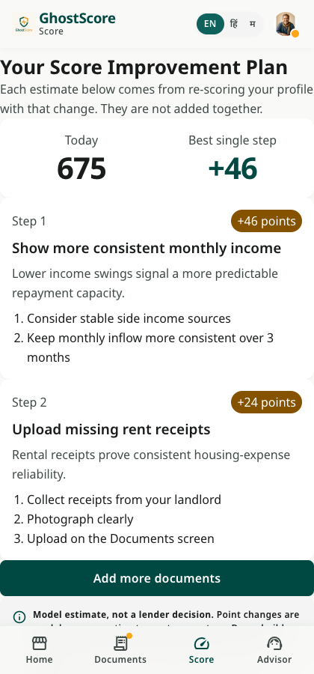
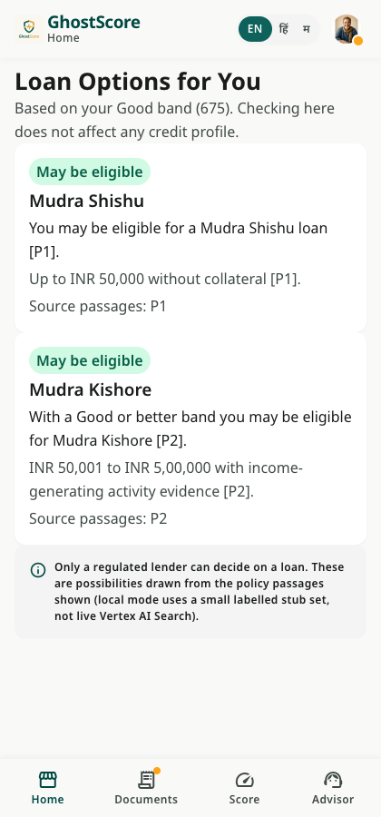
Snapshots of the prototype
Notes:
Real screenshots of the running prototype with synthetic persona Priya, in local mode.

Slide 8
Technologies used
Google Cloud: Gemini on Vertex AI, Vertex AI (scoring and what-if), Vertex AI Search, Document AI, BigQuery, Pub/Sub, Cloud SQL / AlloyDB, Cloud Run
Backend: Python, FastAPI, Pydantic, scikit-learn (local baseline model)
Frontend: Stitch-generated screens, Tailwind CSS, vanilla JavaScript
Testing: pytest (19 API tests), Playwright browser test of the full journey
Infra: Dockerfile for Cloud Run, gcloud setup and deploy scripts (written, not yet run against a live project)
Notes:
All eight Google services are used in the design; in the prototype they run as labelled stubs unless MODE=gcp.

Slide 9
Prototype performance / benchmarking
Measured on a laptop in local mode (stub Gemini, local model), 40 calls each:
• POST /score: median 4.3 ms, p95 5.4 ms
• GET /plan: median 23.3 ms, p95 37.3 ms
• GET /options: median 0.8 ms, p95 1.3 ms
Model: gradient boosting on the UCI Default of Credit Card Clients data (30,000 rows, 22% default rate). AUC 0.77 on a held-out 20% split of that same dataset.
Quality: 19 of 19 API tests pass; the browser test passes through upload, review, score, plan, options and chat.
Read this: latencies exclude real Gemini, Document AI and Vertex AI calls. The AUC is on Taiwan 2009 credit-card data and says nothing about Indian borrowers or the payment-regularity features.
Notes:
Do not present the latency as production performance. Re-measure after deploying to Cloud Run.

Slide 10
Additional details / future development
1. Deploy to live Google Cloud and re-measure with real Gemini, Document AI and Vertex AI.
2. Replace the baseline with a larger credit-risk dataset behind the same feature-mapping layer, after checking licence and terms.
3. Account Aggregator for consented bank data (gives payment regularity, not due-date punctuality).
4. Per-applicant explanations, so "what helped" reflects the person and not global model weights.
5. Pilot with a regulated lender, validate on real outcomes, and monitor for bias.
6. Real translation in Hindi and Marathi through Gemini.
Notes:
Item 4 is a known gap: the current score screen shows global model weights.

Slide 11
Links
GitHub public repository: [ADD LINK]
Demo video (3 minutes): [ADD LINK]
Final product link: [ADD LINK]
Making the invisible visible
Notes:
The three links are placeholders: none exist yet.

