Slide 1



22AIE201
FUNDAMENTALS OF AI
AI CHATBOT
SENTIMENTAL ANALYSIS

Slide 2
GROUP-14
A Deepthi -CB.SC.U4AIE23007
A Sai Sanjana -CB.SC.U4AIE23013
K Prerana -CB.SC.U4AIE23038
P Srikari Shasi -CB.SC.U4AIE23053
Rithish A B -CB.SC.U4AIE23057

Slide 3

CONTENT
01
INTRODUCTION
02
PROBLEM STATEMENT
03
OBJECTIVE
04
RANDOM FOREST
05
DATASET
06
METHODOLOGY
07
MATHS BEHIND CHATBOT

Slide 4
INTRODUCTION
In today’s data-driven world, sentiment analysis has become essential for businesses to capture and respond to customer feedback. By analyzing product reviews, companies can gain a clearer understanding of customer satisfaction.
This project addresses these needs by creating a sentiment analysis chatbot that classifies customer reviews into positive, neutral, or negative sentiments.
The backbone of the chatbot’s sentiment analysis is a Random Forest classifier, a powerful machine learning algorithm that combines multiple decision trees in an ensemble approach.
To make the chatbot engaging and easy to use, a Tkinter graphical user interface (GUI) is integrated, offering a clean and approachable environment where users can effortlessly input their reviews and receive personalized feedback.
By combining sentiment analysis with an interactive GUI, this chatbot becomes a valuable tool

Slide 5
PROBLEM STATEMENT
In today’s digital age, businesses and organizations receive vast amounts of feedback from customers in the form of reviews, comments, and social media posts.
Understanding the sentiment behind this feedback is critical for improving products, services, and customer satisfaction.
However, accurately classifying sentiments especially distinguishing neutral responses from positive or negative ones remains a challenge .
The primary challenge lies in refining the model to reduce misclassifications of neutral sentiments, which are often mistaken for positive .

Slide 6
OBJECTIVE
The objective of this project is to develop a robust sentiment analysis model that accurately classifies text data into positive, negative, and neutral sentiments.
We are using the Random Forest algorithm due to its effectiveness in handling complex data , which helps in identifying the most influential words or phrases contributing to each sentiment.
To achieve this, the project incorporates comprehensive preprocessing techniques which prepare the data for meaningful analysis.

Slide 7
DATASET
The dataset contains 10,000 entries and 2 columns.
Columns:
An integer rating (e.g., 1-5), indicating the user's rating for a product.
ReviewText: Text containing the user's review of the product.
Missing Values
column has a few missing values (6 out of 10,000).
dataset is suitable for sentiment analysis using the overall rating as a proxy for sentiment and reviewText as the input text for analysis.

Slide 8
RANDOM FOREST
Ensemble Method: Combines multiple decision trees to improve prediction accuracy and reduce overfitting.
Voting System: Each tree predicts, and final sentiment is based on majority vote.
TF-IDF Transformation: Converts text to numerical form, highlighting important words.
Class Weight Balancing: Ensures fair sentiment representation.
Result: Achieved an accuracy of 80%
High Accuracy: Effective with complex text data.
Robustness: Handles noisy data and text nuances.
Feature Selection: Highlights important words automatically.
Pipeline: Used TfidfVectorizer + RandomForestClassifier.
Hyperparameter Tuning: Parameters like tree count and max features can be optimized.

Slide 9
DECISION TREE
Fantastic
Review Text:
terrible
good
The product is fantastic!! The product is good Terrible product, can’t use it It is better but can improve the quality The product is okay
okay
better

Slide 10
DECISION TREE
Positive
Fantastic
No
Yes
Review Text:
terrible
good
The Product is fantastic!!
No
Yes
okay
better

Slide 11
DECISION TREE
Fantastic
No
Yes
Review Text:
terrible
good
The Product is okay
No
Yes
okay
better
Neutral

Slide 12
METHODOLOGY
Data Preprocessing
Text Cleaning: Removing special characters, punctuation, and converting text to lowercase to ensure consistency and reduce noise in the dataset.
Sentiment Mapping: Converting numerical ratings into sentiment labels (positive, neutral, negative) to simplify classification.
Text Vectorization and Bag of Words
TF-IDF Vectorization: Transforming words into numerical features based on their importance in the dataset, focusing on terms that contribute to sentiment classification.
Custom Bag-of-Words: Utilizing predefined word lists for immediate classification of certain sentiments, enhancing efficiency and response time.

Slide 13
METHODOLOGY
Sentiment Analysis in Customer Reviews:
Using sentiment categorization (positive, neutral, negative) to provide feedback, improving customer engagement and offering real-time insights for businesses.
Model Selection: Random Forest for Sentiment Analysis:
Random Forest Classifier: Using a group of decision trees together for stronger and more accurate classification, which helps understand different ways people write in reviews and avoids the risk of learning only specific details(overfitting) from the training data.
Class Weighting: Ensuring fair representation of all sentiment categories to address data imbalances and enhance model accuracy.

Slide 14
METHODOLOGY
Implementation with Tkinter GUI:
User-Friendly Interface: Providing a simple, accessible layout for users to enter the reviews and receive sentiment-based responses through Tkinter, improving user experience and interaction.
Additionally, the GUI’s responsive design ensures that users receive real-time feedback, making the interaction smooth and enjoyable.

Slide 15
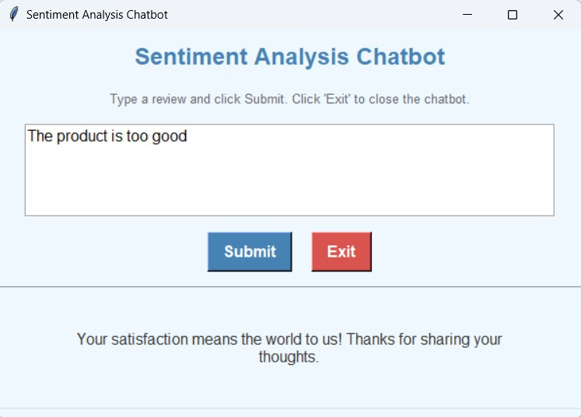
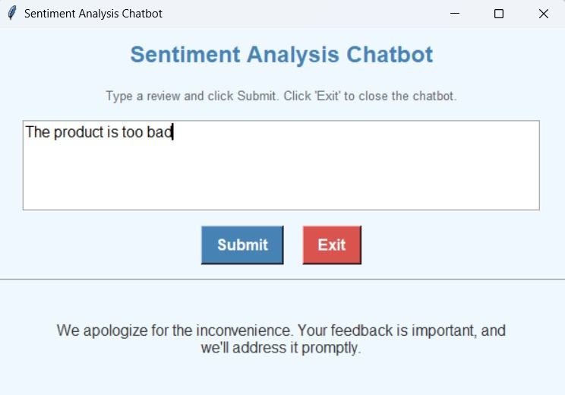
RESULTS

Slide 16
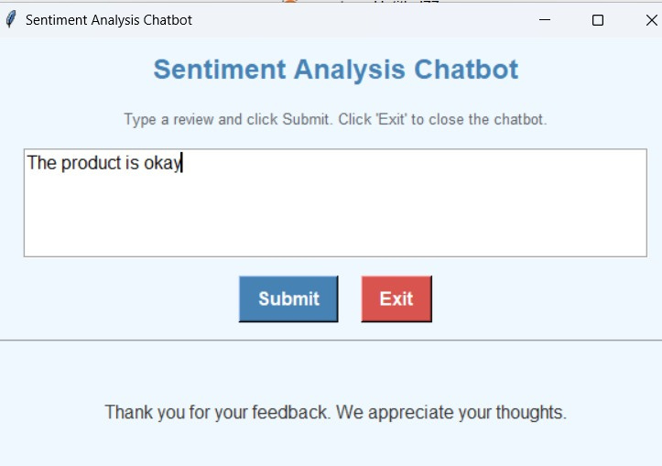
RESULTS

Slide 17

ACCURACY
80%
The Random Forest classifier accurately detects sentiment by understanding the different ways people express themselves in reviews.

Slide 18


CONCLUSION
The sentiment analysis chatbot, powered by a Random Forest classifier, classifies reviews as positive, neutral, or negative, providing instant insights into customer feedback.
This enables prompt, sentiment-driven responses, improving customer satisfaction and engagement.
Tkinter GUI and efficient TF-IDF vectorization, the chatbot delivers fast, accurate sentiment analysis.
It’s a valuable tool for enhancing customer relations and supporting business growth.

Slide 19
FUTURE SCOPE
Additionally, the GUI’s response Future enhancements for this sentiment analysis chatbot could include adding sarcasm detection to handle more nuanced sentiments, improving accuracy in cases where tone may differ from word choice.
Finally, integrating more advanced NLP techniques, such as deep learning-based sentiment models, could further enhance accuracy and adaptability to complex feedback.

Slide 20

THANK YOU

Slide 21


Contributions
07
13
38
53
57
TOKENIZATION,
VECTORIZATION
TRAINING
AND
TESTING
TRAINING
AND
ANALYSIS
RANDOM FOREST MODEL,
PLOTTING
DATASET,
DATA PREPROCESSING,

