Slide 1


GHOUSIA COLLEGE OF ENGINEERING
Anudip Foundation for social welfare
Project seminar on
“Currency Convert App"
Under Guidance OF, submitted by,
Vanisha Nagesh PAVAN RAJ HR (AF04888014)
DEEPTHI S (AF04888780)
SUSHMITA K A (AF04888798)
KOWSHIK B G (AF04888785)

Slide 2
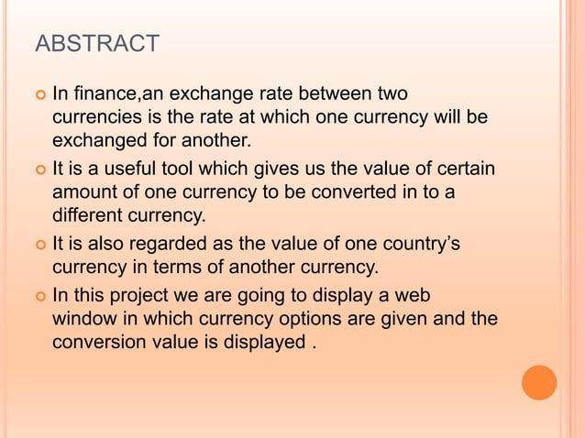

Slide 3
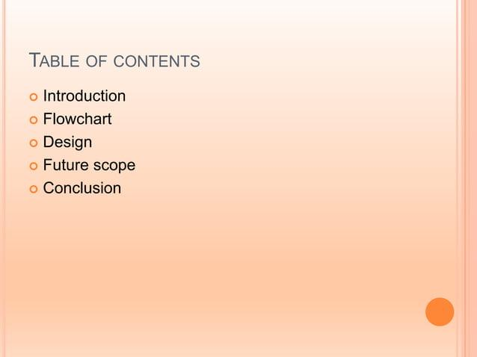

Slide 4
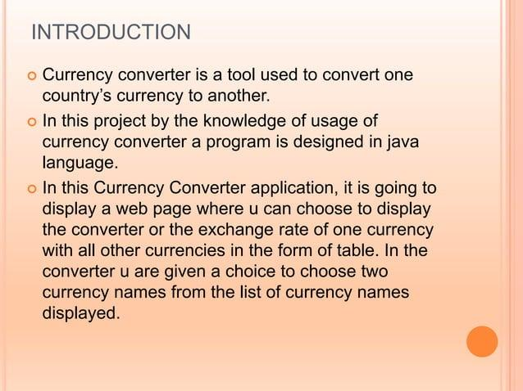

Slide 5
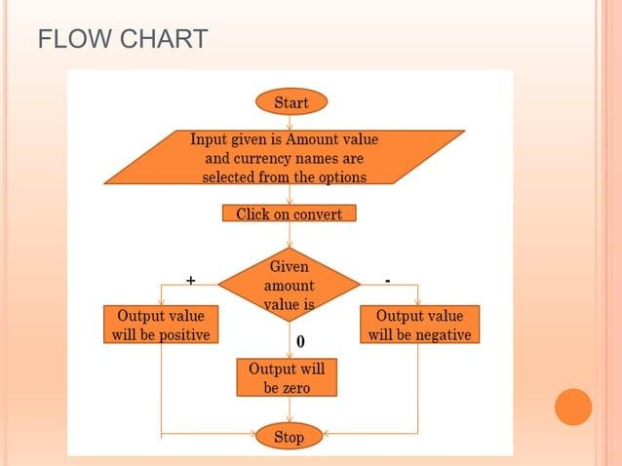

Slide 6
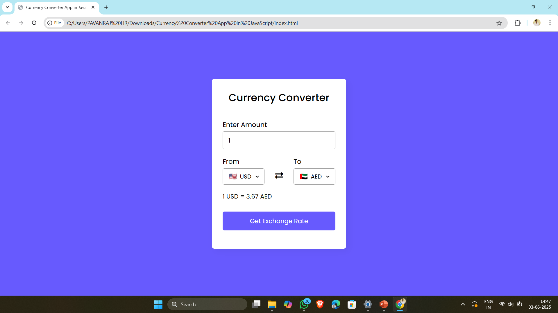
Home page

Slide 7
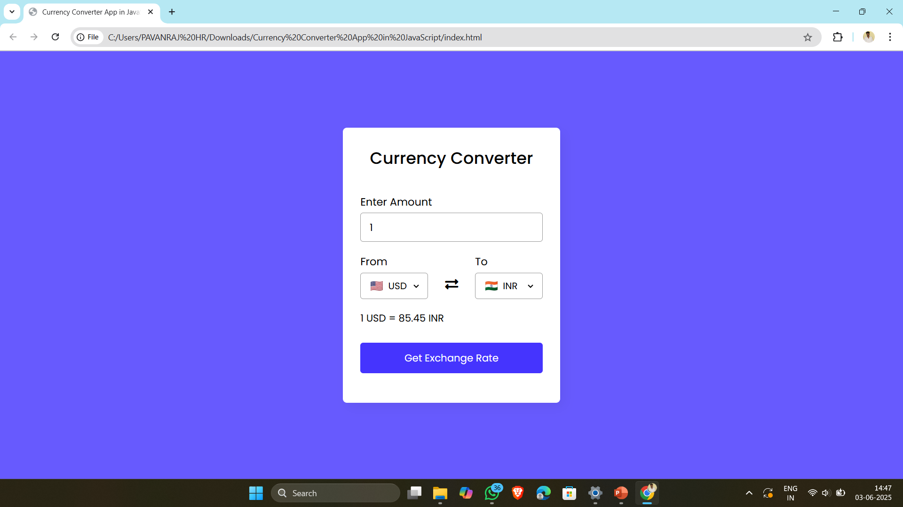
CONVERT USD TO INR

Slide 8

COVERT USD TO MWK

Slide 9
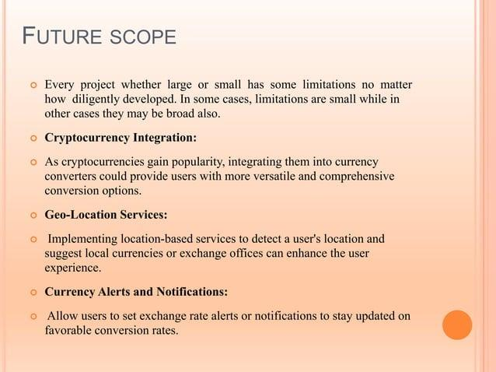

Slide 10
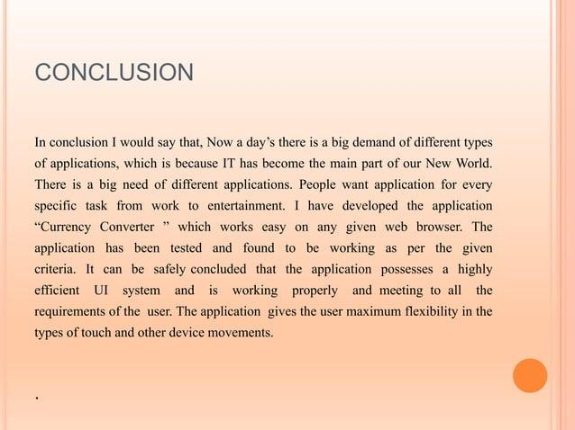

Slide 11


