Slide 1
PETSCHEWY
ECOMMERCE ANDROID APP FOR PURCHASING PETS FOOD AND TOYS

Slide 2
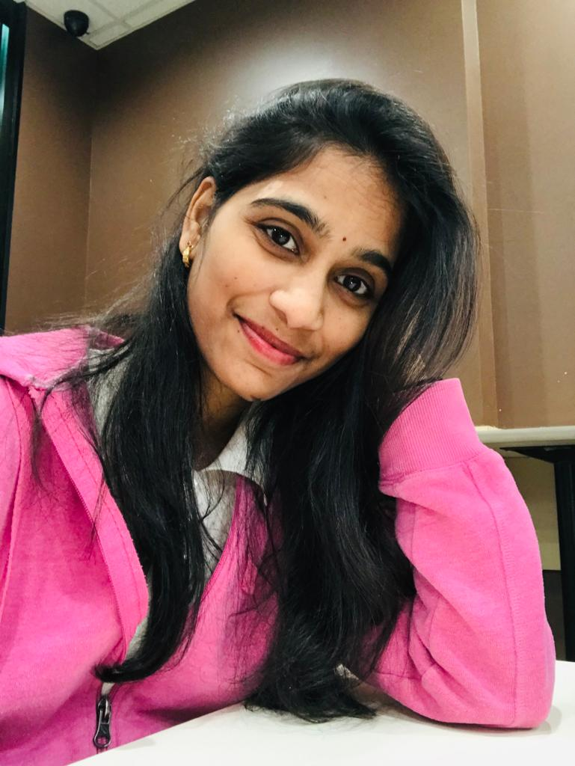
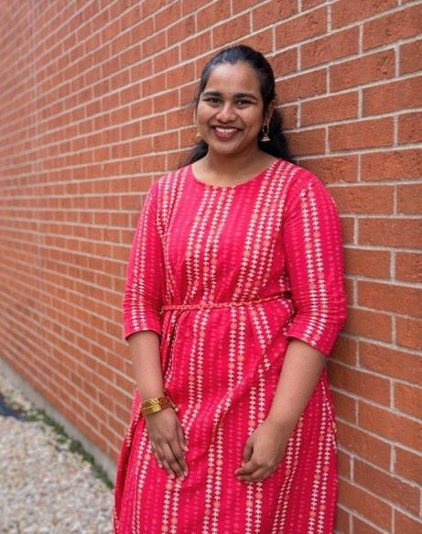

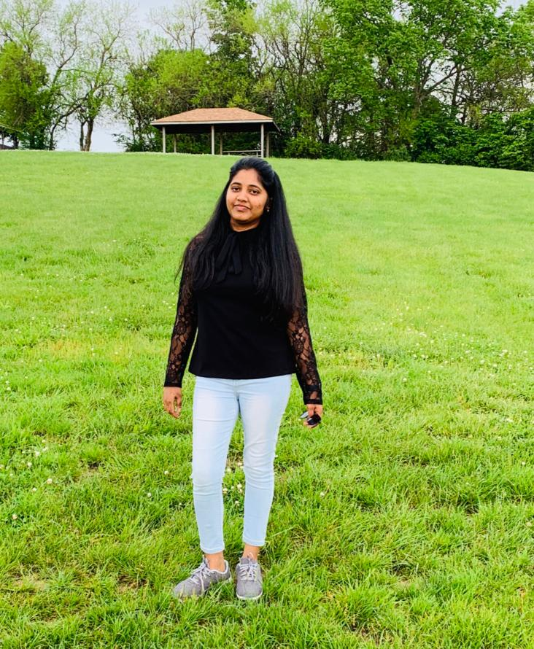

Meet the Team
Priyanka Bodapati
Deepthi Chokka
Sushma Yedugani
Suma Soma
Nikitha Kethireddy

Slide 3
Agenda
Introduction
Software and hardware requirements
Firebase configuration
Previous term tasks
Individual tasks and their demo’s
Summary

Slide 4
Project Introduction
The prime objective of this project is to develop a general purpose e-commerce store .
Our project is the e-commerce store where products for pets like food, and their toys can be bought from the comfort of home through the Internet with one touch away, speak or type on their smartphones.

Slide 5
Hardware requirements
Operating system: Windows 10
Intel Core i5 processor
Ram: 2 GB
Hard disk: 20 GB hard disk space
Any android mobile with minimum API level of
API 21: Android 5.0(Lollipop)
A stable internet connection

Slide 6
Software requirements
Android Studio
Firebase
Emulator

Slide 7
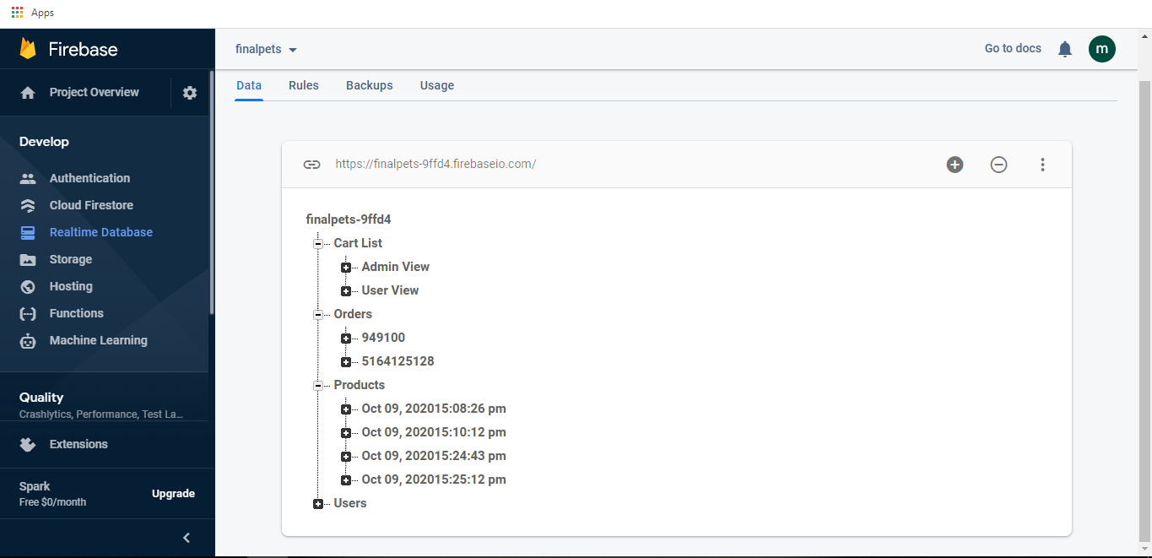
Firebase Configuration

Slide 8
Previous term completed tasks
Login
Sign up
Forgot password

Slide 9
Current Term Tasks

Slide 10
Suma’s Responsibilities
Email Notifications Upon Registration
Admin Login
Admin Home Page
Admin- Add product
Admin- Check for New Orders
Home Page-User
Set Security Questions
Forgot Password

Slide 11
SuMA’S other contributions
Cart
Search
Share
FAQ

Slide 12
Suma’s Demo

Slide 13
Deepthi’s Responsibilities
Admin- Product maintenance
Search
Contact Us
Header

Slide 14
Deepthi’S other contributions
Admin Login
Admin- Add product
Admin- Product maintenance
Admin- Check for New Orders
Wish List
Order confirmation
Order History

Slide 15
Deepthi’s Demo

Slide 16
PRIYANKA’s Responsibilities
Wish List
Shipping address Confirmation
FAQ

Slide 17
PRIYANKA’S other contributions
Order History
Header
About Page
Live Chat

Slide 18
PRIYANKA’s Demo

Slide 19
SuSHma’s Responsibilities
Cart
Share
Checkout(Payment)

Slide 20
SuSHMA’S other contributions
Search
Contact Us
Live Chat

Slide 21
SuSHma’s Demo

Slide 22
Nikitha’s Responsibilities
Order History
About Page
Live Chat

Slide 23
NIKITHA’S other contributions
Home Page-User
Cart
Checkout(Payment)

Slide 24
NIKITHA’s Demo

Slide 25
Summary
We have shared our work into individual tasks and worked on them.
As of now we have completed 90% of the total project.
We need to work on UI Improvements and Documentation.

Slide 26
ANY QUERIES?
Priyanka Bodapati
Deepthi Chokka
Sushma Yedugani
Suma Soma
Nikitha Kethireddy

Slide 27
