Slide 1
IMDb.com
Presented by: Deepthi Kandregula, Ravali Maryala & Karen Cenal

Slide 2
Introduction
The medium of movies has rapidly changed over the course of its creation. Gone are the days where audiences have to depend on one of the big six Hollywood Studios (i.e. Warner Brothers, Disney, Fox, Paramount, Sony and Universal) to produce movies.
With cheaper technology and the introduction of streaming platforms such as Netflix and Amazon Prime, movies can be easily produced and distributed in shorter time frames.
As a result, the number of feature films released in the US has been increasing ten-fold.
Keeping track of what movies are released is a challenge

Slide 3

IMDb.com
IMDb.com, or Internet Movie Database, is an online database of information related to films, television programs, and the like.
With its simple layout, the site showcases various demographics of the film. These items can range from data pertaining directly with the film such as the name of the cast and crew to miscellaneous information such as trivia and movie ratings.
The site provides a feature called “IMDb Charts” where it condenses titles into a “Top 250” based on how the user desired filters

Slide 4
Data collection
https://www.imdb.com/search/title/?title_type=feature&year=2017-01-01,2017-12-31&start=51&ref_=adv_nxt
https://www.imdb.com/search/title/?title_type=feature&year=2018-01-01,2018-12-31&ref_=adv_prv
https://www.imdb.com/search/title/?title_type=feature&year=2018-01-01,2018-12-31&start=51&ref_=adv_nxt
https://www.imdb.com/search/title/?title_type=feature&year=2018-01-01,2018-12-31&start=101&ref_=adv_nxt
https://www.imdb.com/chart/top/?ref_=nv_mv_250
https://www.imdb.com/search/title/?title_type=feature&year=2017-01-01,2017-12-31&ref_=adv_prv

Slide 5
Objectives
We want to analyze the webscraped data from imdb website and compare the ratings.
How is the market being affected by these ratings?
Why are people not rating ,is it because of duration?
How are ratings , duration affecting the gross revenue.
Using the feature Top Rated Movies features for a couple of years analyze the rating trends.

Slide 6
We made use of BeautifulSoup to scrape the data from the website imdb.com We used the methods get(), find() to get the desired data for the columns. We dropped some columns that has NA for visualizations.
Data description/ summary
Title ID | Unique ID listed on imdb., used to search the movie titles released in 2018
Movie Name | This field has the movie names
Genre | This describes the categories movies fall into
Rating | This shows the ratings movies received
Gross | The gross revenue movie made in dollars($)
Director | This gives the director names of the particular movie
Certificate | This describes what kind of people could watch the movie
Duration | This gives the length of movie in minutes

Slide 7
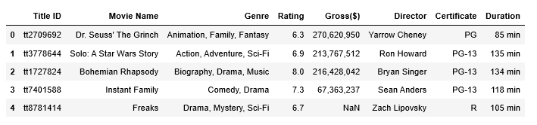
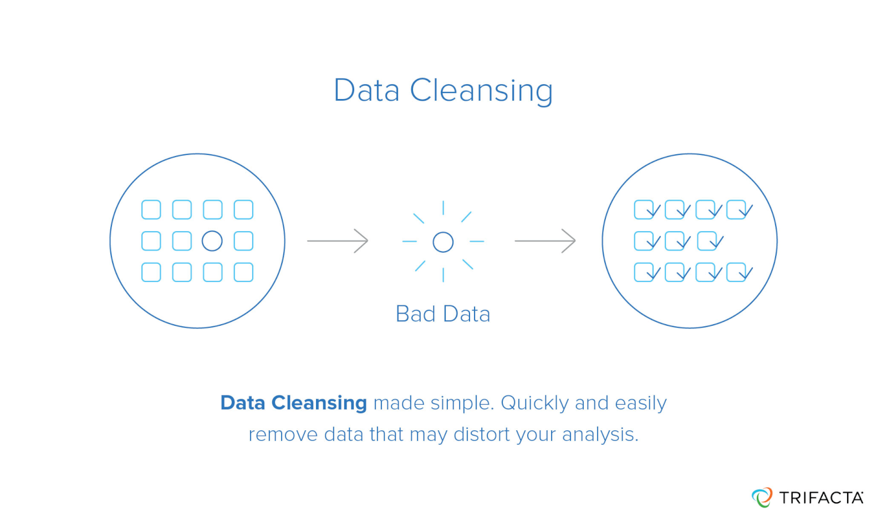
Process – Data Cleaning
Analyze the web scraped data

Slide 8
Challenges
Analyzing featured movies against top rated movies for different time range
Data is pulled in different ways. For eg: Gross is pulled with special characters “,”. Duration is having mins appended in the data frame.
Multiple data records are empty.

Slide 9
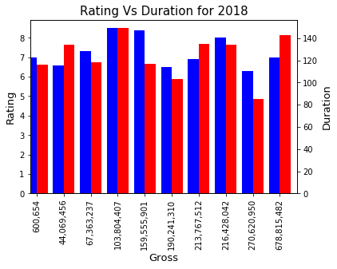
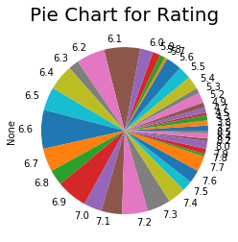
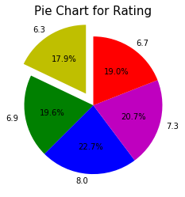
Data Visualization
How is the market being affected by these ratings?

Slide 10
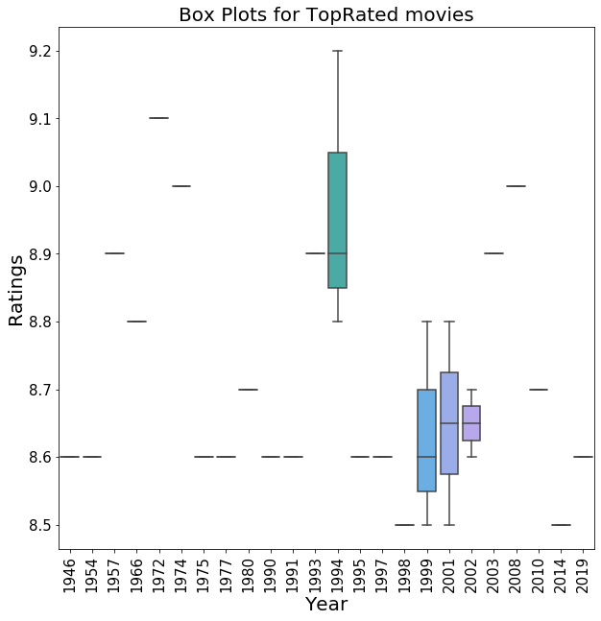
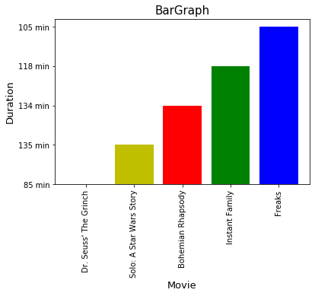
Why are people not rating ,is it because of duration?
Comparison between Rating levels Vs Duration and Gross Vs Duration

Slide 11
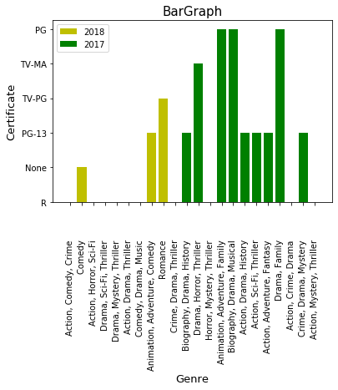

Grouping data
Grouping the certificates to analyze affect on ratings..

Slide 12
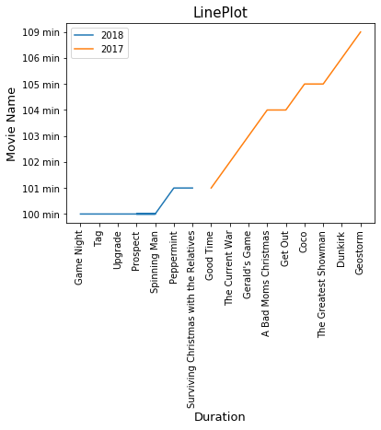
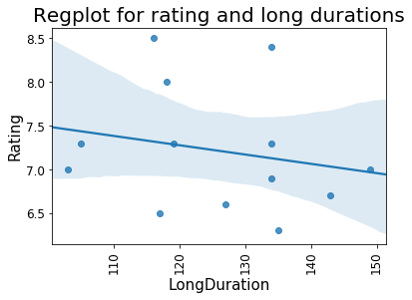
Grouping and plotting duration
Comparisons between Movie Name VS Duration and Short Duration Vs Long Duration

Slide 13
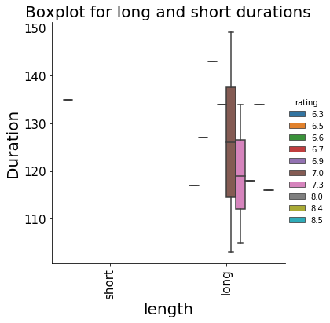
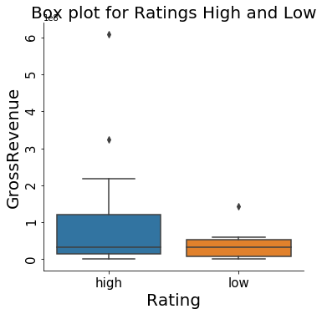
How are ratings , duration affecting the gross revenue.
Comparisons between Rating – Year; Gross-Rating and TopRated Movies-Rating Vs Year

Slide 14
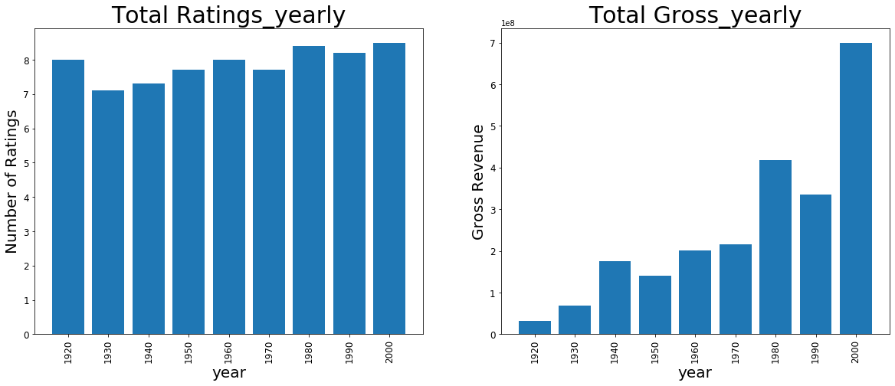
Using the feature Top Rated Movies features for couple of years analyze the rating trends.
Compare data across years to analyze our results

Slide 15

Results-More data more income
On analyzing all our objectives we conclude that whenever people rate the movies with their opinion, the gross increases. Currently the year range 2000-2020 has the highest gross revenues since people actively rated movies.

Slide 16

Thank You. Questions

