Slide 1
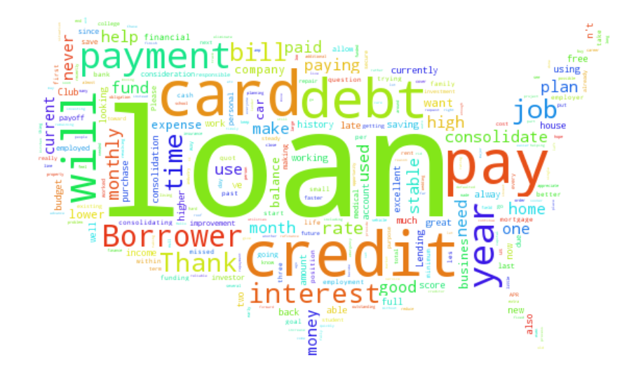
PROJECT-11
Loan Prediction Using Machine Learning Algorithms
180030900-P. Sai Deepthi

Slide 2
INTRODUCTION
In this project we are going to predict the loan applicants eligibility for credit using several machine learning algorithms.
What is Prediction of loan applicants for eligibility?
Loans are the core business of banks. The main profit comes directly from the loan’s interest.
The loan companies grant a loan after an intensive process of verification and validation.
However, they still don’t have assurance if the applicant is able to repay the loan with no difficulties.
In this project, we’ll build a predictive model to predict if an applicant is able to repay the lending company or not.
We will use various models to predict the target variable.

Slide 3
METHODOLOGY
1
2
3
4
Collection of Data (Train and Test Sets)
Data Pre Processing(Outlier Removal)
Building Models
Prediction(Loan defaulter/non defaulter)

Slide 4
OBJECTIVES
DataSet Platform-Kaggle
DataSet Link-
https://www.kaggle.com/burak3ergun/loan-data-set
The algorithms that need to be used in this project are:
a) Logistic Regression
b) Decision Tree
c) Random Forest
d) Bayes algorithm

Slide 5
LOGISTIC REGRESSION
Logistic regression is a supervised learning classification algorithm used to predict the probability of a target variable.
The nature of target or dependent variable is dichotomous, which means there would be only two possible classes.
In simple words, the dependent variable is binary in nature having data coded as either 1 (stands for success/yes) or 0 (stands for failure/no).
Mathematically, a logistic regression model predicts P(Y=1) as a function of X.

Slide 6
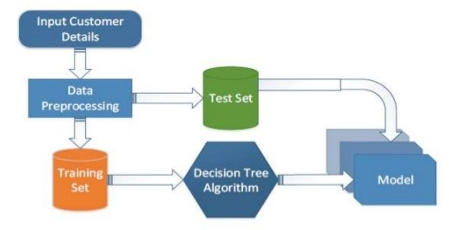
DECISION TREE
The goal of using a Decision Tree is to create a training model that can use to predict the class or value of the target variable by learning simple decision rules inferred from prior data(training data).
In Decision Trees, for predicting a class label for a record we start from the root of the tree.
Architecture of Proposed Model

Slide 7
RANDOM FOREST
Random forest is a supervised learning algorithm.
One big advantage of random forest is that it can be used for both classification and regression problems, which form the majority of current machine learning systems.
Random forest adds additional randomness to the model, while growing the trees. Instead of searching for the most important feature while splitting a node, it searches for the best feature among a random subset of features. This results in a wide diversity that generally results in a better model.

Slide 8
BAYES ALGORITHM
It is a classification technique based on Bayes' Theorem with an assumption of independence among predictors.
In simple terms, a Naive Bayes Classifier assumes that the presence of a particular feature in a class is unrelated to the presence of any other feature.
It is a probabilistic classifier, which means it predicts on the basis of the probability of an object.

Slide 9
STEPS
Importing Dataset
Loading Dataset and visualization
Selecting columns
Applying Machine Learning algorithms
a) Logistic Regression
b) Decision Tree
c) Random Forest
d) bayes algorithm
Finally comparing result.

Slide 10

CONCLUSION
From the Exploratory Data Analysis, we could generate insight from the data. How each of the features relates to the target. Also, it can be seen from the evaluation of three models that Logistic Regression performed better than others, Random Forest did better than Decision Tree.

