Slide 1
SRE Maturity - Scalability

Slide 2
Scalability is the Ability of a system, application, or network to handle a growing amount of work, or its potential to be accommodated according to that growth.
Scalable system can efficiently and effectively handle an increasing amount of data, traffic, or demand without causing a significant decrease in performance.

Slide 3
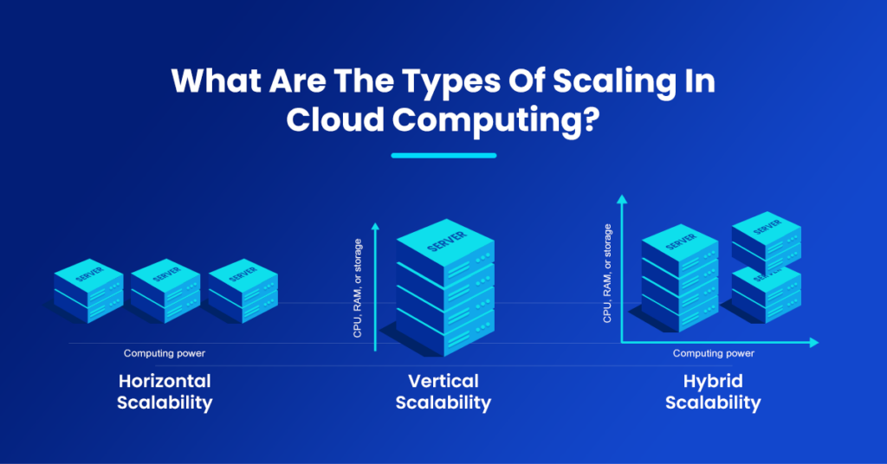

Slide 4
Scalability is important for several reasons:
Handling Growth: It enables systems to accommodate growth in user base, data volume, or traffic without a significant decrease in performance.
Improved Performance: Scalable systems can distribute workloads effectively, preventing bottlenecks and maintaining optimal performance levels.
Cost Efficiency: Scalability allows for more efficient resource utilization, avoiding over-provisioning and optimizing costs.
Adaptability: It provides the flexibility to adapt to changing requirements and demands.
Enhanced Reliability: Scalable architectures often contribute to improved fault tolerance and system reliability.

Slide 5
Autoscaling
Automatic adjustment of resources based on the current demand or load on a system
Dynamic Resource Provisioning:
Autoscaling dynamically adjusts the number of computing resources (e.g., virtual machines, containers) allocated to an application based on factors such as incoming traffic, workload, or performance metrics.
Load Balancing:
Autoscaling often works in conjunction with load balancing mechanisms. As demand increases, additional instances of an application are added, and load balancers distribute incoming requests across these instances to ensure even resource utilization.
Scaling Policies:
Autoscaling policies define rules or conditions that trigger scaling actions. These policies can be based on metrics like CPU utilization, memory usage, network traffic, or custom application-specific metrics.
Vertical and Horizontal Scaling:
Autoscaling can involve both vertical and horizontal scaling. Vertical scaling (scaling up) involves adding more resources to an existing instance, while horizontal scaling (scaling out) involves adding more instances to distribute the workload.
Automatic and Manual Scaling:
Autoscaling can be automatic, where the system dynamically adjusts resources based on predefined rules, or manual, where administrators trigger scaling actions based on their assessment of the current needs.
Cloud Provider Support:
Most major cloud service providers offer autoscaling features as part of their platform. For example, Amazon Web Services (AWS) has Auto Scaling Groups, Google Cloud Platform (GCP) has Instance Groups, and Microsoft Azure has Virtual Machine Scale Sets.

Slide 6
An Availability Zone (AZ) is a distinct location within a geographical region containing one or more data centers that are isolated from the failures of other Availability Zones

Slide 7
Benefits of autoscaling
Cost Optimization: Autoscaling allows resources to be allocated based on actual demand, helping to optimize costs by avoiding over-provisioning during periods of low traffic.
Improved Performance: Ensures that applications can handle increased demand without degradation in performance.
Enhanced Reliability: Distributes workloads across multiple instances, improving fault tolerance and overall system reliability.
Flexibility and Agility: Enables systems to adapt quickly to changes in demand, ensuring that resources are available when needed.

