Slide 1
Getting Started with AngularJS

Slide 2
Topics Covered
Single Page Application
Overview AngularJS
MVC Architecture
Directives
Expressions
Controllers
Filters
Modules
Event Handlers
Routing

Slide 3
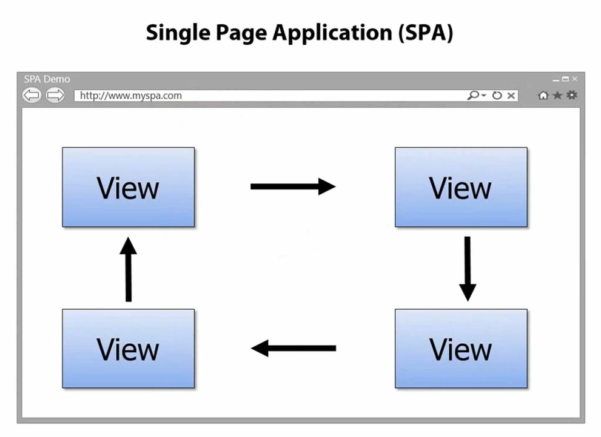
What is SPA
In traditional web applications, the client (browser) initiates the communication with the server by requesting a page. The server then processes the request and sends the HTML of the page to the client. In subsequent interactions with the page –e.g. the user navigates to a link or submits a form with data– a new request is sent to the server, and the flow starts again: the server processes the request and sends a new page to the browser in response to the new action requested by the client.
In Single-Page Applications (SPAs) the entire page is loaded in the browser after the initial request, but subsequent interactions take place through Ajax requests. This means that the browser has to update only the portion of the page that has changed; there is no need to reload the entire page.
First off, a Single Page Application is one in which we have a shell page and we can load multiple views into that.

Slide 4
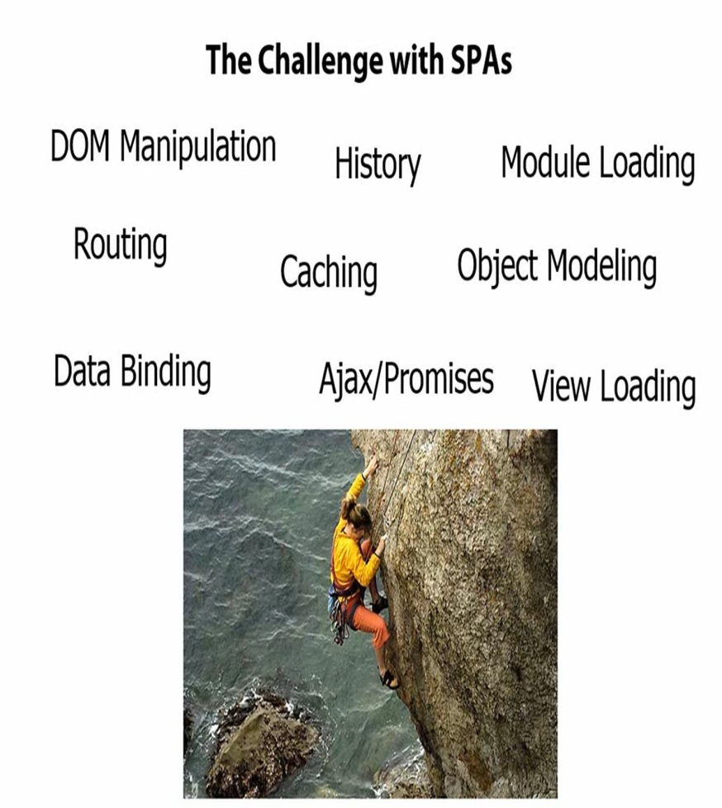
Challenges of SPA
The challenge with building SPAs from scratch is there’s a lot of different issues to deal with: DOM manipulation and history and how do you dynamically load modules and how do you deal with promises when you make async calls and things like that.
Routing becomes a huge issue because you have to have some way to track “Where are we? And where are we going?”

Slide 5
Why use it?
The problem – HTML is great for static pages, but has no tools for web applications
The solution – extend and adapt HTML vocabulary with some additional declarations that are useful for web applications.
Less boilerplate code
Less effort in mundane tasks allowing for better focus on what is ACTUALLY VALUABLE – THE LOGIC
More efficiency in development
Separation of concerns

Slide 6
What is Angular JS
Instead of manipulating the DOM “directly,” you annotate your DOM with metadata (directives), and Angular manipulates the DOM for you.
AngularJS is an MV* framework that is ideal for use when building client-side single-page apps. It is not a library, but a framework for building dynamic web pages. It focuses on extending HTML and providing dynamic data binding, and it plays well with other frameworks (e.g., jQuery).
If you are building a single-page app, AngularJS will be perfect for you.
Example sites are : Gmail , Google DOC , Twitter , Face Book

Slide 7
What is AngularJS
Open-source JavaScript framework
Developed in 2009 by Miško Hevery and Adam Abrons
Maintained by Google
AngularJS is perfect for SPAs (Single Page Applications)
AngularJS extends HTML with new attributes

Slide 8
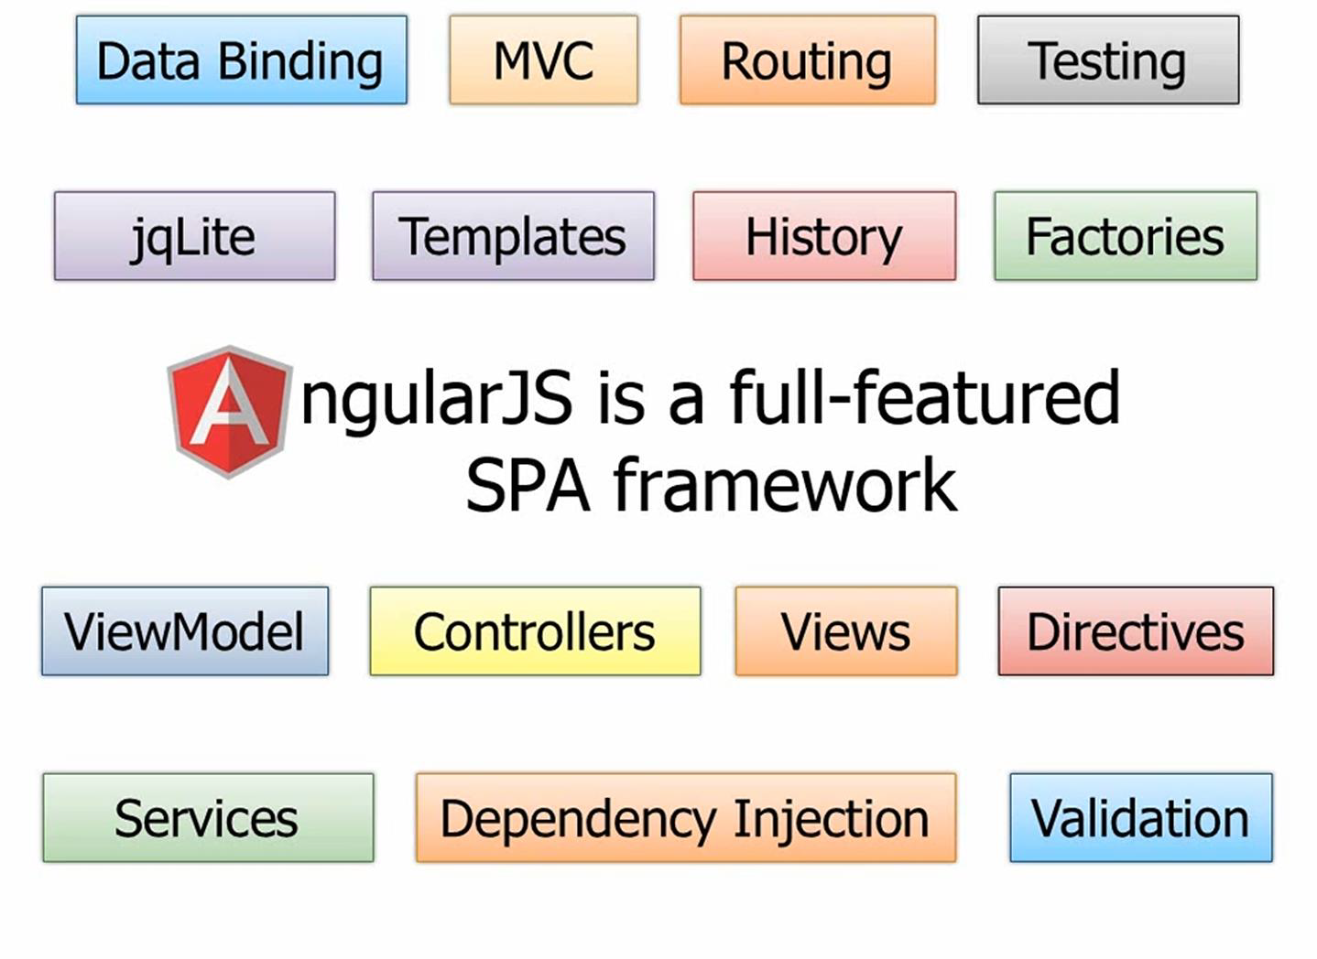
AngularJS Features
AngularJS is a powerful JavaScript based development framework to create RICH Internet Application(RIA).
AngulajJS provides developers options to write client side application (using JavaScript) in a clean MVC(Model View Controller) way.
Application written in AngularJS is cross-browser compliant. AngularJS automatically handles JavaScript code suitable for each browser.
AngularJS is open source, completely free, and used by thousands of developers around the world. It is licensed under the Apache License version 2.0.

Slide 9
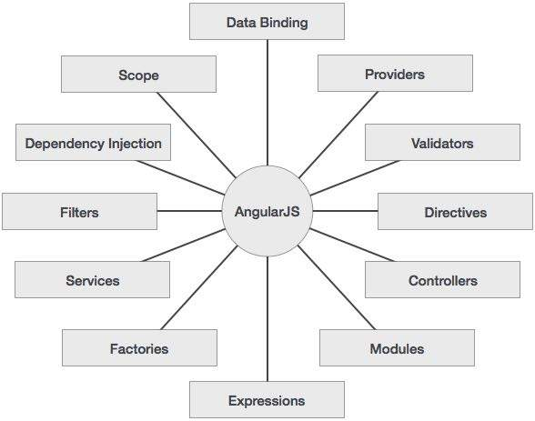
AngularJS

Slide 10
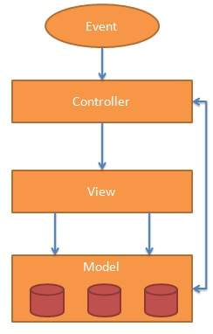
What is MVC :
Model View Controller or MVC as it is popularly called, is a software design pattern for developing web applications.
it isolates the application logic from the user interface layer and supports separation of concerns.
The controller receives all requests for the application and then works with the model to prepare any data needed by the view.
The view then uses the data prepared by the controller to generate a final presentable response.
The Model: Holds the data ,Notifies the View and the Controller for changes in the data
The View : presentation of the data in particular format. Displays stuff (buttons, labels, …)This is what your users will see Knows about the Model.
The Controller : The controller responds to user input and performs interactions on the data model objects. Controls everything Knows about both the Model and the View The “logic” resides in it What to happen, when and how

Slide 11
Angular JS is MVC
MVC = Model-View-Controller
Less dependencies
Improves maintainability
It is easier to read and understand code

Slide 12
Advantages and Disadvantages
Advantages :
Provides capability to create SPA
Due to data binding capability to HTML gives user a rich and responsive experience
It is unit testable
Dependency injection and separation of concerns
Reusable components
Disadvantages :
Not secure : server side authentication and authorization is must to keep an application secure
Not degradable : if you’re application user disables JavaScript then user will just see the basic page and nothing more.

Slide 13
Start with AngularJS
We can implement the AngularJS into application in two ways.
Local directives : download the angular.min.js.jar file form angular.org and store into your local directives
CDN : provide URL to connect to angularjs JAR by online.

Slide 14
AngularJS Example
<!DOCTYPE html> <html> <head> <script src="http://ajax.googleapis.com/ajax/libs/angularjs/1.2.26/angular.min.js"></script> </head> <body> <div ng-app=""> <p>Name: <input type="text" ng-model="name"></p> <p ng-bind="name"></p> </div> </body> </html>
Notes:
AngularJS starts automatically when the web page has loaded.
The ng-app directive tells AngularJS that the <div> element is the "owner" of an AngularJS application.
The ng-model directive binds the value of the input field to the application variable name.
The ng-bind directive binds the innerHTML of the <p> element to the application variable name.

Slide 15
AngularJS Directives
AngularJS lets you extend HTML with new attributes called Directives.
AngularJS directives are extended HTML attributes with the prefix ng-.
The ng-app directive initializes an AngularJS application.
The ng-app directive defines the root element of an AngularJS application.
The ng-app directive will auto-bootstrap (automatically initialize) the application when a web page is loaded.
The ng-init directive initialize application data.
The ng-init directive defines initial values for an AngularJS application.
Normally, you will not use ng-init. You will use a controller or module instead.

Slide 16
AngularJS Directives
The ng-model Directive
The ng-model directive binds the value of HTML controls (input, select, textarea) to application data.
The ng-model directive can also:
Provide type validation for application data (number, email, required).
Provide status for application data (invalid, dirty, touched, error).
Provide CSS classes for HTML elements.
Bind HTML elements to HTML forms
The ng-repeat Directive
The ng-repeat directive clones HTML elements once for each item in a collection (in an array).

Slide 17
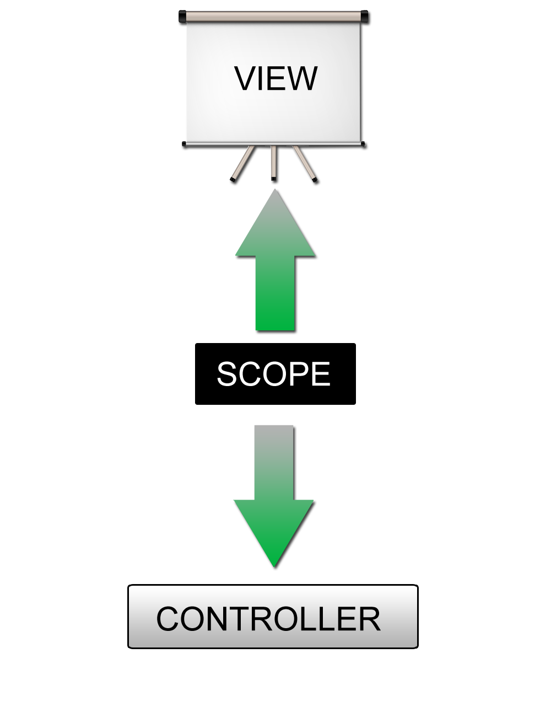
Two-way data binding
View is updated automatically when the Model is changed
Model is updated automatically when a value in the View has changed
No DOM manipulation boilerplate needed!

Slide 18
AngularJS Expressions
AngularJS expressions are written inside double braces: {{ expression }}.
AngularJS expressions binds data to HTML the same way as the ng-bind directive.
AngularJS will "output" data exactly where the expression is written.
AngularJS expressions are much like JavaScript expressions: They can contain literals, operators, and variables.
Example {{ 5 + 5 }} or {{ firstName + " " + lastName }}

Slide 19
AngularJS Filters
AngularJS filters can be used to transform data:
Filters can be added to expressions and directives using a pipe character.
Filter | Description
currency | Format a number to a currency format.
filter | Select a subset of items from an array.
lowercase | Format a string to lower case.
orderBy | Orders an array by an expression.
uppercase | Format a string to upper case.

Slide 20
Adding Filters to Directives
A filter can be added to a directive with a pipe character (|) and a filter.
<div ng-app="" ng-controller="namesController"> <ul> <li ng-repeat="x in names | orderBy:'country'"> {{ x.name + ', ' + x.country }} </li> </ul>

Slide 21
AngularJS Controllers
AngularJS controllers control the data of AngularJS applications.
A controller is a JavaScript Object, created by a standard JavaScript object constructor.
The view doesn’t have to know about the controller, and the controller definitely doesn’t want to know about the view.
Notes:
The way it works in Angular is you have a View, which is what we’ve been doing in the previous section with our Directives, our Filters and our Data Binding.
But we don’t want to put all of our logic into the View because it’s not very maintainable or testable or all those types of things.
Instead we’re going to have a special little JavaScript object – a container - called a Controller. The Controller will drive things. It’s going to control ultimately what data gets bound into the View. If the View passes up data to the controller it will handle passing off maybe to a service which then updates a back-end data store.
The glue between the View and the Controller is something called the Scope, and in Angular you’re going to see a lot of objects or variables that start with $. $scope represents the scope object.

Slide 22
AngularJS HTML DOM Element
Some of the directives are used to bind application data to attributes of HTML DOM Elements.
Name | Description
ng-disabled | Disables a given control
ng-show | Shows a given control
ng-hide | Hides a given control
ng-click | Represents angularJS click event

Slide 23
AngularJS Form Validation
In AngularJs we can validate the form fields by attaching errors with it.
$dirty - states that value has been changed.
$invalid- states that value entered is invalid.
$error- states the exact error.
Form Include function : HTML does not support embedding another html in one. We can achive this by
Using Ajax - Make a server call to get the corresponding html page and set it in innerHTML of html control.
Using Server Side Includes - JSP, PHP and other web side server technologies can include html pages within a dynamic page.
In angularJS we have a “ ng-include “ directives which performs this operation.
<div ng-include="'main.htm'"></div>
<div ng-include="'subjects.htm'"></div>

Slide 24
AngularJS XMLHttpRequest
AngularJS provides $http control which works as a service to read data from the server. The server makes a database call to get the desired records. AngularJS needs data in JSON format. Once the data is ready, $http can be used to get the data from server
$http.get(url) is the function to use for reading server data.
$http is an XMLHttpRequest object for requesting external data.
function studentController($scope,$http) {
var url="data.txt";
$http.get(url).success( function(response) {
$scope.students = response; });
}

Slide 25
AngularJS Modules
Why Modules?
Helps package our code into reusable modules.
The declarative process is easier to understand.
Modules can be loaded in any order.
Easily testable and maintainable components.
Helps organize your application.

Slide 26
AngularJS Modules
Modules define applications. All application controllers should belong to a module.
Modules make your application more readable, and keep the global namespace clean.
Controllers Pollute the Global Namespace
Global values should be avoided in applications. They can easily be overwritten or destroyed by other scripts.
AngularJS modules can solve (or reduce) this problem.
Application Module - used to initialize an application with controller(s).
Controller Module - used to define the controller.

Slide 27
A Controller Without a Module
<!DOCTYPE html> <html> <head> <script src="http://ajax.googleapis.com/ajax/libs/angularjs/1.2.26/angular.min.js"></script> </head> <body> <div ng-app="" ng-controller="myCtrl"> {{ firstName + " " + lastName }} </div> <script> function myCtrl($scope) { $scope.firstName = "John"; $scope.lastName = "Doe"; } </script> </body> </html>

Slide 28
A Controller With a Module
<!DOCTYPE html><html><head> <script src="http://ajax.googleapis.com/ajax/libs/angularjs/1.2.26/angular.min.js"></script> </head> <body> <div ng-app="myApp" ng-controller="myCtrl"> {{ firstName + " " + lastName }} </div> <script> var app = angular.module("myApp", []); app.controller("myCtrl", function($scope) { $scope.firstName = "John"; $scope.lastName = "Doe"; }); </script> </body> </html>

Slide 29
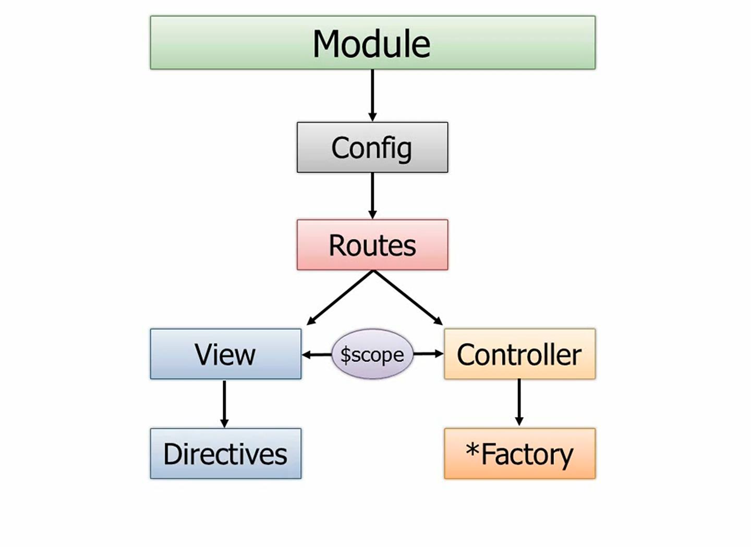
AngularJS

Slide 30
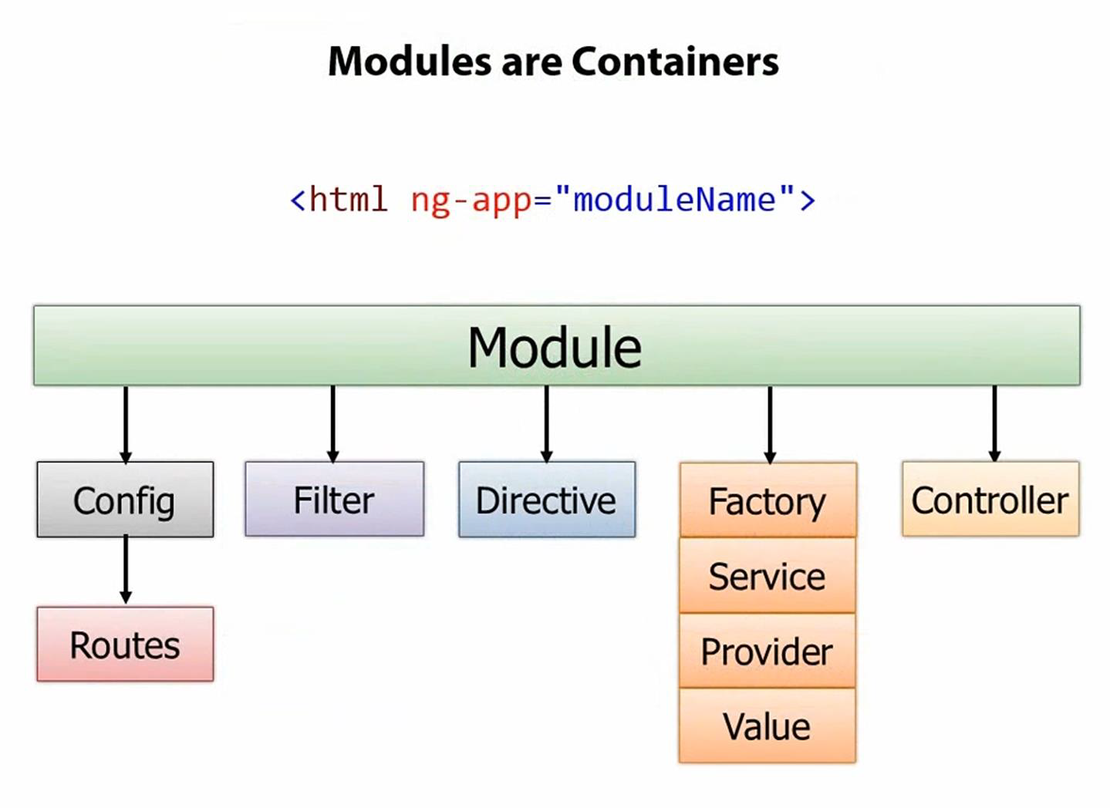
AngularJS

Slide 31
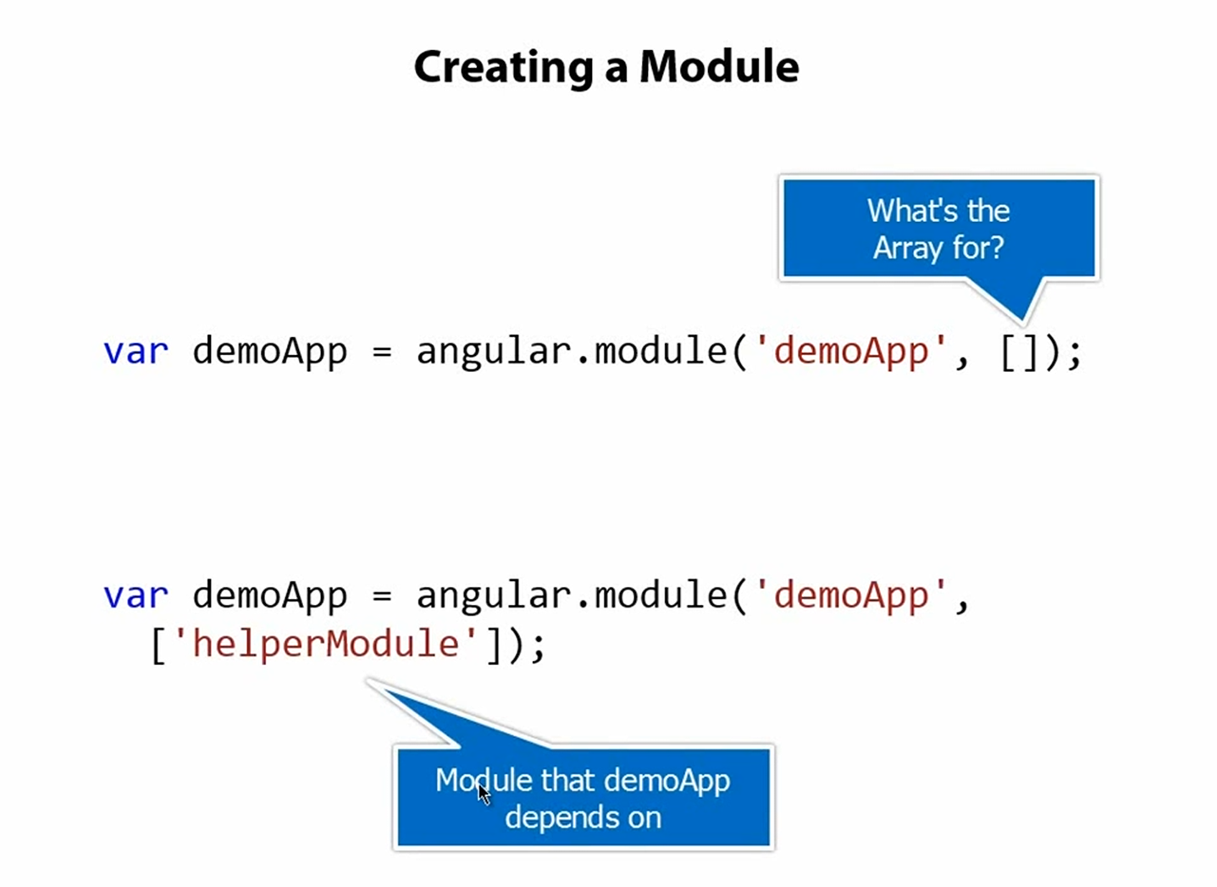
Angular JS

Slide 32
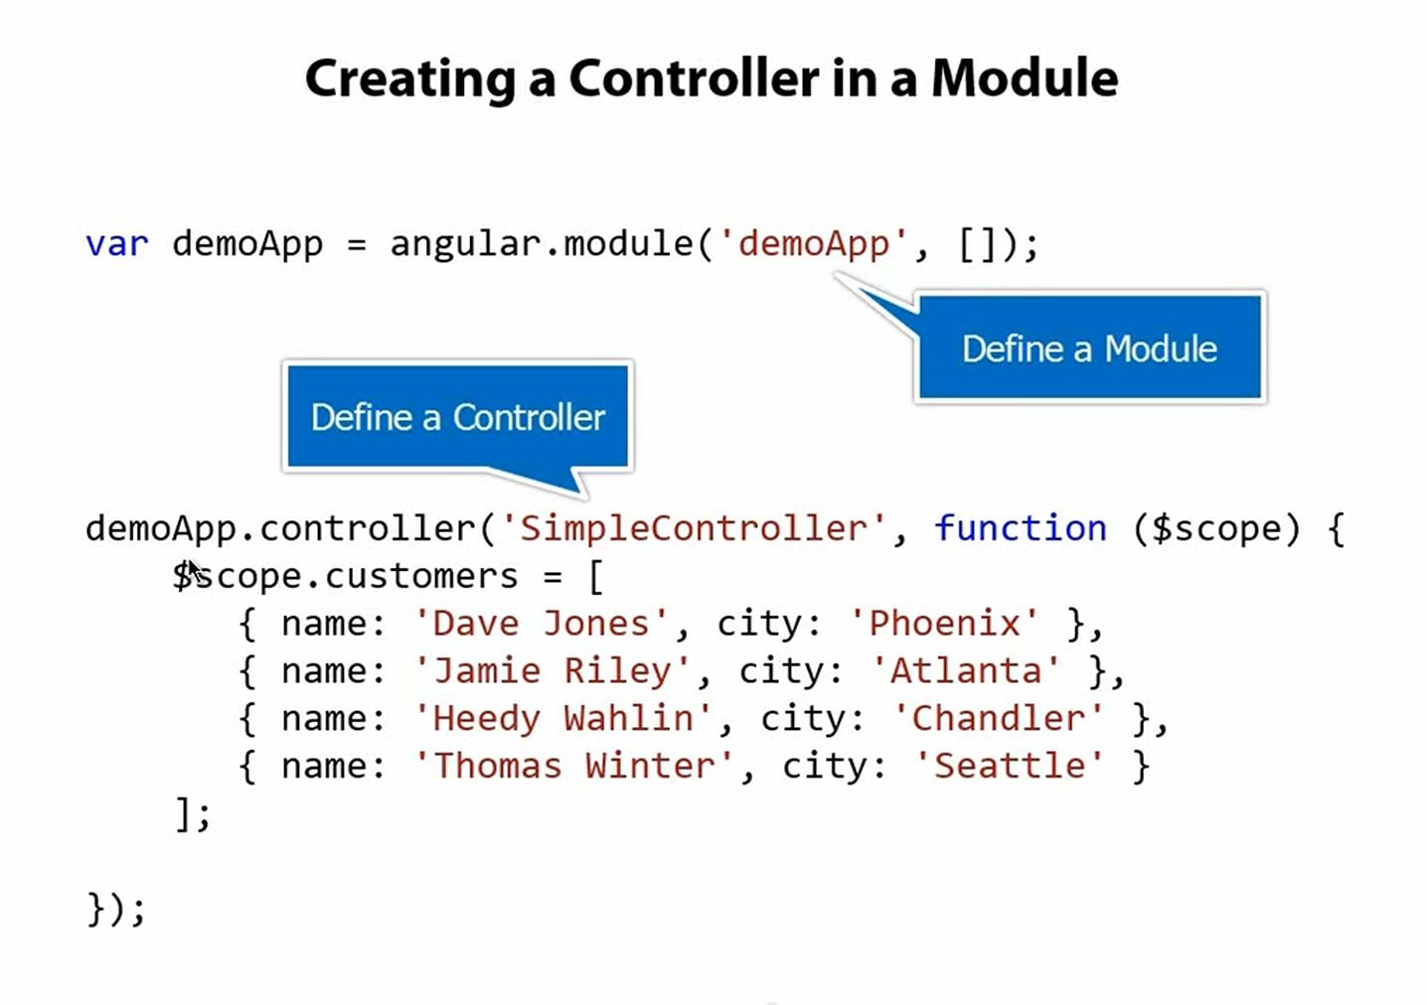
Angular JS

Slide 33
AngularJS Routing with Multiple Views
angularJS supports SPA with multiple views . To do this AngulaJS has provided directives and services
ngRoute : The ngRoute module provides routing and deep linking services and directives for angular applications. To add this to your application we need to download the file ( angular-route.js) or CDN with this link : https://ajax.googleapis.com/ajax/libs/angularjs/1.2.28//angular-route.min.js
ngView: ng-view tag simply creates a place holder where a corresponding view (html or ng-template view) can be placed based on the configuration. The ngView directive is used to display the HTML templates or views in the specified routes.
ng-template : ng-template directive is used to create an html view using script tag. It contains "id" attribute which is used by $routeProvider to map a view with a controller.
$routeProvider : The $routeProvider (provider in ngRoute Module) is used to configure the routes. We use the module’s config() to configure the $routeProvider. The config() takes a function which takes the$routeProvider as parameter and the routing configuration goes inside the function. $routeProvider has a simple API, accepting either the when() or otherwise() method.

Slide 34
Steps to create routes
Create a module named mainApp and load ngRoute as a dependent module.
Configure the routes using $routeProvider. It takes two parameter a) templateURL : view name to be displayed when condition satisfied. b) controller: the controller attached with the view page.
Create the view mentioned in templateURL
Call the module in ng-app which will bootstraps out application
Declare the ngView which will act as a placeholder of view pages in main page
Include angular.min.js and angular-route.min.js files
Call the external js file and run the example.

Slide 35
AngularJS Service and Factory
AngularJS supports the concepts of "Separation of Concerns" using services architecture. Services are javascript functions and are responsible to do a specific tasks only.
AngularJS provides many inbuilt services for example, $http, $route, $window, $location etc. Each service is responsible for a specific task for example, $http is used to make ajax call to get the server data. $route is used to define the routing information and so on.
Services are singletons, which are objects that are instantiated only once per app (by the $injector). They provide an interface to keep together methods that relate to a specific function.
There are two ways to create a service.
factory
service

Slide 36
AngularJs Service
What is a service?
It provides us method to keep data across the lifetime of the angular app
It provides us method to communicate data across the controllers in a consistent way
This is a singleton object and it gets instantiated only once per application
It is used to organize and share data and functions across the application
For example:
module.service(‘MyService’,function(){
this.method= function(){ }
}
When declaring serviceName as an inject able argument you will be provided with an instance of the function. In other words this keyword is used . This object instance becomes the service object that angularJS registers and injects later to other services/controllers if required.

Slide 37
AngularJS Factory
Factory : it is similar to services in AngularJS the difference is services are singleton and factory are multithreaded. Each time new instance is created.
module.factory('MyService', function() {
var factory = {};
factory.method1 = function() {
}
return factory;
});
When declaring factoryName as an inject able argument you will be provided with the value that is returned by invoking the function reference passed to module.factory.

Slide 38
AngularJs Provider
Provider
Provider is the most configurable of all three. All other providers are derived from it. It enables us define how the service will be provided even before the injection system is in place. This is achieved with configure call where we register work during the modules configuration phase.
Syntax: Syntax: module.provider( ‘providerName’, function );
Result: When declaring providerName as an inject able argument you will be provided the value that is returned by invoking the $get method of the function reference passed to module.provider.
Usage: Could be useful for returning a ‘class’ function that can then be new’ed to create instances but that requires some sort of configuration before being injected. Perhaps useful for classes that are reusable across projects.

Slide 39
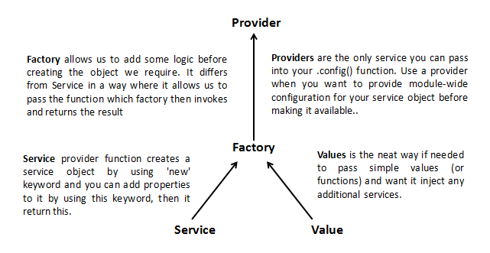
AngularJS

Slide 40
Custome Directives
'A' - <span ng-sparkline></span>
'E' - <ng-sparkline></ng-sparkline>
'C' - <span class="ng-sparkline"></span>
'M' - <!-- directive: ng-sparkline -->

