Slide 1
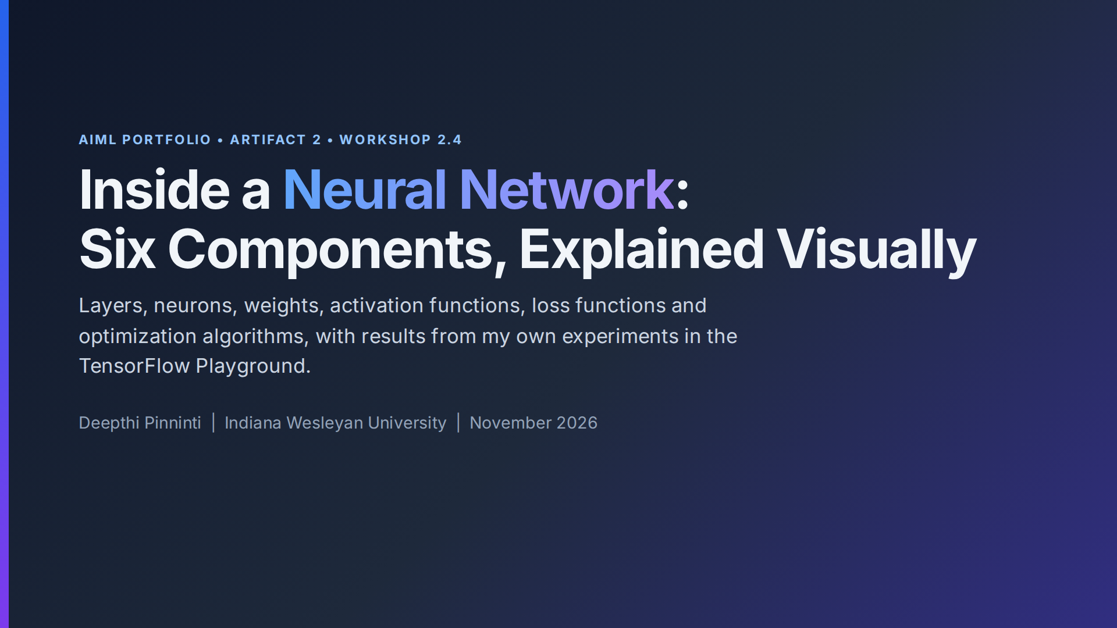
Notes:
Welcome. This presentation explains the six building blocks of a neural network and shows what I learned by experimenting in the TensorFlow Playground.

Slide 2
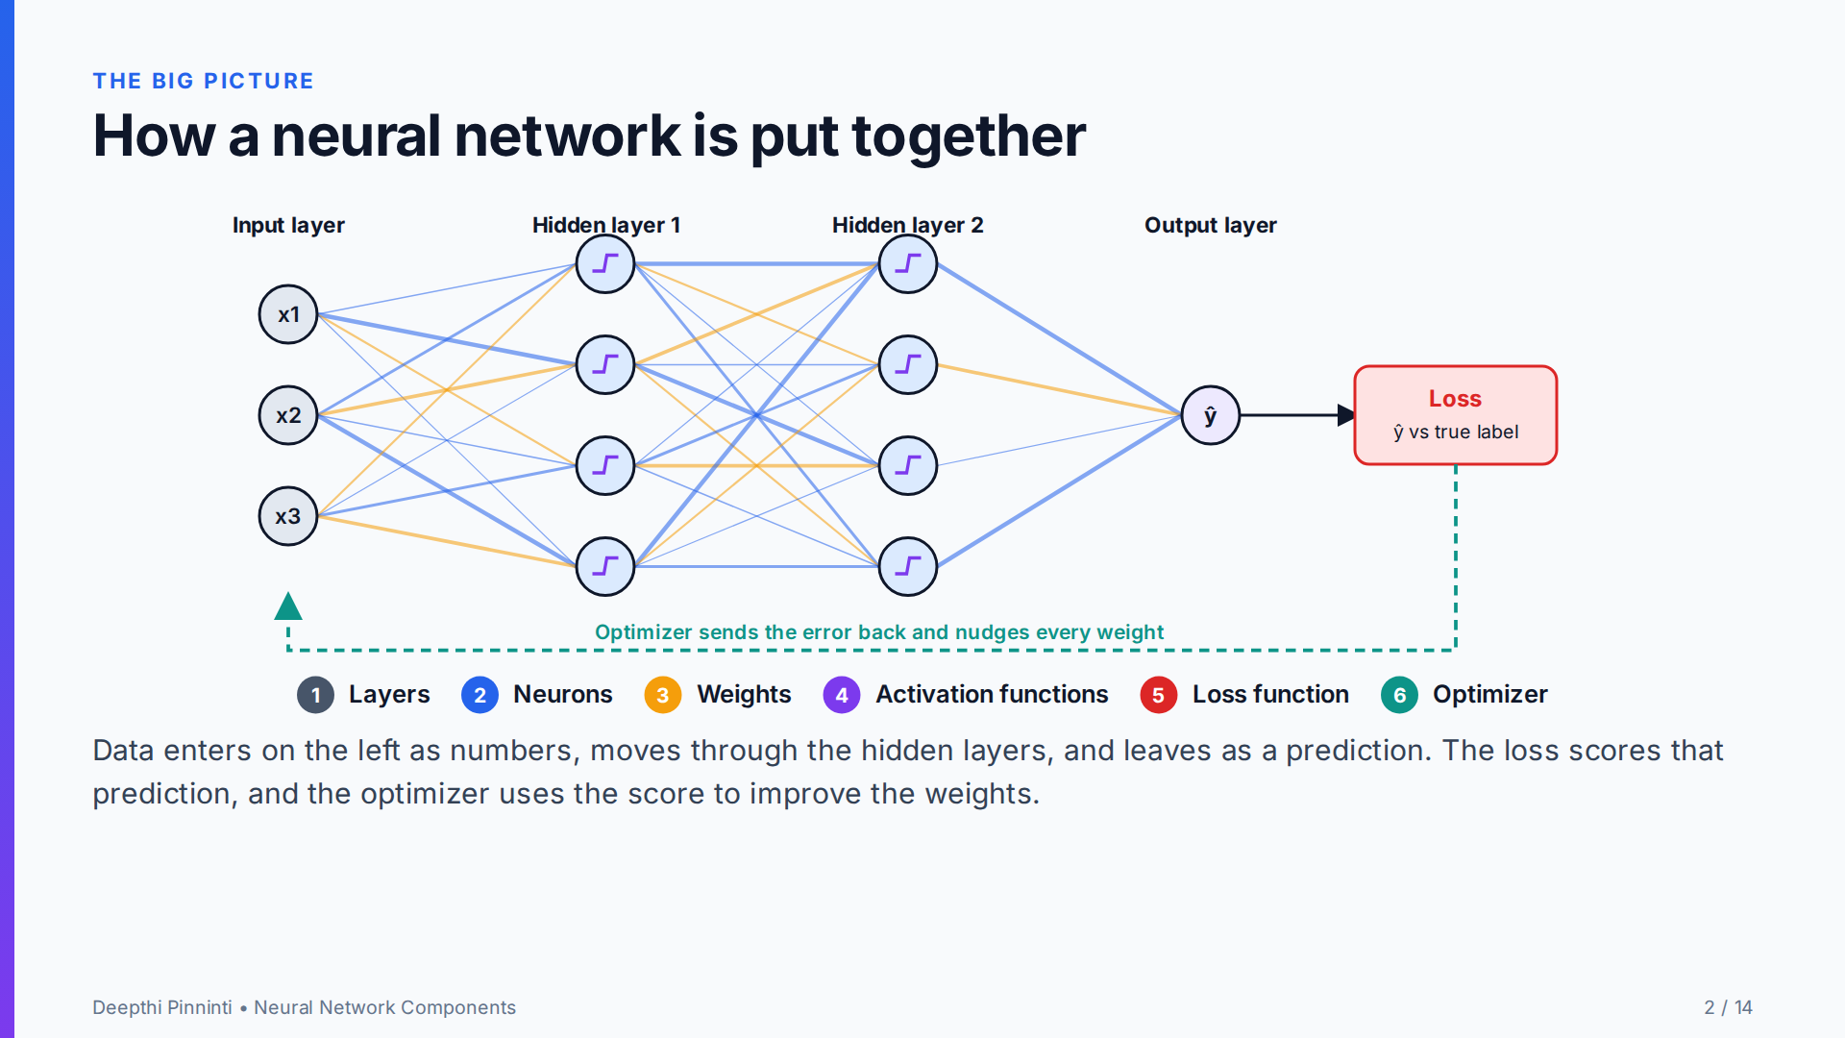
Notes:
This one diagram contains all six components. Lines are weights, circles are neurons, the little curve inside a neuron is its activation function. The loss box scores the prediction and the dashed arrow is the optimizer sending the error back to adjust the weights.

Slide 3
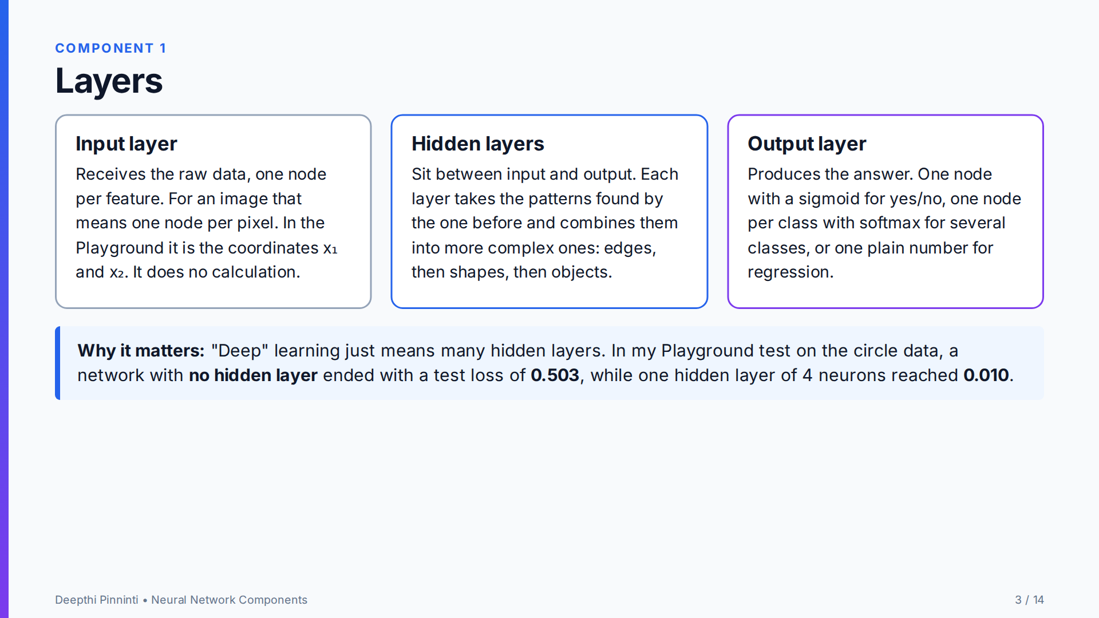
Notes:
Layers are the stages of the network. Input holds the features, hidden layers learn intermediate patterns, and the output gives the prediction. The last line shows my own experiment result.

Slide 4
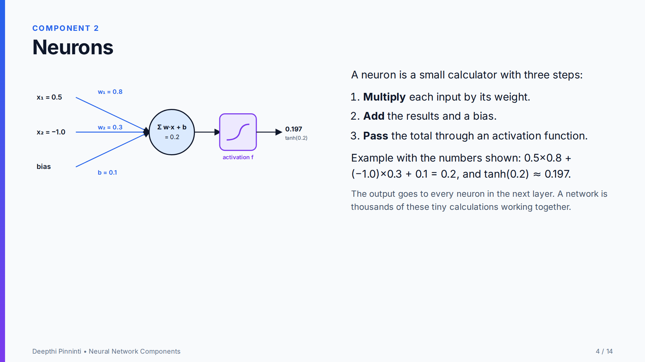
Notes:
A single neuron does three things: weighted sum, add bias, apply an activation. I calculated the example by hand: 0.5 times 0.8 is 0.4, minus 0.3, plus 0.1 gives 0.2, and tanh of 0.2 is about 0.197.

Slide 5
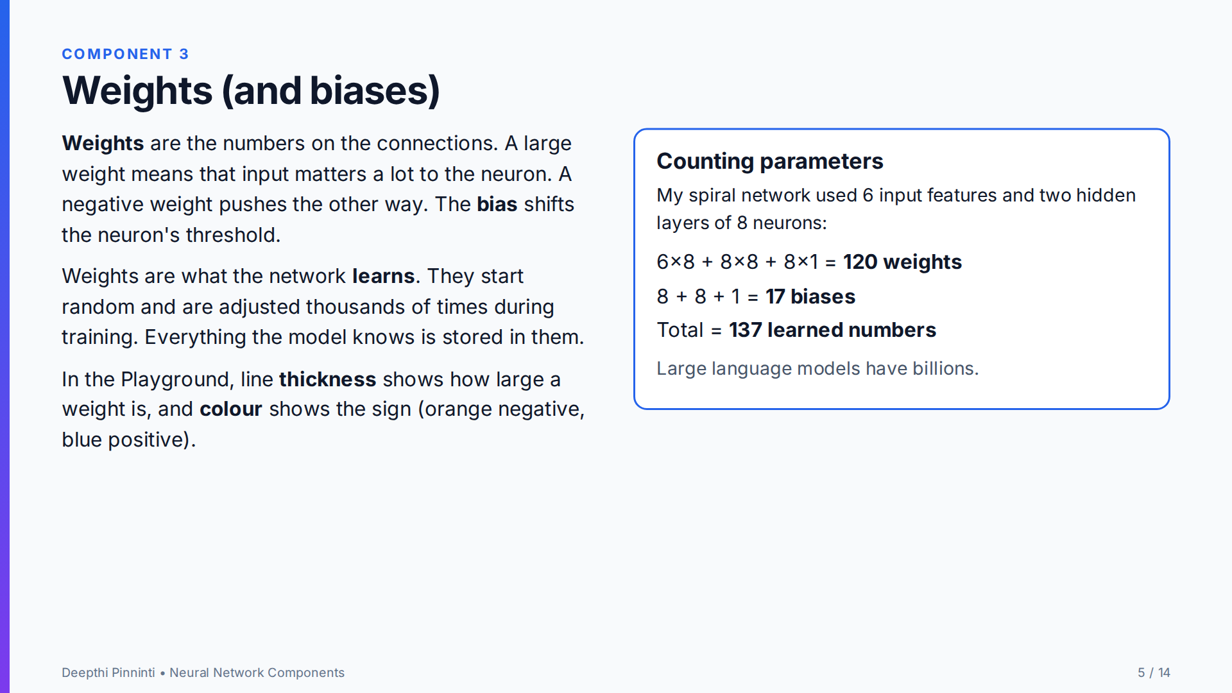
Notes:
Weights are the knowledge of the network. In the Playground you can see them as lines whose thickness shows size and colour shows sign. My spiral network had 137 numbers to learn.

Slide 6
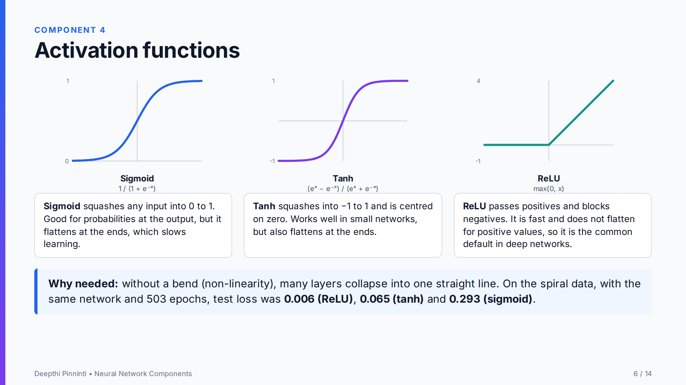
Notes:
Activation functions add the bend that lets a network learn curved boundaries. I compared all three on the spiral data in the Playground with identical settings.

Slide 7
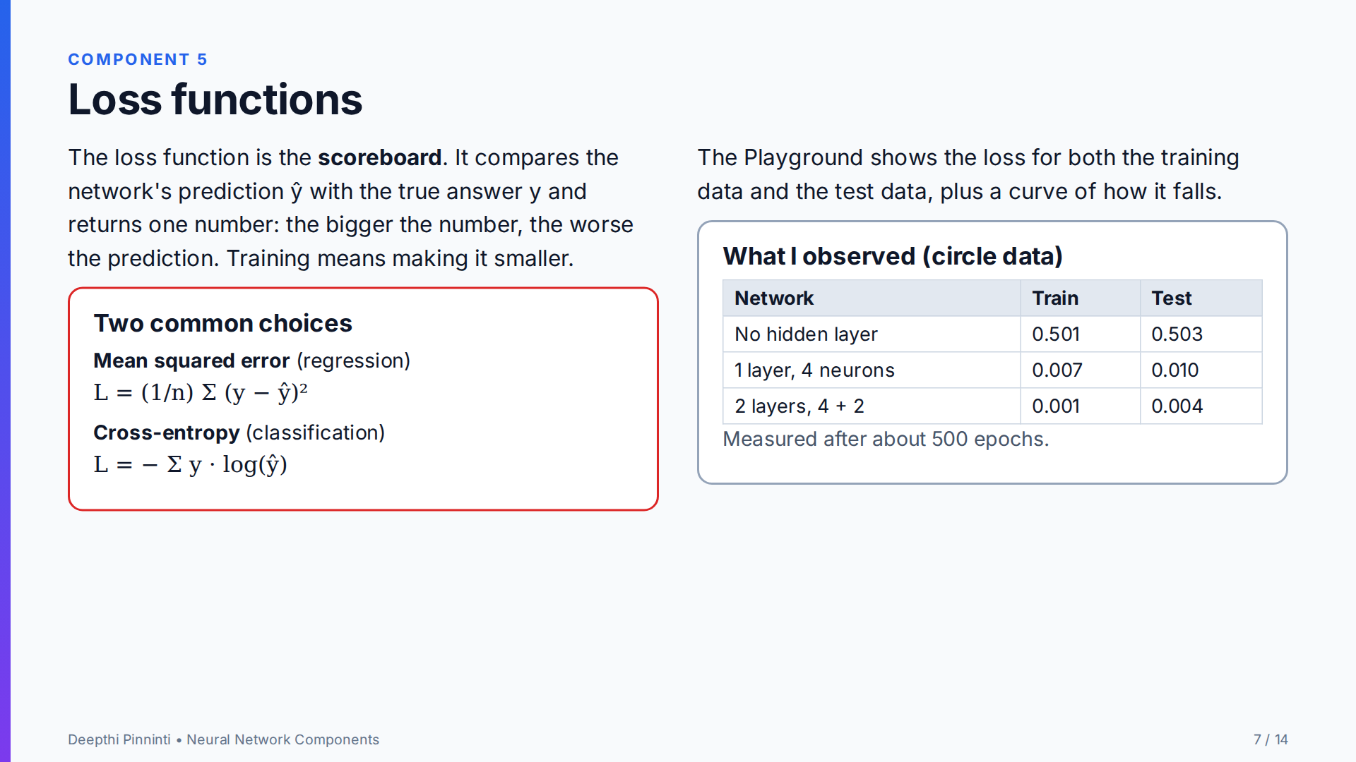
Notes:
The loss is the single number that tells us how wrong the model is. It is what the optimizer tries to reduce. The table shows how it dropped as I added hidden layers.

Slide 8
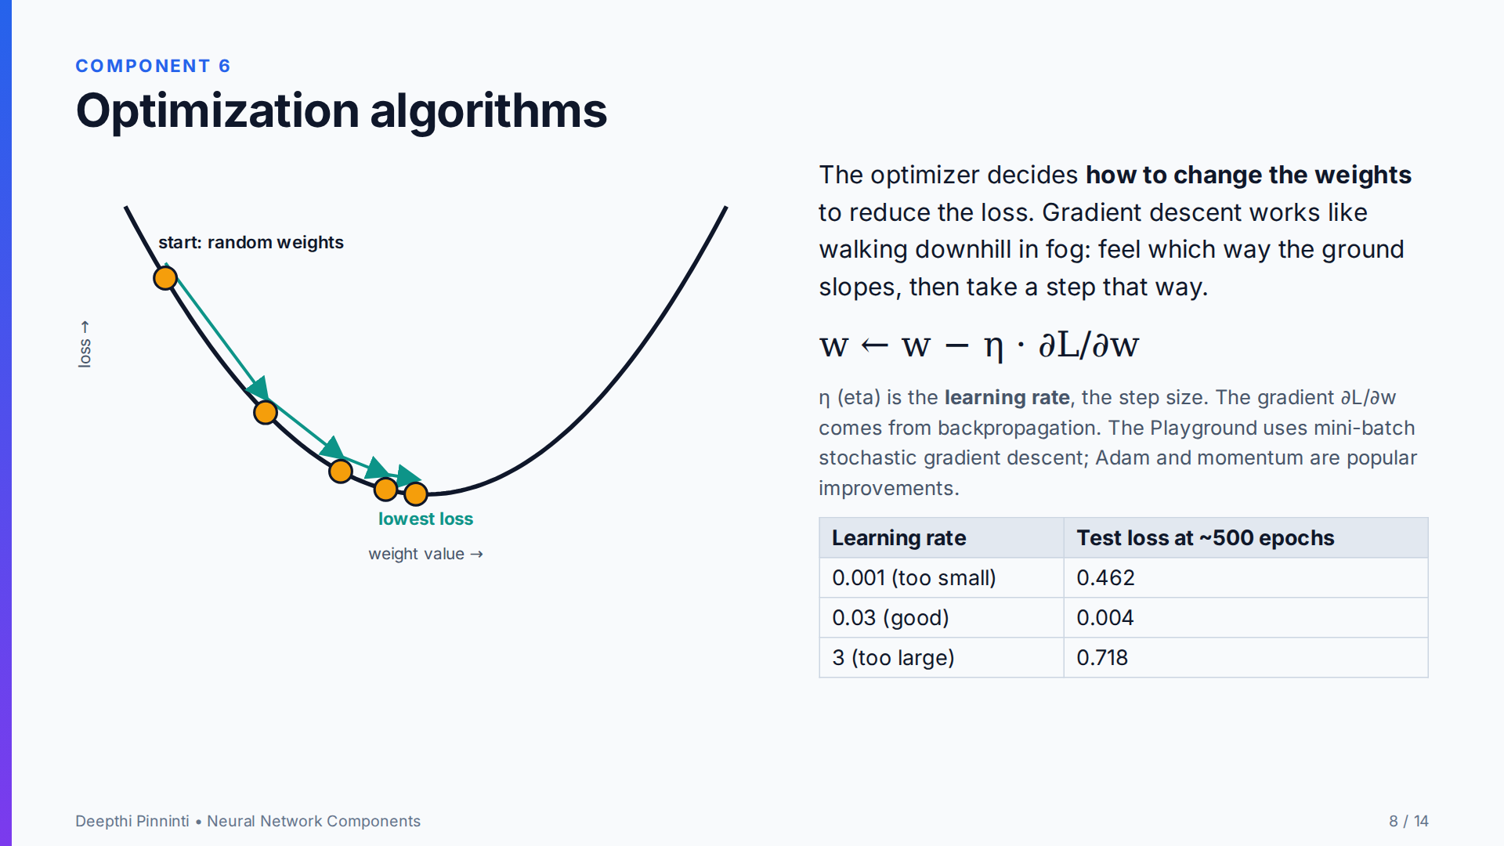
Notes:
The optimizer is gradient descent. The learning rate controls the step size. Too small and it barely learns, too large and it overshoots. I tested three values on the circle data.

Slide 9
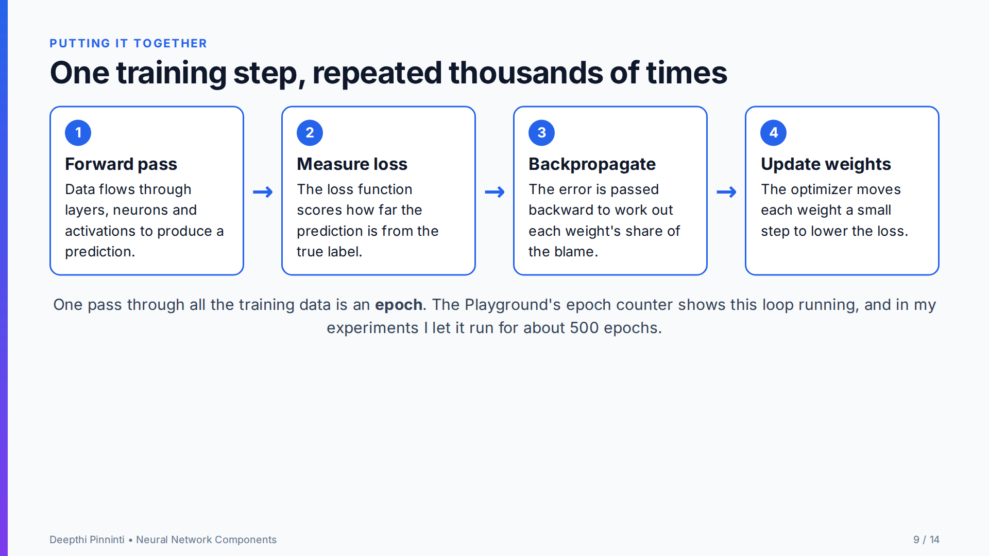
Notes:
This is the training loop that connects all six components. Forward pass, loss, backpropagation, update. One full pass over the data is an epoch.

Slide 10
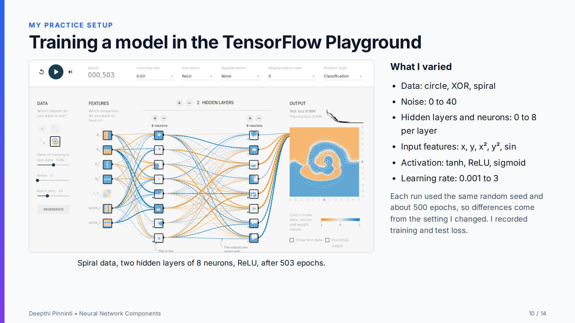
Notes:
This is the Playground setup I used. I changed one setting at a time and recorded training and test loss after about 500 epochs, using the same random seed so runs are comparable.

Slide 11
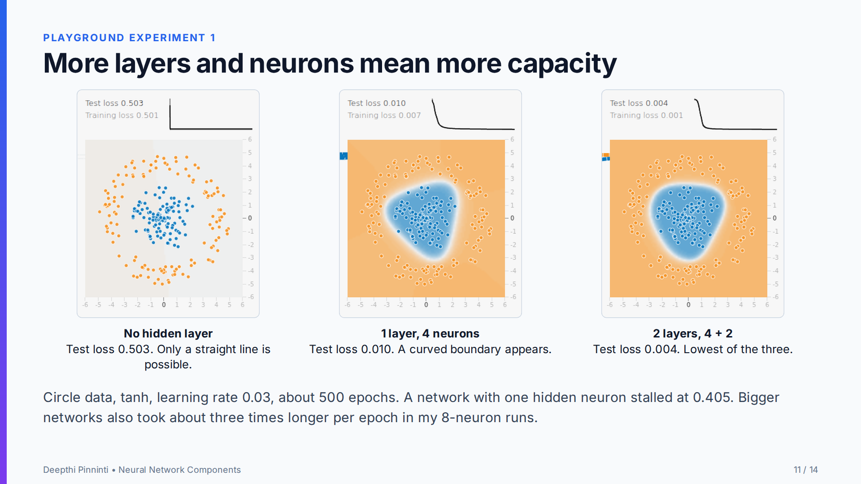
Notes:
The circle cannot be separated by a straight line. With no hidden layer the loss stays near 0.5. Adding neurons lets the network bend the boundary around the inner circle.

Slide 12
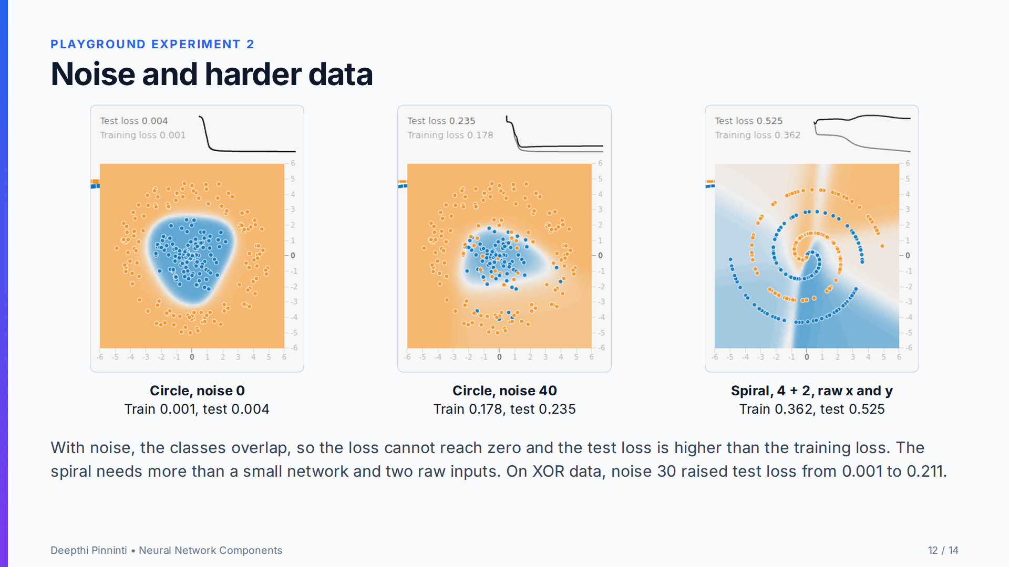
Notes:
Noise makes classes overlap, so even a good network cannot be perfect, and the gap between train and test loss grows. The spiral is much harder than the circle.

Slide 13
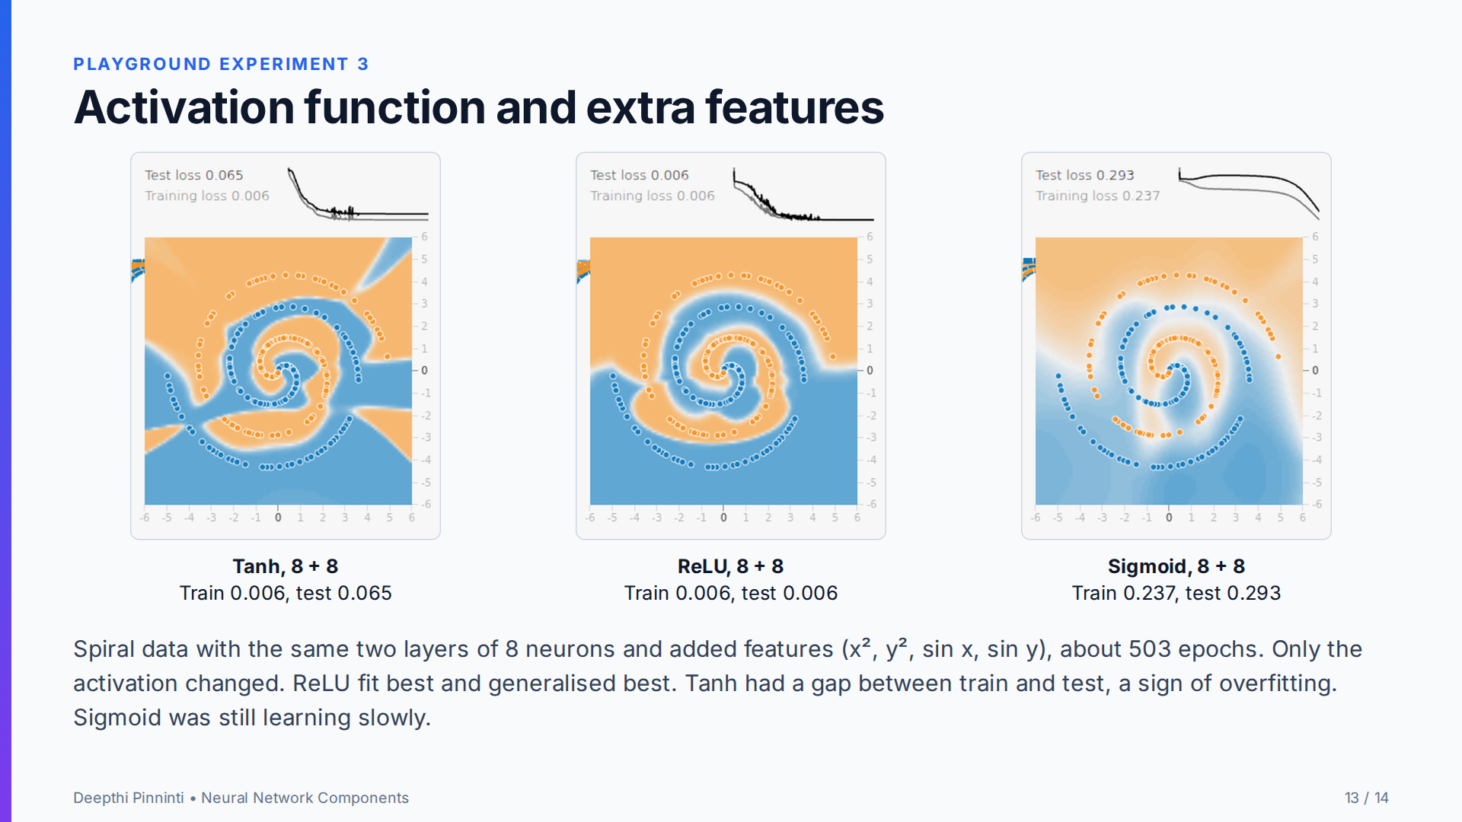
Notes:
All three runs used identical settings except the activation function. ReLU reached the lowest loss and generalised best. Tanh overfit slightly. Sigmoid learned slowly.

Slide 14
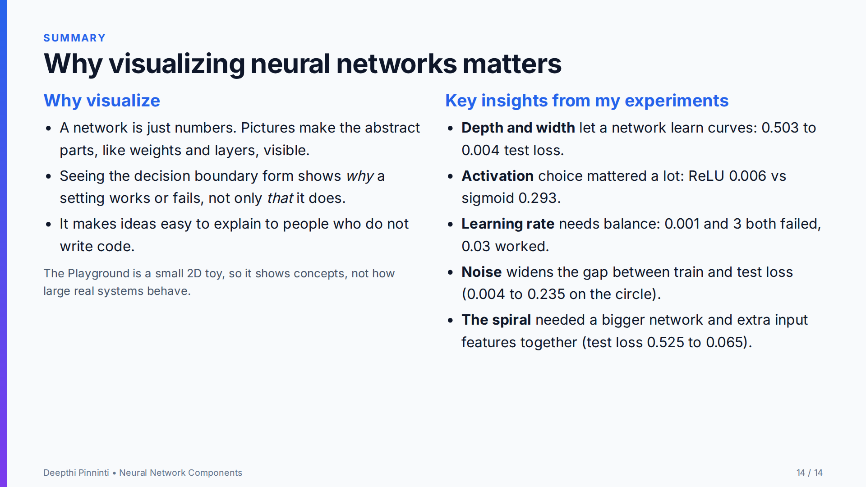
Notes:
To finish: visualization turns abstract numbers into something you can see and explain. The experiments showed that layers, activation, learning rate and data quality all change the result, and I could see each effect directly.

