Slide 1

CL-AFF Shared Task – In Pursuit Of Happiness
Presented By
Group 17

Slide 2
1
Introduction to the Problem Statement and Motivation
What is In Pursuit of Happiness?
In Pursuit of happiness is an interesting field of research where the problem statement is to understand, define & quantify “Happiness” in short, it is an attempt to answer the question, “What makes one happy?”
Motivation
This understanding has many business use cases such as answering “What are the popular sports/movies/books/purchased products/tourist destinations that make people happy?”
Thus modelling happiness and analysis of happy moments can be a major help to many avenues.

Slide 3
1
Task Divison and Our Focus
The Task:
GIVEN: An account of a happy moment, marked with individual's demographics, recollection time and relevant labels.
TASK 1: WHAT ARE THE INGREDIENTS FOR HAPPINESS ?
Semi-supervised learning task: Predict agency and social labels
TASK 2: HOW CAN WE MODEL HAPPINESS ?
Unsupervised task: Propose new characterizations and insights (not necessarily and not limited to themes) for happy moments in the test set, e.g., in terms of affect, emotion, participants and content.
Our Major Focus
We have proposed several deep learning models to achieve Task 1 i.e. predicting agency and social labels for the happy moments.

Slide 4

1
Data Analysis

Slide 5
1
Dataset Description and Source
The dataset we have used is HappyDB Corpus, a corpus of crowd-sourced happy moments published by Megagon Labs.
It is a labelled data with 10,560 entries of happy moments.
Each entry has single-sentence happy moments from the available HappyDBcorpus, annotated with demographic labels of the author, as well as labels that are agency, social and concept labels.
The features in dataset includes happy ‘moment’, information of author like ‘age’, ‘country’, ‘gender’, ‘married’, ‘parenthood’ and features indicating time effect of happy moment like ‘reflection’ and ‘duration’.

Slide 6
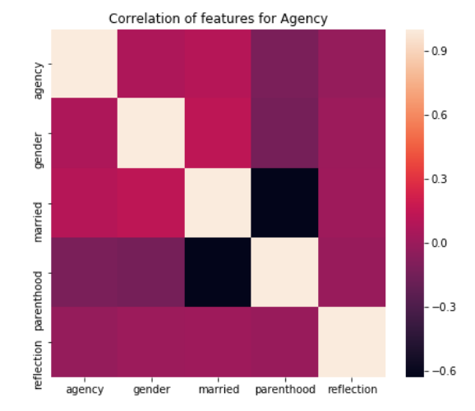
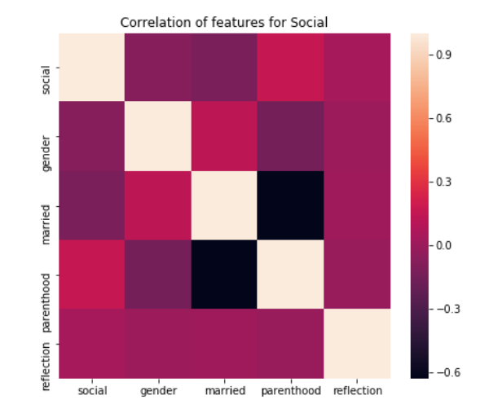
1
Correlation Between Features
We have perform correlation analysis between features to isolate the features we need to work on and their dependent features if any.

Slide 7
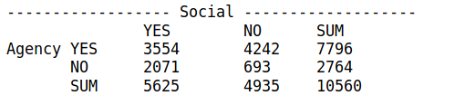
<number>
Label Based Analysis
According to Task 1, we need to predict agency and social, both binary features.
Agency: focus of control of author
Social: conceptualizes interpersonal engagement in the moment
Data Distribution for Agency and Social :
The data thus seems a little skewed with more positive responses for Social label than for Agency label. **

Slide 8
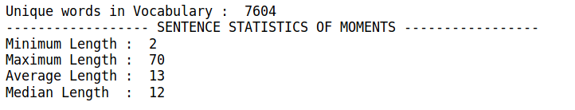
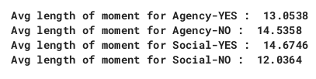
<number>
Moments Statistics
The moment description has the following statistics :
Sentence Level Stats:
Sentence Level Stats based on labels ( Yes/No) :
These stats will help us take better decisions for data prepocessing before we feed the data to our model. **

Slide 9
<number>
We have come up with various approaches to achieve Task 1.
The section after this deals with each model in-depth, followed by an analysis of the best suitable model.
So, let’s start..

Slide 10
1. Baseline Model

Slide 11
<number>
Model Details
The baseline follows a simple rule-based approach.
The classifier predicts “YES” for all the moments for both the labels, agency and social.
The model was evaluated on the following metric:
 | Agency | Social
Accuracy | 73.82% | 53.26%

Slide 12
2. XGBoost Classifier

Slide 13
This model focusses on profile features( age,gender,country,married,parenthood,reflection, and duration ) excluding the actual moment.
The data was preprocessed by performing label encoding for the features as follows :
-> gender - [0:f, 1:m, 2:nan, 3:o]
-> married - [0:divorced, 1:married, 2:nan
3:separated, 4:single, 5:widowed]
-> parenthood - [0:n, 1:nan, 2:y]
-> reflection - [0:24h, 1:3m]
<number>
Model Details

Slide 14
<number>
Model Evaluation
And Conclusion
The model obtained the following score on our evaluation metric:
The model fails to provide accuracy better than our baseline model. Why?
Can we use profile features to represent our happy moments and predict agency and social?
Can this model be used anywhere?
 | Agency | Social
Accuracy | 61.2% | 72.83%

Slide 15
3. Text Based Feature Engineering

Slide 16
<number>
Model Details
This models uses the n-gram approach to build features out of the moment.
For the purpose, we used n=4 and created n-grams along with preprocessing steps like stop word removal and stemming done on them.
The 4-grams were then represented as TF-IDF features and fed to the model for prediction.
We have compared accuracies on several models and the following results were obtained.

Slide 17
<number>
Model Evaluation
And Conclusion
The model obtained the following score on our evaluation metrics:
Model | Agency (Accuracy) | Social (Accuracy)
Naive Bayes | 50.19% | 72.54%
Logistic Regression | 50% | 72.92%
XGBoost Forest | 58% | 74.59%
NN with 2 hidden layers | 49.19% | 74.61%

Slide 18
3. Emotion Based Feature Engg.

Slide 19
<number>
Model Details
In this model, we follow the bottom up approach i.e. studying the moments to define features.
Social is a happy moment involving more than one person.
So can we identify if there is more than one person involved?
We use POS Tagging to identify this. Part Of Speech tags sequence that repeats might help us to make a rule for identifying socially influenced moments.

Slide 20




For this purpose, we use POS Tagging to find out patterns that indicate presence of more than one person.
Social = YES
<number>
POS Tagging For Social
Moment data | POS tag
I was happy when my son got 90% marks in his examination
My father bought me a bicycle.
Social = NO
Moment Data | POS tag
I cooked a new recipe for dinner and it turned out great
I got an A on the test that I barely studied for.

Slide 21
<number>
Observations on Social POS Tagging
Conclusion for Social Label
Social = YES
Presence of Pronoun followed by JJ*NN or presence of IN followed by NNS has high probability of the sentence being a Social Happy Moment.
Social = NO
Typically, all the non-social moments only involve I or just a statement. With the previous observations, we concluded the below:
Do not remove stopwords. Or do not include pronouns in the stopword list.
Do not stem the words. Friends & friend may impact the prediction.
Try building Bag of words with the relevant pos tags.

Slide 22
Using POS Tagging is rather tricky for agency since the moments are very concise. However, we offer two intuitive hypothesis for agency:
Hypothesis 1: Agent not in control is not verbose
Experiment : The average lengths of both yes and no values of agency are 13.05 and 14.53 which are not similar.
Hence we cannot use this hypothesis.
Hypothesis 2 : Use of neutral sentiments when agent is in control
Experiment: We manually examined a sample of both the classes of agency with Semantria Lexalytics tool to calculate the sentiment of given sentences.
<number>
Agency Hypothesis
Agency | Sentence | Sentiment
YES | went to movies with my friends it was fun | 0.550
YES | The day I got my degree in industrial engineering | 0.0
NO | My father bought me a bicycle. | 0.0
NO | My girlfriend told me she is really happy with me and that she was happy she met me. | 0.68

Slide 23
<number>
Observations on Agency Hypothesis and Analysis
Conclusion for Agency Hypothesis
Our hypothesis fails since we did not notice any useful pattern in both classes.
Emotion Features don’t map Agency well !!
Model Summary
Model | Preprocessing | Features | Feature Representation | Social | Agency
XGBoost Forest | POS Tagging | Noun Phrases | TFIDF | 84 | 76.39%
XGBoost Forest | POS Tagging | All except verbs, punct, adjectives & adverbs | Word2Vec | 88.9% | NA
XGBoost Forest | POS Tagging | All except adjectives & adverbs | Word2Vec | NA | 82.53%

Slide 24
4. Convolutional Neural Network

Slide 25
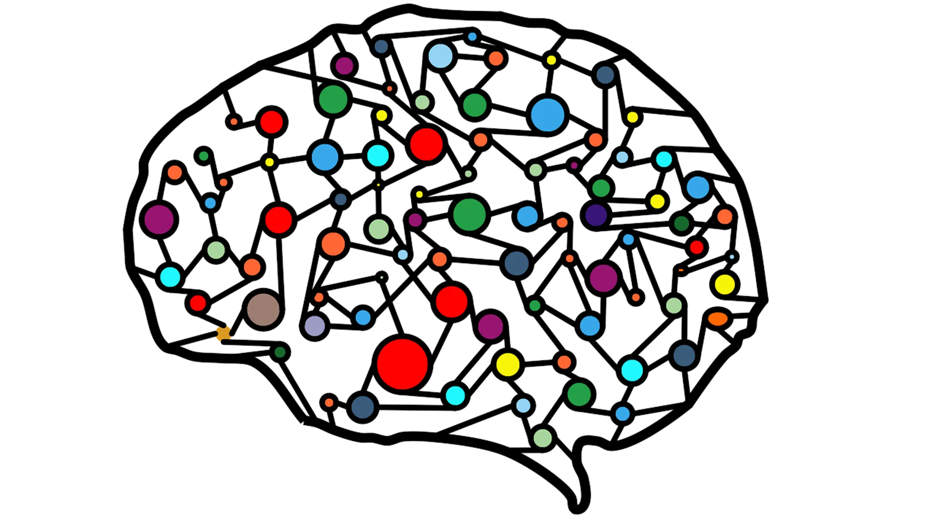
<number>
Model Details
We now use deep learning to tackle task 1.
The model workflow is as follows:
Data Preprocessing
Sentence Padding
1. Sentences -> Bag Of words
2. Stop Word Removal
3. Punctuation removal
(except for don’t : dont)
Label Vectorization
Pre-pad sentences
with 0s to
make them of
same length
CNN Model
The agency and
Social labels:
One Hot
Encoded

Slide 26
<number>
Preprocessi-ng Details
The Bag Of Words representation is used to construct an index.
Every word is given a number except 0 (reserved for padding)
The sentences are converted to vectors containing word numbers. Hence sentences are vectorized.
All sentences are pruned or padded to be of the same length. We have set the max length to 20.

Slide 27
<number>
GloVe :
Pre-Trained &
Trained on HappyDB
We use GloVe word embeddings for better representation of the sentences.
The model is evaluated first on pre-trained word embeddings ( trained from twitter data of 100 dim vectors ).
The word embeddings are then trained on the sentences that we have in the happy moments of the dataset.
Since the dataset is limited, pre-trained embeddings give us a better accuracy for both agency and social labels.

Slide 28
<number>
CNN Model Design
Embedding Layer
Convolutional Layer
1D
The layer tranforms
2D matrix to 1D
using filters/kernel
Dropout Layer
reduce overfitting
&
improve
generalization error
(value = 0.2)
Input :
Padded 1D Sentences
Ouput :
2D repsresentation (20 x 100)
Dense Layers
( 2 detached)
Max Pooling Layer

Slide 29
<number>
Contd Model Details..
The embeddings in the embedding layer are : randomly initialized, pre-trained glove and trained on corpus Glove. They are kept fixed throughout the training.
A 1D convolutional layer, generally used for NLP, employs a kernel that slides over 2D input, producing a 1D output of max length.
After convolving the data, dropout and max pooling are performed.
We run the model twice, once for predicting agency and then for social.

Slide 30
<number>
Model Evaluation
Model Evaluation has yielded the following results:
Model | Embeddings | Social | Agency
CNN | Randomly initialized | 88.46% | 82.177%
CNN | Pre-Trained GloVe | 89% | 83.08%
CNN | GloVe trained on Corpus | 80.6% | 81.065%

Slide 31
<number>
Conclusion

Slide 32
<number>
Future Work

Slide 33
<number>
References
The CL-Aff Happiness Shared Task: Results andKey Insights paper by Kokil Jaidka et al.
CruzAffect at AffCon 2019 Shared Task:A feature-rich approach to characterize happiness paper by Jiaqi Wu et al.
[CL-Aff Shared Task] Happiness IngredientsDetection using Multi-Task Deep Learning paper by Weizhao Xin and Diana Inkpen.

Slide 34
<number>
Thanks!
Find the code here: https://github.com/DeepthiKarnam00/InPursuitOfHappiness
Hope you learnt something new..

Slide 35
<number>
Big concept
Just in case we need this slide for design

