Slide 1
ASP . NET CORE
DEEPTHI R

Slide 2
Introduction to ASP.NET Core
ASP.NET Core is a cross-platform, high-performance, open-source framework for building modern, cloud-based, Internet-connected applications. With ASP.NET Core, you can:
Build web apps and services, IoT apps, and mobile backends.
Use your favorite development tools on Windows, macOS, and Linux.
Deploy to the cloud or on-premises.
Run on .NET Core or .NET Framework.

Slide 3
Why choose ASP.NET Core?
ASP.NET Core provides the following benefits:
A unified story for building web UI and web APIs.
Architected for testability.
Razor Pages makes coding page-focused scenarios easier and more productive.
Blazor lets you use C# in the browser alongside JavaScript. Share server-side and client-side app logic all written with .NET.
Ability to develop and run on Windows, macOS, and Linux.
Open-source and community-focused.
Integration of modern, client-side frameworks and development workflows.

Slide 4
Support for hosting Remote Procedure Call (RPC) services using gRPC.
A cloud-ready, environment-based configuration system.
Built-in dependency injection.
A lightweight, high-performance, and modular HTTP request pipeline.
Ability to host on the following:
Kestrel
IIS
HTTP.sys
Nginx
Apache
Docker
Side-by-side versioning.
Tooling that simplifies modern web development.

Slide 5
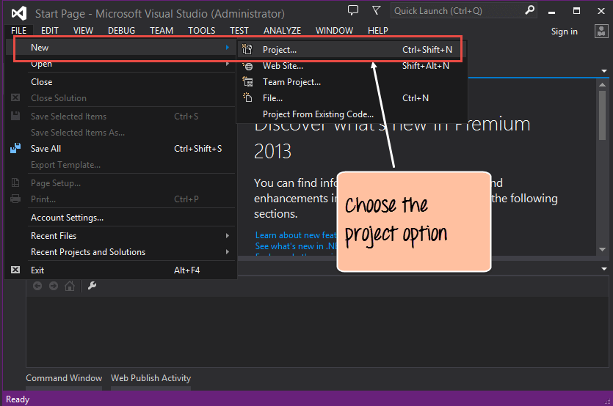

Slide 6
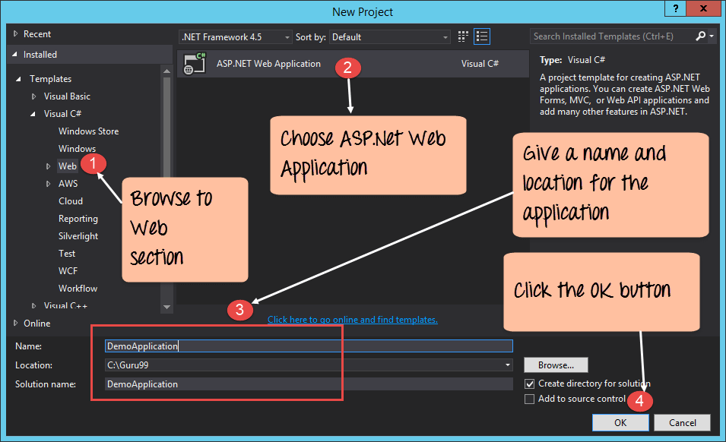

Slide 7
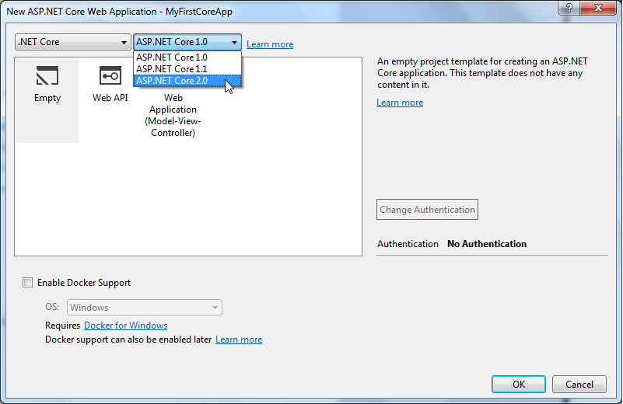

Slide 8
