Slide 1

DEEPTHI SUDHARSAN (CB.EN.U4AIE19022) SARATHI T S (CB.EN.U4AIE19058) ASMITHA U (CB.EN.U4AIE19065) ROSHAN TUSHAR S (CB.EN.U4AIE19071)
TEAM - 7

Slide 2
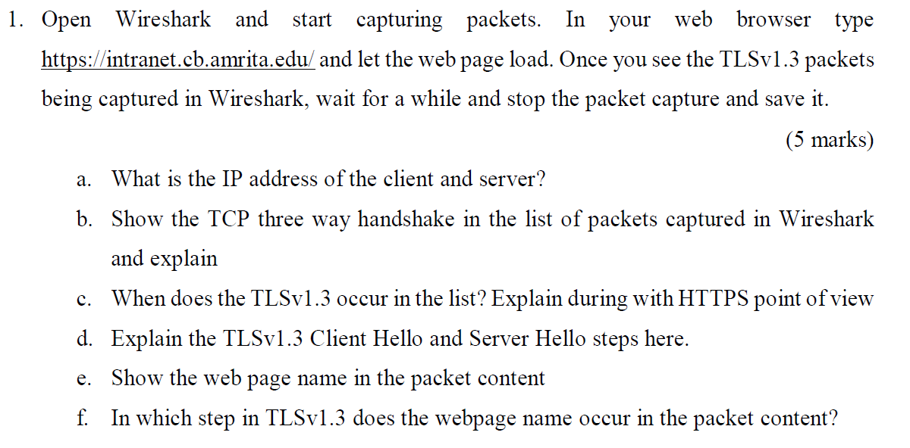
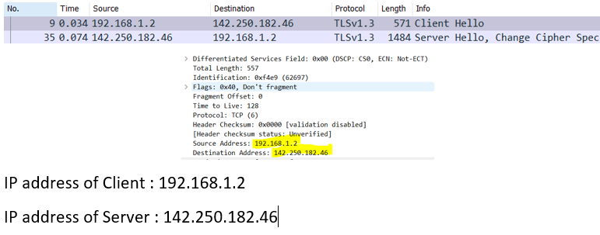

Slide 3
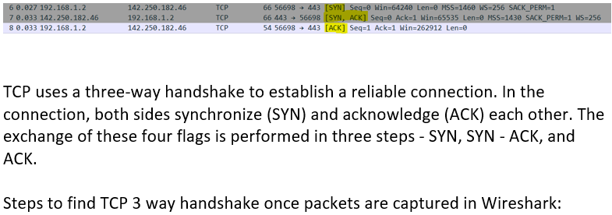
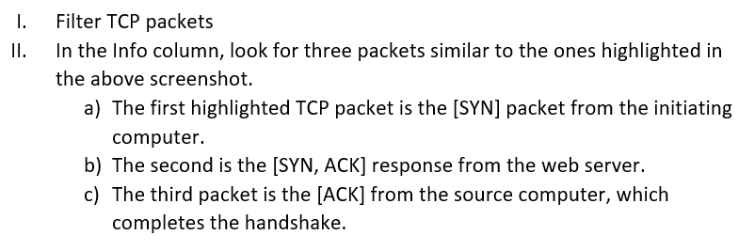

Slide 4
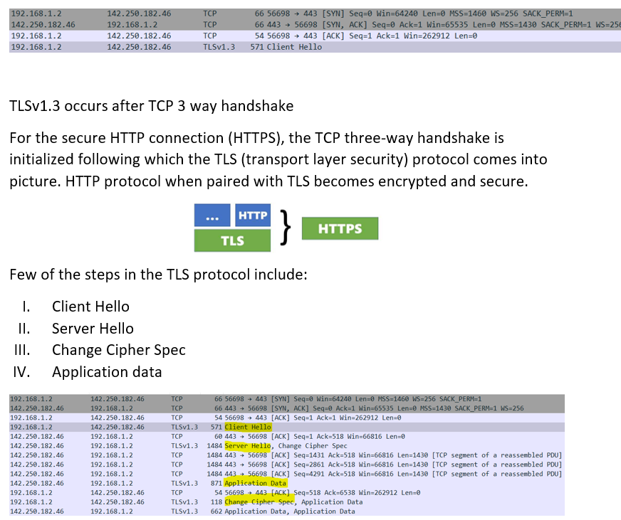

Slide 5
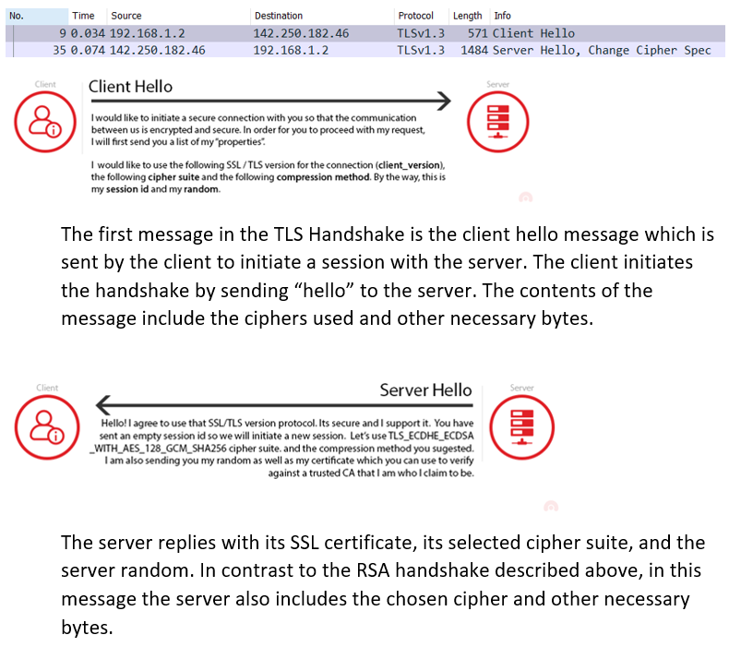

Slide 6
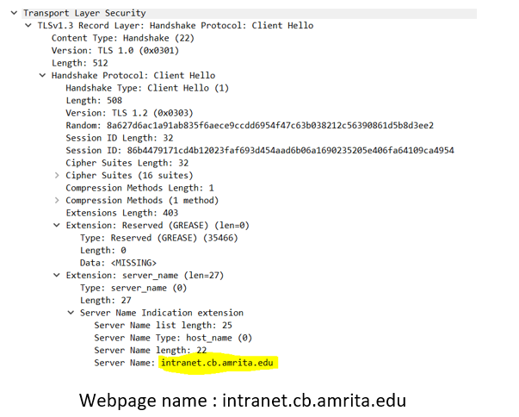
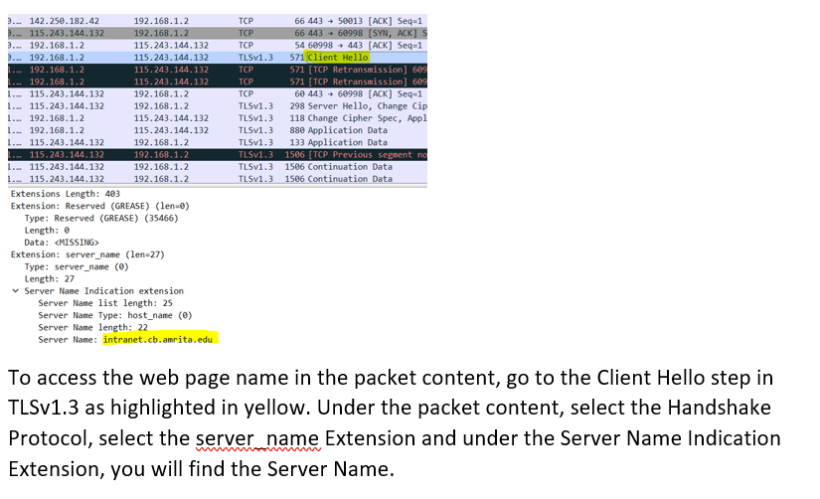

Slide 7

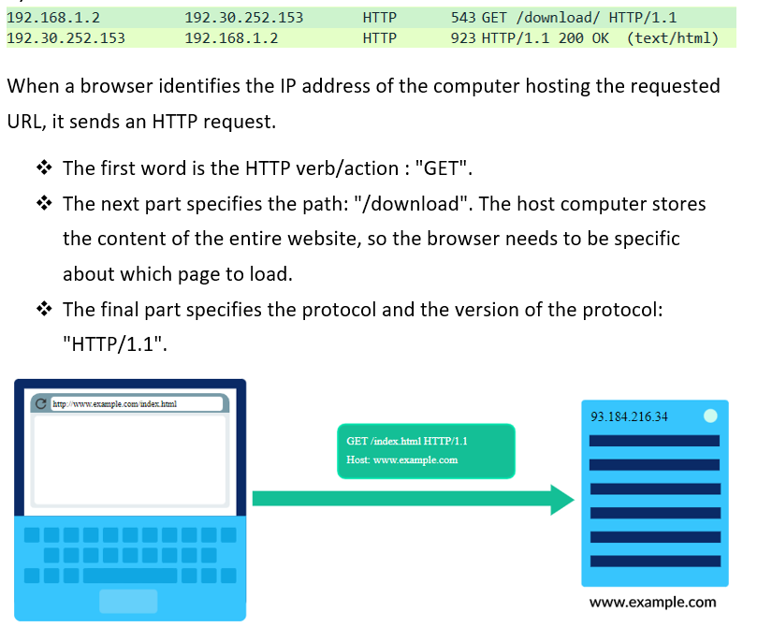
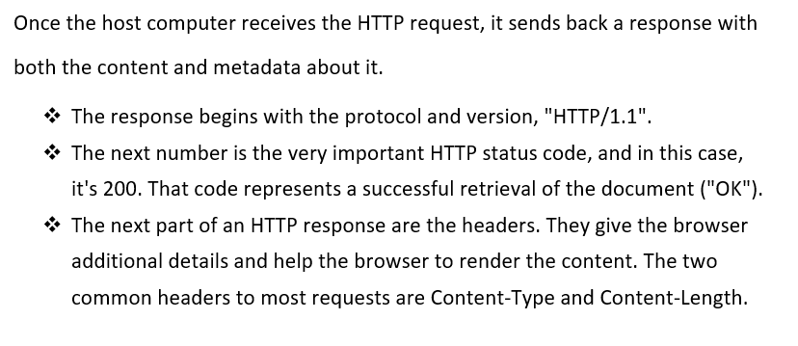

Slide 8
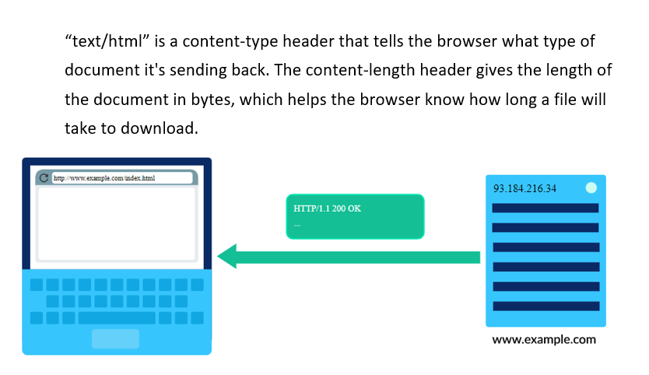


Slide 9

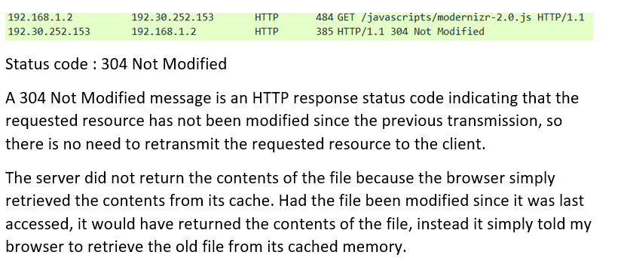
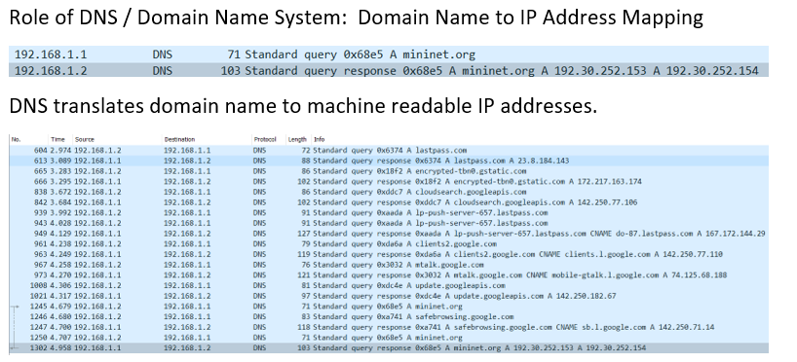

Slide 10
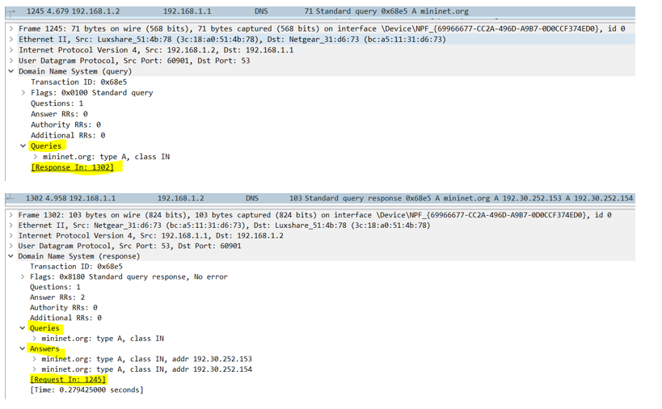
DNS uses the User Datagram Protocol (UDP) to serve DNS queries. UDP is preferred because it is fast and has low overhead (its packets have a smaller header and therefore take less bandwidth to send the payload/the data compared to TCP). A DNS query is a single UDP request from the DNS client followed by a single UDP reply from the server.

Slide 11
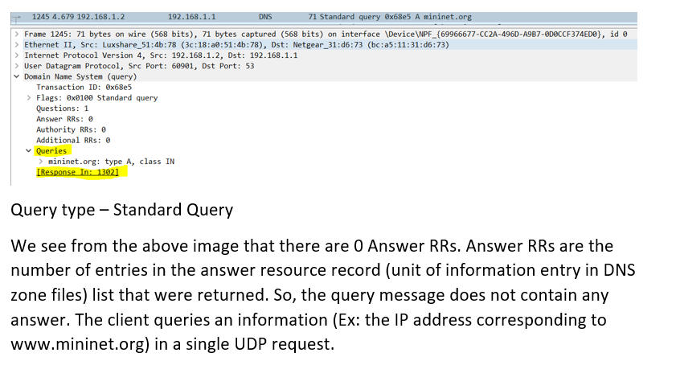

Slide 12
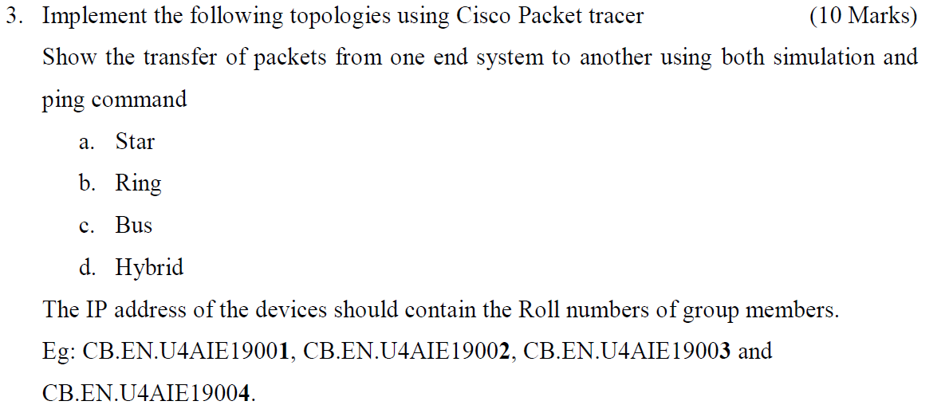
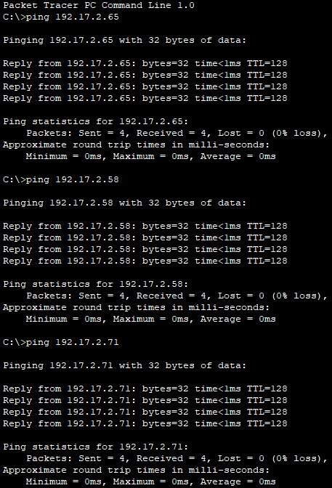
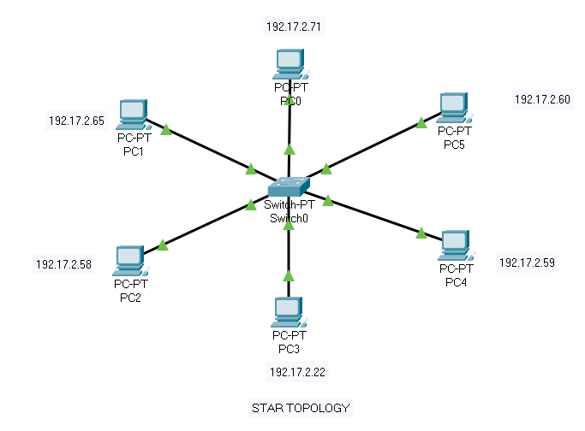
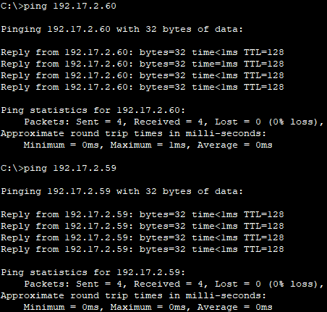
Each individual piece of a network is attached to a central node (often called a hub or switch).

Slide 13
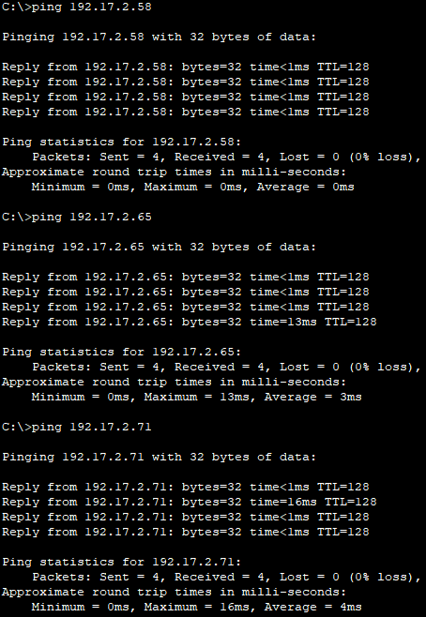
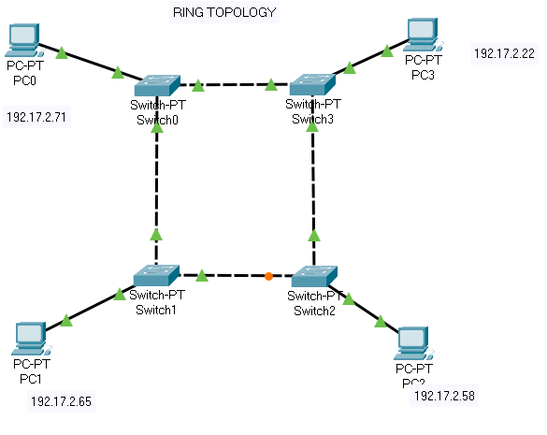
Network configuration where device connections create a circular data path.

Slide 14
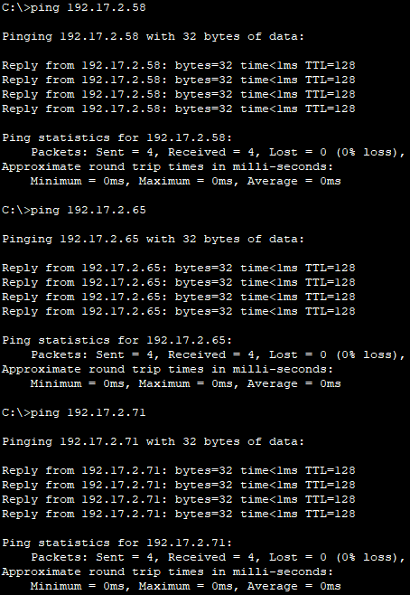
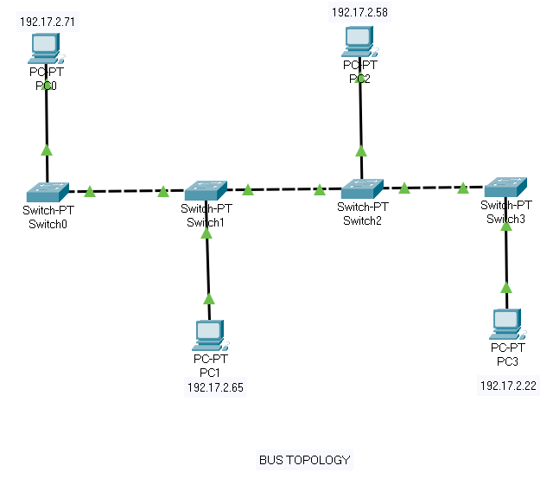
A topology for a Local Area Network (LAN) in which all the nodes are connected to a single cable.

Slide 15

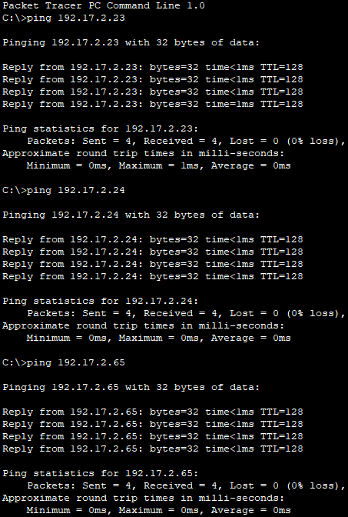
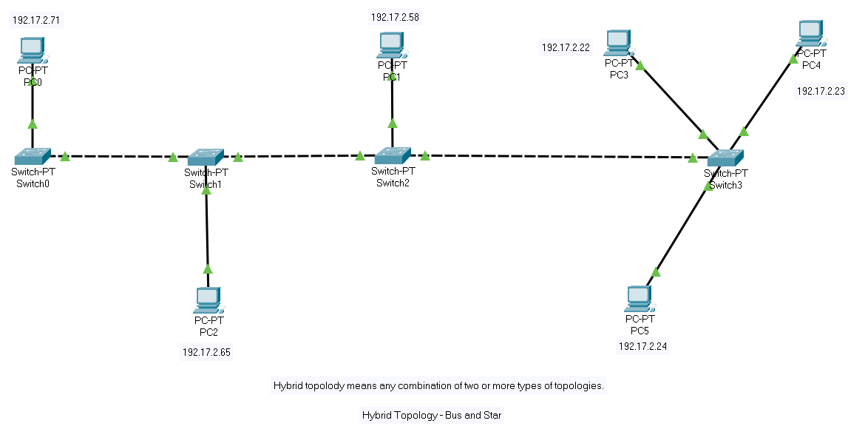
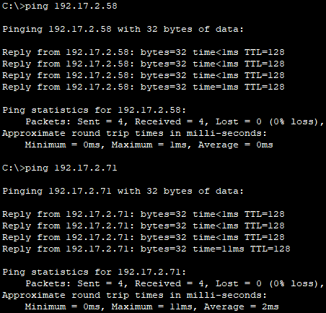
Network topology that is a combination of two or more network topologie

