Slide 1
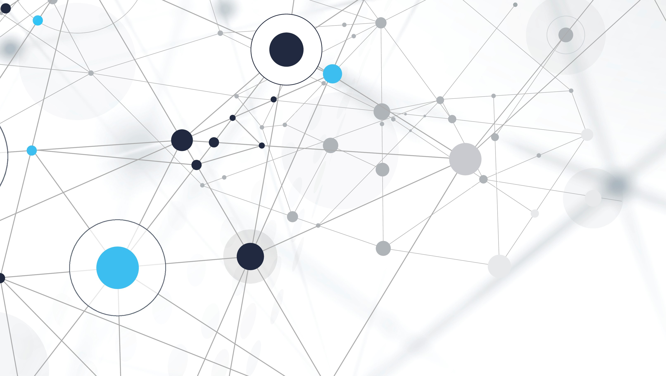
DEEPTHI SUDHARSAN (CB.EN.U4AIE19022) SARATHI T S (CB.EN.U4AIE19058) ASMITHA U (CB.EN.U4AIE19065) ROSHAN TUSHAR S (CB.EN.U4AIE19071)
TEAM - 7

Slide 2
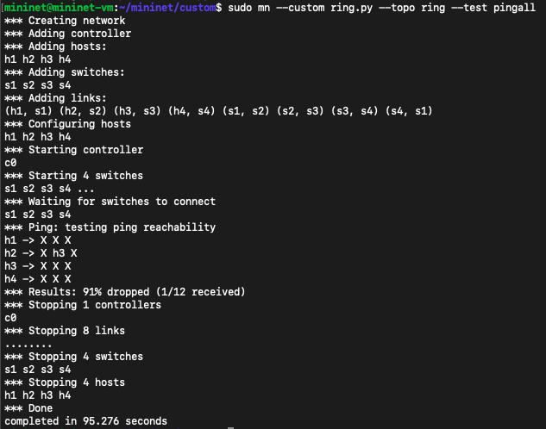
Mininet is a software emulator for prototyping a large network on a single machine.
RING TOPOLOGY
Network configuration where device connections create a circular data path.

Slide 3
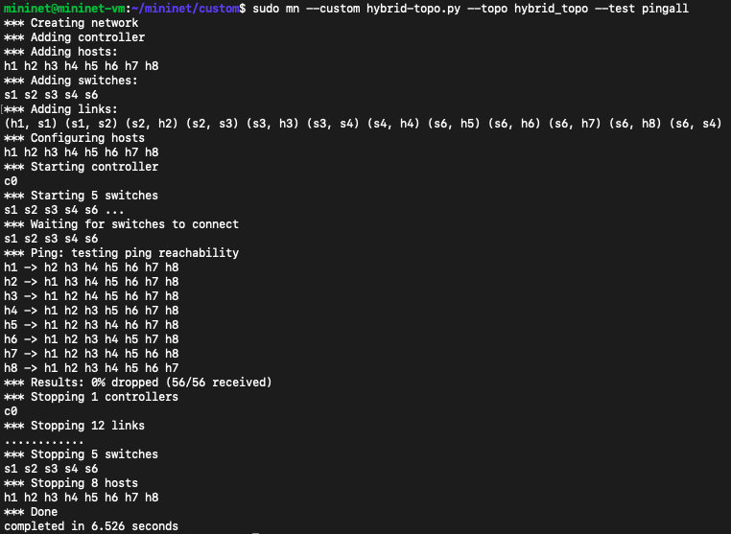
HYBRID TOPOLOGY
Network topology that is a combination of two or more network topology

Slide 4
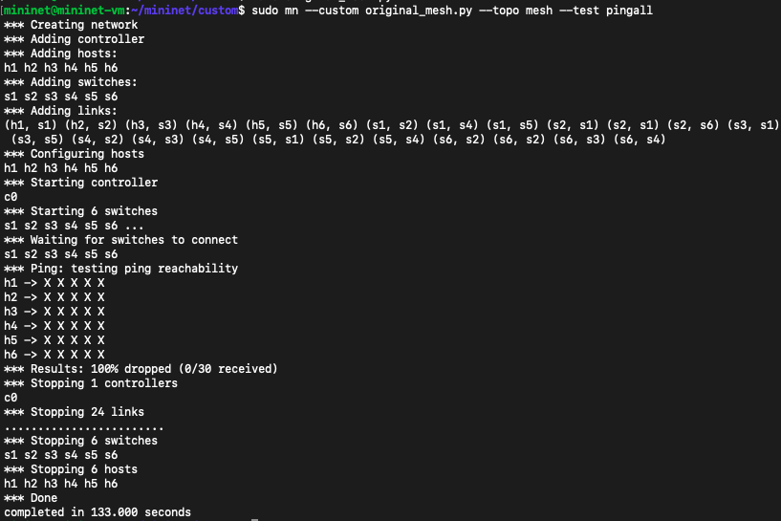
MESH TOPOLOGY
A mesh network is a local network topology in which the infrastructure nodes connect directly, dynamically and non-hierarchically to as many other nodes as possible and cooperate with one another to efficiently route data from/to clients.

Slide 5
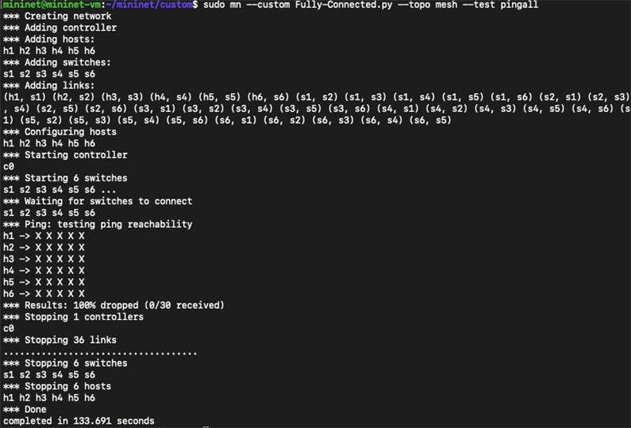
FULLY CONNECTED TOPOLOGY
A network topology in which there is a direct path (branch) between any two nodes.

