Slide 1

Automated Animal Feeding and Smart Parking System
19AIE114 PROJECT
Deepthi Sudharsan (CB.EN.U4AIE19022)
Kavya S Kumar (CB.EN.U4AIE19037)
Meghna B Menon (CB.EN.U4AIE19043)

Slide 2
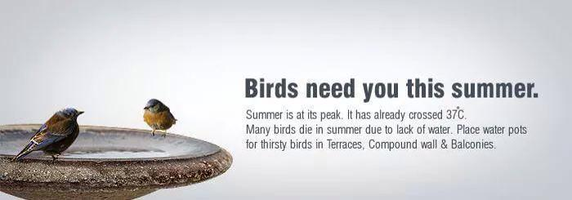
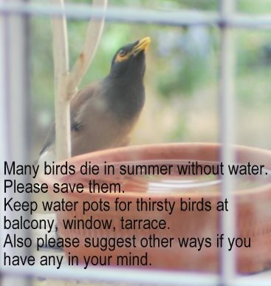
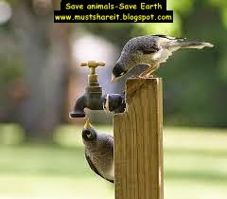


Automated Animal Feeding using
Ultrasonic and PIR Motion Sensor
Summers are cruel to all alike, but birds and stray animals find it harder to survive the heat without shade or water to quench their thirst.
Birds fly for miles to get to a water body and many die before they get any closer. Stray animals are no different, in the winters they struggle for food and in summers, water.

Slide 3



Our project helps these animals and birds survive summer at the same time eases the process for us. It refills the dishes of water automatically by attaching sensors to detect low levels of water, ensuring a full dish of water for our little friends at all times.
But our project is not only for the animals outside our houses, it is also for our beloved pets. Instead of having to fill water bowls for our pets every time, this automatic refilling pet bowl fills it for them, so our pets will never go thirsty.

Slide 4
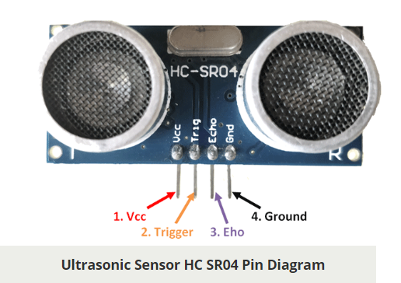
HC-SR04 WORKING
HC-SR04 Ultrasonic (US) sensor is a very popular sensor used in many applications where measuring distance or sensing objects are required. The module has two eyes like projects in the front which forms the Ultrasonic transmitter and Receiver.

Slide 5
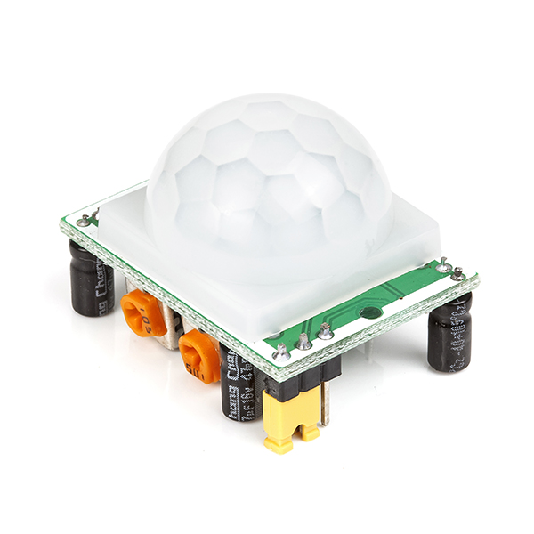
PIR MOTION SENSOR WORKING
PIR sensor detects a human being moving around within approximately 10m from the sensor. This is an average value, as the actual detection range is between 5m and 12m.PIR are fundamentally made of a pyro electric sensor, which can detect levels of infrared radiation. PIR sensors are incredible, they are flat control and minimal effort, have a wide lens range, and are simple to interface with.

Slide 6
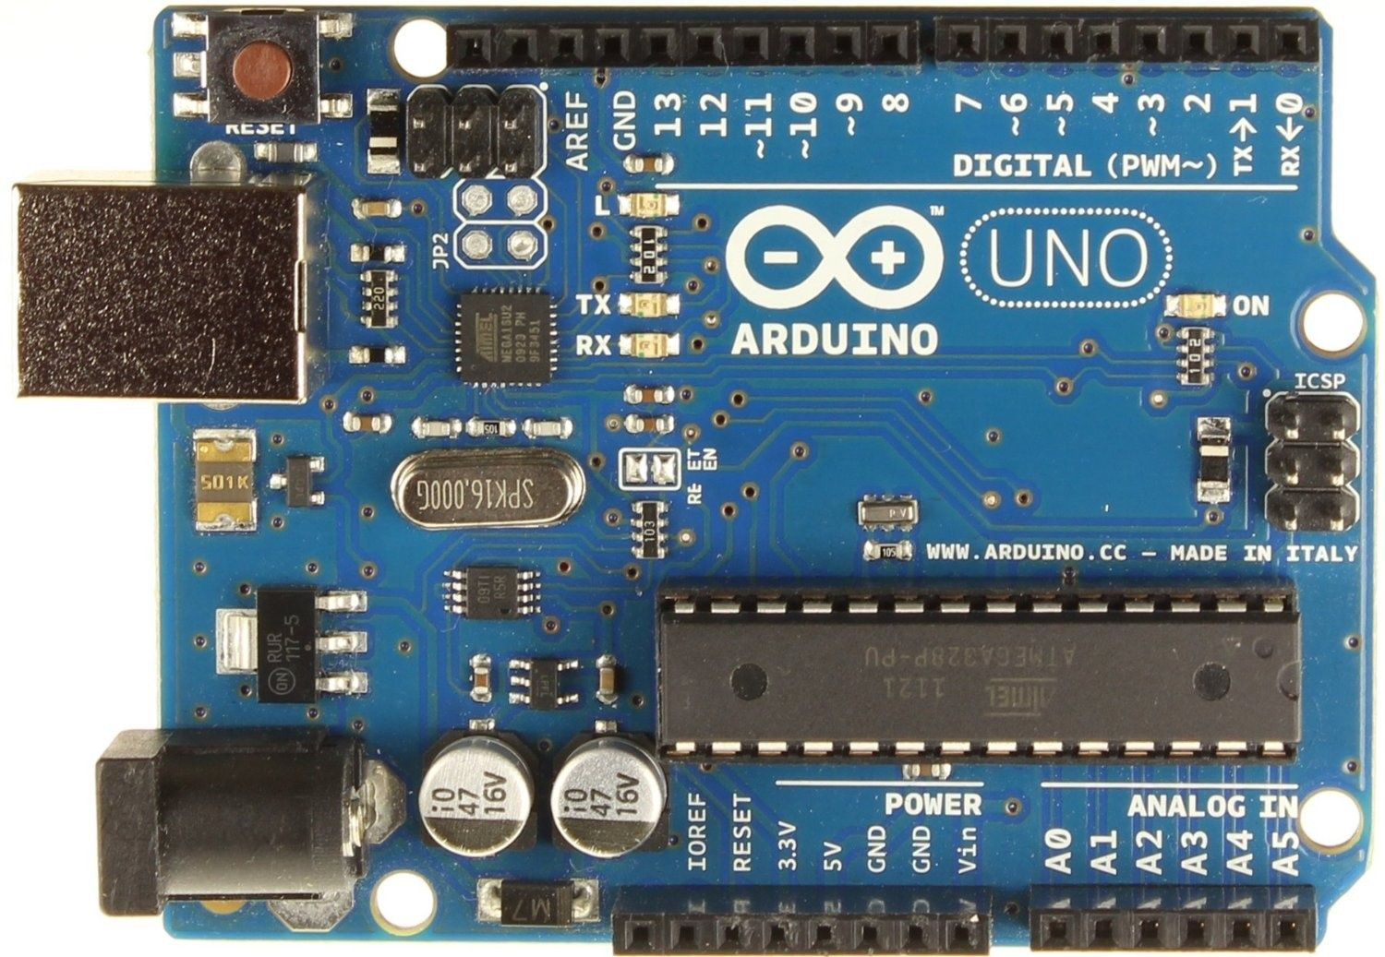
COMPONENTS AND TOOLS REQUIRED
COMPONENTS :
ARDUINO UNO
ULTRASONIC SENSOR
PIR MOTION SENSOR
SERVOMOTOR
BREAD BOARD
CONNECTING WIRES
TOOLS:
TINKERCAD CIRCUIT AND 3D DESIGNS

Slide 7
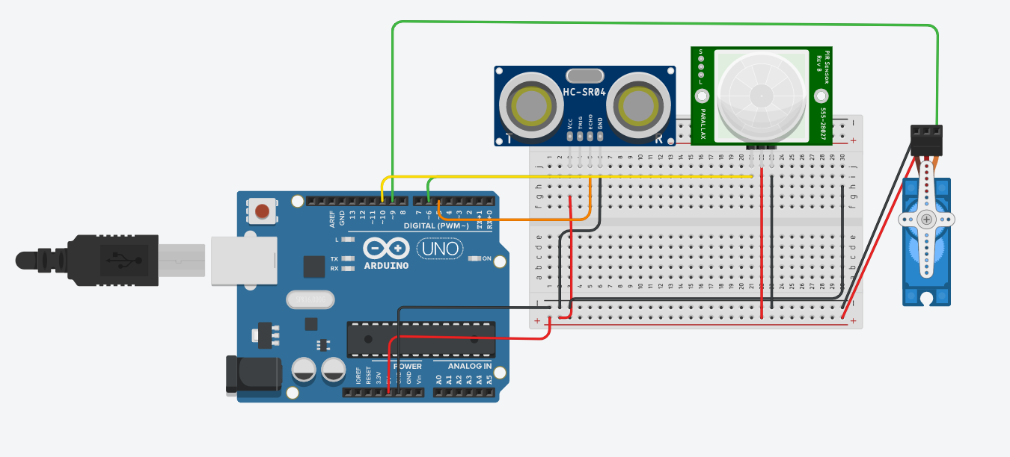
CIRCUIT DESIGN

Slide 8
WORKING LOGIC
The Ultrasonic Sensor is used to keep track of the level of water in the pet bowl. It is attached to a tank fixed at the side of the bowl facing downwards towards the water in the bowl.
The PIR Motion Sensor will detect the movement of any animal in its surrounding.
The bowl will refill when the PIR sensor detects an animal in front of the bowl and the ultrasonic sensor will detect the decrease in the level water and sends the signal to the tank, and the valve of the tank is opened to refill the bowl with the help of a motor attached near the valve.
During the refilling process, the Ultrasonic Sensor is used to prevent the overflowing or excessing filling of the pet bowl.

Slide 9
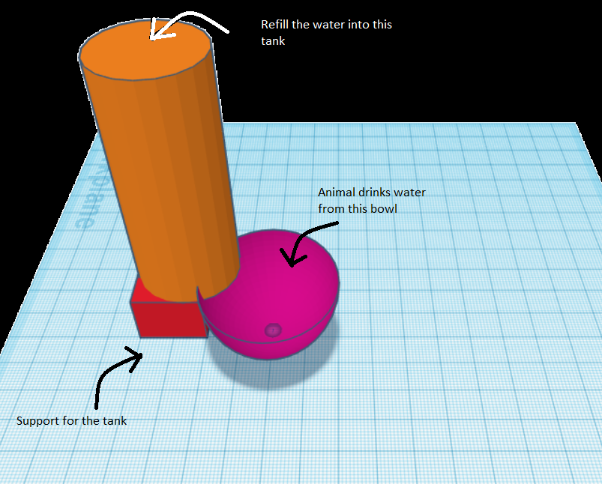
Basic 3D Modelling of the
Automated Animal Feeding System
Using TinkerCad
Basic 3D Modelling of the Automated Animal Feeding System Using TinkerCad
Top View of the System
The animal is expected to drink the water from the pink bowl and the cylinder represents the model of a tank in which we are expected to fill water when required.
The red cube represents the support for the tank as the tank is placed at a higher level.

Slide 10
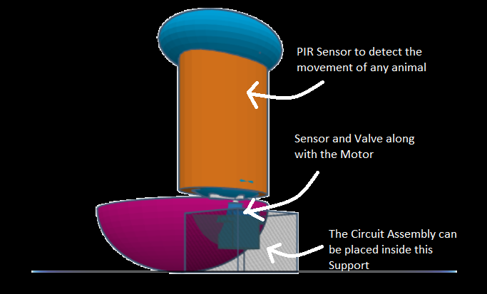
Side View of the System
SIDE VIEW OF THE SYSTEM
As we can see clearly from the above model, the tank is slightly immersed into a small portion of the bowl so that the sensor can detect the level of the water and if the water level is below a specific threshold distance then the valve (with the help of the motor) will open for the water from the tank to flow into the bowl.

Slide 11
CODE
#include <Servo.h> //Servo library
const int tPinf = 6, ePinf = 5,sPinf=10; //trig pin of sensors to pin 6 and 8
Servo myservo; //initialize a servo object for the connected servo
float pos = 0;
int val = LOW; // we start, assuming no motion detected
unsigned long timef;
unsigned long distancef;
void setup() {
pinMode(tPinf, OUTPUT); // Sets the trig pin as an output
pinMode(ePinf, INPUT); // Sets the echo pin as an input
pinMode(sPinf,INPUT);
Serial.begin(9600);
myservo.attach(9);
}

Slide 12
void loop() {
val = digitalRead(sPinf);
// Clears the trig pin
digitalWrite(tPinf, LOW); delayMicroseconds(2);
// Sets the trig pin on HIGH for 10 micro seconds
digitalWrite(tPinf, HIGH); delayMicroseconds(10);
digitalWrite(tPinf, LOW);
// Reads the echo pin, returns the sound wave travel time in microseconds
timef = pulseIn(ePinf, HIGH);
// Calculating the distance from time through velocity of air
distancef = timef*0.034/2.0;
// Conditions for buzzer
//The distance given, is for simulation in tinker-cad can be adjusted accordingly
if(distancef>30&&distancef<50&&val==HIGH){
Serial.println(distancef);
myservo.write(90);
}
if(distancef<20){
Serial.println(distancef);
myservo.write(0);
}
}

Slide 13
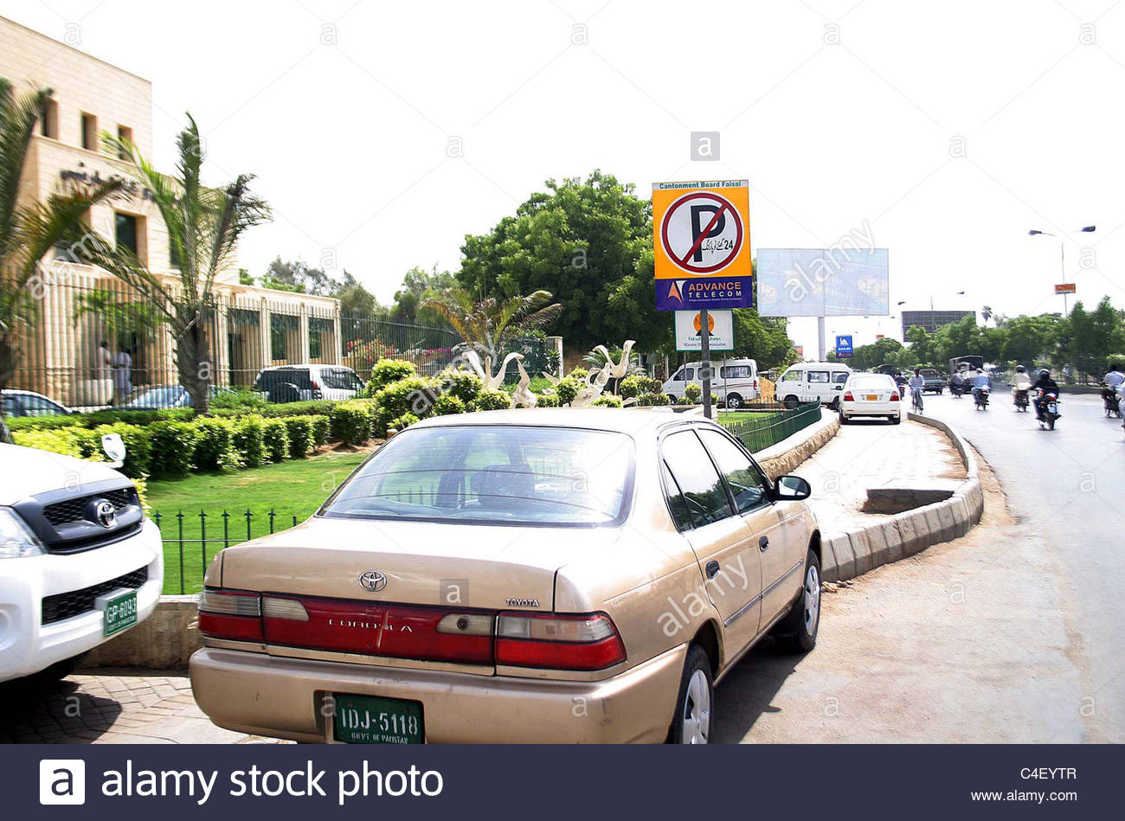
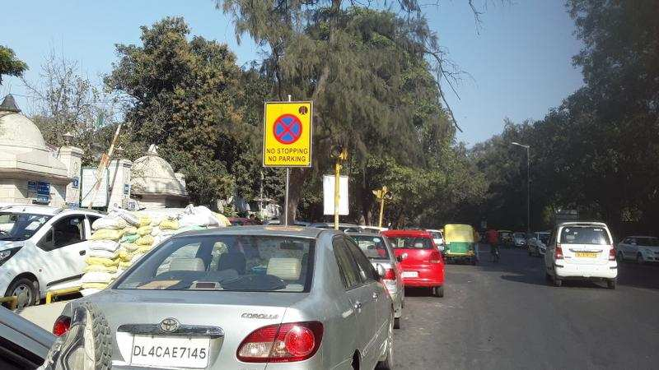
Smart Parking System using
Ultrasonic Sensor
A major problem in Indian metropolises is the skewed demand for on-street parking since it’s cheaper than off-street parking. On-street parking issues often cause delays, especially on roads with heavy traffic.
As we can often see parking in non-parking zones is very common in India.
Our project proposes a method to help reduce on- street parking in front of no-parking boards.

Slide 14
COMPONENTS AND TOOLS REQUIRED
COMPONENTS :
ARDUINO UNO
ULTRASONIC SENSORS
BREAD BOARD
CONNECTING WIRES
PIEZZO BUZZER
TOOLS:
TINKERCAD CIRCUITS

Slide 15
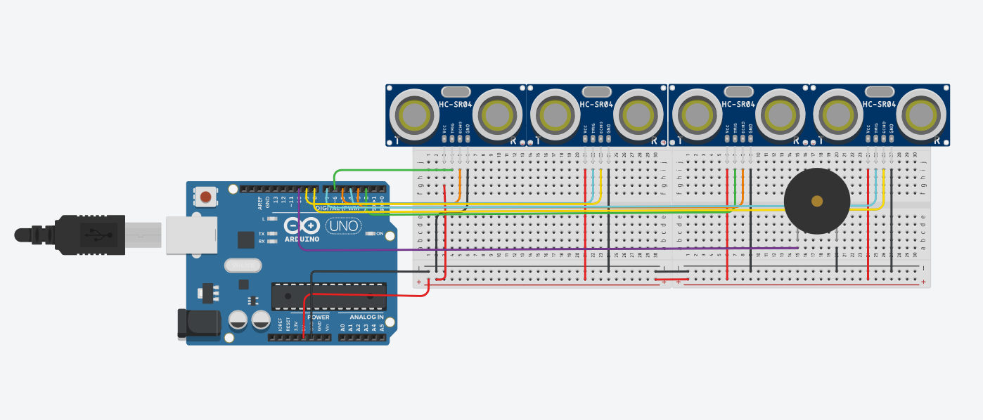
CIRCUIT DESIGN

Slide 16
WORKING LOGIC
The Ultrasonic Sensors are used to check if a car is parked at the no parking zone. These sensors are attached to the no parking signs and are used to detect the presence of a car. More number of Ultrasonic sensors are used to help tell apart whether the object (if present) within the cone range of the sensor is a car based on whether all the sensors are able to detect an object at the same time (as width of the car rear or front is more).

Slide 17
CODE
void loop() {
digitalWrite(tPin1, LOW); delayMicroseconds(2);
digitalWrite(tPin1, HIGH); delayMicroseconds(10);
digitalWrite(tPin1, LOW);
time1 = pulseIn(ePin1, HIGH);
digitalWrite(tPin2, LOW); delayMicroseconds(2);
digitalWrite(tPin2, HIGH); delayMicroseconds(10);
digitalWrite(tPin2, LOW);
time2 = pulseIn(ePin2, HIGH);
digitalWrite(tPin3, LOW); delayMicroseconds(2);
digitalWrite(tPin3, HIGH); delayMicroseconds(10);
digitalWrite(tPin3, LOW);
time3 = pulseIn(ePin3, HIGH);
digitalWrite(tPin4, LOW); delayMicroseconds(2);
digitalWrite(tPin4, HIGH); delayMicroseconds(10);
digitalWrite(tPin4, LOW);
time4 = pulseIn(ePin4, HIGH);
distance1 = time1*0.034/2.0;
distance2 = time2*0.034/2.0;
distance3 = time3*0.034/2.0;
distance4 = time4*0.034/2.0;
const int tPin1 = 6, ePin1 = 5;
const int tPin2 = 4, ePin2 = 9;
const int tPin3 = 2, ePin3 = 3;
const int tPin4 = 7, ePin4 = 8;
const int buzzer = 10;
int stop = 0;
unsigned long time1,time2,time3,time4;
unsigned long distance1,distance2,distance3,distance4;
void setup() {
pinMode(tPin1, OUTPUT);
pinMode(ePin1, INPUT);
pinMode(tPin2, OUTPUT);
pinMode(ePin2, INPUT);
pinMode(tPin3, OUTPUT);
pinMode(ePin3, INPUT);
pinMode(tPin4, OUTPUT);
pinMode(ePin4, INPUT);
pinMode(buzzer, OUTPUT);
Serial.begin(9600);
}

Slide 18
delay(100);
if(distance1<=100&&distance2<=100&&distance3<=100&&distance4<=100){
if(stop == 0){
for(int i =0; i<50; i++){
tone(buzzer, 1000); // Send 1KHz sound signal
delay(50);
noTone(buzzer); // Stop sound
delay(50);
}
stop = 1;
}
} if(distance1>=100||distance2>=100||distance3>=100||distance4>=100){
stop = 0;
}
Serial.println(stop);
}

Slide 19
THANK YOU

