Slide 1
INTELLIGENCE OF BIOLOGICAL SYSTEMS - 3
OPTIMIZATION FORMULATIONS OF TRAVELLING SALESMAN PROBLEM
GROUP-E
Done By:
Deepthi Sudharsan (CB.EN.U4AIE19022)
Sajja Tarun Teja (CB.EN.U4AIE19055)
Sannidhi Sri Sai Hanuma (CB.EN.U4AIE19057)
Vijai Simmon S (CB.EN.U4AIE19068)

Slide 2
Optimization is finding the best/optimum output by maximizing or minimizing a given function such that it also satisfies certain constraints.
One of the most famous NP-hard optimization problems is the Travelling Salesman Problem.
The shortest optimum distance/cost-efficient path a salesman can take given the cities he has to visit exactly once before returning to the starting point is the most basic visualization of this problem.
One amongst the many applications the TSP has these days is under the field of bioinformatics

Slide 3
TRAVELLING SALESMAN PROBLEM APPROACHES
The Travelling Salesman problem (TSP) can be approached using different methods.
The problem can be approached using Integer Linear Programming, Backtracking, Branch and bound, Naïve and Dynamic method of approach, etc.
Let us look at the concept and computation of TSP using Naive method of approach and backtracking.

Slide 4
TSP USING NAIVE AND DYNAMIC PROGRAMMING
To find the shortest possible route/distance that visits every city exactly once and returns to the starting point when the cities and distance between the cities are given.
Hamiltonian Tour exists to find the shortest route because the graph is complete and many such tours exist, the problem is to find a Hamiltonian cycle with minimum weight.

Slide 5
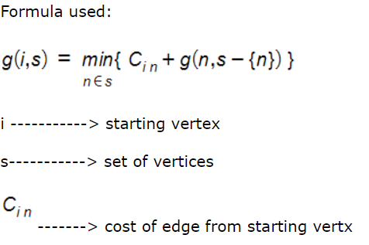
Naive Approach
Consider the first city as the starting and ending point.
Generate all permutations (n-1)! of all cities.
Calculate the minimum cost of every permutation.
Result as the permutation with the minimum cost.

Slide 6
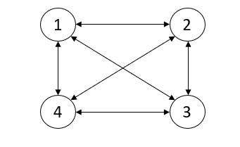
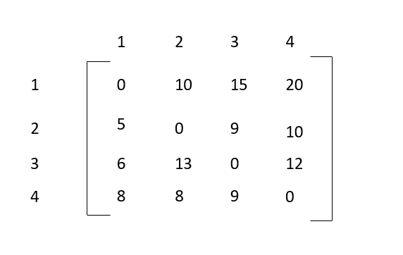
For example:
Weighted directed graph
Adjacency Matrix for the graph

Slide 7
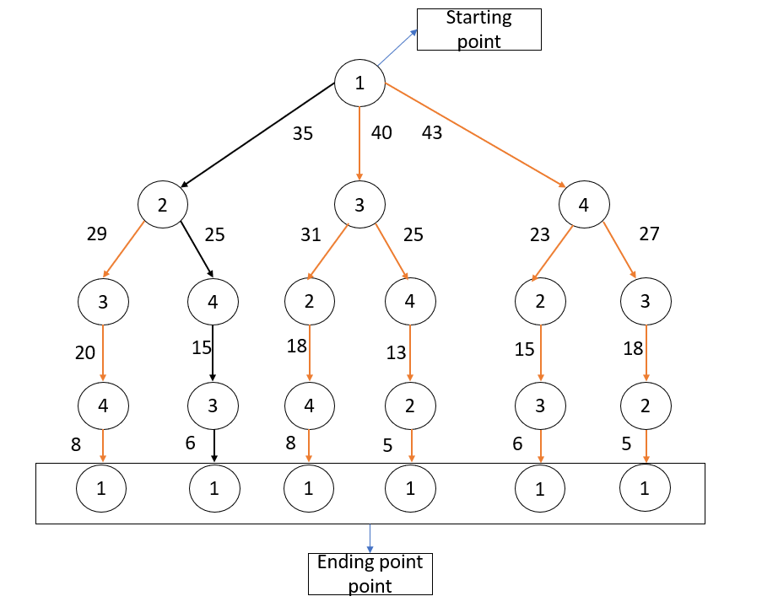
From the above graph, node 1 as the starting point and the ending point and by using a naive and dynamic method the edges with black colour is the shortest route that visits every node exactly with minimum cost as 35.

Slide 8
TRAVELLING SALESMAN PROBLEM USING BACKTRACKING
Back tracking is an algorithmic method of resolving problems repeatedly by trying to create a solution, one piece at a time
removing those solutions that fail to satisfy the problem problems at any given time (at a time, here, referring to the past and reaching any level of the search tree).

Slide 9
Approach in TSP:
Let’s Consider city 1 (which is 0th node) as the starting and ending point. where route is cyclic, we can consider any point as starting point.
So, we Start traversing from the source (starting node) to its adjacent nodes in dfs manner.
Calculate cost of every traversal and keep track of minimum cost and keep on updating the value of minimum cost stored value.
Finally return the minimum cost

Slide 10
TRAVELLING SALESMAN PROBLEM IN BIOINFORMATICS
There are many heuristic methods and algorithms for solving optimization problems.
Some of the popular ones in bioinformatics that are solvable using the TSP approach are Ant Colony Optimization (ACO) Problem and Genetic Algorithm (GA) problem.
This project focuses only on TSP using GA.

Slide 11
GENETIC ALGORITHM (GA)
Inspired by Charles Darwin’s theory of evolution, came the genetic algorithm concept.
It is based on the concept of “survival of the fittest”.
Genetic algorithm reflects the process of natural selection based on the fitness of individuals, and the selected fit individuals give rise to the next generation population.

Slide 12
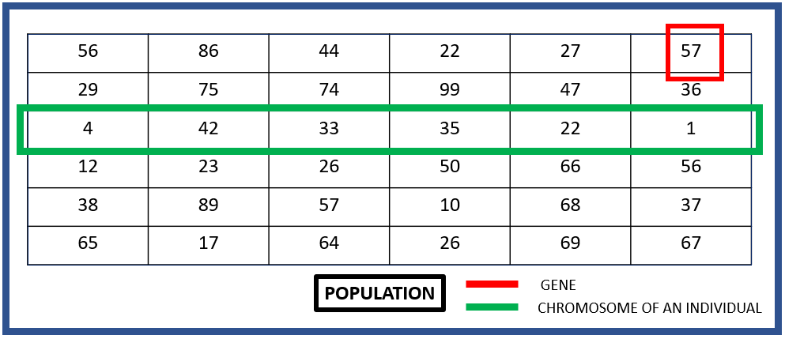
TRAVELLING SALESMAN PROBLEM USING GENETIC ALGORITHM
Let us consider an initial population of 6 individuals.
These unique values in the chromosomes are called alleles

Slide 13
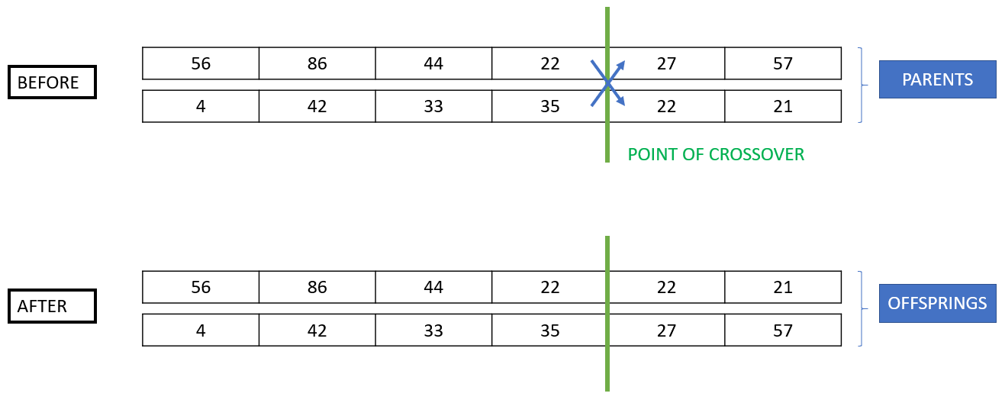
SINGLE POINT CROSSOVER
In single point crossover, a point or index is chosen and the genes after that point of index of the two parents are swapped to give rise to a new individual. In our python computation, we have randomly generated this point or index and then we performed the crossover.
Let us now consider 2 parents from the initial population that we have at hand to see how the crossover works.

Slide 14
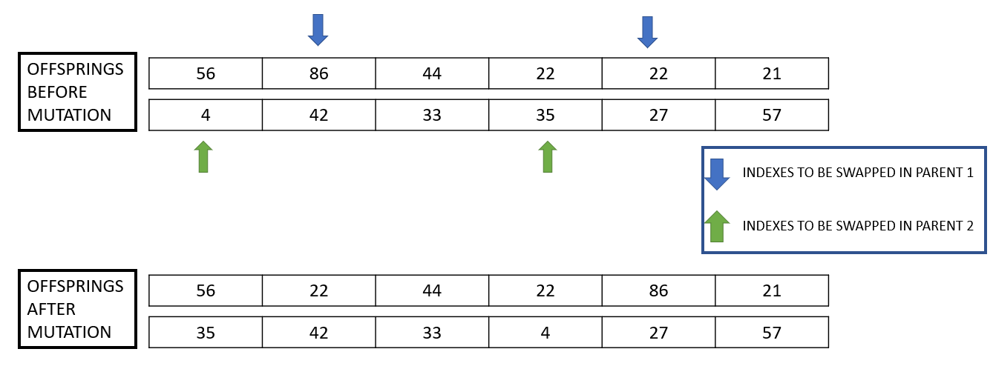
SWAP MUTATION
The alteration in the genome of an organism is called mutation.

Slide 15
ADVANTAGES OF TSP USING GA
GA works well on any problem be it continuous of discrete in nature.
The division of the TSP problem is made simpler in GA compared to other algorithms.
Multi-objective optimization is supported by GA.
Sometimes deserving sub-solutions or partial solutions have a high chance of being a part of the final output.

Slide 16
DISADVANTAGES OF TSP USING GA
Computationally, this method is quite expensive.
The space size often sees an exponential increase due to the large number of elements that are being exposed to mutation.
Worst case time complexity

Slide 17
TRAVELLING SALESMAN PROBLEM USING ILP
Integer Linear Programming (ILP) problems involve the maximization or minimization of a given linear function with respect to a set of linear constraints and all the variables are restricted to take on integer values.
One would be dealing with the minimization of a linear cost/distance function given the set of constraints like all the cities should be visited exactly once before returning to the starting city etc. in the TSP using ILP problem.
The ILP formulation of TSP reduced the complexity of the problem to a simple optimization problem with constraints.

Slide 18
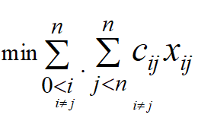
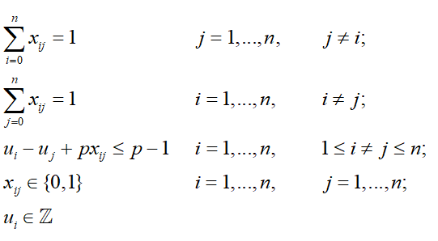
The Method of ILP we chose to implement is known as “Miller-Tucker-Zemlin” formulation
The Objective Function: Subject to the Constraints:

Slide 19
Hamming Distance:
Hamming Distance for two strings is the number of mismatched characters at a given position of the string. This is measured for strings of same character length.
Ex: ABCDE - ABPQE : The Hamming Distance is 2
Ex: 1100011 - 1011010 : The Hamming Distance is 4
Hamming Distance, for our case, can be defined as the difference in the bases among two given kmers of equal k size at corresponding positions.

Slide 20
STRING RECONSTRUCTION
· Reconstruct a string using its K-mer composition.
· A pair of K-mer, if they overlap in K-1 symbol.
For example, From the given K-mers
AAT ATG GTT TAA TGT
TAA
AAT
ATG
TGT
GTT
So, the reconstructed string is TAATGTT

Slide 21
CHALLENGES
• We can't be sure that the initial input sequence has minimum overall hamming distance, so we can't
expect to get the original sequence back after reconstruction
• This logic works better only for a very large k value
• Initial kmer or it's index needs to be fed as input to the model
• Unique kmers are disregrded or placed in a wrong position
• Since this model doesnt take into consideration the prefix-suffix overlap, the final path cannot be reconstructed
together into a perfect chromosome
• Since hamming distance adjacency matrix can sometimes be way too sparse, the size of the final chromosome
tends to be smaller than the initial chromosome as some kmers' distances are dropped during the ILP formulation
• There is also the challenge of K-mer duplicates in the given sequence.

Slide 22
Thanks!

