Slide 1
Stock prediction using Machine Learning 21AIE461 Financial Time-Series Analysis​
TEAM 1

Slide 2
TEAM MEMBERS
11
22
37
39
Anuvarshini SP
Deepthi Sudharsan
Kavya S Kumar
Lakshaya Karthikeyan

Slide 3
01
Dataset

Slide 4
Dataset Description
Google Daily Stock Data
April 2017 to April 2022
7 attributes → only using Date & Close

Slide 5
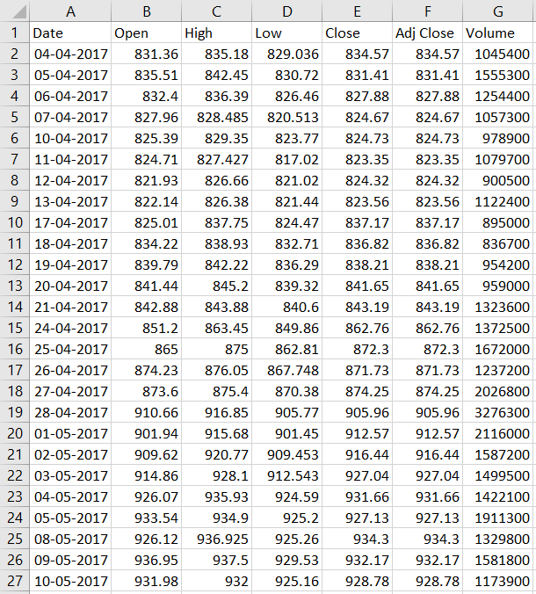
Dataset

Slide 6
02
Objective

Slide 7
Objective
Stock market is characterized by nonlinearities, discontinuities, and high-frequency multi-polynomial components
Reason: it interacts with factors such as political events, general economic conditions, and traders’ expectations
Drawing inferences from historical patterns and making precise predictions of stock values are challenging
Due to this: ML is being experimented with

Slide 8
03
LSSVR

Slide 9
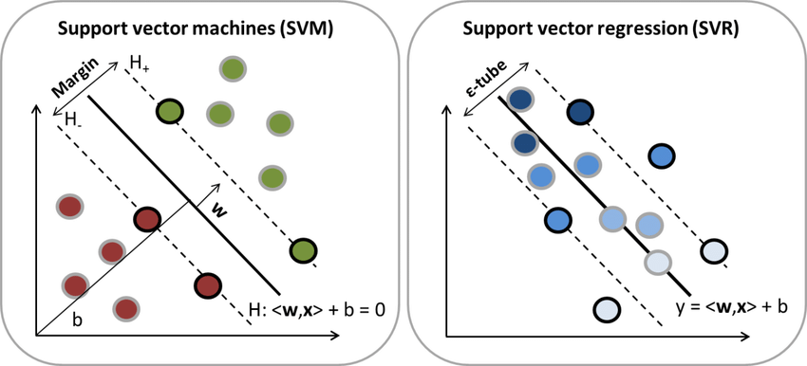
ML Algorithms
ML algorithms: not very sensitive to assumptions about error terms and can tolerate noise and chaotic components
Particularly: SVMs are used for material sciences and financial risk prediction
Support vector regression (SVR) → variant of the SVM
SVR: used to solve nonlinear regression problems by constructing an input–output mapping function

Slide 10
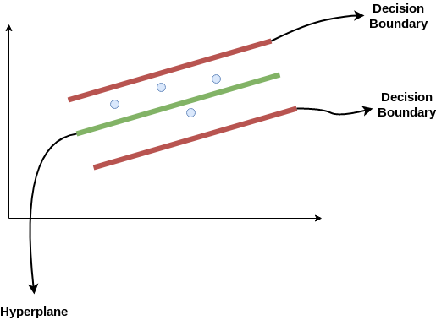
SVR
Finds a function that approximates mapping from an input domain to real numbers on the basis of a training sample
Objective: consider the points that are within the decision boundary line
Best fit line: hyperplane that has a maximum number of points
Main aim: fit the best line within a threshold value (distance between the hyperplane & boundary)
Take only points that are within the decision boundary and have the least error rate, or are within the Margin of Tolerance.

Slide 11
LSSVR
A development of SVR
Involves equality instead of inequality constraints & uses a least squares objective function
Reduces computational complexity and increases efficiency
Solves linear equations instead of a quadratic programming problem
Preferred for large-scale regression that need fast computation
Radial basis function kernel (RBF) is used
Prediction accuracy of LSSVR is highly dependent on the determination of its hyperparameters
Firefly Algorithm used to optimize LSSVR hyperparameters:
the regularization parameter (C)
sigma of the RBF kernel

Slide 12
04
Firefly Algorithm

Slide 13
Firefly Algorithm
Firefly algorithm is a swarm-based metaheuristic algorithm. Firefly Algorithm is inspired by the flashing behavior of fireflies.
Assumptions
Fireflies are attracted to each other.
Attractiveness is proportional to brightness
Dimmer firefly is attracted to the brighter firefly.
Attractiveness decrease as the distance between 2 fireflies increase.
If brightness for both is the same, fireflies move randomly
New solutions are generated by random walks & the attraction of fireflies

Slide 14
Firefly Optimization Algorithm Steps
Initialize parameters
Generate population of n fireflies
Calculate fitness value for each firefly
Check stopping criteria if (CurrentIteration := 1 to Maximum Iteration)
Update position and light intensity for each firefly
Report the best solution

Slide 15
Initialize Parameters
Population Size (n): Number of fireflies
Maximum Iteration (Maxt): Number of iterations required to get the optimal value
Dimension (d): Number of parameters to be optimized
Upper Bound [UB]: Maximum value the parameters can take
Lower Bound [LB]: Minimum value the parameters can take
Initial Values: Parameter values in the beginning

Slide 16

Calculate Fitness Value [Light Intensity] for Each FireFly.
The light intensity of Firefly (i.e., 𝐼_𝑖) at 𝑥_𝑖 is computed by the Value of the Objective Function.
Update Position:
$$x_{i}(t+1)=x_{i}(t)+βe^{−γr^{2}}(x_{j}−x_{i})+αε_{i}$$
$$r_{ij}=\sqrt{\sum{(x_{i}−x_{j})^{2}}} \\ β=β_{o}∗\exp{(}−γ∗r.^2)$$
Random walk:
$$x_{i}(t+1)=x_{i}(t)+αε_{i}$$

Slide 17
Firefly Position Updated as:
While current iteration=1:Max_iteration;
For i = 1 to n -1;
For j = i + 1 to n;
IF ( 𝑰_𝒋 > 𝑰_𝒊 )
Update Position. [move Firefly i towards Firefly j ];
ELSE
Move i randomly;
End IF
Update Position and Light Intensity
End For
End For
End While

Slide 18
Firefly Position Updation:
Check whether new solutions are within bound or not
Merge Population
Sort Population
Rank fireflies according to their light intensity values
The resultant is the optimal values for parameters

Slide 19
05
Code

Slide 20
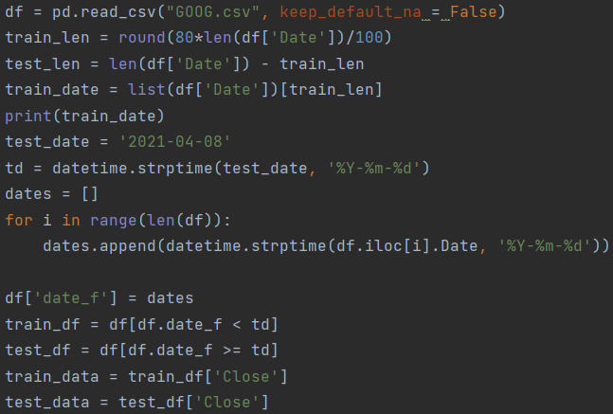
Preprocessing
Read data
Calculating the length of 80% of dataset
Checking date of 80% mark
Changing the “date” column into a date format for easy comparison
Splitting every row before date as train
Every row after date is test
Choosing “Close” column as data for prediction

Slide 21
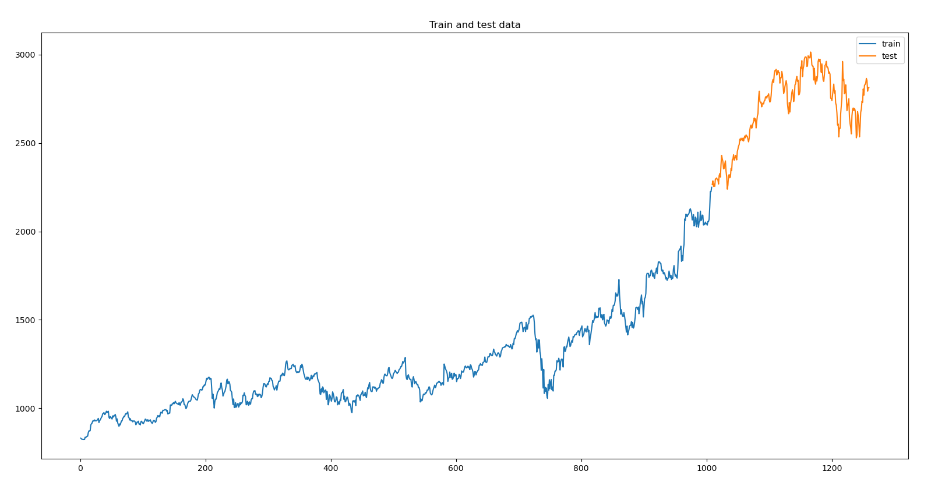
Train Test Split

Slide 22
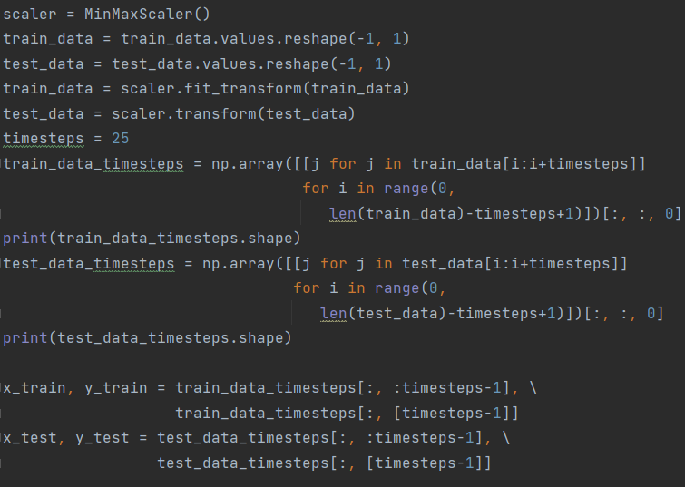
Preprocessing
Scaling values
Stacking “timesteps” (25) data points into rows
Row1 → x1,x2,x3 … x25
Row2 → x2,x3,x4 .. x26
.
.
.
Row(n-25) → x(n-25) … xn
The 25th column is considered to be the target
Train data shape → (985,24)
Test data shape → (227,24)

Slide 23
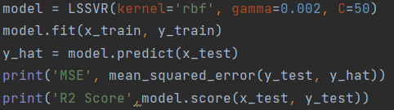
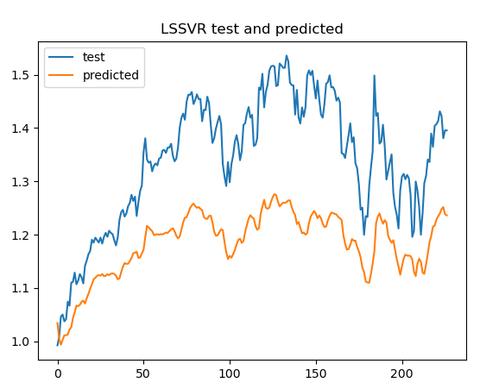

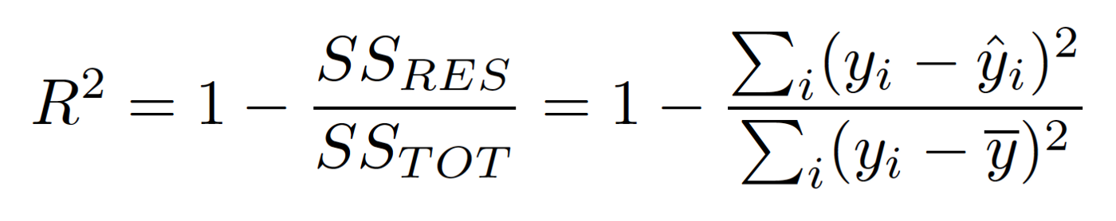
LSSVR code
Gamma and C value are chosen to be 0.02 and 40 respectively

Slide 24
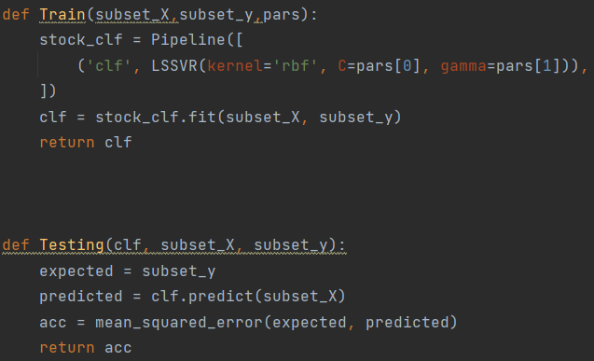
Helper Functions
Train() function:
Takes X and y as parameters
Returns a model fit on this data
Testing() function:
Takes the X_test and y_test as parameters
Predicts using Xtest
Returns the mean squared error between the predicted values and y_test

Slide 25
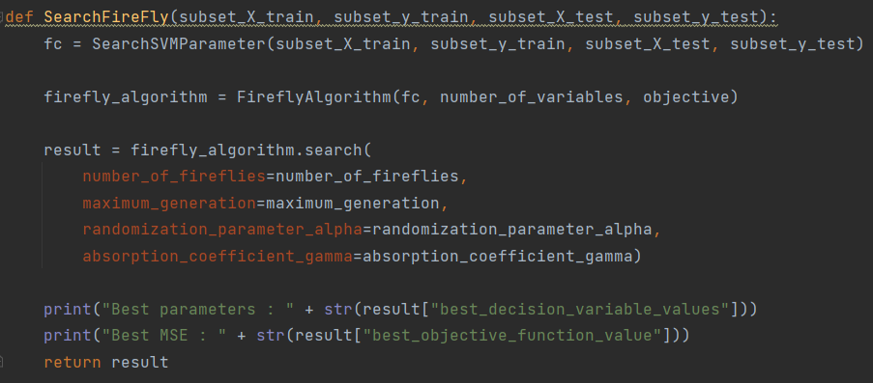
SearchFireflyAlgorithm
Using the Firefly algorithm to find the optimal parameters
The parameters passed into the function are:
Number of fireflies
Maximum generation
Randomization parameters
Absorption co-effecient

Slide 26
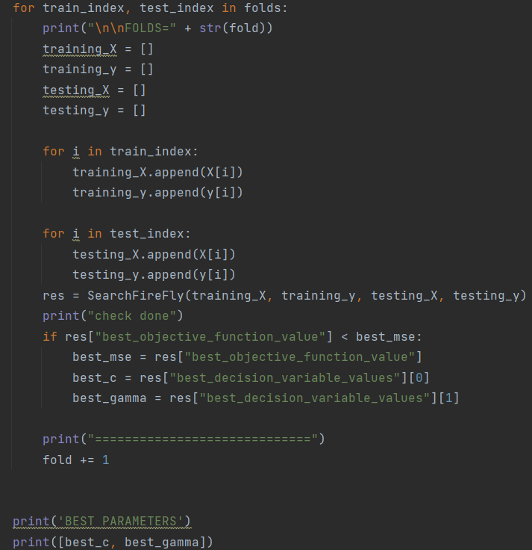
KFold
For each fold:
Firefly algorithm is used to find the optimal parameters
Checking for the lowest MSE
If current MSE is less than best MSE
Those parameters are stored as best parameters and returned

Slide 27
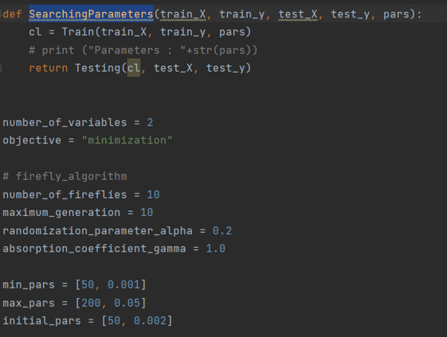
Training data is passed through the Train() function which consists of the LSSVR pipeline and fits the model
After fitting, the Testing() function is called on the test data to predict and the MSE is returned.
Our objective is to minimize our MSE
We define the parameters such as maximum generation, upper and lower bounds for the parameter and the initial parameter values.

Slide 28
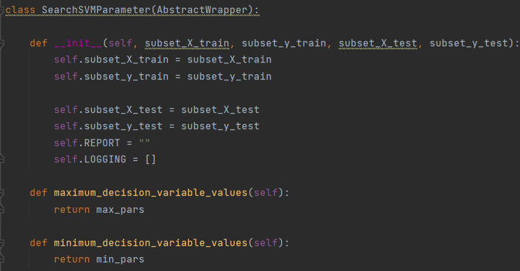
Constructor initializing the train and test split and defining the report and logging variables to store the logs and report.
Functions to return the maximum and minimum decision variable values (List with upper and lower bounds of C and Gamma)

Slide 29
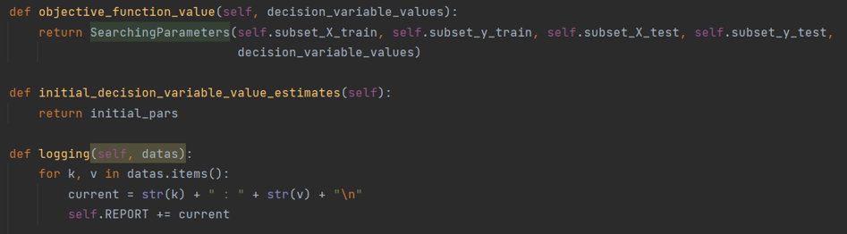
Objective Function value in our case is MSE and our aim is to minimize the MSE. objective_function_value returns the MSE by calling the SearchParameters function
Initial_decision_variable_value_estimates returns the initial C and Gamma parameter values
Logging function logs the best parameters and best objective value in the REPORT variable.

Slide 30
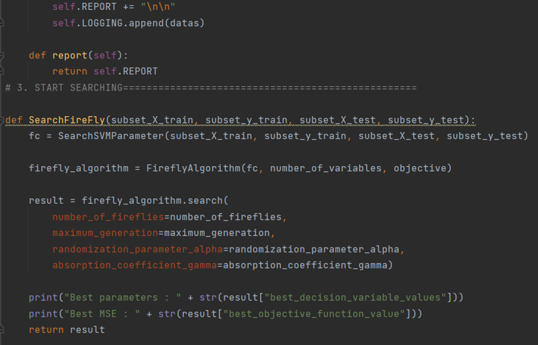
Report function returns the logged report.
SearchFireFly function calls the FireFlyAlgorithm by passing the MSE obtained from SearchSVMParameter function as input along with the number of variables and the objective (minimization)
The result i.e., the best decision variable values and the best objective function value (MSE value) is printed and returned.

Slide 31
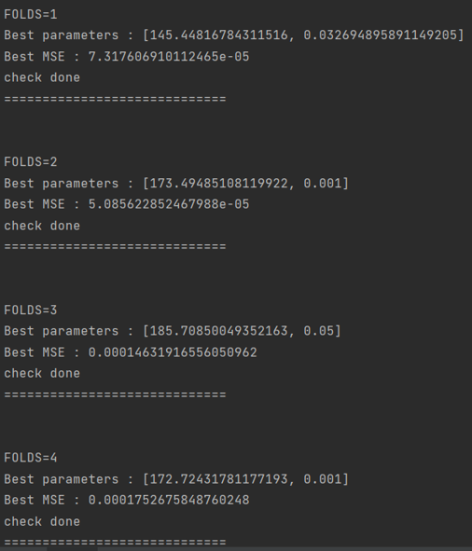
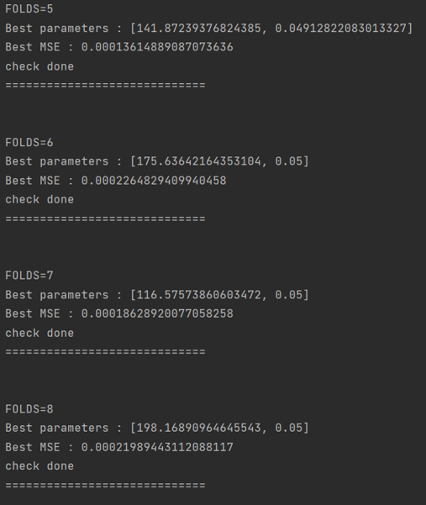
RESULTS
The best C and Gamma decision parameters and MSE scores are returned for 15 folds.

Slide 32
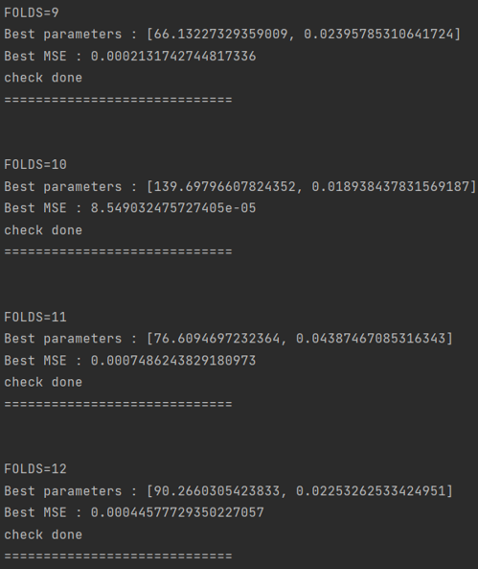
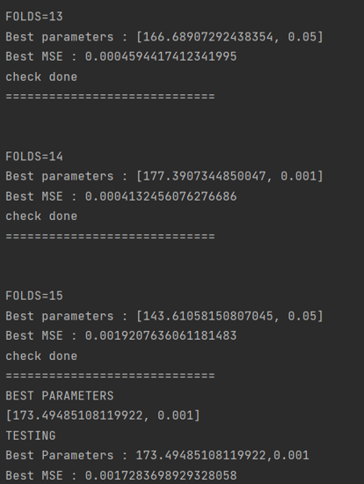
Based on the least MSE result obtained from the 15 folds, the best parameters are printed and these parameters are used on the testing data. We were able to achieve an MSE of 0.001728 on the testing data as shown.

Slide 33
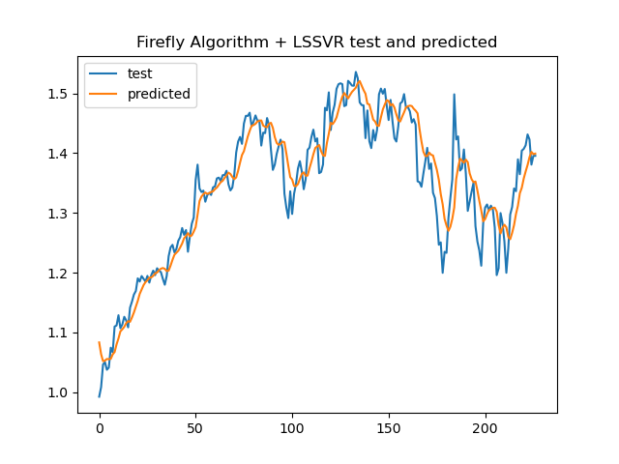
Plot

Slide 34
Thank you! Reference paper: “Forward Forecast of Stock Price Using Sliding-Window Metaheuristic-Optimized Machine-Learning Regression”

