Slide 1
Technical Presentation
Network system
MEF-70.1 SD-WAN Service Attributes and Services Frameworks
By:
D A Deepthi Yamini

Slide 2
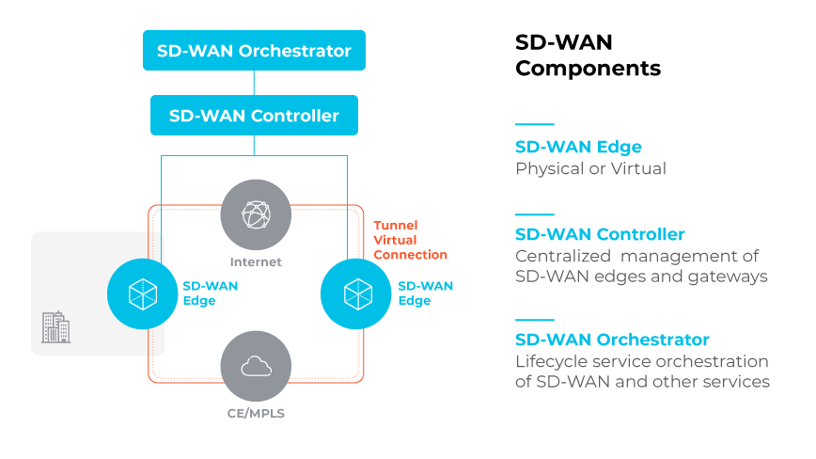
Introduction
SD-WAN is a technology that enables organizations to manage and optimize their wide area networks (WANs) using software-defined networking (SDN) principles. SD-WAN solutions provide centralized management, application-aware traffic steering, and secure network connectivity.
19/02/2025
Computer Science and Engineering
1

Slide 3
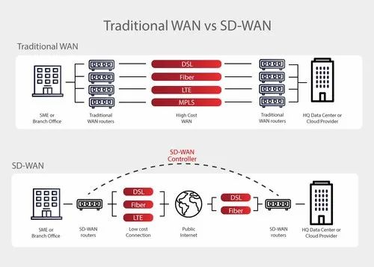
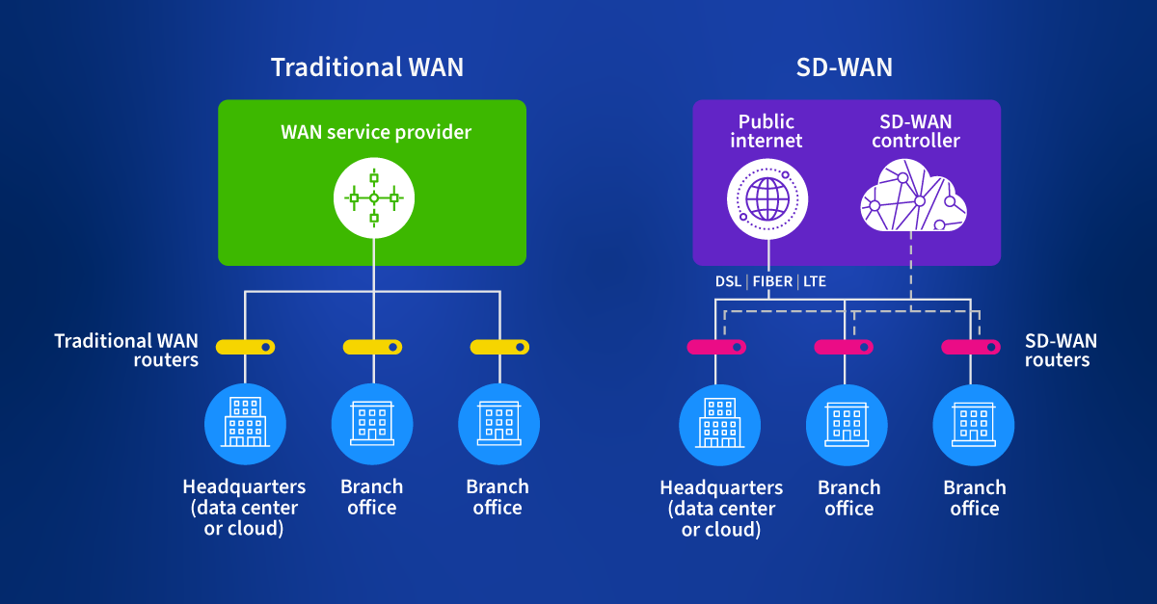
"The drawbacks of traditional networks and the necessity of SD-WAN"
19/02/2025
Computer Science and Engineering
1

Slide 4
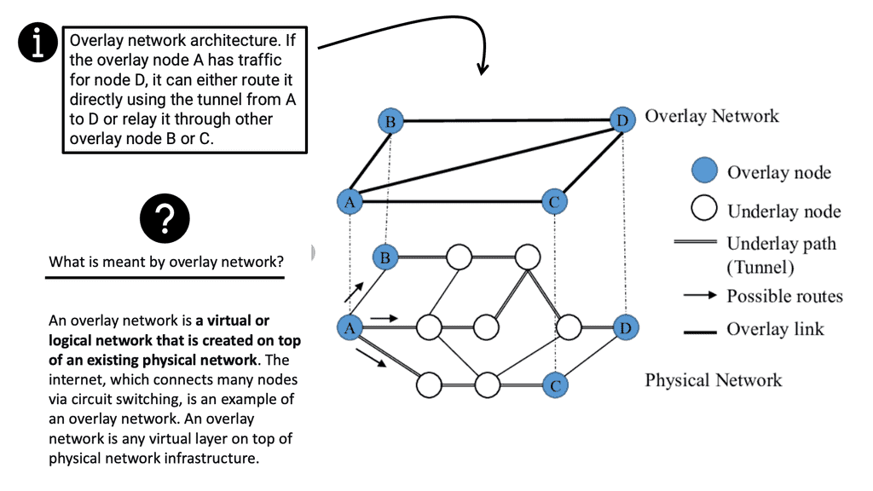
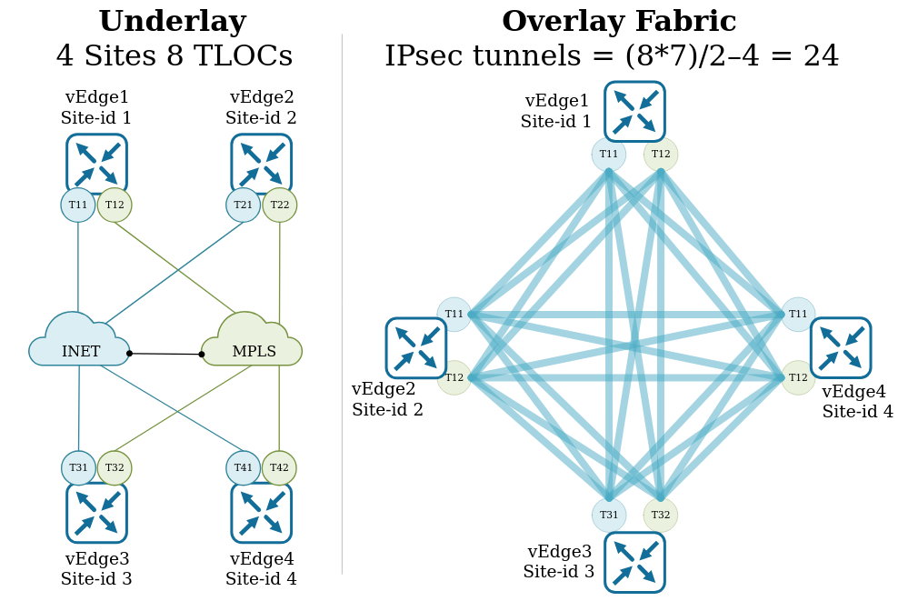
Overlay and Underlay Network
Overlay Network
The overlay network is a virtual network that runs on top of the underlay network.
It's a logical network that provides a centralized, software-defined control plane for managing WAN traffic.
Underlay Network
The underlay network refers to the physical infrastructure that underpins the SD-WAN solution.
This includes the various transport services, such as MPLS, Internet, and LTE.

Slide 5
SD-WAN Services
SD-WAN uses a centralized control function to steer traffic securely and intelligently across the WAN and directly to trusted SaaS and IaaS providers. This approach enables businesses to leverage any combination of transport services, including MPLS, LTE, and broadband internet services
SD-WAN Service Framework Models
Managed SD-WAN: A fully managed service, where the service provider is responsible for designing, implementing, and managing the SD-WAN solution.
Co-Managed SD-WAN: A shared responsibility model, where the organization and the service provider collaborate on the design, implementation, and management of the SD-WAN solution.
DIY SD-WAN: A do-it-yourself approach, where the organization is responsible for designing, implementing, and managing the SD-WAN solution.

Slide 6
The advantages of using SD-WAN:
Improved Application Performance: SD-WAN optimizes application performance by prioritizing traffic, reducing latency, and ensuring Quality of Service (QoS).
Reduced Costs: SD-WAN lowers WAN costs by leveraging lower-cost Internet connections, reducing the need for expensive MPLS lines, and minimizing the number of physical devices required.
Simplified Management: SD-WAN provides a centralized, cloud-based management platform for monitoring, configuring, and troubleshooting WAN connections, making it easier to manage and maintain the network.
main challenges in SD-WAN:
Technical Complexity: SD-WAN requires a deep understanding of network infrastructure, including routers, firewalls, and WAN connections, which can be complex to manage.
Security Concerns: SD-WAN relies on internet connections, which can be vulnerable to cyber threats, and requires additional security measures to ensure data encryption and integrity.
Change Management and Training: SD-WAN implementation requires significant changes to network architecture, policies, and procedures, and specialized skills and training for IT staff.

Slide 7
Thank You
19/02/2025
Computer Science and Engineering
1

