Slide 1

Bluestock Mutual Fund Analysis Capstone Project
End-to-End Mutual Fund Analytics using Python, SQLite & Power BI
Technologies Used: Python | Pandas | SQLite | Power BI | Plotly | Seaborn
Prepared By: Deepthi Sree Kotagiri

Slide 2

Problem Statement & Objectives
Problem Statement
The mutual fund industry generates large volumes of data related to fund performance, investor transactions, NAV movements, and market trends. Extracting meaningful insights from this data is essential for investors and fund managers.
Objectives
• Build a complete ETL pipeline for mutual fund data
• Perform Exploratory Data Analysis (EDA)
• Analyze fund performance using financial metrics
• Develop an interactive Power BI dashboard
• Perform advanced risk and investor analytics
• Generate actionable investment insights

Slide 3
Data Sources
Datasets Used
Fund Master Data
Scheme information
Categories
Risk grades
NAV History
Daily NAV records (2022–2026)
Scheme Performance
Returns, Sharpe Ratio, Alpha, Beta

Slide 4
Investor Transactions
SIPs, Redemptions, Lumpsum Investments
Portfolio Holdings
Sector allocation and holdings
Benchmark Indices
NIFTY 50
NIFTY 100

Slide 5
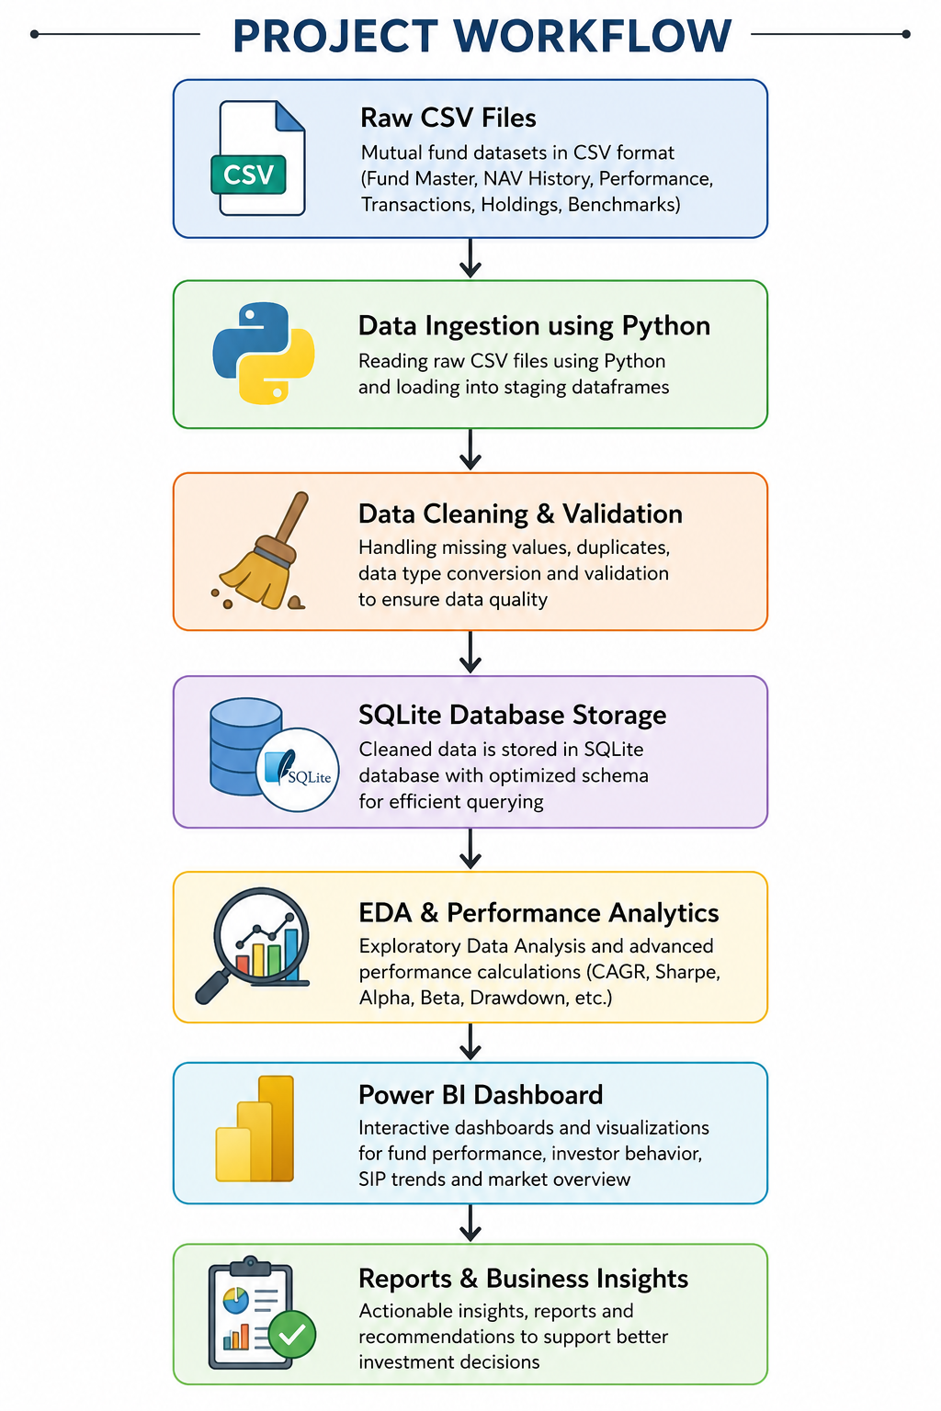
System Architecture
Project Workflow
Outcome
Built a complete analytics pipeline transforming raw mutual fund data into actionable insights.

Slide 6
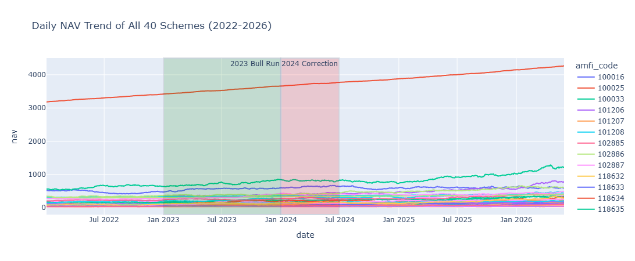

EDA Highlights
Key Exploratory Analysis
NAV Trend Analysis
• Analyzed NAV movement across 40 schemes
• Identified strong growth during market rallies

Slide 7
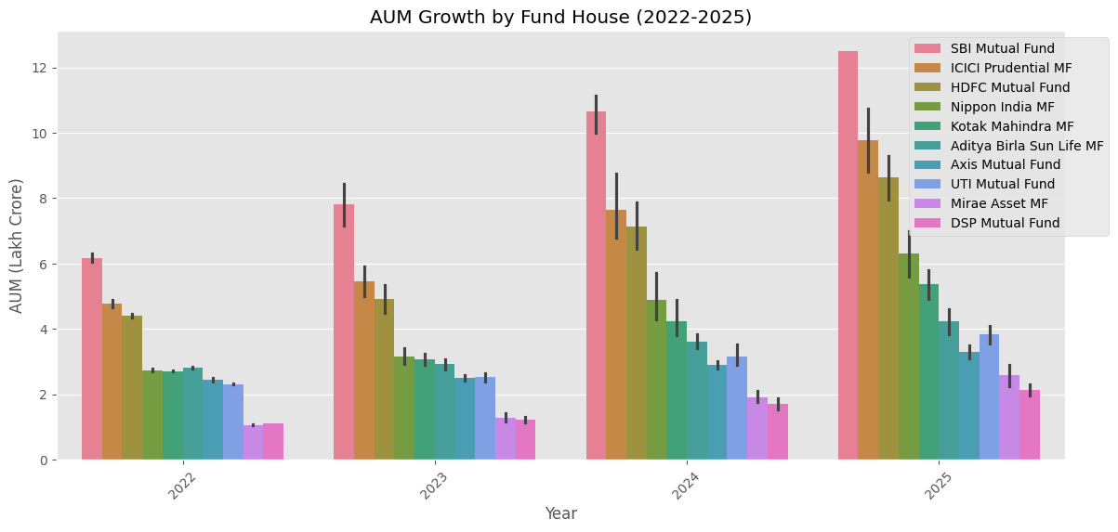
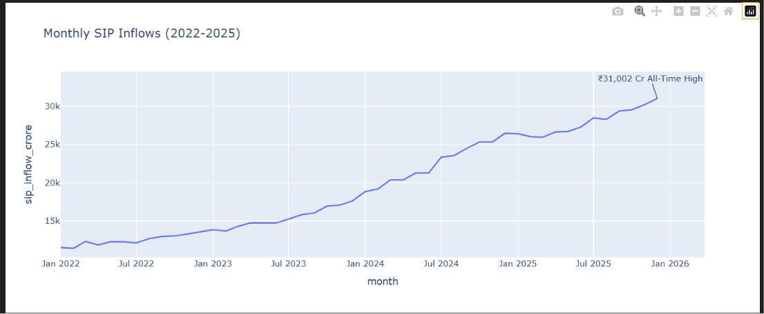
AUM Growth Analysis
• SBI Mutual Fund emerged as the market leader
• Significant industry growth observed between 2022–2025
SIP Inflow Trends
• Continuous increase in monthly SIP investments
• Strong investor participation throughout the period

Slide 8
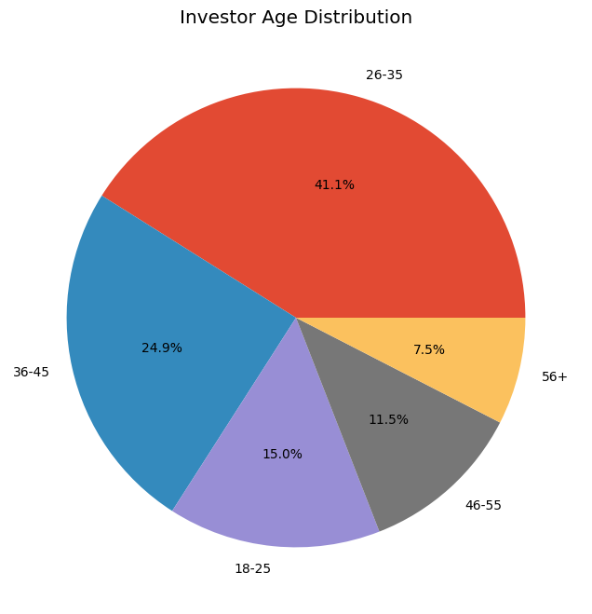
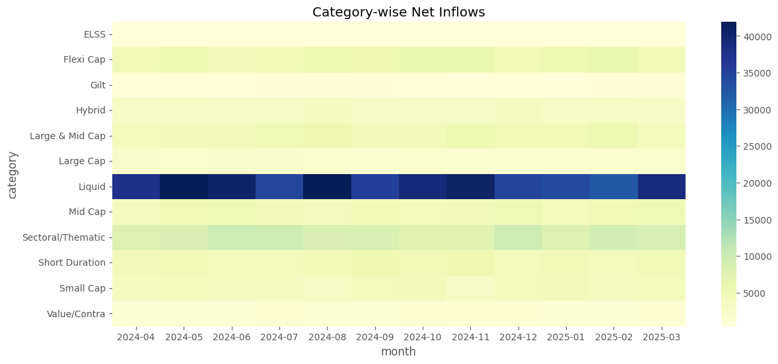
Investor & Market Insights
Category Inflows
• Equity-oriented categories received the highest inflows
• Mid-cap and flexi-cap funds showed strong popularity
Investor Demographics
• Young investors contributed significantly to SIP investments

Slide 9
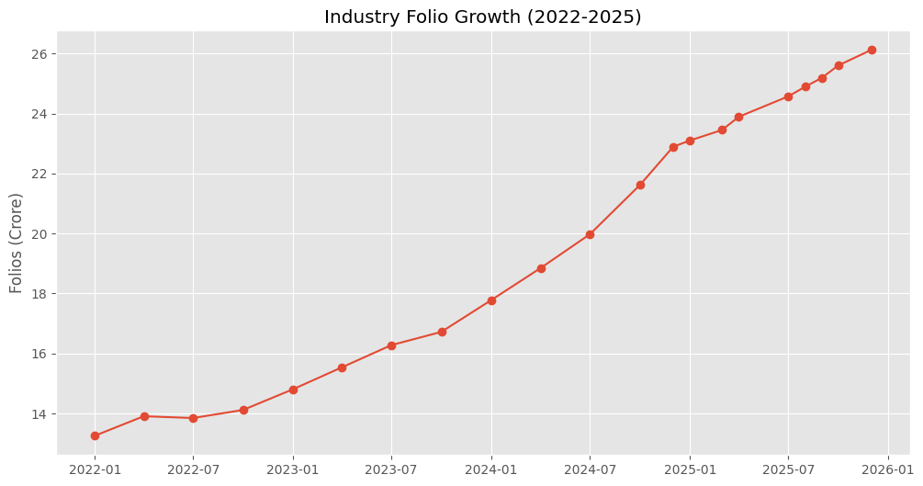
Folio Growth
• Industry folios increased from 13.26 Cr to 26.12 Cr
• Demonstrated growing retail investor participation

Slide 10
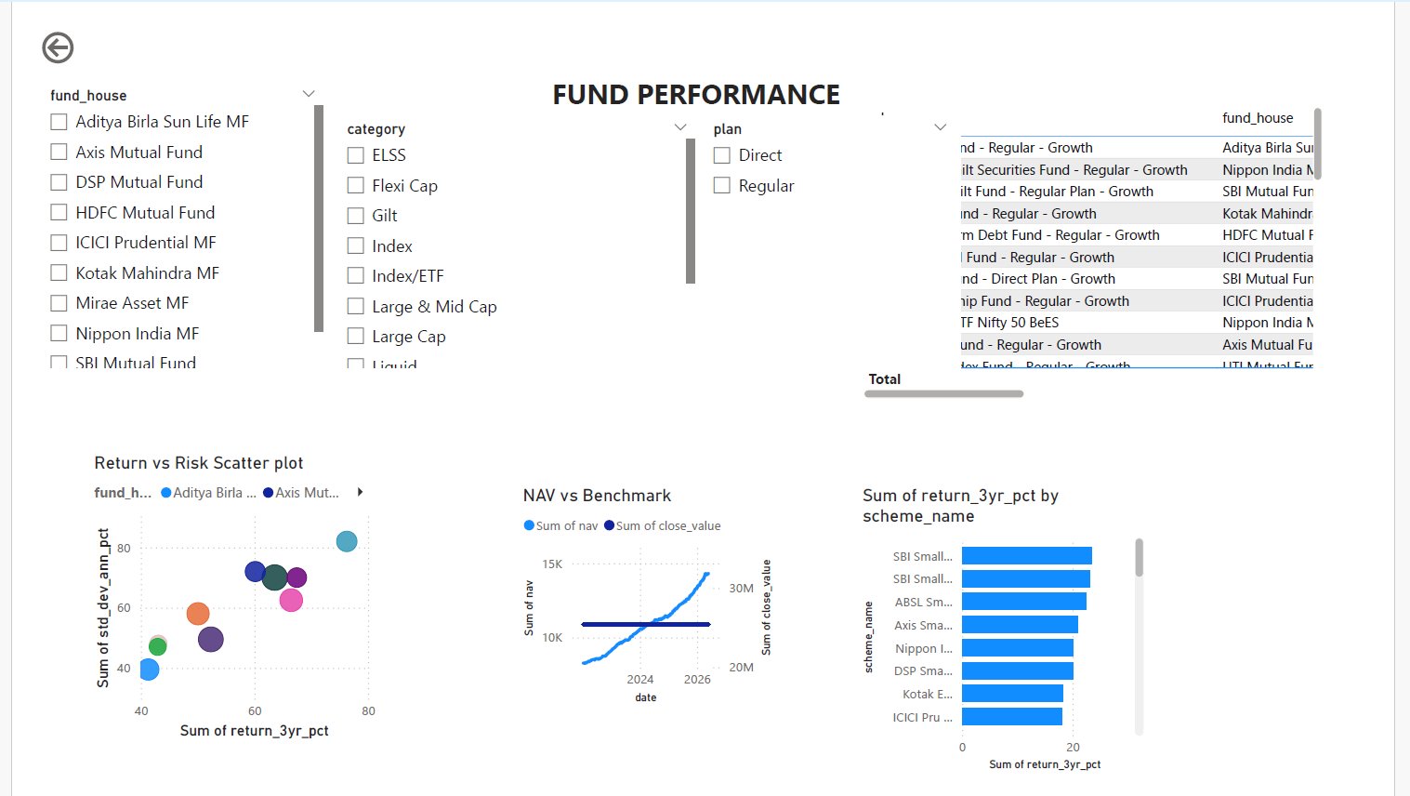
Performance Analytics
Fund Performance Evaluation
CAGR Analysis
• Compared long-term growth across all schemes

Slide 11
Sharpe Ratio Analysis
Identified funds delivering superior risk-adjusted returns
Sortino Ratio
Measured downside-risk-adjusted performance
Result
Top-performing funds consistently achieved higher risk-adjusted returns.

Slide 12
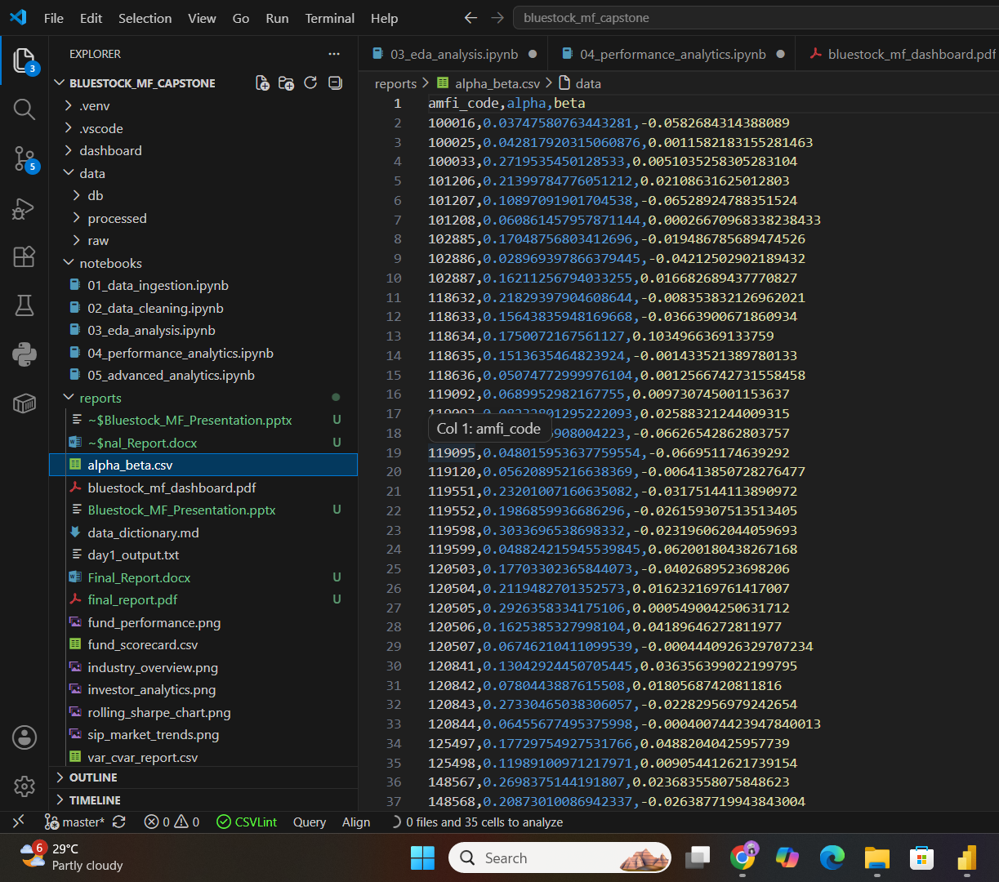
Advanced Risk Metrics
Alpha & Beta
• Measured fund performance against benchmark indices
Maximum Drawdown
• Identified worst historical declines

Slide 13
Fund Scorecard
Composite ranking based on:
• 3-Year Return
• Sharpe Ratio
• Alpha
• Expense Ratio
• Maximum Drawdown

Slide 14
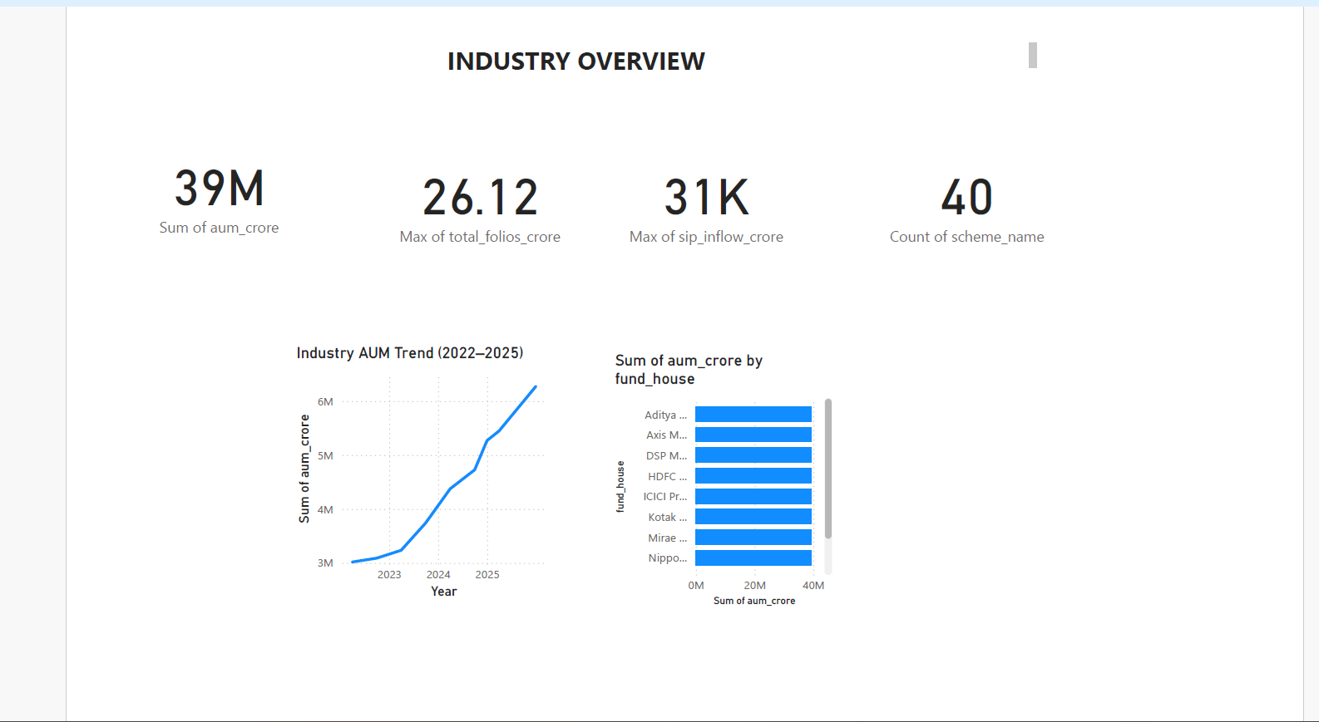
Dashboard Screenshots
Power BI Dashboard
Industry Overview
Features:
Total AUM
• Total SIP Inflows
• Folio Count
• Scheme Count

Slide 15
Fund Performance
Features:
• Return vs Risk Analysis
• Benchmark Comparison
• Fund Scorecard

Slide 16
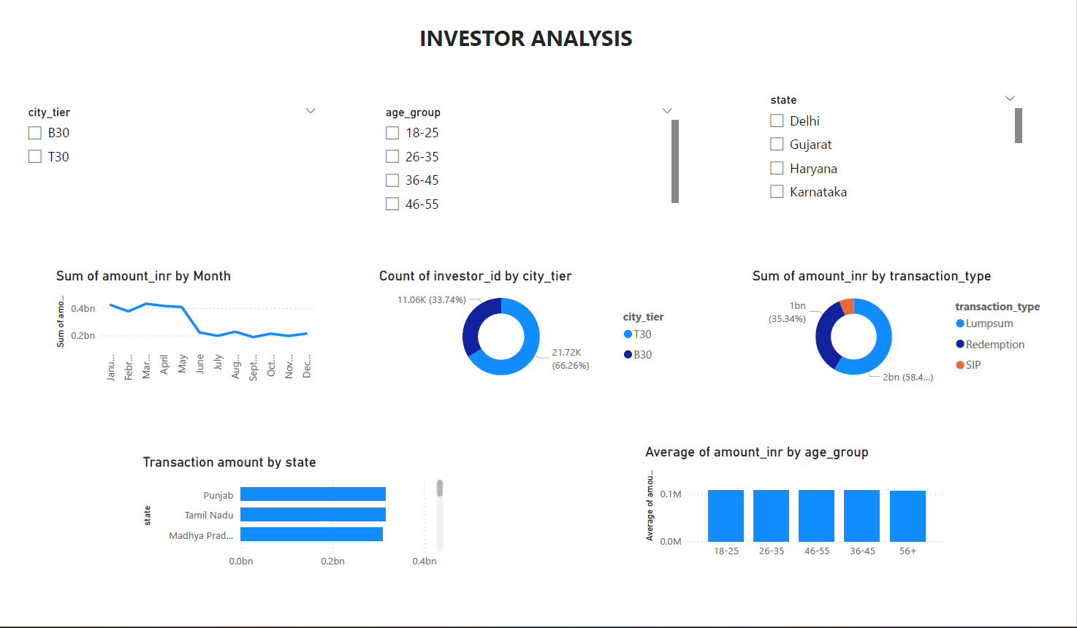
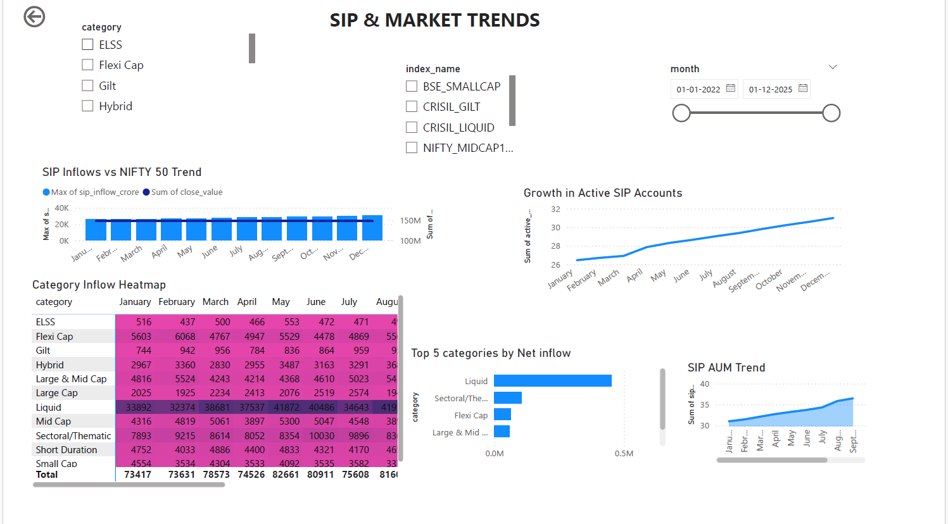
Investor Analytics
Features:
• Investor Demographics
• Transaction Analysis
• Geographic Distribution
SIP & Market Trends
Features:
• SIP Inflows
• Market Index Trends
• Category-wise Analysis

Slide 17
Key Findings & Recommendations
Key Findings
SIP inflows reached record highs during the study period.
Equity funds dominated investor preferences.
High-Sharpe funds consistently outperformed peers.
Several investors showed SIP discontinuity risk.
Portfolio concentration varied significantly across funds.

Slide 18
Recommendations
• Expand dataset coverage
• Introduce machine learning models
• Deploy dashboard to cloud platforms
• Enhance recommendation engine with personalization

Slide 19
THANK YOU

