Slide 1

8th Semester Project on Title “Sign language recognition based on Computer Vision”
Ms. Deepthi Varambally
Section: C Roll no:45
Registration Number: 120907580
Ms. Pritika Kohli
Section: C Roll No:43
Registration Number: 120907558
Mr. Suraj Pai
Section: C Roll No: 9
Registration Number: 120907042
Guide: Prof. T.K. Padma Shri
Associate Professor Senior Scale
Department of Electronics and Communication
2
Department of Electronics and Communication Engineering, MIT, Manipal

Slide 2
Update-Contents
INPUTS FROM PREVIOUS WEEK
PROGRESS REPORT
METHODOLOGY
COMING WEEK IN A GLANCE
Notes:
Explain the course contents of Basic electronics in brief.

Slide 3
Inputs from previous week
Collection of training data for 3 gestures with various variations.
Normalization of binary image space for generalization.
Labelling and annotation of joints for semantics.
Notes:
Explain the course contents of Basic electronics in brief.

Slide 4
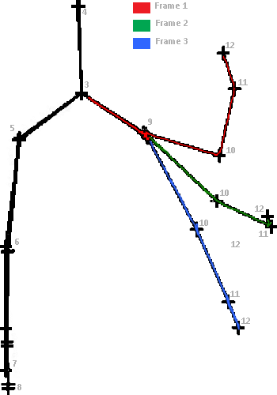
Joint Number | Joint
3 | Shoulder Centre
4 | Head
5 | Shoulder Left
6 | Elbow Left
7 | Wrist Left
8 | Hand Left
9 | Shoulder Right
10 | Elbow Right
11 | Wrist Right
12 | Hand Right

Slide 5
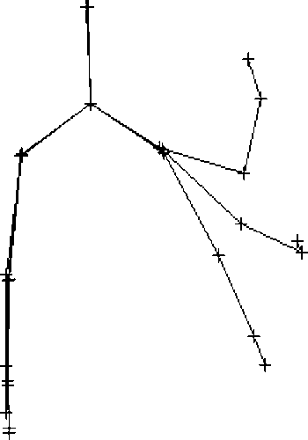
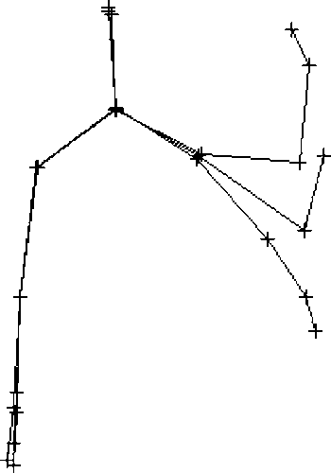
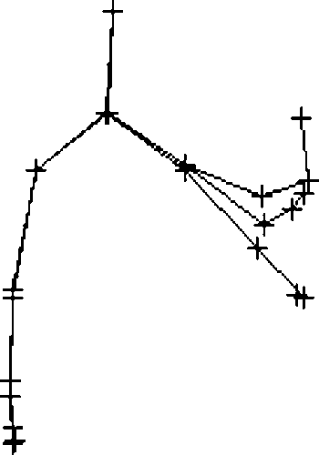
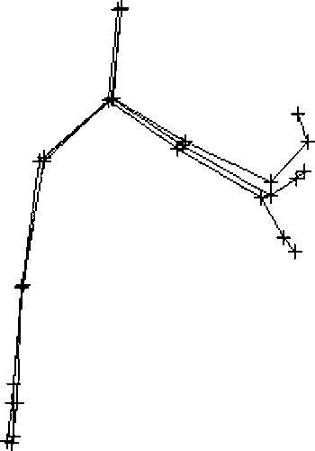
Normalization

Slide 6
Progress Report
108
Varied training data has been collected from 3 different people in different conditions.
The factors under consideration are:
Distance from the sensor ( Over a range of 1.2-3m)
The training data is collected over 3 different distances.
For each gesture, 4 variants are collected at each distance.
1.5m
2.0m
2.5m
A total of 12 variants per gesture is taken per person.
A total of 36 variants(3 people) per gesture have been collected.
Notes:
Greetings followed by explaining the Importance of the course and Establishing the connect….

Slide 7
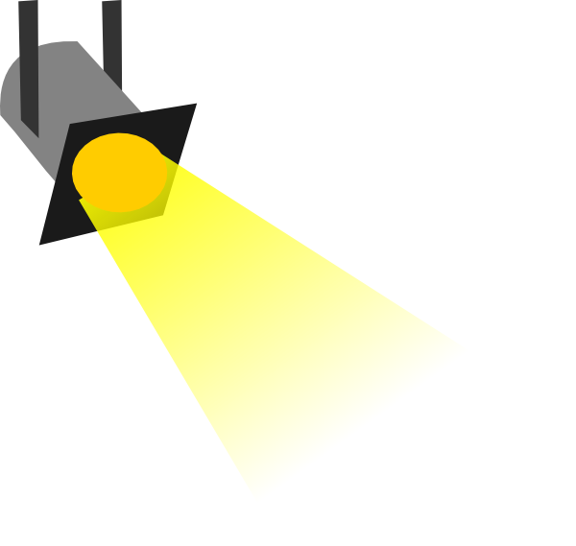
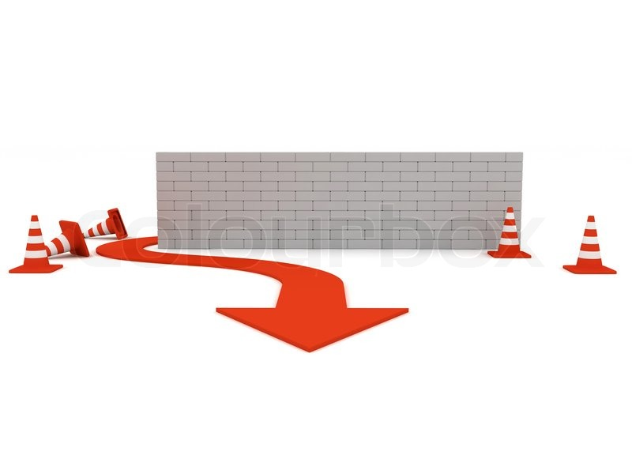

2. Lighting Conditions
For every distance index, one image has been taken with contrasting lighting as compared to the other three.
A total of 54 contrasting images have been obtained
3. Obstacles in between
Images have been randomized with obstacles to obtain varied training data.
4. Gesture Speed Variation
Every gesture has been recorded with different time indices to maintain generalization.

Slide 8
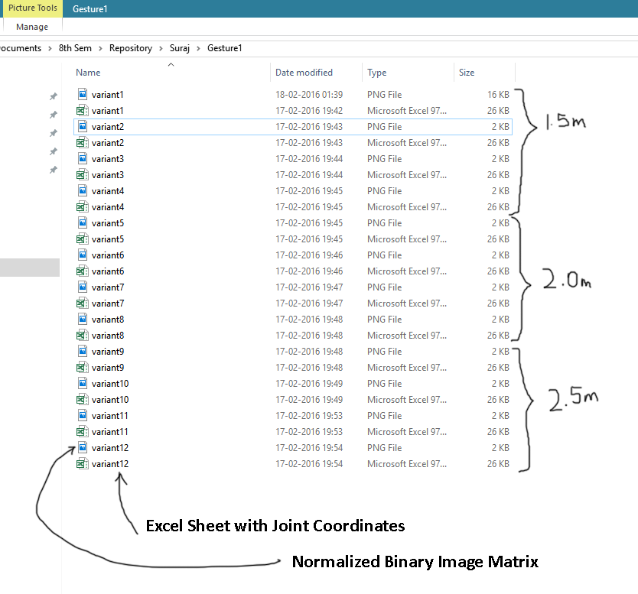
Notes:
Explain the course contents of Basic electronics in brief.

Slide 9
Algorithm to detect gesture when initiated
In contrast to arbitrarily choosing frames for motion capture, we are now using an algorithm to detect when the motion begins and assign 3 frames accordingly.
If motion starts at 120th frame,
f1=120
f2=160
f3=200

Slide 10
Next week
To collect varying gestures, we are planning to have a desk at KC to collect gestures from random people. This will serve two purposes.
Hyperlocal statistics
ISL sensitivity
Gestural information
Increase in datasets
Data with extrema can be obtained
Increased efficiency in training

Slide 11
Mock Form
A baseline will be established for average height and weight. Data sets of people with varying height above and below baseline will be taken. Gender differences will also be incorporated.
Field | Value
Height
Weight
Age
ISL gesture identification test for sensitivity analysis
Gestures recorded
Variation sets

Slide 12
Commencing training for EBPTA with collected binary data sets.

