Slide 1
NETFLIX
Content Analysis
Exploring catalog composition, growth, and audience-targeting trends across 8,800+ global titles
Python · Pandas · Matplotlib · Power BI
Data Analytics Portfolio Project | Deepti R

Slide 2
The Business Question
1
Is the catalog shifting from movies toward TV shows?
What does Netflix's
catalog actually
look like — and how
is it evolving?
2
Which countries and genres dominate the library — and where's the growth headroom?
3
How has content acquisition volume changed over time?
Streaming platforms compete on catalog depth and relevance. Content, growth, and product teams need a clear read on the existing library before deciding where to invest next.
4
Are runtimes trending shorter to match viewing habits?
Netflix Content Analysis
2

Slide 3
The Dataset
8,807
12
1925–2021
0
Titles
Original Fields
Release Span
Duplicate Records
Source: Netflix Movies and TV Shows dataset (Kaggle)
Key Fields
• type & title
• date_added & release_year
• director & cast
• rating & duration
• country
• listed_in (genre)
Data Quality Checks
Missing values imputed in director, cast, country, rating & duration • Zero duplicates confirmed • IQR outlier scan applied
Netflix Content Analysis
3

Slide 4
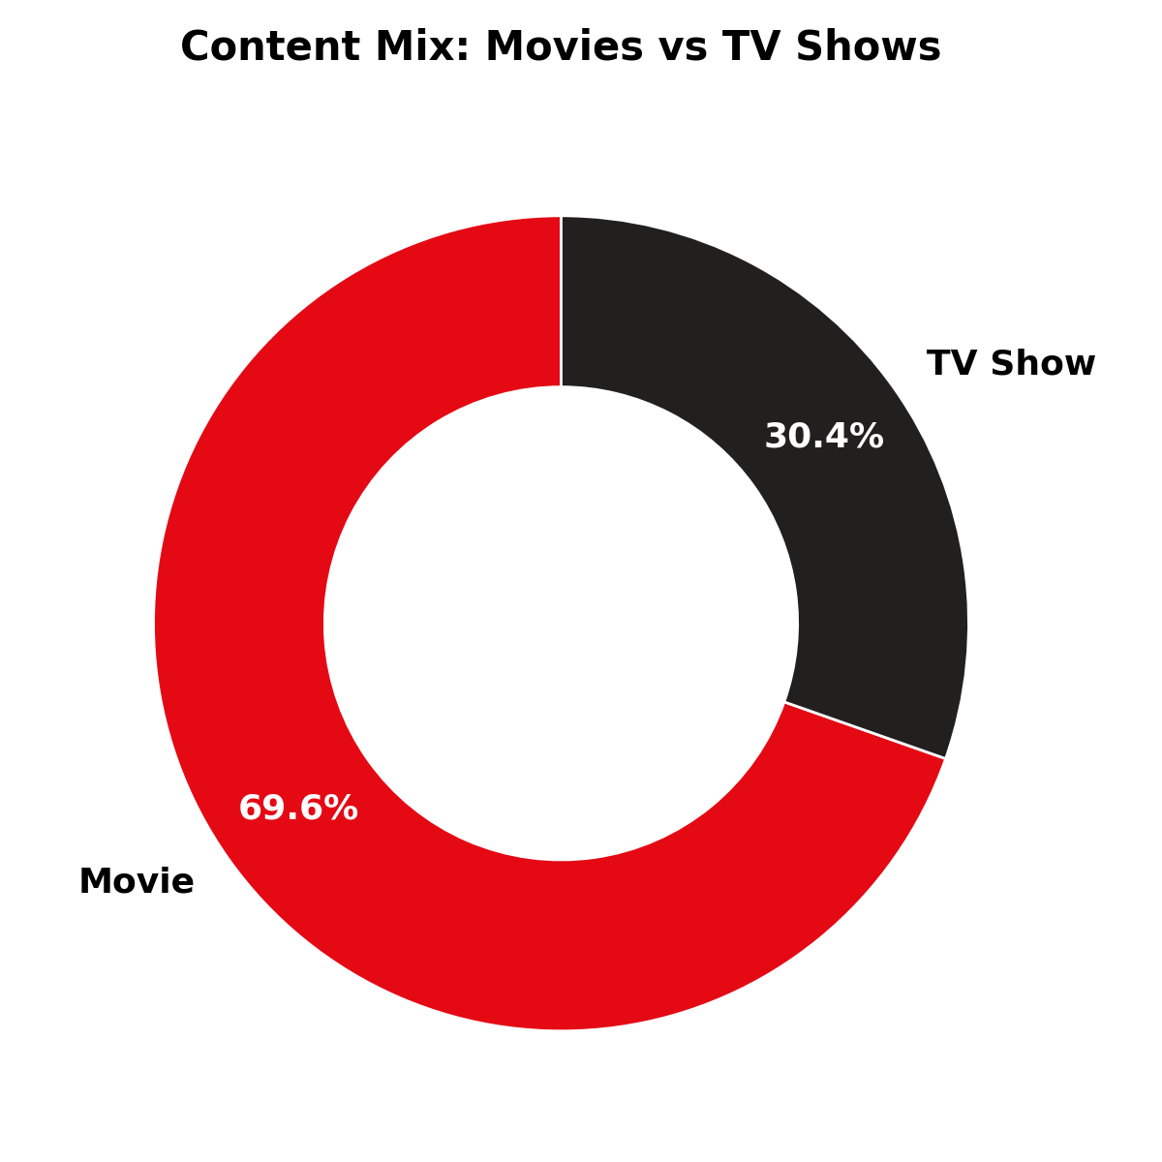
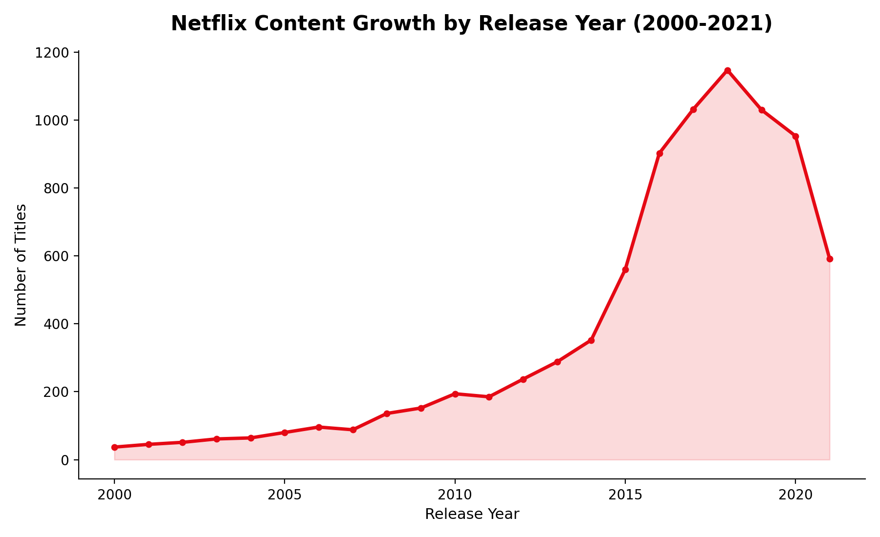
Catalog Composition & Growth
Insight: Movies still dominate at 69.6% of the catalog, but acquisition volume grew ~5x between 2012 and its 2018 peak (237 → 1,147 titles/year) before cooling post-2019.
Netflix Content Analysis
4

Slide 5
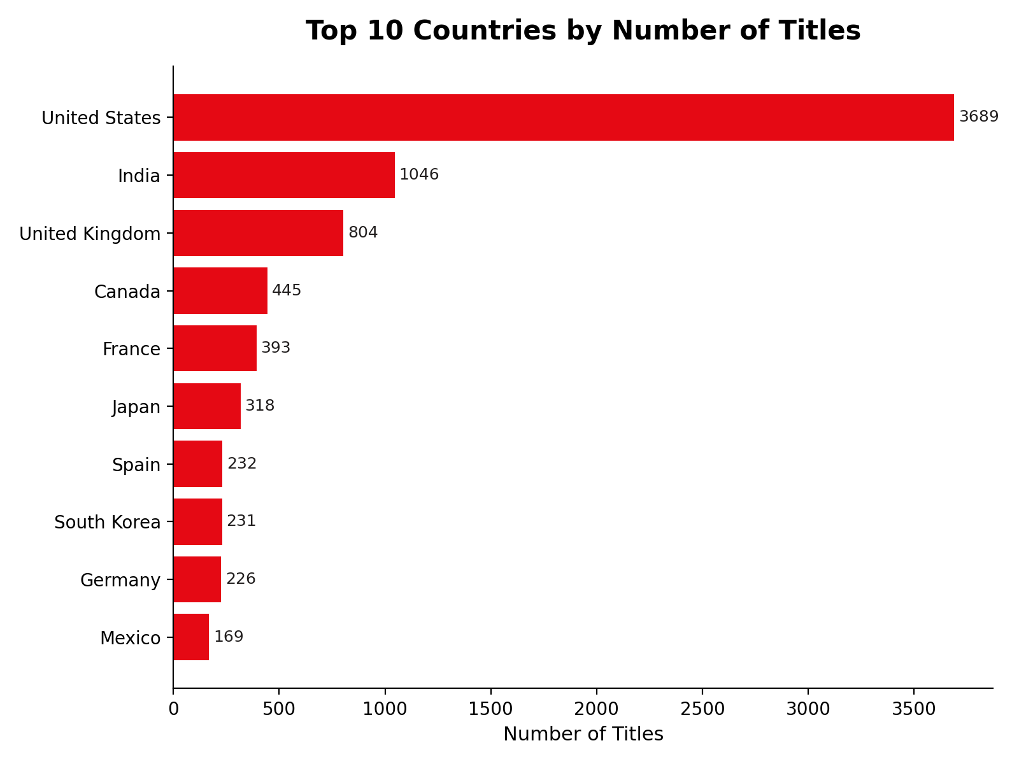
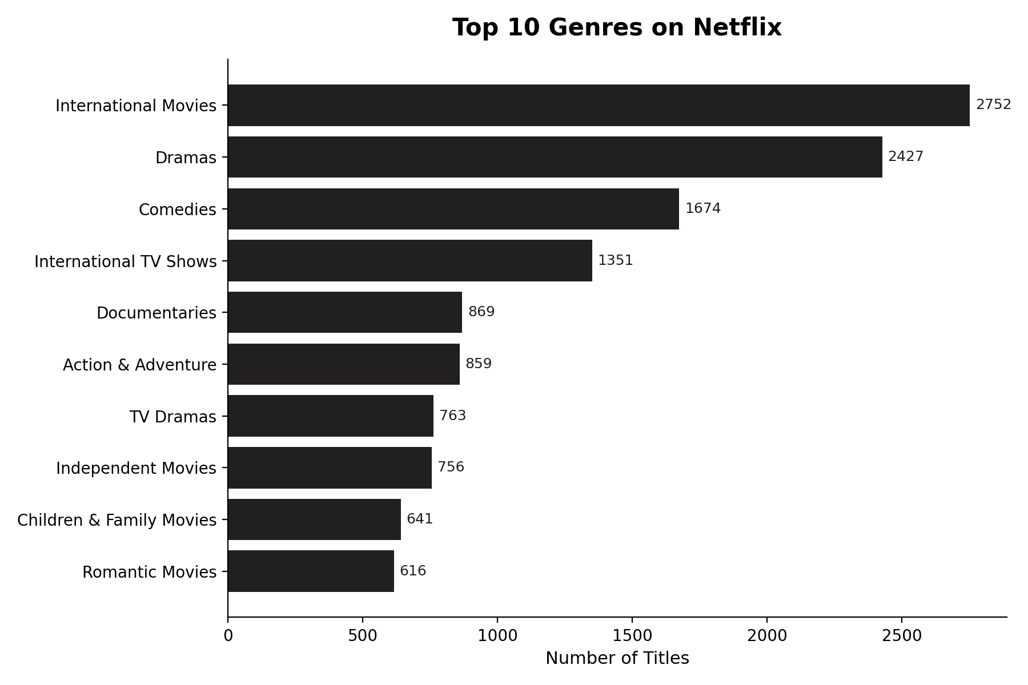
Where the Content Comes From
Insight: The U.S. (3,689) and India (1,046) lead content supply — India nearly 3x the next country — while International Movies and Dramas anchor the genre mix, reflecting a deliberate localization strategy.
Netflix Content Analysis
5

Slide 6
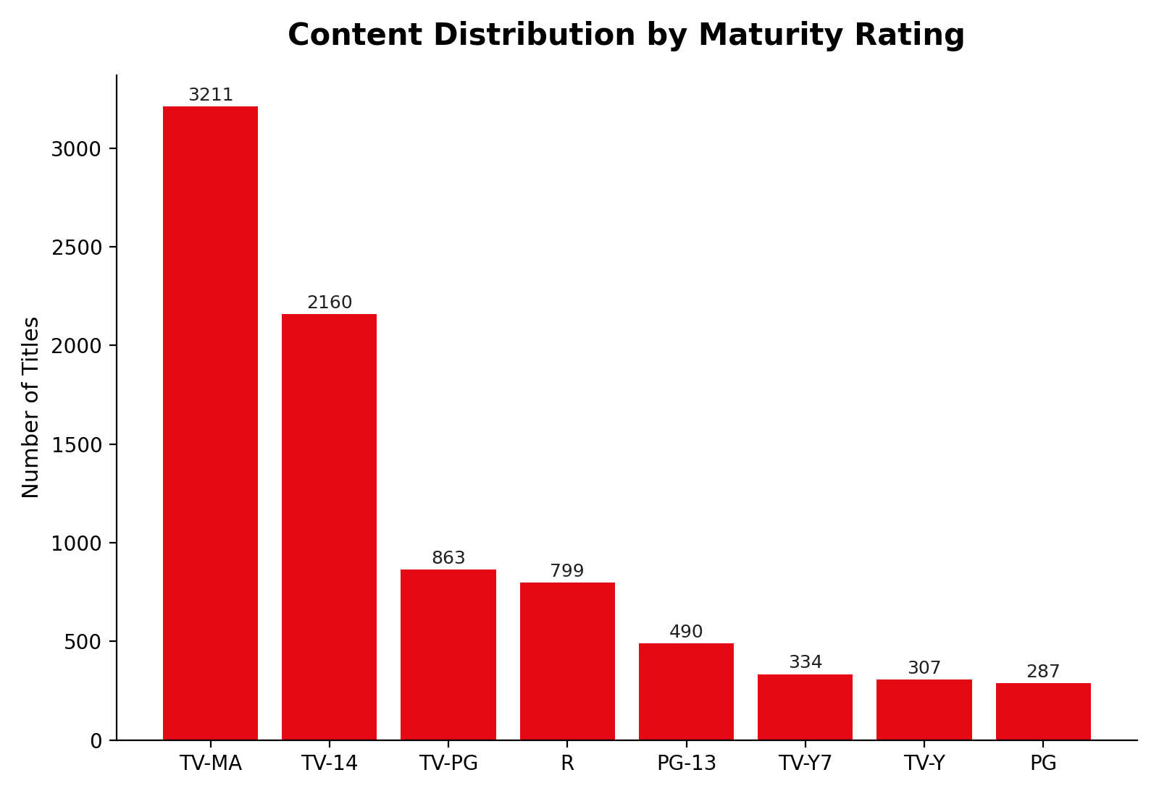
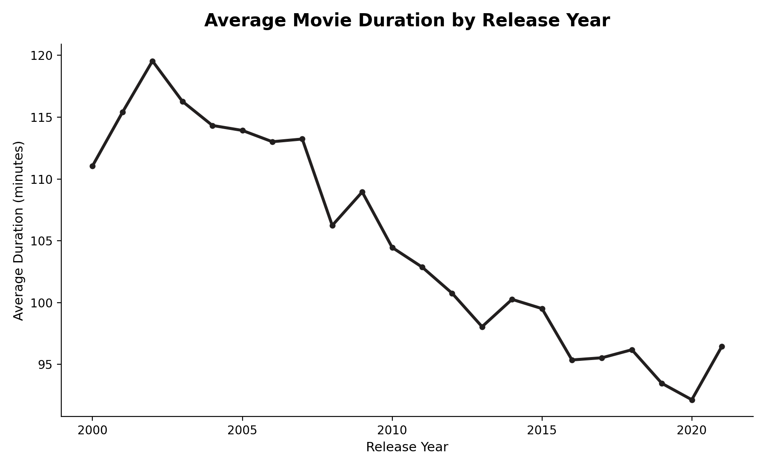
Audience & Runtime Trends
Insight: TV-MA is the largest rating segment (36% of titles), and average movie runtime fell from ~115 to 96 minutes since the early 2000s — shorter, mobile-friendly formats.
Netflix Content Analysis
6

Slide 7
Interactive Power BI Dashboard
A self-serve, two-page report so stakeholders can explore catalog trends without touching raw data.
KPI Cards
Total titles, average duration, and segment counts at a glance
Interactive Slicers
Filter the entire report live by content type and country
Trend & Category Views
Pie, bar, column and line charts covering type mix, geography, genre, rating, and release-year growth
File: netflixDashboard.pbix
Open in Power BI Desktop (free) to interact with the live report — included in the project repository alongside the analysis notebook.
Netflix Content Analysis
7

Slide 8
Thank You
Full analysis, dataset, notebook, and dashboard available on GitHub
github.com/Deepti-Ravishankar/Netflix-Content-Analysis
Deepti R | deeptiravishankar92@gmail.com

