Slide 1
Finance Sector Capstone Project Business Analytics Stream PGPDS, IIIT-B APRIL 2023
Stock Price Analysis and Forecasting
- Ravi Raj Singh Shekhawat
- Deepti Sisodiya
- Deepanshu Kumar

Slide 2
Objective
Objectives:
Examine the stock prices based on trends and stock correlations.
Stocks should be evaluated using capital asset pricing metrics.
Provide the customer investment ideas to help her reach her financial objective of generating strong yet reliable returns to support her Organization.
Data Available:
Information about 12 US-listed stocks and the SP500 index.
The equities are from the Finance, Healthcare, Technology, and Aviation sectors.
Three securities from each of these sectors.

Slide 3
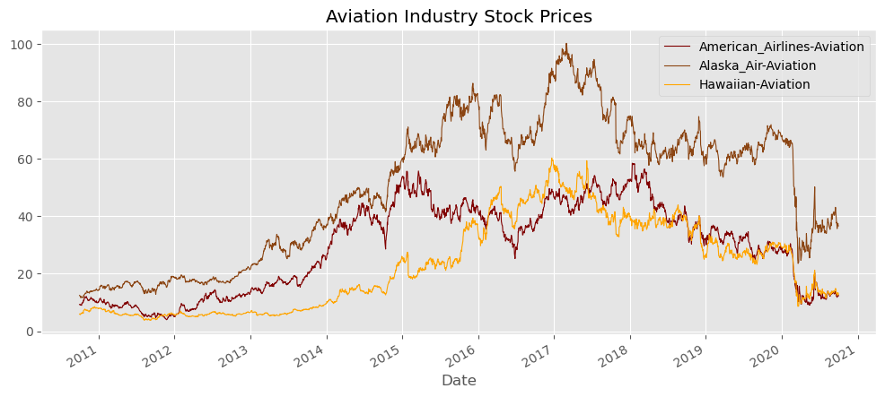
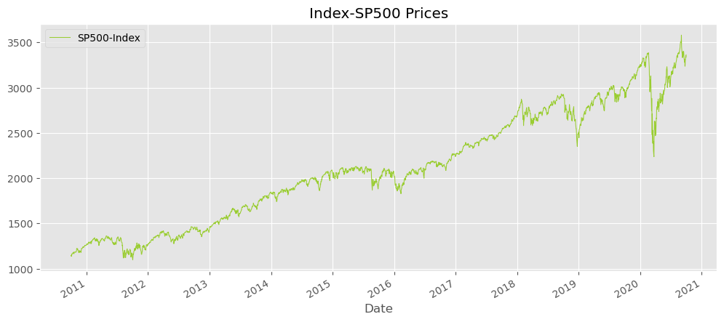
Price Trend-Actual Prices
Aviation sector:
Up to 2017–18, all three of the aviation sector's stocks showed an upward trend.
Ups and downs last from 2017 to 2018 till March 2020.
The sharp decline in pricing could be seen around March 2020.
This may be ascribed to the Covid epidemic, which severely impacted the top and bottom lines of all businesses in the aviation sector.
Alaska Airlines is suffering a greater decline.
All stock prices have seen a little but encouraging trend since March.
Significant variation in price level
From March 2020 onward, the stocks will behave in a downward trend with the SP500 index.

Slide 4
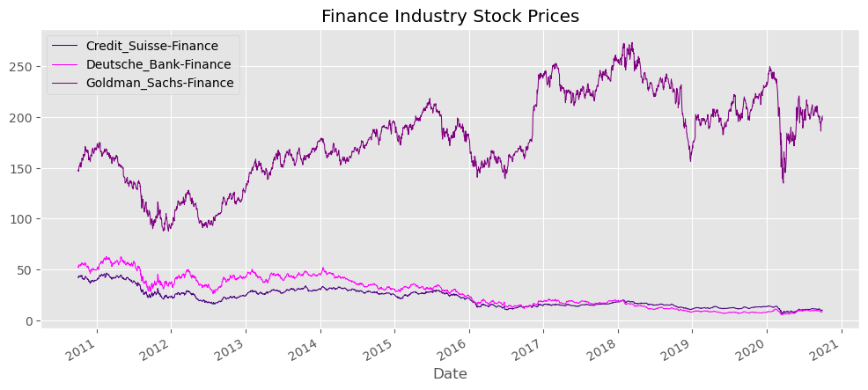
Price Trend-Actual Prices
Finance sector:
Substantial price differential between the other two stocks and Goldman Sachs.
While Goldman Sachs exhibits a rough but generally favourable trajectory, Credit Suisse and Deutsche Bank exhibit a distinct negative tendency.
The sharp decline in pricing could be seen around March 2020.
This may be ascribed to the Covid epidemic, which severely impacted the top and bottom lines of all businesses in the aviation sector.
After March, Goldman's recovery is comparable to the index, although it hasn't yet returned to its pre-covid levels.

Slide 5
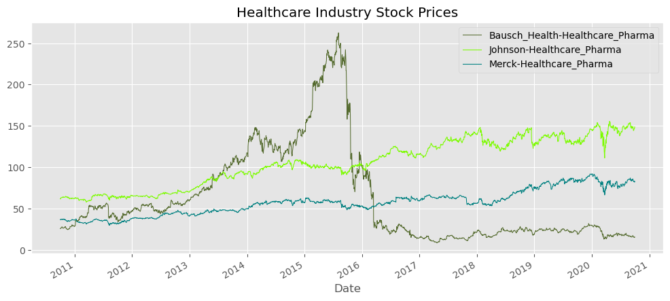
Price Trend-Actual Prices
Healthcare sector:
Bausch saw a fairly sharp decline through 2016 as a result of accusations of improper accounting after starting off weak and reaching its peak in the middle of 2015. The issue was made worse by Bausch's enormous debt load.
Merck and Jhonson & Jhonson expand consistently.
Merck and J&J are two businesses that recovered quickly from the Covid outbreak, but Bausch has not yet done so.

Slide 6
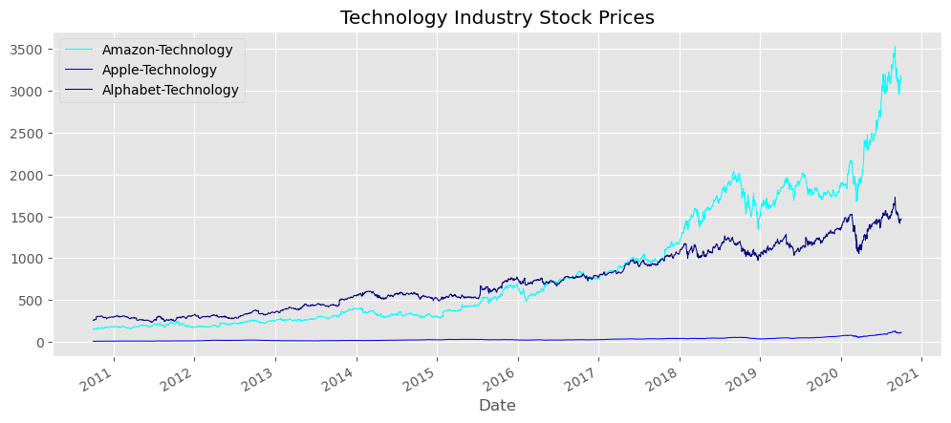
Price Trend-Actual Prices
Technology sector:
All three of the equities exhibit a distinct upward tendency, with Amazon being the most sought-after.
While Apple is making steady progress, Amazon is growing at an incredible rate.
In the beginning of the time, Google was at the top, but starting in 2018, Amazon's prices have surpassed Google's.
The prices of these stocks range substantially. Apple trades more than Google since its pricing are the lowest.

Slide 7
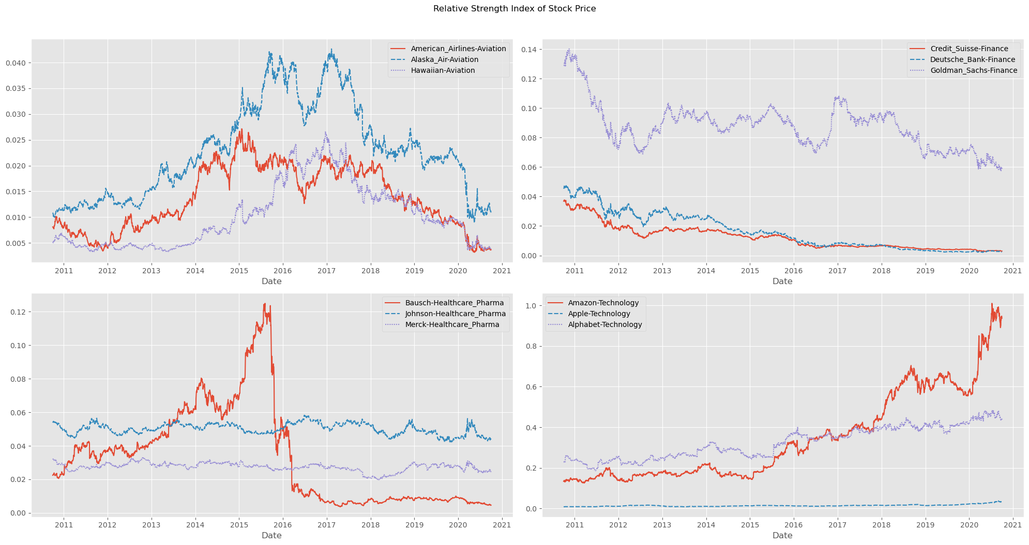
Relative Strength index of Stock prices
The preceding findings are also supported by the relative strength Index. Technology is the only sector that is growing, despite the fact that their pricing points are very different.
2. J&J and Bausche move in tandem with the index when it comes to healthcare.
3. Stocks in the financial and healthcare sectors are in decline.

Slide 8
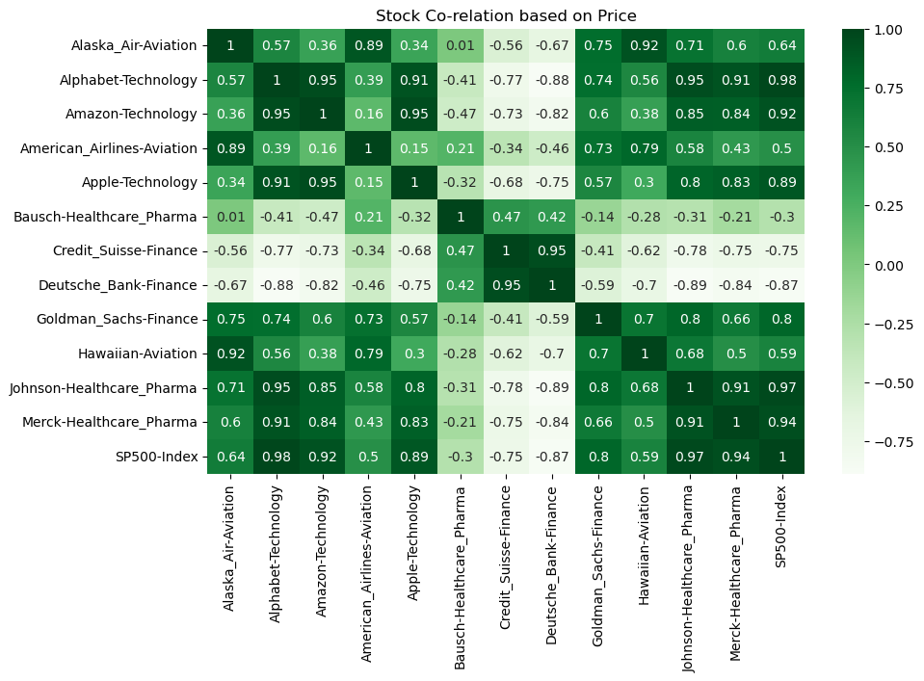
Correlation - Price
1. Apple, Amazon, Google, Goldman Sachs, J&J, Merck & Co., and Alaska are among the stocks having a strong positive correlation (0.6 to 1).
2. American Airlines and Hawaiian Holdings are two stocks having a Weak Positive Correlation (0 to 0.6).
3. Bausch Health, Credit Suisse, and Deutsche Bank are stocks with negative correlations (0 to -1).

Slide 9
Capm-Metrics used for selection of stocks
1. Annualized Return
2. Cumulative Return
3. Annualized Risk
4. Sharpe Ratio
5. Beta
6. Expected Return

Slide 10
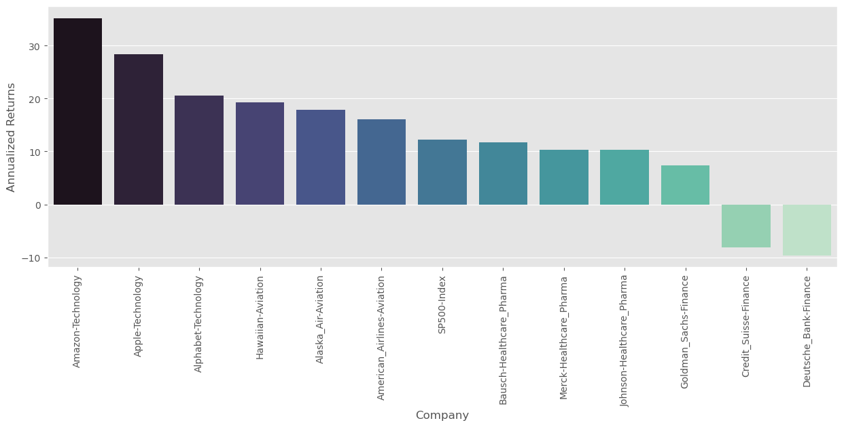
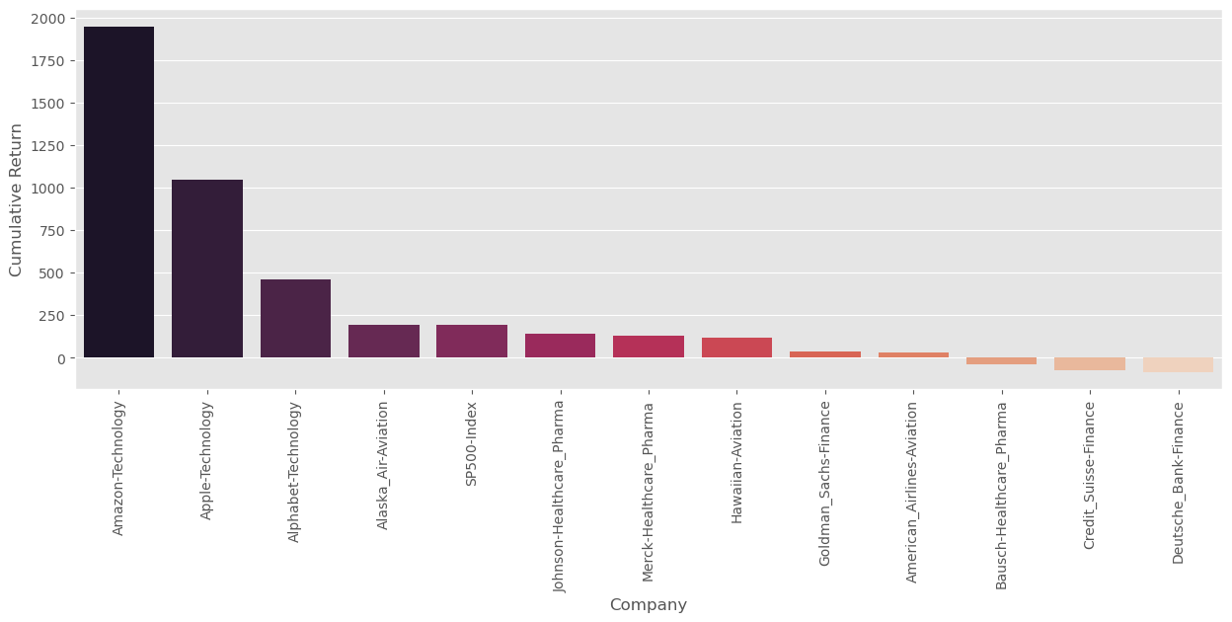














CAPM-Annualized Return
Credit Suisse and Deutsche Bank can be deleted since they have negative annualized returns and cumulative returns.
The best-performing stocks in terms of annualized and cumulative returns are tech stocks.

Slide 11
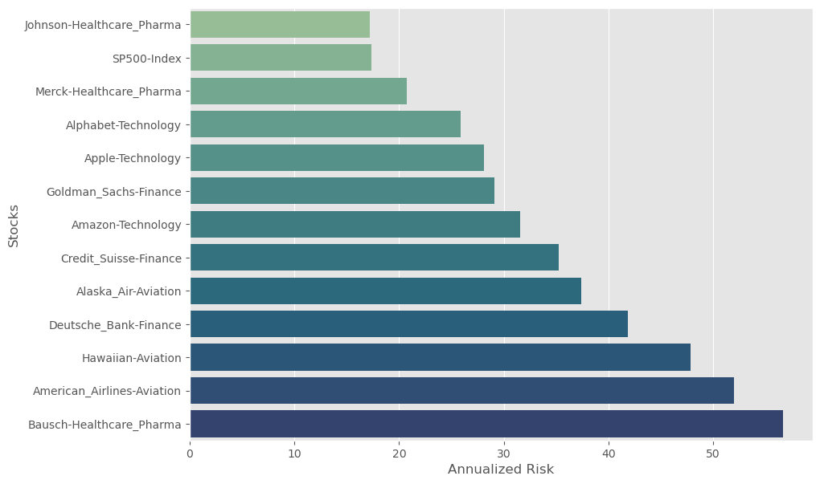
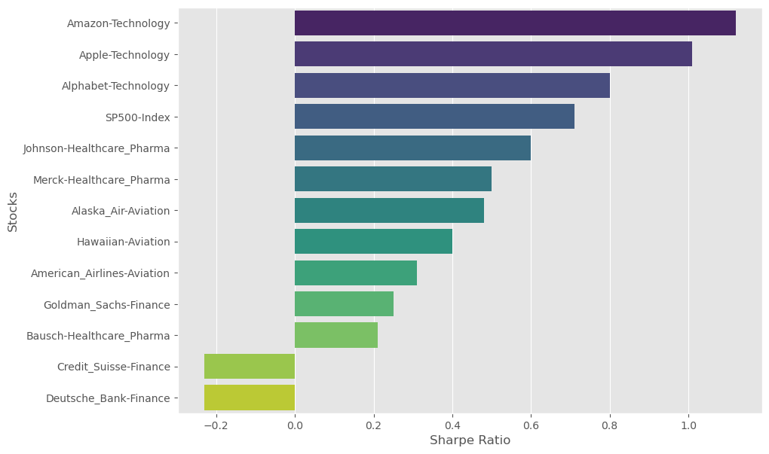






CAPM- Annualized Risk & Sharpe Ratio
The Sharpe Ratio is a combined risk and return index. The better the stock, the higher the Sharpe ratio.
The final portfolio can exclude stocks like Amazon, Apple, and Google that have Sharpe Ratios higher than the SP500 index.

Slide 12
CAPM Results
Stock Name | Annualized Returns | Cumulative Return | Annualized Risk | Sharpe Ratio | Beta | Expected Return
Credit_Suisse-Finance | -8.19 | -76.39 | 35.25 | -0.23 | 0.257315 | 5.520612
Deutsche_Bank-Finance | -9.62 | -84.03 | 41.87 | -0.23 | 0.306614 | 6.434632
Bausch-Healthcare_Pharma | 11.71 | -39.65 | 56.67 | 0.21 | 0.236193 | 5.129012
Goldman_Sachs-Finance | 7.32 | 36.07 | 29.1 | 0.25 | 0.25976 | 5.565955
American_Airlines-Aviation | 16.03 | 32.29 | 51.95 | 0.31 | 0.663337 | 13.048266
Hawaiian-Aviation | 19.29 | 116.28 | 47.86 | 0.4 | 1 | 19.29
Alaska_Air-Aviation | 17.87 | 194.28 | 37.4 | 0.48 | 0.498565 | 9.993394
Merck-Healthcare_Pharma | 10.34 | 126.64 | 20.72 | 0.5 | 0.100919 | 2.621033
Johnson-Healthcare_Pharma | 10.3 | 141.1 | 17.22 | 0.6 | 0.086496 | 2.353634
SP500-Index | 12.29 | 193.39 | 17.36 | 0.71 | 0.162274 | 3.758567
Alphabet-Technology | 20.6 | 461.28 | 25.86 | 0.8 | 0.140511 | 3.355081
Apple-Technology | 28.4 | 1047.77 | 28.13 | 1.01 | 0.152948 | 3.585651
Amazon-Technology | 35.22 | 1948.49 | 31.57 | 1.12 | 0.128986 | 3.141409

Slide 13
Results of analysis of recommended stocks (From 01-10-2010 to 30-09-2020)
Invested Fund : 500,000 USD
Investment Period :10 Years
Matured Amount : 6.26 Mil USD
Annual ROI Portfolio : 29%
Annualized Risk : 28.52%
Stocks | Annualized Returns | Annualized Risk | Stock Cumulative Return | Invested Amount | Stock Value
Amazon | 35.22 | 31.57 | 1948.49 | 166667 | 3414150.00
Apple | 28.40 | 28.13 | 1047.77 | 166667 | 1912950.00
Google | 20.60 | 25.86 | 461.28 | 166667 | 935466.67

Slide 14
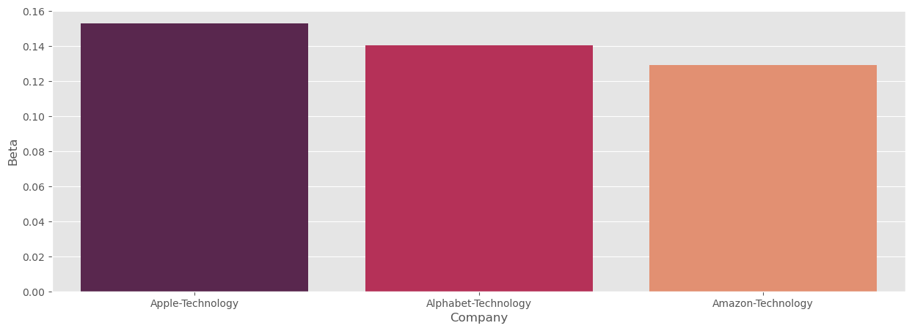
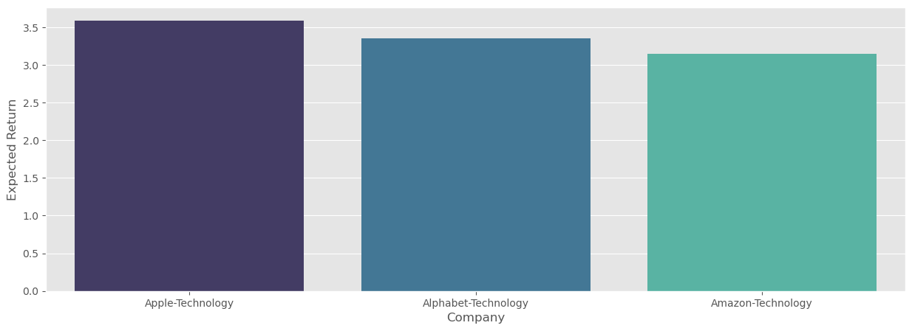
Recommended stocks – Volatility and Expected Return
Beta
Expected Return
Recommended Stocks | Beta | Expected Return
Index-SP500 (for reference only) | 0.2 | 3.8
Amazon | 0.1 | 3.1
Apple | 0.2 | 3.6
Google | 0.1 | 3.4
1. All of the tech stocks' volatility is not particularly concerning and is almost on par with the SP500 index.
2. All technology stocks have a projected return that is greater than or equal to the SP500 Index.
3. The tech stocks might be chosen for the portfolio since they provide balanced volatility and predicted returns.

Slide 15
Thank You

