Slide 1
Crime Type and Occurrence Prediction Using Machine Learning Algorithm

Slide 2
ABSTRACT
This study imposes one such crime pattern analysis by using crime data obtained from Kaggle open source which in turn used for the prediction of most recently occurring crimes. The major aspect of this project is to estimate which type of crime contributes the most along with time period and location where it has happened. Some machine learning algorithms such as Random Forest Classifier is implied in this work in order to classify among various crime patterns and the accuracy achieved was comparatively high when compared to precomposed works

Slide 3
EXISTING SYSTEM
In pre-work, the dataset obtained from the open source are first pre-processed to remove the duplicated values and features.
Decision tree has been used in the factor of finding crime patterns and also extracting the features from large amount of data is inclusive. It provides a primary structure for further classification process.

Slide 4
The classified crime patterns are feature extracted using Deep Neural network. Based on the prediction, the performance is calculated for both trained and test values. The crime prediction helps in forecasting the future happening of any type of criminal activities and help the officials to resolve them at the earliest.

Slide 5
DISADVANTAGES OF EXISTING SYSTEM
The pre-existing works account for low accuracy since the classifier uses a categorical values which produces a biased outcome for the nominal attributes with greater value.
The classification techniques does not suited for regions with inappropriate data and real valued attributes.
The value of the classifier must be tuned and hence there is a need of assigning an optimal value.

Slide 6
PROPOSED SYSTEM
The data obtained is first pre-processed using machine learning technique filter and wrapper in order to remove irrelevant and repeated data values. It also reduces the dimensionality thus the data has been cleaned. The data is then further undergoes a splitting process. It is classified into test and trained data set.

Slide 7
The model is trained by dataset both training and testing .It is then followed by mapping. The crime type, year, month, time, date, place are mapped to an integer for ensuring classification easier. The independent effect between the attributes are analysed initially by using Random Forest Classifier.

Slide 8
The crime features are labelled that allows to analyse the occurrence of crime at a particular time and location. Finally, the crime which occur the most along with spatial and temporal information is gained. The performance of the prediction model is find out by calculating accuracy rate. The language used in designing the prediction model is python and run on data analysis and machine learning model.

Slide 9
ADVANTAGES OF PROPOSED SYSTEM
The proposed algorithm is well suited for the crime pattern detection since most of the featured attributes depends on the time and location.
It also overcomes the problem of analyzing independent effect of the attributes.
The initialization of optimal value is not required since it accounts for real valued, nominal value and also concern the region with insufficient information.
The accuracy has been relatively high when compared to other machine learning prediction model.

Slide 10
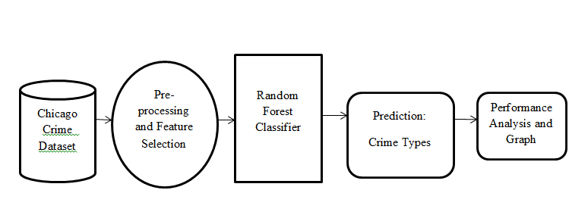
SYSTEM ARCHITECTURE

Slide 11
HARDWARE REQUIREMENTS
System : Pentium i3 Processor.
Hard Disk : 500 GB.
Monitor : 15’’ LED
Input Devices : Keyboard, Mouse
Ram : 4 GB

Slide 12
SOFTWARE REQUIREMENTS
Operating System : Windows 10 / 11.
Coding Language : Python 3.8.
Web Framework : Flask.
Frontend : HTML, CSS, JavaScript.

Slide 13
REFERENCE
Kanimozhi N, Keerthana N V, Pavithra G S, Ranjitha G,Yuvarani S, “Crime Type and Occurrence Prediction Using Machine Learning Algorithm”, IEEE Conference, 2021.

