Slide 1
Project-6
Bank Loan Case Study
BY.DEEPTIRANI BENIA

Slide 2
Project Description:
As a data analyst, do exploratory data analysis (EDA) for a finance company that specialises in giving loans to urban consumers. The company has the difficulty of customers with insufficient credit history abusing the system and defaulting on loans. The goal is to use EDA to identify trends in the data and ensure that qualified candidates are not rejected.The dataset contains loan application information divided into two categories: clients having payment troubles (late installment payments) and those who do not have payment concerns. A loan application has four possible outcomes: approved, cancelled, refused, and unused offer.The commercial objectives are to uncover trends that indicate if a customer would struggle to make installment payments. This data can be used to make judgements like refusing loans, decreasing loan amounts, or lending at higher interest rates to risky applicants, The company's goal is to better understand the primary elements that contribute to loan defaults in order to make better loan approval decisions.The background of risk analytics in banking and financial services is critical to comprehending the project, particularly the importance of numerous variables in anticipating and managing loan default risks.

Slide 3
Approach:
The emphasis is on reducing default risks, particularly from consumers with a limited credit history. The dataset is divided into two categories: consumers who have difficulty making payments and those who do not. There are four possible loan application outcomes: approved, cancelled, refused, and unused offer.The primary business objectives are to discover trends that indicate possible payment issues and to understand the key variables causing loan defaults. The goal of EDA is to optimise decision-making in loan approval by reducing rejections for qualified applicants while minimising financial losses associated with defaults. To navigate the relevance of variables in this environment, a solid understanding of risk analytics in banking and financial services is required.
Tech stack used:The primary tool used in the technology stack was Microsoft Excel 2007. The project largely relied on Excel's vast functionalities, sophisticated data handling capabilities, and robust charting tools, playing an integral rolein both analysis and reporting phases.

Slide 4
Graph of column with missing values<50%
TASK1:Identify Missing Data and Deal with it Appropriately: As a data analyst, you come across missing data in the loan application dataset. It is essential to handle missing data effectively to ensure the accuracy of the analysis.
Task: Identify the missing data in the dataset and decide on an appropriate method to deal with it using Excel built-in functions and features.
Explanation: In order to handle missing data the following steps were done;
1.The percentage of blank cells in a new row (50000) using the function was calculated
=(COUNTBLANK()/COUNT())*100
2.With the help of conditional formatting all the columns which had a
percentage of missing cells more than 50% were identified and deleted.
3.Then filled all the missing cells with the median (row 50001) of that particular column (median as
mean will be ineffective because of outliers.

Slide 5
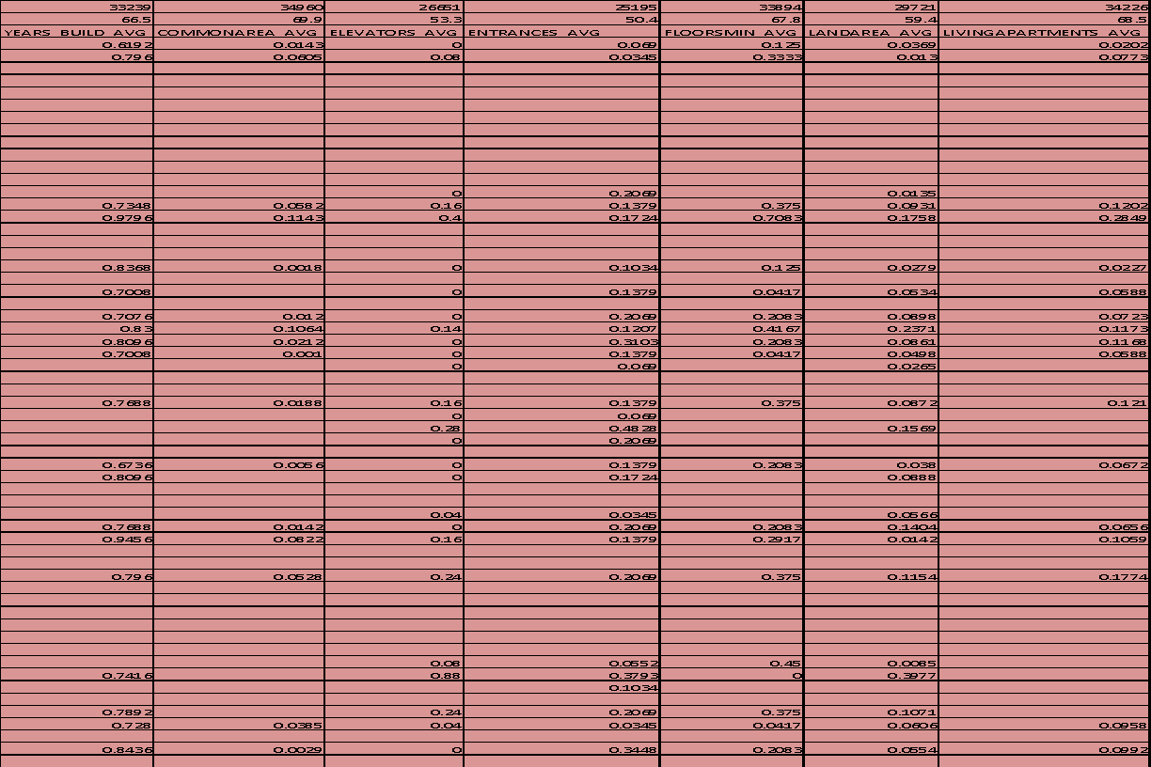
Columns with missing value more than 50%

Slide 6
TASK2:Identify Outliers in the Dataset: Outliers can significantly impact the analysis and distort the results. You need to identify outliers in the loan application dataset.
Task: Detect and identify outliers in the dataset using Excel statistical functions and features, focusing on numerical variables.
Explanation: In order to identify the outliers the quartile function was used as the following:
1.The ﬁrst and third quartile using the function =QUARTILE(ARRAY,1) and =
QUARTILE(ARRAY,3) was calculated.
2. Then the inter quartile range(IQR) by subtracting the ﬁrst quarter from the third quarter was calculated.
3. Lastly the lower and upper bound using the formula lower bound = Q1 - 1.5*IQR, upper
bound = Q3 + 1.5*IQR was calculated.
4. Another column was created to check if the values in the previous column lie between the
range of upper bound and lower bound which will be true and false if the value is an oulier.
COLUMNS | CNT_CHILDREN | AMT_INCOME_TOTAL | AMT_CREDIT | AMT_ANNUITY | AMT_GOODS_PRICE | REGION_POPULATION_RELATIVE
Q1 | 0 | 112500 | 270000 | 16456.5 | 238500 | 0.010006
Q3 | 1 | 202500 | 808650 | 34596 | 679500 | 0.028663
IQR | 1 | 90000 | 538650 | 18139.5 | 441000 | 0.018657
UPPER LIMIT | 2.5 | 337500 | 1616625 | 61805.25 | 1341000 | 0.0566485
LOWER LIMIT | -1.5 | -22500 | -537975 | -10752.75 | -423000 | -0.0179795

Slide 9
TASK 3: Analyze Data Imbalance: Data imbalance can affect the accuracy of the analysis, especially for binary classification problems. Understanding the data distribution is crucial for building reliable models.
Task: Determine if there is data imbalance in the loan application dataset and calculate the ratio of data imbalance using Excel functions.
Explanation: In order to check the data imbalance in the dataset first of all I created different pivot tables for
columns in which the data imbalance was to be checked and generated column charts for each
of them in a different sheet.
No Payment Difficulties | Payment Difficulties/Data Imbalance | Ratio of Data Imbalance
45973 | 4026 | 11.41902633

Slide 10
Loan Type | Count of Loan Type
Cash loans | 45276
Revolving loans | 4723
Grand Total | 49999

Slide 11
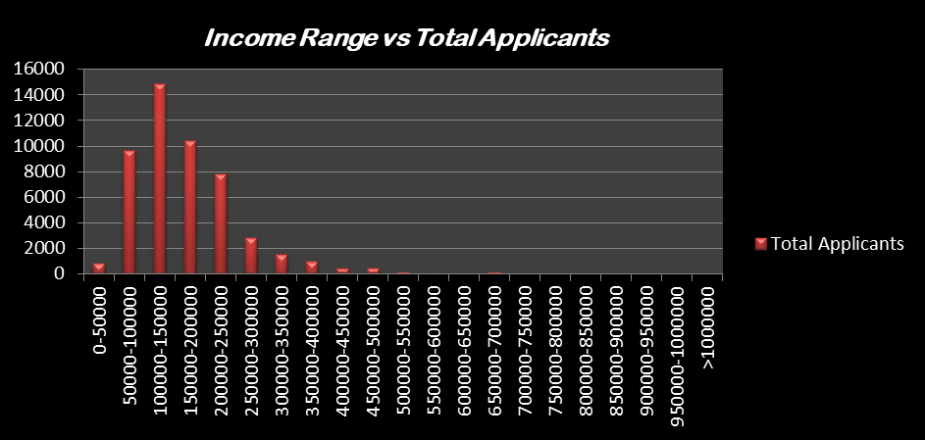
TASK4:Perform Univariate, Segmented Univariate, and Bivariate Analysis: To gain insights into the driving factors of loan default, it is important to conduct various analyses on consumer and loan attributes.
Task: Perform univariate analysis to understand the distribution of individual variables, segmented univariate analysis to compare variable distributions for different scenarios, and bivariate analysis to explore relationships between variables and the target variable using Excel functions and features.
Segmented univariate analysis: segmented univariate analysis is an extension of univariate
analysis as Segmented analysis here means that the data variable is analyzed in subsets(as ranges).

Slide 12
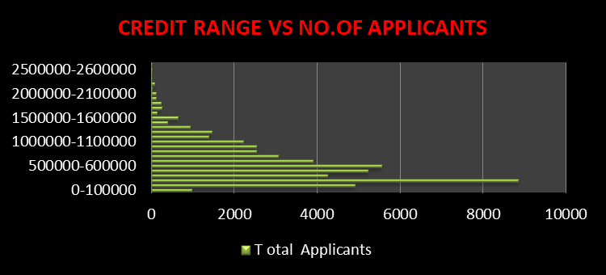

Slide 16
Univariate analysis: This type of analysis data consists of only one variable. The analysis of univariate data is thus the simplest form of analysis since the information deals with only one quantity that changes. It does not deal with causes or relationships and the main purpose of the analysis is to describe the data and find pattern that exist within it.
Gender | Non-Defaulters | Defaulters
Male | 15412 | 1762
Female | 30559 | 2264
Total | 45971 | 4026

Slide 17
Age Group | Younger | Mid Age | Older
Age Range | 20-40 | 41-60 | 61-90
Total | 20719 | 22099 | 4778
Defaulters | 2129 | 1499 | 242
Non-Defaulters | 18590 | 20600 | 4536

Slide 18
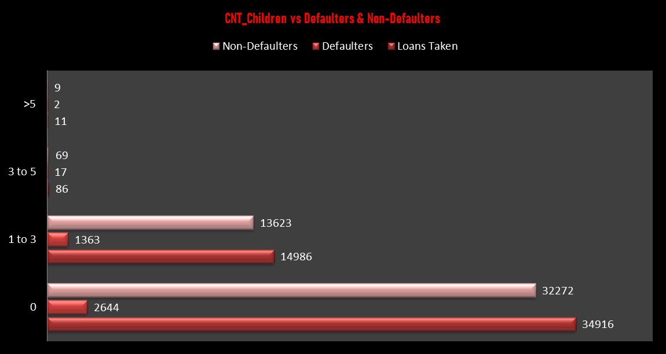

Slide 19
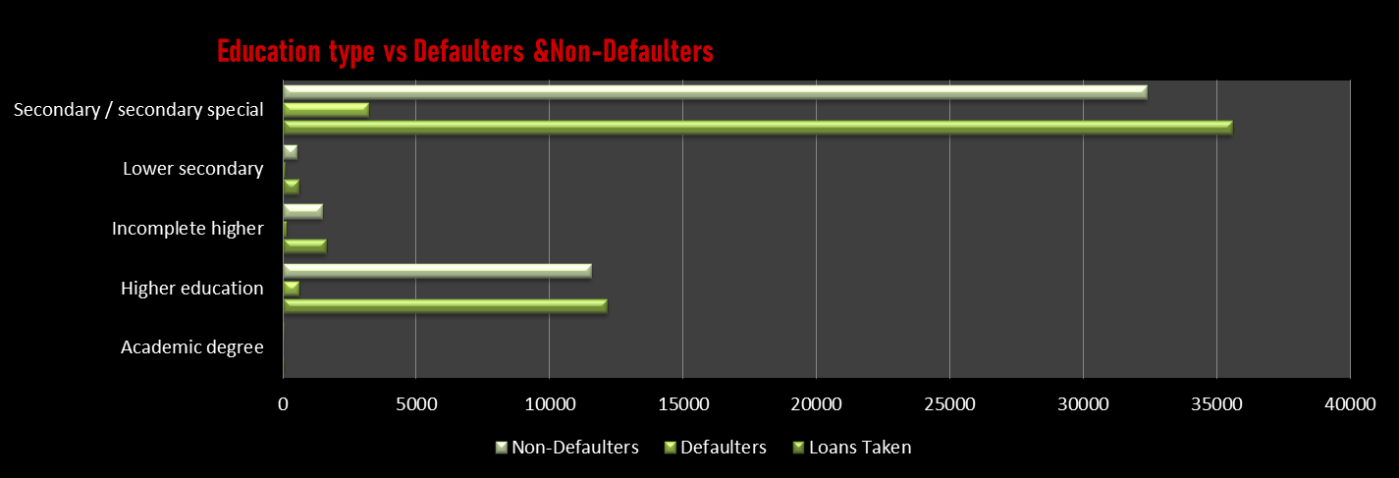

Slide 20
Bivariate analysis: Bivariate analysis is one of the statistical analyses where two variables are observed. One variable here is dependent while the other is independent. These variables are usually denoted by X and Y. So, here we analyze the changes occurring between the two variables and to what extent. Apart from bivariate, there are other two statistical analyses, which are Univariate (for one variable) and Multivariate (for multiple variables).

Slide 22
TASK 5:Identify Top Correlations for Different Scenarios: Understanding the correlation between variables and the target variable can provide insights into strong indicators of loan default.
Task: Segment the dataset based on different scenarios (e.g., clients with payment difficulties and all other cases) and identify the top correlations for each segmented data using Excel functions.
CORRELATIONS MATRIX OF DEFAULTERS:
 | AMT_INCOME_TOTAL | AMT_CREDIT | AMT_ANNUITY | AMT_GOODS_PRICE | REGION_POPULATION_RELATIVE
AMT_INCOME_TOTAL | 1
AMT_CREDIT | 0.015271444 | 1
AMT_ANNUITY | 0.018004594 | 0.749665201 | 1
AMT_GOODS_PRICE | 0.013261653 | 0.982130206 | 0.74932991 | 1
REGION_POPULATION_RELATIVE | -0.006180303 | 0.067775624 | 0.073123998 | 0.076500471 | 1
YEARS BIRTH | -0.009035912 | 0.142507056 | 0.008752534 | 0.14096789 | 0.016460517
YEARS EMPLOYED | -0.011758484 | 0.018782058 | -0.07811389 | 0.023125793 | 0.007710084
YEARS REGISTRATION | 0.009568333 | 0.042838246 | -0.021589147 | 0.04342161 | 0.046127179
YEARS_ID_PUBLISHED | 0.009118745 | 0.043779933 | 0.021329621 | 0.049851329 | 0.005122121
FLAG_MOBIL | #DIV/0! | #DIV/0! | #DIV/0! | #DIV/0! | #DIV/0!
FLAG_EMP_PHONE | 0.011657983 | -0.017405837 | 0.078846392 | -0.021649074 | -0.007727337
FLAG_WORK_PHONE | -0.011875045 | -0.052629114 | -0.035804098 | -0.028295112 | -0.026921987
FLAG_CONT_MOBILE | -0.001651428 | 0.030642933 | 0.034863848 | 0.027860595 | -0.002509474
FLAG_PHONE | -0.008271927 | 0.036387061 | 0.004841298 | 0.050726515 | 0.078115256
FLAG_EMAIL | 0.000379597 | -0.004036924 | 0.096360456 | -0.002323483 | 0.050737138
CNT_FAM_MEMBERS | 0.013121678 | 0.06124869 | 0.075838463 | 0.055033664 | -0.017257146
REGION_RATING_CLIENT | -0.012846697 | -0.045024534 | -0.061578289 | -0.051199549 | -0.430032303
REGION_RATING_CLIENT_W_CITY | -0.01266585 | -0.052954314 | -0.079418668 | -0.056589982 | -0.431675881
HOUR_APPR_PROCESS_START | 0.014482013 | 0.045396384 | 0.044891881 | 0.057519415 | 0.156049669
REG_REGION_NOT_LIVE_REGION | 0.000594885 | 0.006456715 | 0.031759358 | 0.007059122 | -0.003105241
REG_REGION_NOT_WORK_REGION | 0.001665752 | 0.023536318 | 0.065686571 | 0.024983486 | 0.019170075
LIVE_REGION_NOT_WORK_REGION | 0.002228043 | 0.034604167 | 0.074238732 | 0.035396362 | 0.059536379

Slide 23
YEARS BIRTH | YEARS EMPLOYED | YEARS REGISTRATION | YEARS_ID_PUBLISHED | FLAG_MOBIL | FLAG_EMP_PHONE | FLAG_WORK_PHONE | FLAG_CONT_MOBILE | FLAG_PHONE
1
0.588245517 | 1
0.288428 | 0.192435337 | 1
0.247892323 | 0.232658322 | 0.090291985 | 1
#DIV/0! | #DIV/0! | #DIV/0! | #DIV/0! | #DIV/0!
-0.584905295 | -0.999899229 | -0.190586407 | -0.231376169 | #DIV/0! | 1
-0.166202939 | -0.20518453 | -0.058053686 | -0.036506553 | #DIV/0! | 0.205356525 | 1
0.0077705 | -0.011818551 | 0.0124658 | -0.005761818 | #DIV/0! | 0.011928014 | 0.01713917 | 1
0.049108318 | 0.033474909 | 0.065081426 | 0.039142364 | #DIV/0! | -0.032542305 | 0.29825961 | 0.017151262 | 1
-0.078030455 | -0.051623065 | 0.009238182 | -0.033383248 | #DIV/0! | 0.051184266 | 0.015201497 | 0.007582037 | 0.025468396
-0.199134357 | -0.183363017 | -0.15179448 | 0.044026557 | #DIV/0! | 0.183480334 | 0.06767423 | -0.001637682 | 0.00310596
-0.045016529 | -0.0092372 | -0.115624493 | -0.025324662 | #DIV/0! | 0.009192186 | 0.024253798 | 0.02633495 | -0.062845235
-0.038077836 | -0.004126285 | -0.10812252 | -0.014420115 | #DIV/0! | 0.004132384 | 0.029153013 | 0.025221794 | -0.055001395
-0.057895674 | -0.051652953 | 0.057804127 | -0.005519899 | #DIV/0! | 0.051867099 | 0.048220577 | -0.010097486 | 0.058727446
-0.039612086 | -0.036401422 | -0.01584823 | -0.024135123 | #DIV/0! | 0.035853044 | 0.07252018 | -0.053557463 | 0.011531209
-0.075512656 | -0.086927664 | -0.016394237 | -0.041092845 | #DIV/0! | 0.085935835 | 0.100892722 | 0.007172253 | 0.024091913
-0.054495086 | -0.073733182 | -0.013576147 | -0.029554625 | #DIV/0! | 0.073036483 | 0.069701382 | 0.006095666 | 0.028271408

Slide 24
FLAG_EMAIL | CNT_FAM_MEMBERS | REGION_RATING_CLIENT | REGION_RATING_CLIENT_W_CITY | HOUR_APPR_PROCESS_START
1
-0.000856653 | 1
-0.022725594 | 0.057279521 | 1
-0.019500794 | 0.057987728 | 0.950768899 | 1
-0.008034183 | -0.023902962 | -0.278881752 | -0.25307393 | 1
0.022861742 | -0.003937853 | -0.031399629 | -0.029546733 | 0.049424395
0.016072424 | -0.008639937 | -0.103282721 | -0.099238119 | 0.076148974
0.00631375 | -0.010644522 | -0.123204343 | -0.118786695 | 0.066057815

Slide 25
REG_REGION_NOT_LIVE_REGION | REG_REGION_NOT_WORK_REGION | LIVE_REGION_NOT_WORK_REGION
1
0.525502749 | 1
0.100525936 | 0.806743886 | 1
Those which are highlighted in pink color are the top correaltions.There also exist some negative correlations such as Amount_credit & Flag_work home,Amount income total &Flag work home, Amount income total & Flag_phone etc etc.
The correlation between Amount_credit & Amount Goods price is the highest.

Slide 26
CORRELATIONS MATRIX OF Non-DEFAULTERS:
 | AMT_INCOME_TOTAL | AMT_CREDIT | AMT_ANNUITY | AMT_GOODS_PRICE | REGION_POPULATION_RELATIVE
AMT_INCOME_TOTAL | 1
AMT_CREDIT | 0.377965752 | 1
AMT_ANNUITY | 0.445418 | 0.760582436 | 1
AMT_GOODS_PRICE | 0.384548363 | 0.986904954 | 0.765569181 | 1
REGION_POPULATION_RELATIVE | 0.181941261 | 0.095539444 | 0.116063848 | 0.098938662 | 1
YEARS BIRTH | -0.073769425 | 0.051084182 | -0.010719841 | 0.048684805 | 0.030435419
YEARS EMPLOYED | -0.161680938 | -0.074733443 | -0.110215883 | -0.072483595 | -0.006767142
YEARS REGISTRATION | -0.06893375 | -0.008053758 | -0.034180066 | -0.011284757 | 0.058501361
YEARS_ID_PUBLISHED | -0.032286356 | 0.008290189 | -0.009196312 | 0.009304156 | 0.002236288
FLAG_MOBIL | 0.002009697 | 0.00372218 | 0.000393705 | 0.003633671 | 0.003461456
FLAG_EMP_PHONE | 0.162219844 | 0.076005444 | 0.111051977 | 0.073786826 | 0.00674935
FLAG_WORK_PHONE | -0.034502225 | -0.011512143 | -0.017828984 | 0.010105914 | -0.015101101
FLAG_CONT_MOBILE | -0.016970699 | 0.024439133 | 0.022377193 | 0.022139344 | -0.004898838
FLAG_PHONE | 0.00273884 | 0.017200016 | 0.005847484 | 0.033105642 | 0.093910712
FLAG_EMAIL | 0.087488653 | 0.011859749 | 0.062752816 | 0.011409483 | 0.038691982
CNT_FAM_MEMBERS | 0.041599302 | 0.064876937 | 0.075935182 | 0.062930035 | -0.023005074
REGION_RATING_CLIENT | -0.205031899 | -0.102556478 | -0.128312327 | -0.104900325 | -0.539333113
REGION_RATING_CLIENT_W_CITY | -0.220044862 | -0.111639948 | -0.141387572 | -0.113185041 | -0.536859601
HOUR_APPR_PROCESS_START | 0.08543156 | 0.056524809 | 0.053087671 | 0.065357649 | 0.167612161
REG_REGION_NOT_LIVE_REGION | 0.078942904 | 0.027812773 | 0.045490762 | 0.03029452 | -0.003185217
REG_REGION_NOT_WORK_REGION | 0.157051351 | 0.05609686 | 0.081270156 | 0.057479004 | 0.063145413
LIVE_REGION_NOT_WORK_REGION | 0.147730123 | 0.05443061 | 0.073754927 | 0.054613236 | 0.087419766

Slide 27
YEARS BIRTH | YEARS EMPLOYED | YEARS REGISTRATION | YEARS_ID_PUBLISHED | FLAG_MOBIL | FLAG_EMP_PHONE
1
0.623474675 | 1
0.335028046 | 0.208846476 | 1
0.270073313 | 0.274516224 | 0.103548902 | 1
0.008068695 | 0.002280151 | 0.000304657 | 0.006016013 | 1
-0.619443937 | -0.999736158 | -0.206572521 | -0.273500944 | -0.00220893 | 1
-0.175419095 | -0.234135541 | -0.059505721 | -0.050945857 | 0.002308233 | 0.234398497
0.012765423 | 0.016889392 | -8.39513E-05 | 0.004976838 | -0.00021446 | -0.016876487
0.041288098 | 0.022252592 | 0.071428092 | 0.031387579 | 0.002923322 | -0.021521368
-0.093733189 | -0.068700648 | -0.033249993 | -0.033383068 | 0.001133268 | 0.068273194
-0.284379407 | -0.234765183 | -0.171482728 | 0.025054258 | 0.000801334 | 0.234270918
-0.00902485 | 0.040937165 | -0.082562812 | 0.008097427 | 0.000383258 | -0.040711716
-0.00708431 | 0.043223355 | -0.074745932 | 0.012667326 | 0.000192888 | -0.043056438
-0.09638927 | -0.092999147 | 0.002396446 | -0.037971336 | -0.00131599 | 0.092629657
-0.060427036 | -0.037941756 | -0.027899954 | -0.033228477 | 0.000568904 | 0.037186935
-0.095915233 | -0.109907472 | -0.034657988 | -0.047811506 | 0.001069823 | 0.108639307
-0.06988551 | -0.097638131 | -0.023280394 | -0.033751626 | 0.000951506 | 0.096624336

Slide 28
FLAG_WORK_PHONE | FLAG_CONT_MOBILE | FLAG_PHONE | FLAG_EMAIL | CNT_FAM_MEMBERS
1
0.022757235 | 1
0.299091108 | 0.004592469 | 1
-0.010316581 | -0.011554223 | 0.015187351 | 1
0.06756039 | -0.005199228 | -0.018197054 | 0.024271007 | 1
0.0025479 | 0.013115747 | -0.088733037 | -0.05899463 | 0.022204476
0.007884758 | 0.013238981 | -0.083627775 | -0.05652979 | 0.021214058
0.034759717 | 0.004390895 | 0.060495723 | 0.023413137 | -0.010117379
0.064368753 | 0.001664795 | 0.006392 | 0.016899293 | -0.013156094
0.068767963 | -0.002504657 | -0.004029678 | 0.042585702 | 0.008363421
0.041507195 | -0.002720566 | -0.006697622 | 0.043363844 | 0.017119617

Slide 29
REGION_RATING_CLIENT | REGION_RATING_CLIENT_W_CITY | HOUR_APPR_PROCESS_START
1
0.950468157 | 1
-0.282820908 | -0.261757104 | 1
-0.042818496 | -0.038588698 | 0.051186937
-0.145268301 | -0.137999544 | 0.07357221
-0.149762727 | -0.143453231 | 0.059752705

Slide 30
REG_REGION_NOT_LIVE_REGION | REG_REGION_NOT_WORK_REGION | LIVE_REGION_NOT_WORK_REGION
1
0.449554959 | 1
0.080451998 | 0.861374946 | 1
Those which are highlighted in pink color are the top correaltions.There also exist some negative correlations such as Year_Registration & Flag_work home, Amount _Annuity & Region_rating client, Flag_CONT_mobile& Flag_EMP_phone etc etc.
The correlation between Amount_credit & Amount Goods price is the highest.

Slide 31
RESULT
Participating in this extensive project allowed for a better understanding of Excel's numerous functions. The investigation of concepts such as graphs,pie charts, correlation coefficients, and univariate and bivariate analysis improved understanding of statistical principles. Handling a larger and more complicated dataset resulted in a more effective approach to data analysis difficulties overall.

