Slide 1
PROJECT 6
IMPACT OF CAR FEATURES
BY:DEEPTIRANI BENIA

Slide 2
PROJECT DESCRIPTION
Over the past few decades, the automotive industry has undergone significant change, with an increasing emphasis on technological innovation, environmental sustainability, and fuel efficiency. Understanding the elements that influence consumer demand for cars is more crucial than ever due to growing manufacturer competition and a shifting consumer landscape. Electric and hybrid cars have become more popular in recent years, and people are becoming more interested in alternative fuels like natural gas and hydrogen. The market is still dominated by conventional gasoline-powered vehicles, however consumers can choose from a variety of fuel kinds and grades.
As a data analyst, the client wanted to know how a car manufacturer may meet customer demand while optimising pricing and product development decisions to maximise profitability for the supplied dataset.
The relationship between a car's characteristics, market category, and price could be examined in order to determine which features and categories are most well-liked by customers and generate the highest profits for the manufacturer. Using data analysis techniques such as regression analysis and market segmentation, the manufacturer might create a price plan that balances customer demand and profitability, as well as indicate which product characteristics to prioritise in future product development. This could help the manufacturer improve its market competitiveness and long-term profitability.

Slide 3
APPROACH
In this project, I utilized Excel to visualize the information. After reading the data, I cleaned it up and replaced a few values. Pivot tables, Power Query, and data visualizations were the modelling techniques I employed. However, I struggled with regression analysis because it is unfamiliar to me.

Slide 4


TECK STACK USED
Insight Required: How does the popularity of a car model vary across different market categories?
Task 1.A: Create a pivot table that shows the number of car models in each market category and their corresponding popularity scores.
Task 1.B: Create a combo chart that visualizes the relationship between market category and popularity.

Slide 6
Market Cateogary | Average of Popularity | Count of Model
Crossover | 1545.263063 | 1110
Crossover,Diesel | 873 | 7
Crossover,Exotic,Luxury,High-Performance | 238 | 1
Crossover,Exotic,Luxury,Performance | 238 | 1
Crossover,Factory Tuner,Luxury,High-Performance | 1823.461538 | 26
Crossover,Factory Tuner,Luxury,Performance | 2607.4 | 5
Crossover,Factory Tuner,Performance | 210 | 4
Crossover,Flex Fuel | 2073.75 | 64
Crossover,Flex Fuel,Luxury | 1173.2 | 10
Crossover,Flex Fuel,Luxury,Performance | 1624 | 6
Crossover,Flex Fuel,Performance | 5657 | 6
Crossover,Hatchback | 1675.694444 | 72
Crossover,Hatchback,Factory Tuner,Performance | 2009 | 6
Crossover,Hatchback,Luxury | 204 | 7
Crossover,Hatchback,Performance | 2009 | 6
Crossover,Hybrid | 2563.380952 | 42
Crossover,Luxury | 884.5487805 | 410
Crossover,Luxury,Diesel | 2149.411765 | 34
Crossover,Luxury,High-Performance | 1037.222222 | 9
Crossover,Luxury,Hybrid | 630.9166667 | 24
Crossover,Luxury,Performance | 1344.849558 | 113
Crossover,Luxury,Performance,Hybrid | 3916 | 2
Crossover,Performance | 2585.956522 | 69
Diesel | 1730.904762 | 84
Diesel,Luxury | 2275 | 51
Exotic,Factory Tuner,High-Performance | 1046.380952 | 21
Exotic,Factory Tuner,Luxury,High-Performance | 517.5384615 | 52
Exotic,Factory Tuner,Luxury,Performance | 520 | 3
Exotic,Flex Fuel,Factory Tuner,Luxury,High-Performance | 520 | 13
Exotic,Flex Fuel,Luxury,High-Performance | 520 | 11
Exotic,High-Performance | 1271.333333 | 261
Exotic,Luxury | 112.6666667 | 12
Exotic,Luxury,High-Performance | 467.0759494 | 79
Exotic,Luxury,High-Performance,Hybrid | 204 | 1
Exotic,Luxury,Performance | 217.0277778 | 36
Exotic,Performance | 1391 | 10
Factory Tuner,High-Performance | 1941.415094 | 106
Factory Tuner,Luxury | 617 | 2
Factory Tuner,Luxury,High-Performance | 2133.367442 | 215
Factory Tuner,Luxury,Performance | 1413.419355 | 31
Factory Tuner,Performance | 1695.695652 | 92
Flex Fuel | 2217.302752 | 872
Flex Fuel,Diesel | 5657 | 16
Flex Fuel,Factory Tuner,Luxury,High-Performance | 258 | 1
Flex Fuel,Hybrid | 155 | 2
Flex Fuel,Luxury | 746.5384615 | 39
Flex Fuel,Luxury,High-Performance | 878.9090909 | 33
Flex Fuel,Luxury,Performance | 1380.071429 | 28
Flex Fuel,Performance | 1680.471264 | 87
Flex Fuel,Performance,Hybrid | 155 | 2
Hatchback | 1318.865835 | 641
Hatchback,Diesel | 873 | 14
Hatchback,Factory Tuner,High-Performance | 1205.153846 | 13
Hatchback,Factory Tuner,Luxury,Performance | 886.8888889 | 9
Hatchback,Factory Tuner,Performance | 2159.045455 | 22
Hatchback,Flex Fuel | 5657 | 7
Hatchback,Hybrid | 2121.25 | 72
Hatchback,Luxury | 1379.5 | 46
Hatchback,Luxury,Hybrid | 454 | 3
Hatchback,Luxury,Performance | 1566.131579 | 38
Hatchback,Performance | 1039.646825 | 252
High-Performance | 1821.447236 | 199
Hybrid | 2105.569106 | 123
Luxury | 1102.65731 | 855
Luxury,High-Performance | 1668.017964 | 334
Luxury,High-Performance,Hybrid | 568.8333333 | 12
Luxury,Hybrid | 673.6346154 | 52
Luxury,Performance | 1292.615156 | 673
Luxury,Performance,Hybrid | 2333.181818 | 11
N/A | 1676.889364 | 3742
Performance | 1348.873544 | 601
Performance,Hybrid | 155 | 1
(blank)
Grand Total | 1554.911197 | 11914
Market Cateogary | Average of Popularity | Count of Model
Crossover | 1545.263063 | 1110
Crossover,Diesel | 873 | 7
Crossover,Exotic,Luxury,High-Performance | 238 | 1
Crossover,Exotic,Luxury,Performance | 238 | 1
Crossover,Factory Tuner,Luxury,High-Performance | 1823.461538 | 26
Crossover,Factory Tuner,Luxury,Performance | 2607.4 | 5
Crossover,Factory Tuner,Performance | 210 | 4
Crossover,Flex Fuel | 2073.75 | 64
Crossover,Flex Fuel,Luxury | 1173.2 | 10
Crossover,Flex Fuel,Luxury,Performance | 1624 | 6
Crossover,Flex Fuel,Performance | 5657 | 6
Crossover,Hatchback | 1675.694444 | 72
Crossover,Hatchback,Factory Tuner,Performance | 2009 | 6
Crossover,Hatchback,Luxury | 204 | 7
Crossover,Hatchback,Performance | 2009 | 6
Crossover,Hybrid | 2563.380952 | 42
Crossover,Luxury | 884.5487805 | 410
Crossover,Luxury,Diesel | 2149.411765 | 34
Crossover,Luxury,High-Performance | 1037.222222 | 9
Crossover,Luxury,Hybrid | 630.9166667 | 24
Crossover,Luxury,Performance | 1344.849558 | 113
Crossover,Luxury,Performance,Hybrid | 3916 | 2
Crossover,Performance | 2585.956522 | 69
Diesel | 1730.904762 | 84
Diesel,Luxury | 2275 | 51
Exotic,Factory Tuner,High-Performance | 1046.380952 | 21
Exotic,Factory Tuner,Luxury,High-Performance | 517.5384615 | 52
Exotic,Factory Tuner,Luxury,Performance | 520 | 3
Exotic,Flex Fuel,Factory Tuner,Luxury,High-Performance | 520 | 13
Exotic,Flex Fuel,Luxury,High-Performance | 520 | 11
Exotic,High-Performance | 1271.333333 | 261
Exotic,Luxury | 112.6666667 | 12
Exotic,Luxury,High-Performance | 467.0759494 | 79
Exotic,Luxury,High-Performance,Hybrid | 204 | 1
Exotic,Luxury,Performance | 217.0277778 | 36
Exotic,Performance | 1391 | 10
Factory Tuner,High-Performance | 1941.415094 | 106
Factory Tuner,Luxury | 617 | 2
Factory Tuner,Luxury,High-Performance | 2133.367442 | 215
Factory Tuner,Luxury,Performance | 1413.419355 | 31
Factory Tuner,Performance | 1695.695652 | 92
Flex Fuel | 2217.302752 | 872
Flex Fuel,Diesel | 5657 | 16
Flex Fuel,Factory Tuner,Luxury,High-Performance | 258 | 1
Flex Fuel,Hybrid | 155 | 2
Flex Fuel,Luxury | 746.5384615 | 39
Flex Fuel,Luxury,High-Performance | 878.9090909 | 33
Flex Fuel,Luxury,Performance | 1380.071429 | 28
Flex Fuel,Performance | 1680.471264 | 87
Flex Fuel,Performance,Hybrid | 155 | 2
Hatchback | 1318.865835 | 641
Hatchback,Diesel | 873 | 14
Hatchback,Factory Tuner,High-Performance | 1205.153846 | 13
Hatchback,Factory Tuner,Luxury,Performance | 886.8888889 | 9
Hatchback,Factory Tuner,Performance | 2159.045455 | 22
Hatchback,Flex Fuel | 5657 | 7
Hatchback,Hybrid | 2121.25 | 72
Hatchback,Luxury | 1379.5 | 46
Hatchback,Luxury,Hybrid | 454 | 3
Hatchback,Luxury,Performance | 1566.131579 | 38
Hatchback,Performance | 1039.646825 | 252
High-Performance | 1821.447236 | 199
Hybrid | 2105.569106 | 123
Luxury | 1102.65731 | 855
Luxury,High-Performance | 1668.017964 | 334
Luxury,High-Performance,Hybrid | 568.8333333 | 12
Luxury,Hybrid | 673.6346154 | 52
Luxury,Performance | 1292.615156 | 673
Luxury,Performance,Hybrid | 2333.181818 | 11
N/A | 1676.889364 | 3742
Performance | 1348.873544 | 601
Performance,Hybrid | 155 | 1
(blank)
Grand Total | 1554.911197 | 11914
RESULT: Based on an average of 5657.00 views ,the market cateogories “Crossover,Flex,Fuel,
Performance”, “Flex Fuel Diesel”, and “Hatchback,Flex Fuel” has the greatest averagepopularity.

Slide 7
Insight Required: What is the relationship between a car's engine power and its price?
Task 2: Create a scatter chart that plots engine power on the x-axis and price on the y-axis. Add a trendline to the chart to visualize the relationship between these variables.
RESULT: As seen by the rising costs associated with more engine power ,there appears to be a
positive correlation between car’s price and engine power. Here the 1001 HP car has the highest Price , indicating correlation between engine power and price.

Slide 8
Insight Required: Which car features are most important in determining a car's price?
Task 3: Use regression analysis to identify the variables that have the strongest relationship with a car's price. Then create a bar chart that shows the coefficient values for each variable to visualize their relative importance.

Slide 9
SUMMARY OUTPUT
Regression Statistics
Multiple R | 0.127316325
R Square | 0.016209446
Adjusted R Square | 0.016126145
Standard Error | 59796.08359
Observations | 11812
ANOVA
 | df | SS | MS | F | Significance F
Regression | 1 | 6.95762E+11 | 6.95762E+11 | 194.5877223 | 7.06082E-44
Residual | 11810 | 4.22275E+13 | 3575571612
Total | 11811 | 4.29233E+13
 | Coefficients | Standard Error | t Stat | P-value | Lower 95% | Upper 95% | Lower 95.0% | Upper 95.0%
Intercept | 199123.7739 | 10193.33109 | 78.78297711 | 6.1287E-214 | 179143.1644 | 219104.3835 | 179143.1644 | 219104.3835
Engine HP | -50594.08409 | 1037.114028 | -48.78353075 | 0 | -52626.99858 | -48561.1696 | -52626.99858 | -48561.1696
Engine Cylinders | -65209.70577 | 1571.708434 | -41.48969641 | 0 | -68290.51343 | -62128.8981 | -68290.51343 | -62128.8981
Number of Doors | 70398.64117 | 2208.680517 | 31.87361894 | 6.1287E-214 | 66069.2632 | 74728.01914 | 66069.2632 | 74728.01914
highway MPG | 82972.31337 | 1997.708827 | 41.53373718 | 0 | 79056.47469 | 86888.15204 | 79056.47469 | 86888.15204
city mpg | 80778.30462 | 1689.059642 | 47.82442407 | 0 | 77467.46924 | 84089.14 | 77467.46924 | 84089.14

Slide 10
RESULT: With a coefficient of 7003.308, the engine cylinders have the largest correlation with
car pricing. The price of car is least correlated with the number of doors (-4474.095258).
This implies that a car’s price is mostly determined by the number of engine cylinders.
On the other hand, the number of doors has little bearing.
Insight Required: How does the average price of a car vary across different manufacturers?
Task 4.A: Create a pivot table that shows the average price of cars for each manufacturer.
Task 4.B: Create a bar chart or a horizontal stacked bar chart that visualizes the relationship between manufacturer and average price.
RESULT: It is concluded that Bugatti has the highest average price of any brand
with $1,757,224. Maybach comes next with an average price of $546,222.
For car manufacturer, these information can help with pricing and positioning
Initiatives.

Slide 12
Insight Required: What is the relationship between fuel efficiency and the number of cylinders in a car's engine?
Task 5.A: Create a scatter plot with the number of cylinders on the x-axis and highway MPG on the y-axis. Then create a trendline on the scatter plot to visually estimate the slope of the relationship and assess its significance.
Task 5.B: Calculate the correlation coefficient between the number of cylinders and highway MPG to quantify the strength and direction of the relationship.

Slide 13
Correlation Coefficient =
-0.620312551
Highway MPG tends to decline as the no of engine cylinders increase. A negative association was found between the two variables.
The automobile with 16 cylinders has the lowest highway MPG of 14,depicts how engine capacity affects fuel economy.
Also a relatively significant negative link is indicated the correlation coefficient of 0.620312551 , which is derived between the number of
cylinders and highway MPG.
Building the Dashboard:
Task 1: How does the distribution of car prices vary by brand and body style?
Hints: Stacked column chart to show the distribution of car prices by brand and body style. Use filters and slicers to make the chart interactive. Calculate the total MSRP for each brand and body style using SUMIF or Pivot Tables.

Slide 14
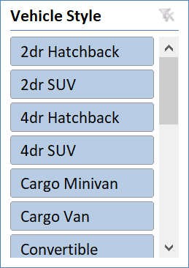
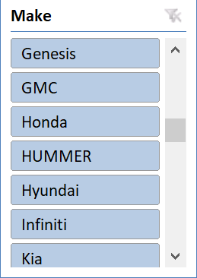
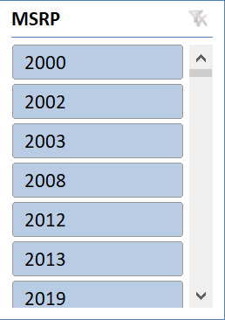

Slide 15
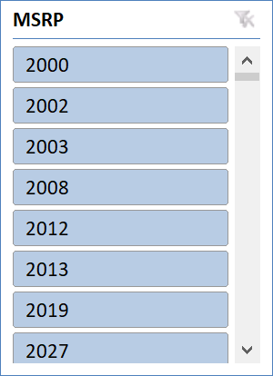
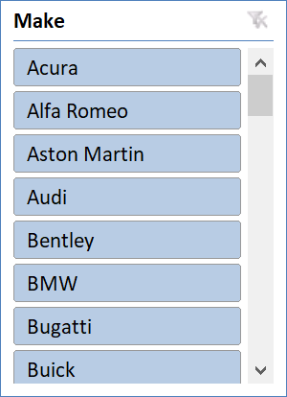
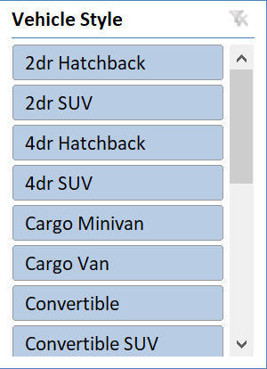
Task 2: Which car brands have the highest and lowest average MSRPs, and how does this vary by body style?

Slide 16
Task 3: How do the different feature such as transmission type affect the MSRP, and how does this vary by body style?

Slide 17
Task 4: How does the fuel efficiency of cars vary across different body styles and model years?

Slide 18
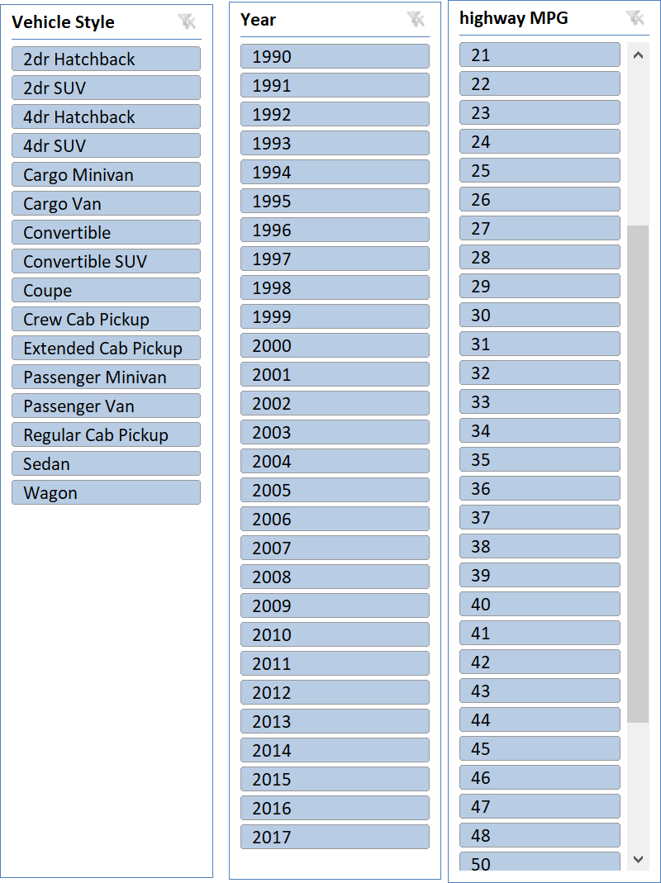
Years | Average of highway MPG
1990 | 23.07317073
1991 | 22.15131579
1992 | 24.05084746
1993 | 24.21634615
1994 | 23.87037037
1995 | 23.23134328
1996 | 23.72519084
1997 | 22.30857143
1998 | 21.85064935
1999 | 22.975
2000 | 24.04237288
2001 | 23.70833333
2002 | 22.76585366
2003 | 22.73529412
2004 | 23.125
2005 | 23.64251208
2006 | 23.42439024
2007 | 21.93913043
2008 | 22.98853868
2009 | 23.88709677
2010 | 24.17406143
2011 | 25.225
2012 | 26.34974093
2013 | 27.44628099
2014 | 26.88601036
2015 | 28.50975836
2016 | 28.53957845
2017 | 28.33292905
Grand Total | 26.3209448

Slide 19
Task 5: How does the car's horsepower, MPG, and price vary across different Brands?

Slide 20

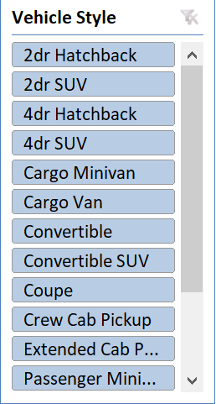
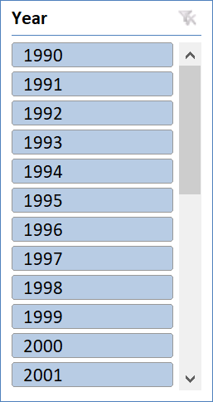
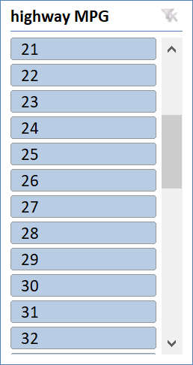

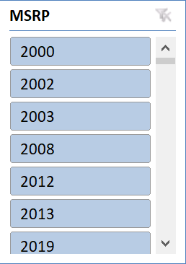

Slide 21
RESULT:
The data suggests that Ford's sedan-style cars with 250 horsepower engines and either manual or automatic transmissions are more popular with consumers, meaning that more people are purchasing them at a higher price. • We can design a car with comparable features by copying Ford's strategy. • In the future, electric cars with good mileage and fewer cylinders might become more popular as consumers value automobiles that offer excellent fuel efficiency at a cheap cost. • When the dependent variable is a numerical value, like price, regression analysis cannot be done on categorical values.
https://drive.google.com/drive/folders/11LKWHefOOjVzPy3FpKaGGg_kKZ4kb45y

