Slide 1
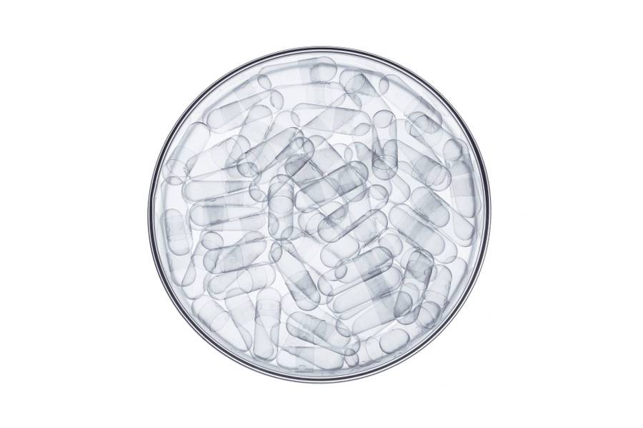
Investmate
A llm chatbot for investment bankers
By – Deepti agarwal

Slide 2
Contents
PROBLEM STATEMENT & SOLUTION
FEATURES OFFERED
PROGRESS FLOW
ARCHITECTURE DIAGRAM
TECHNOLOGIES USED

Slide 3
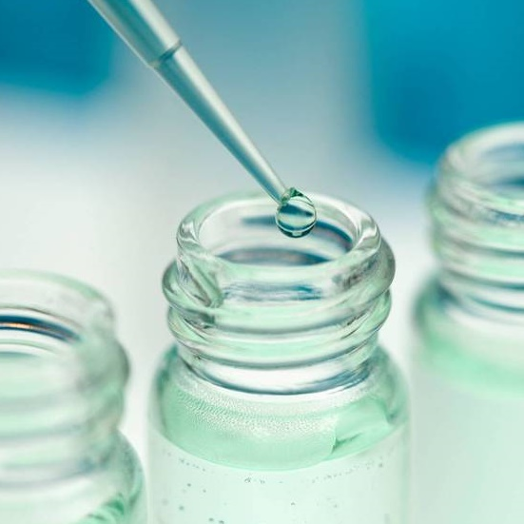
Problem statement
Introduction to GenAI and Simple LLM Inference on CPU and fine-tuning of LLM Model to create a Custom Chatbot
This problem statement is designed to introduce beginners to the exciting field of Generative Artificial Intelligence (GenAI) through a series of hands-on exercises. Participants will learn the basics of GenAI, perform simple Large Language Model (LLM) inference on a CPU, and explore the process of fine-tuning an LLM model to create a custom Chatbots.

Slide 4
Unique idea/solution
I developed the "Investment Banking RAG Chatbot" using Intel's Neural Chat LLM to create a responsive and efficient tool. This chatbot employs Retrieval Augmented Generation (RAG) for detailed responses, orchestrated by Langchain, and leverages a 2-bit quantized LLM from Huggingface. With BGE Embeddings and Chroma DB for data handling, the chatbot offers robust performance. The backend, built with Flask, ensures reliability, while the user-friendly interface provides an engaging experience. This solution demonstrates advanced GenAI applications for accessible and accurate investment banking information.

Slide 5
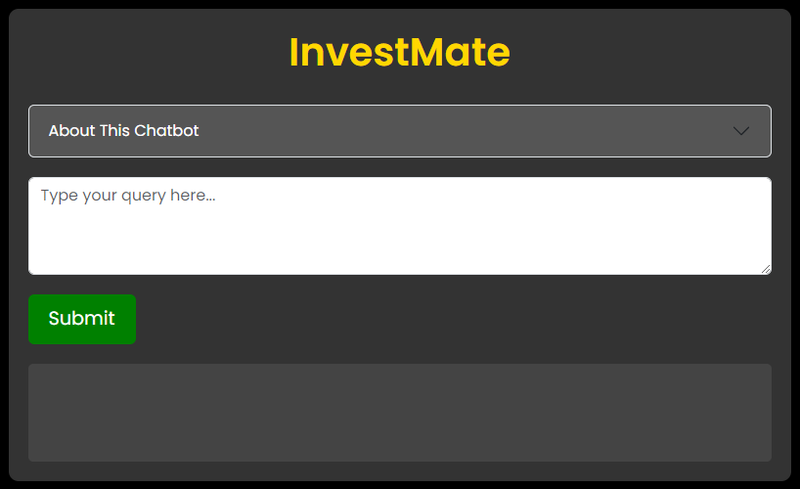

INVESTMATE – INVESTMENT BANKING CHATBOT

Slide 6
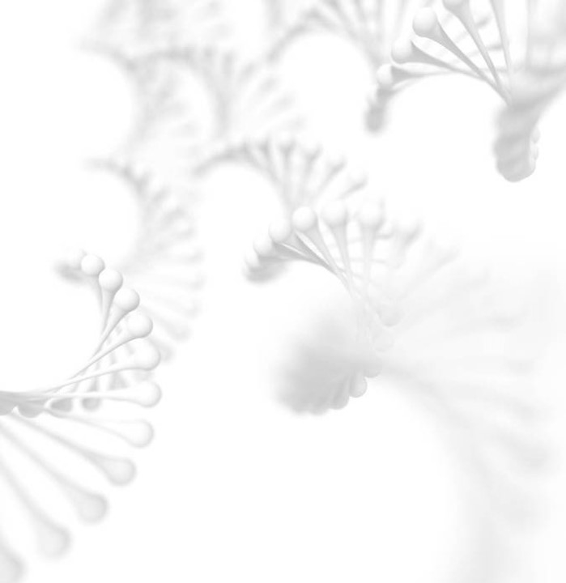
Features offered
Detailed Responses: Utilizes Retrieval Augmented Generation (RAG) to provide in-depth and relevant answers.
High Performance: Powered by Intel’s 2-bit quantized LLM for efficient processing on a CPU.
Advanced Embeddings: Incorporates BGE Embeddings for precise context understanding.
Robust Data Handling: Uses Chroma DB as a vector store to manage and retrieve complex query data effectively.
Comprehensive Information: Integrates information from PDFs to offer thorough insights on investment banking.
Responsive Interaction: Ensures quick and accurate responses to user queries and Intuitive conversational interface.

Slide 7
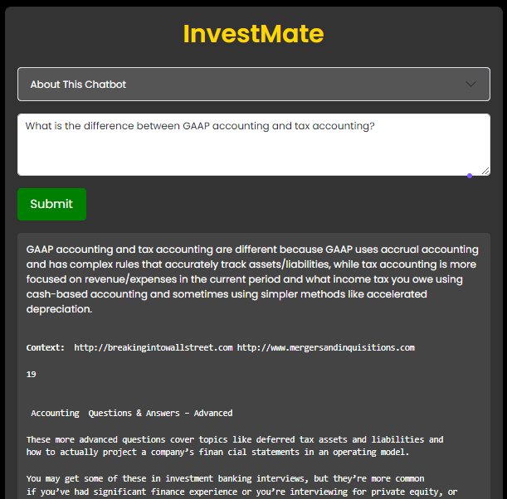
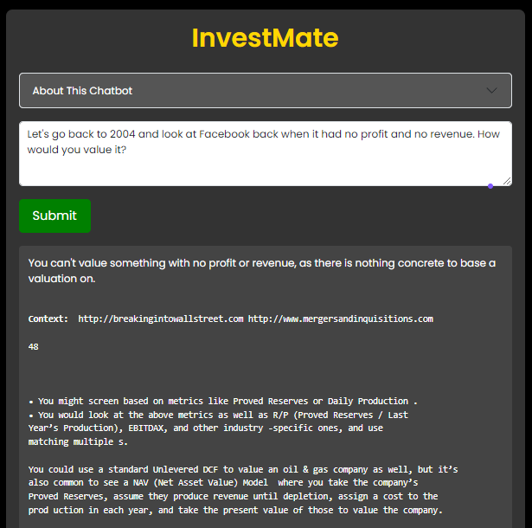
SAMPLE OUTPUTS

Slide 8
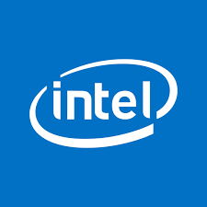
Progress flow
Conceptualization
1
Identified the need for an investment banking chatbot.
Defined the key features and objectives for the chatbot.
Technology selection
2
Chose Intel’s Neural Chat LLM for efficient and high-performance processing.
Decided on using Retrieval Augmented Generation (RAG) to enhance response accuracy.
3
Framework and Orchestration Setup
Selected Langchain as the orchestration framework to manage the chatbot's components.
Established a clear structure for integrating various technologies and tools.

Slide 9
Progress flow
Model integration
4
Integrated Intel’s 4-bit quantized LLM from Huggingface for robust performance.
Ensured the model is optimized for CPU inference.
Embedding and Vector Store Implementation
5
Implemented BGE Embeddings to generate precise context for responses.
Utilized Chroma DB as the vector store to manage and retrieve complex query data efficiently.
Backend development
6
Developed the backend using Flask for a flexible and robust infrastructure.
Created APIs to facilitate smooth interaction between the frontend and the backend.

Slide 10
Progress flow
Frontend development
7
Designed and developed a user-friendly conversational interface.
Ensured the interface is intuitive and engaging for users.
Data integration
8
Incorporated investment banking-related PDFs as primary data sources.
Processed and indexed the data to be used effectively by the chatbot.
Testing and validation
9
Conducted thorough testing to ensure accuracy, responsiveness, and performance.
Validated the chatbot's ability to handle a wide range of investment banking queries.

Slide 11
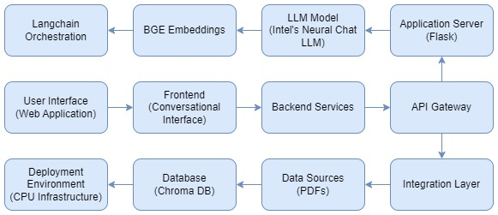
Architecture diagram

Slide 12
Technologies used
Intel’s neural chat llm model (neural-chat-7b-v3-1.Q2_K.gguf)
HTML
CSS
BOOTSTRAP
JAVASCRIPT
FLASK
CHROMA DB
HUGGINGFACE TRANSFORMERS
BGE (BloomGPT Embeddings)
CTRANSFORMERS
LANGCHAIN
VS CODE IDE

Slide 13
Team members and contribution
As the sole developer, I integrated advanced technologies like Intel's Neural Chat LLM and RAG to create a robust investment banking chatbot. Using Langchain for orchestration and Chroma DB for efficient data management, the chatbot offers precise responses and a user-friendly interface. Moving forward, I will continue to enhance its capabilities based on user feedback and advancements in AI technology.

Slide 14
conclusion
In developing the investment banking chatbot, I integrated cutting-edge technologies to create a robust and intelligent system. Leveraging Intel's Neural Chat LLM and RAG technology, I ensured the chatbot delivers precise and detailed responses, enhancing user interactions. The use of Langchain for orchestration streamlined the integration of various components, while Chroma DB efficiently managed data for seamless query handling. The frontend interface offers an intuitive conversational experience, supported by a resilient backend built on Flask. Moving forward, I aim to continuously optimize and expand the chatbot's capabilities, incorporating user feedback and advancements in AI to maintain its relevance and effectiveness in the dynamic field of investment banking.

Slide 15

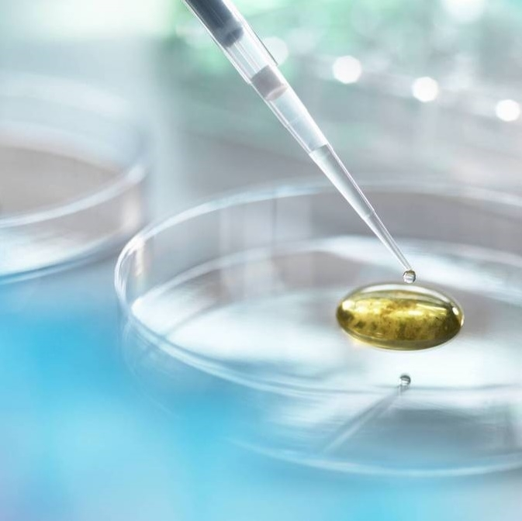
Thank you
DEEPTI AGARWAL
GLA UNIVERSITY, MATHURA

