Slide 1
Human resources slide 1
MindCare –
AI-Powered Mental Health Platform
A Gamified Approach to Therapy Adherence
Team 12

Slide 2
Human resources slide 2
Problem Statement
Many individuals struggle with therapy adherence.
High dropout rates in mental health treatments.
Stigma around discussing mental health issues.
Need for a personalized, engaging, and stigma-free solution.

Slide 3
Human resources slide 4
Our Solution: MindCare
TherapyBuddy :
Guided Gamified Activities :
AI chatbot for personalized mental health conversations.
Engaging self-healing exercises
Mood & Progress Tracking :
Daily Challenges & Streaks :
Insights for better self-awareness
Motivation to stay consistent

Slide 4
Human resources slide 5
Target Audience
Students & Young Adults:
Managing academic stress & social anxiety.
Individuals Hesitant to Share:
Stigma-free & anonymous mental health support.
Working Professionals:
Coping with burnout & workplace stress.
People with Anxiety & Depression:
Encouraging self-healing.
Introverts & Lonely Individuals:
Finding a non-judgmental companion.

Slide 5
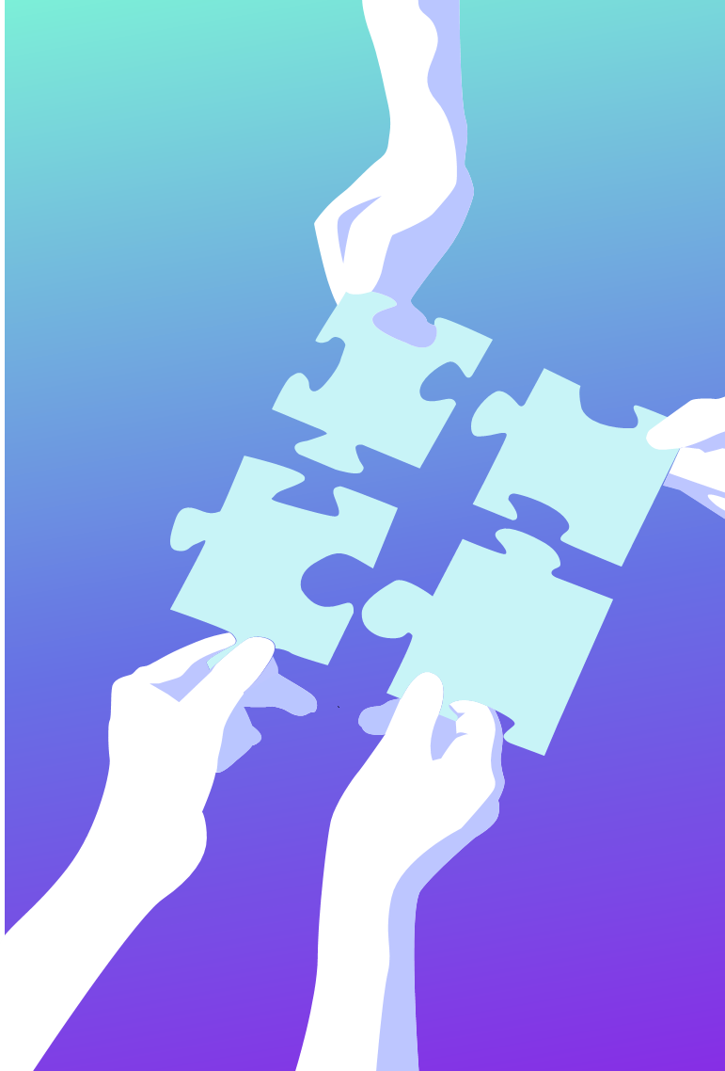
Human resources slide 8
Key Features
TherapyBuddy (AI Chatbot) –
Like a supportive friend, providing real-time personalized conversations
Gamified Guided Activities – Meditation, breathing exercises, and mental wellness games for stress relief
Daily Mental Health Challenges –
Fun tasks to build healthy habits
Gratitude Journal & Mood Tracking – Encouraging self-reflection
Streak Tracking System –
Keeps users motivated & reduces dropouts

Slide 6

Human resources slide 7
Why MindCare Stands Out?
1
2
3
4
Gamified Healing
Personalized Support
Streak Motivation
Privacy First
Making therapy interactive and enjoyable
AI-powered chatbot for tailored guidance
Boosting adherence and reducing dropouts
Safe, stigma-free mental health support

Slide 7
Human resources slide 9
Conclusion
MindCare offers an innovative approach to mental health support by combining AI-powered therapy and gamified activities. With personalized interventions and engaging challenges, it enhances therapy adherence and promotes emotional well-being in a stigma-free environment.
TherapyBuddy acts as a supportive AI companion, providing personalized conversations and empathetic responses. By offering continuous emotional support and encouraging self-reflection, it empowers users to manage their mental health with confidence and consistency.

Slide 8
Human resources slide 10
Thank You

