Slide 1
Feeling the heat: Prediction of rise in average surface temperature using human-economic activity alternative data
Predictive Analytics ( Prof. Anasse Bari )
Team 4: Jahnavi Swetha(jp5867), Deepti Saravanan(ds6812)
Mentor: Chris Davidson

Slide 2
Abstract
Every one degree increase in temperature will impact the planet adversely. Since the 1970s, global mean temperatures have increased 0.2˚C per decade. The rise in temperatures could melt the ice, lead to rising of sea level, change the ocean currents and precipitation, as well as potent a risk to the life on land and water. Greenhouse gas emissions is the most significant contributor to the climate change issue. Understanding the human factors that cause greenhouse gas emissions is imperative to take future action to combat climate change.
Past work has considered many key contributors that include CO2 emissions, ocean and atmospheric dynamics to predict the change in temperature, but did not research into the source of the issue – human activities. In this study, we predict the rise in average surface temperature across countries by tapping into alternative data such as GDP, global car sales, land elevations, etc. The result of the study would hold a high impact on the decision making of respective governments on prioritizing and working towards immediate concerns.

Slide 3
Introduction
The General circulation models (GCMs) have been constructed by numerical representations of atmospheric physical conditions.
These models are based on the laws of physics such as conservation of mass, energy, and momentum and try to predict the climate on the earth.
But, with the complex mathematical equations of Global Climate Models, it is difficult to understand the effect of various human activities on the climate change.
Our work is motivated by the importance of addressing the factors leading to increased emission of greenhouse gases into the atmosphere, which are predominantly human activities.
So, in this study, we apply simple models to predict the rise in average surface temperature using human economic activity alternative data.

Slide 4
What is Climate Modeling?
Understands how the climate system works
Earth’s climatic factors
Mathematical Modeling
Future Climate Predictions
How does a simple energy balance model work?
Increase in temperature because of greenhouse gas emissions
sun
sun
sun
Inflow = Outflow
Reflection cools the surface
z
x
x
x
x - y
x
Greenhouse gas
x-y+z
y
y
z
Earth Surface
Earth Surface
Earth Surface
Reference

Slide 5
Literature Review
Global Climate Models – https://www.ipcc.ch/report/ar4/wg1/
These complex models use atmospheric parameters like greenhouse gases, ocean dynamics, cloud systems to predict the temperature.
There are many key processes that would affect the temperature change but it’s hard to add all of them. Also, there is a constant need of interpretability of these complex models.
European Multi Model Ensemble (EMME): A New Approach for Monthly Forecast of Precipitation - https://link.springer.com/article/10.1007/s11269-021-03042-8 (2022)
The study combined individual forecasts from a group of european climate models to produce an ensemble forecast. Artificial neural networks, support vector regression, decision tree and random forests were used to predict the climate change.
Neural networks and random forest methods performed better than the decision tree and the support vector machine and the ensemble result is better than the individual models.
Improving Predictions of Climate Change – Land Use Change Interactions - https://www.sciencedirect.com/science/article/pii/S0169534720302494?casa_token=cVQMymlYOiMAAAAA:YjiDXSVFhD-ZyQLShvLVwBvMLarE_gYGUXa2VjDpdjSFuGz0yyV2HZa83XA0kQwzTjiKjY0 (2021)
This talks about how the human activities transform the natural landscape which in turn affects the climate change in an area.

Slide 6
Literature Review (contd.)
Prediction of Sea-Surface Temperature (SST) using Deep Learning – https://link.springer.com/article/10.1007/s42452-020-03239-3 (2020)
Using Advanced Very High Resolution Radiometer (AVHRR) infrared satellite SST data (historic), the authors used ANN and LSTM to predict SST (R score of 0.94).
Forecasting Climate Trends using Neural Networks – https://www.frontiersin.org/articles/10.3389/frobt.2019.00032/full (2019)
Constructed image grids using month mean temperature of regions for a period of 30 years and predicted a rise or fall in temperature using LeNet.
97% accuracy was attained.
Forecasting Air Temperature using Deep Neural Networks – https://www.sciencedirect.com/science/article/pii/S1877050920323784 (2020)
Comparative study of three models – Multi-Layer Perceptron (MLP), LSTM and an ensemble of CNN and LSTM, using historical data.
The ensemble performed the best with an accuracy of 73%.

Slide 7
Methodology – Data Collection
Initially the data was collected for the time period of 1950-2020.
Many countries have missing values for the factors considered as features to predict climate change in the early periods.
Imputation methods like Stochastic Regression or using any ML model to fill in the past values using present will not work for a huge chunk of continuous missing data and it might propagate error.
Also, the significance of the kind of human activities is different in comparing the trends from the 1950s and the 2020s.
Hence, we have decided to go with the data between the time period of 1990-2020
The 12 features country-wise selected are Average surface temperature, Population, Land Elevation, GDP, Housing Market, CO2 per capita, Migration Rate, Air Travel, Internet Usage, Fertilizer Consumption, meat Consumption

Slide 8
Methodology – Data Preprocessing
Data Cleaning:
Extracted required columns
Filtered data to include data only from 1990-2021
Extracted required rows in case of any categorical columns
Converted column data types
Linear imputation employed to fill missing data
Extrapolation for data that had contiguous missing blocks
Checked for null values
Treated the null values
Country renaming in case of multiple names for uniformity
Consolidated data distributed between files into a single CSV
Data Fusion:
Based on country and year
Multiple country names – fusion performed using standard ISO codes

Slide 9
Methodology – Feature Selection
Feature Variance (10% threshold)
Pearson Correlation
ANOVA f-score
Univariate Linear Regression
Feature Importance using sequential backward selection
Mutual Information based feature ranking
Final dataset size post feature selection is 1022x16

Slide 10
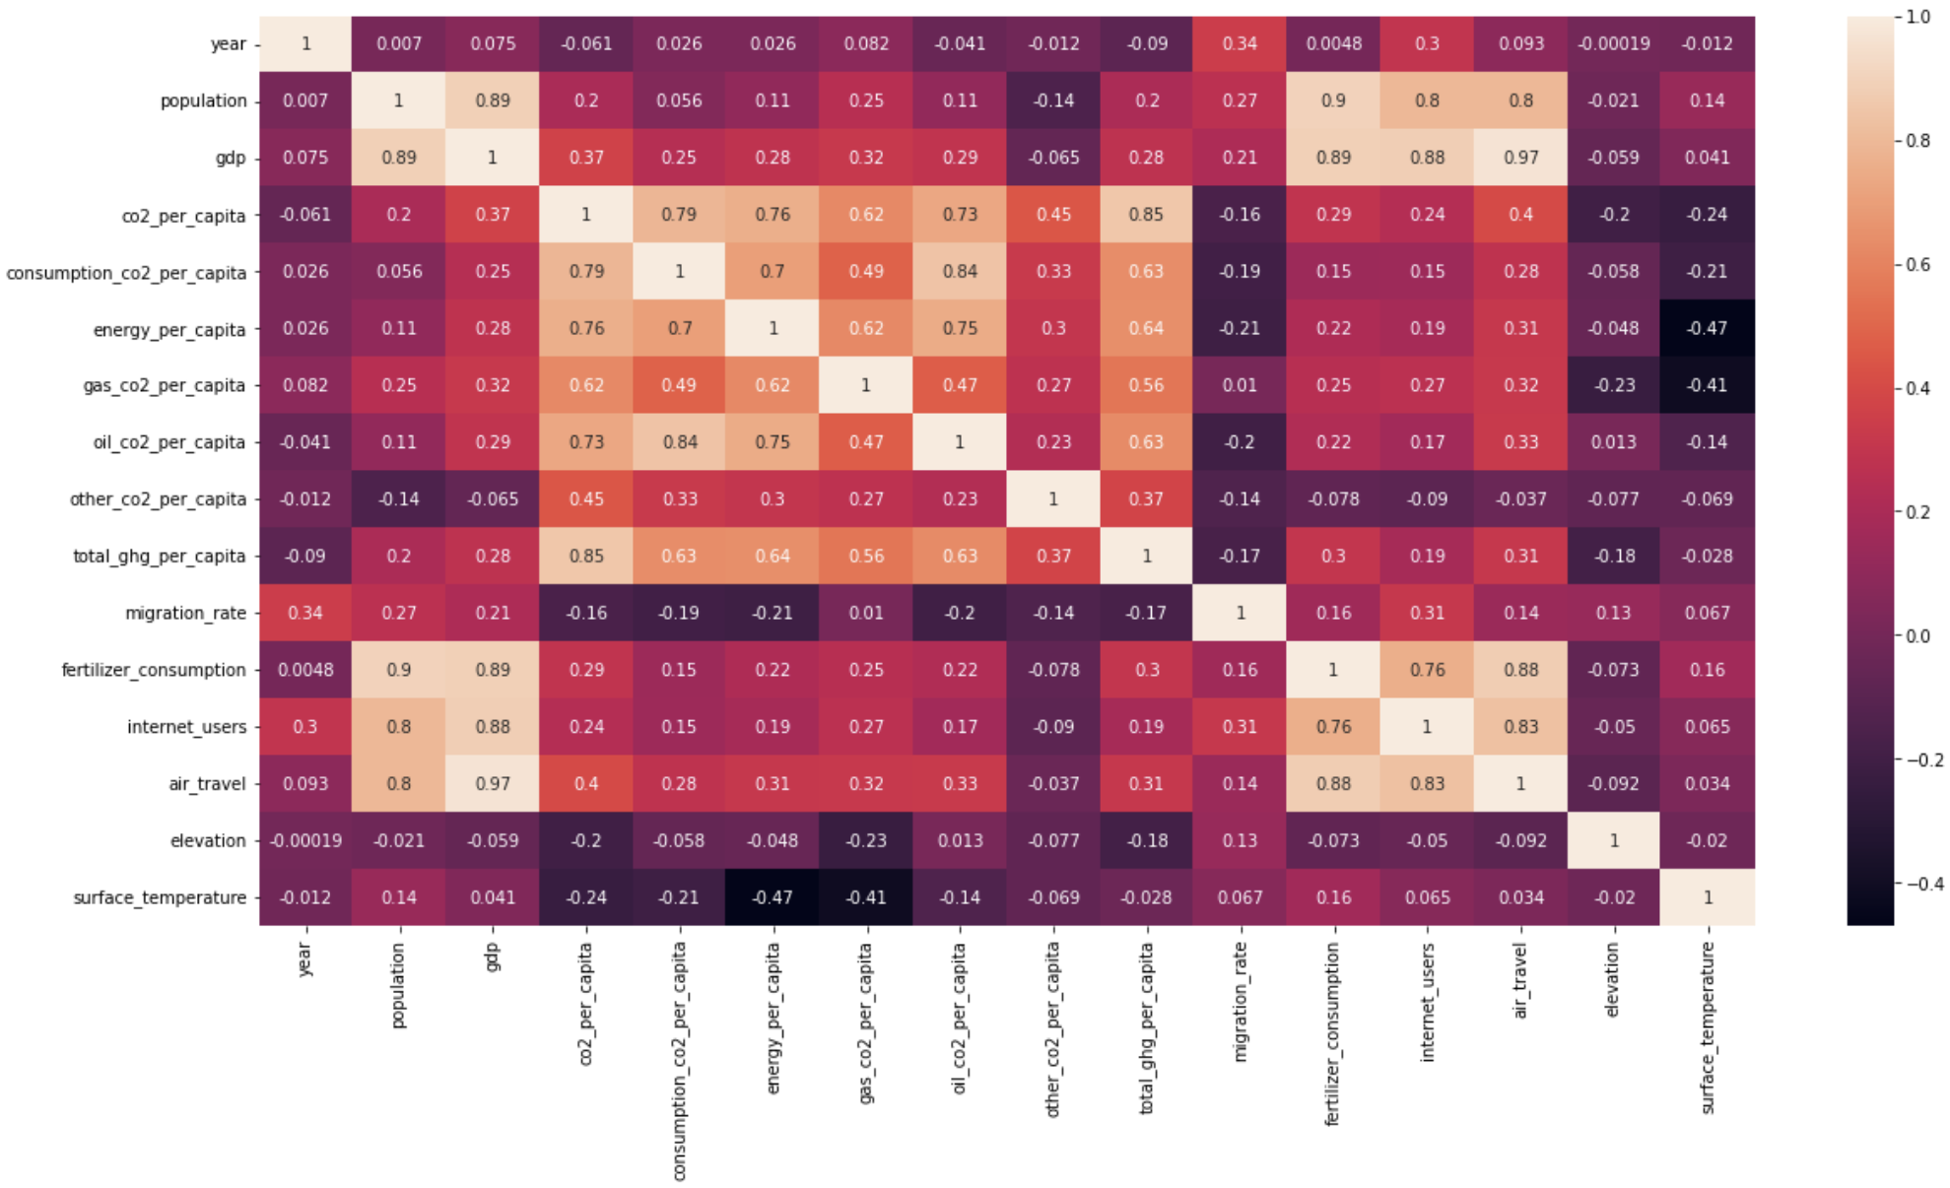
Pearson Correlation

Slide 11
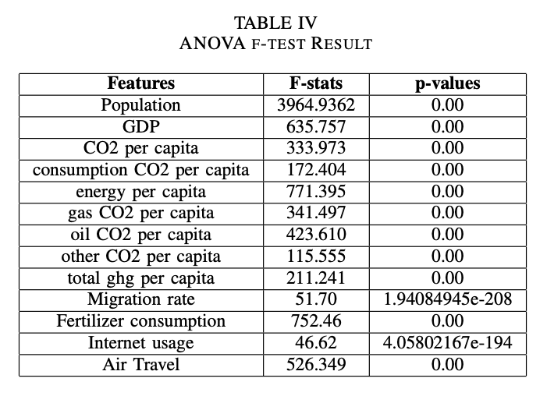
ANOVA f-score
High F-values – explained variance > unexplained variance
P-values < 0.05 – statistically significant

Slide 12
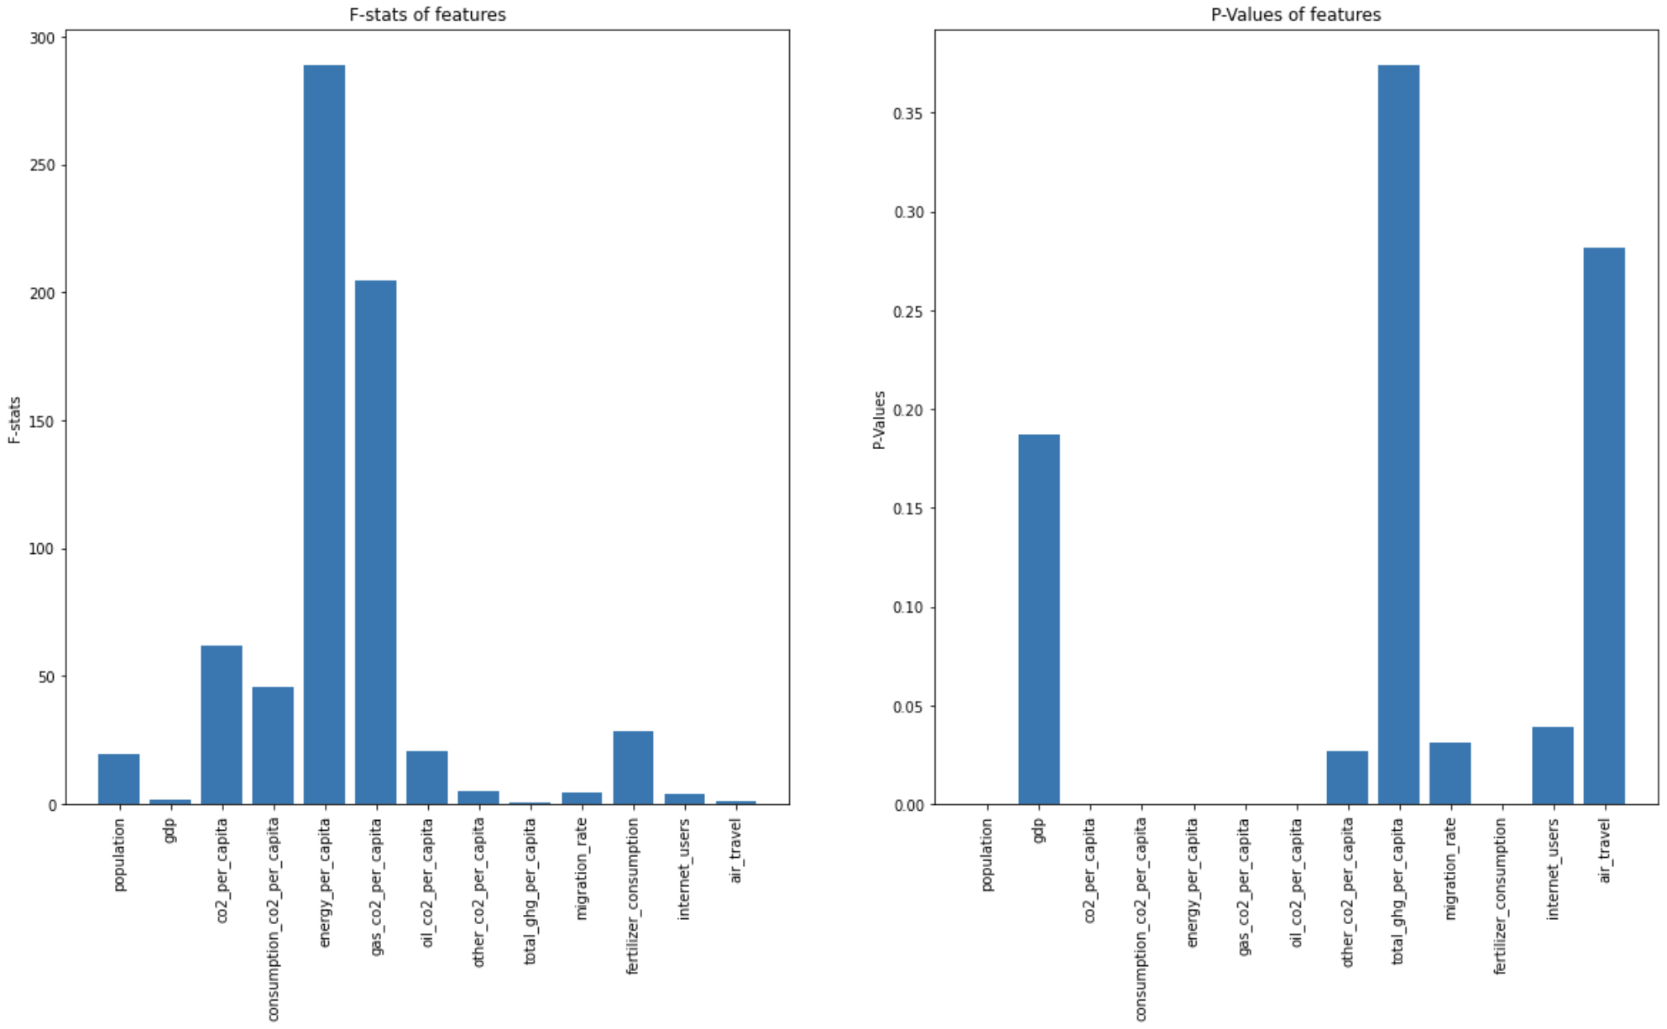
Univariate Linear Regression

Slide 13
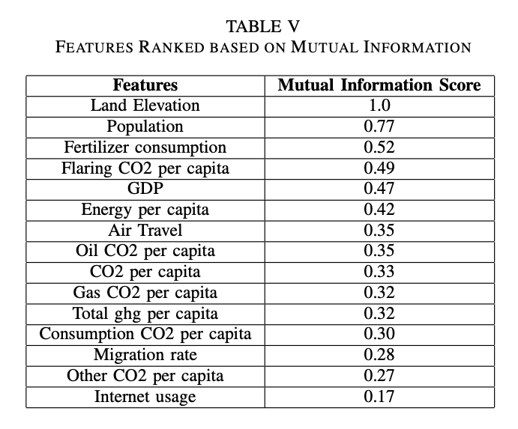
Feature Importance using Sequential Backward Selection
AIC scores of models gradually increased as features were removed.
P-values were less than 0.05 for a few of the features.
Mutual Information based Feature Selection
Measures the strength of association between the feature and average surface temperature
Combining the results from all the feature selection techniques, three features were eliminated – flaring CO2 per capita, energy per capita, total ghg per capita
Final Dataset size: 1022x16

Slide 14
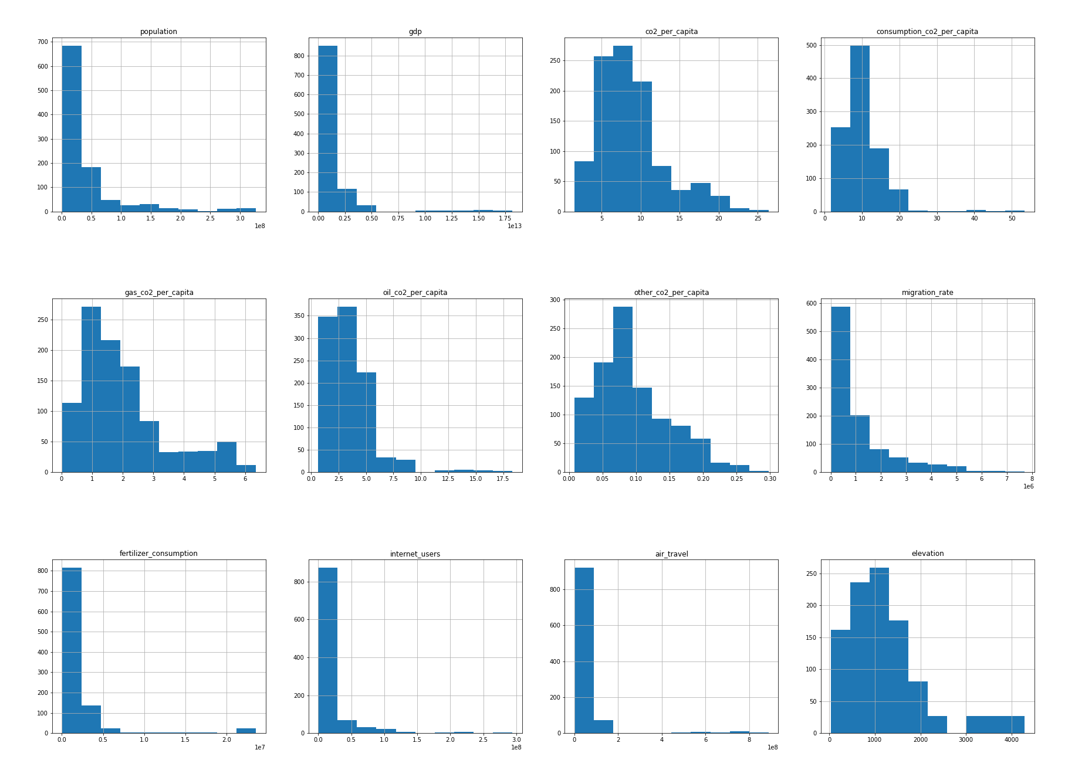
Causation Test - Qualitative Test
Skewed Histograms

Slide 15
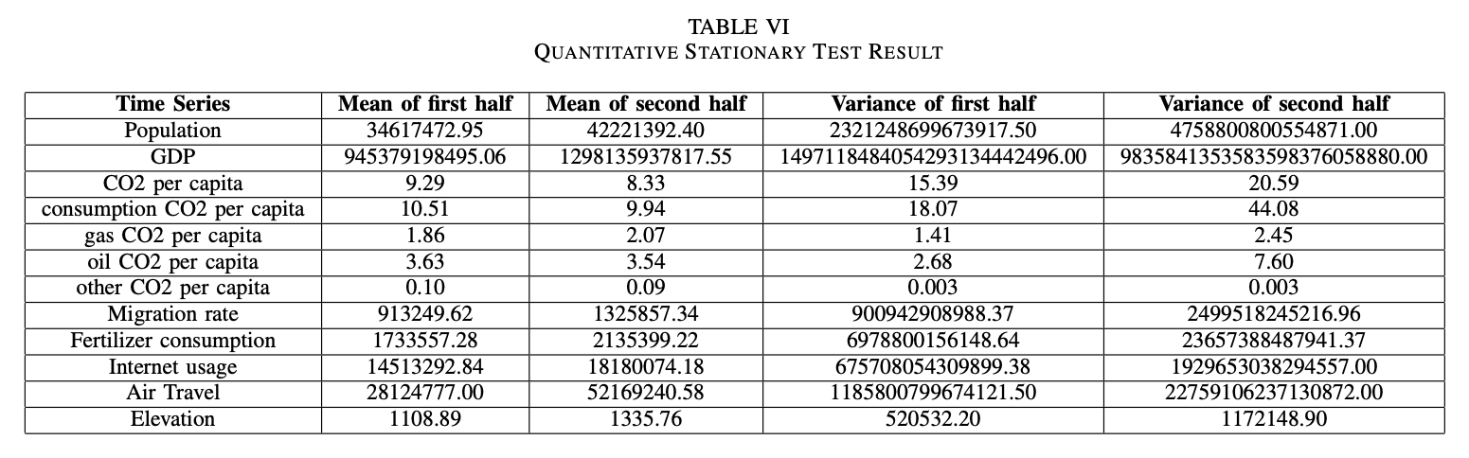
Causation Test - Quantitative Test
Non-stationary features: Population, GDP, Fertilizer consumption, Internet users, air travel

Slide 16
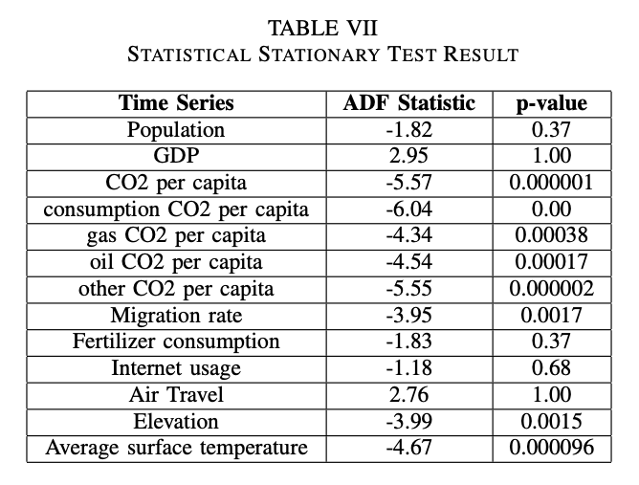
Causation Test - Statistical Test
Non-stationary features: Population, GDP, Fertilizer consumption, Internet users, air travel

Slide 17
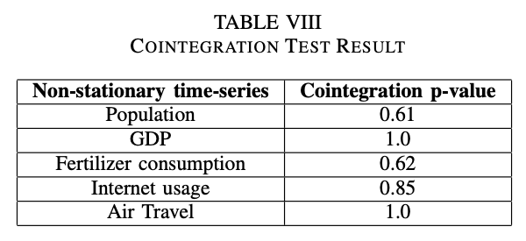
Cointegration Test
None of the non-stationary time series features are cointegrated with the surface temperature
p-values are greater than 0.05

Slide 18
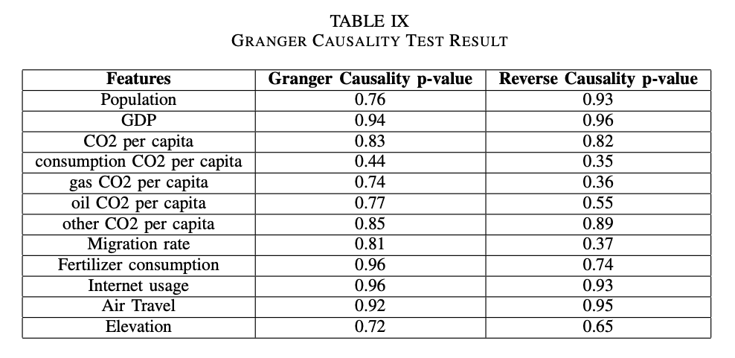
Granger Causality
Assumption: Stationary time-series
Conversion of non-stationary to stationary using difference operation with a shift of one
There is no direct causal relationship
Both Granger Causality and Reverse Causality have p-values greater than 0.05 for all the features

Slide 19
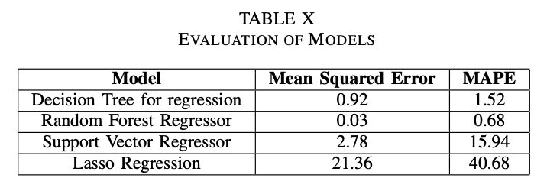
Modeling
Decision Tree for Regression
Random Forest Regressor
Support Vector Regressor
Lasso Regression
LSTM
Experimental Results
Decision Tree and Random Forest for Regression performed the best

Slide 20
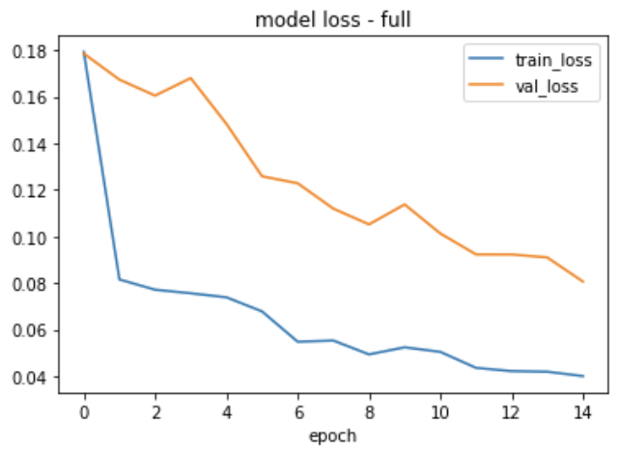
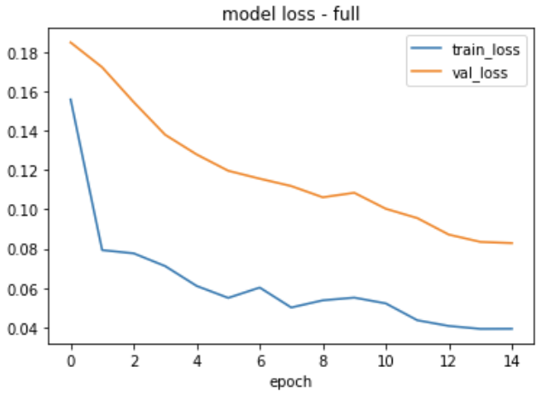
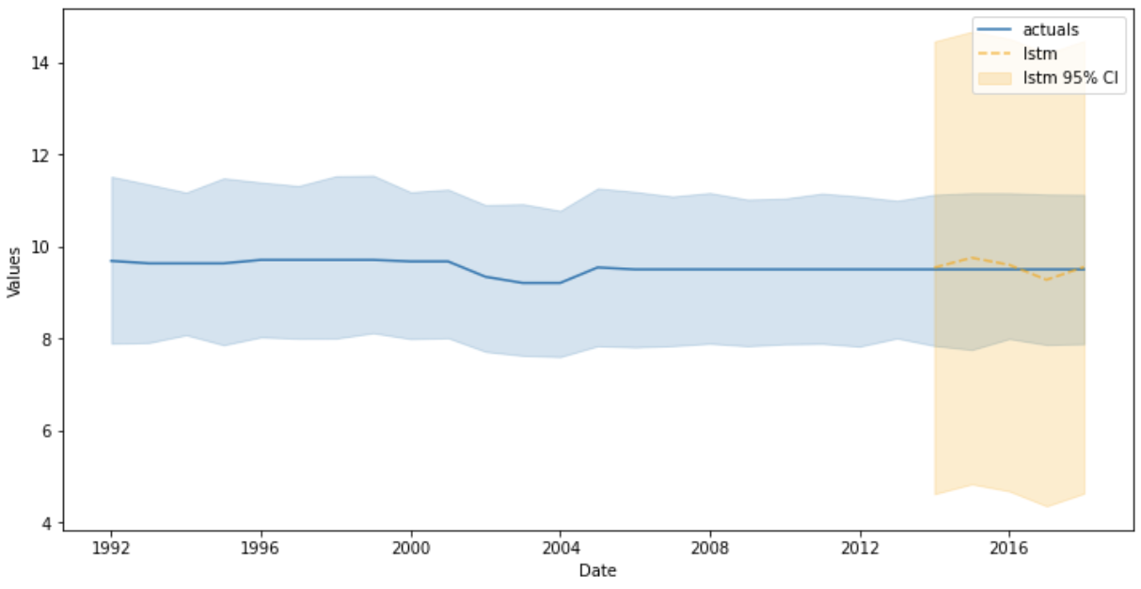
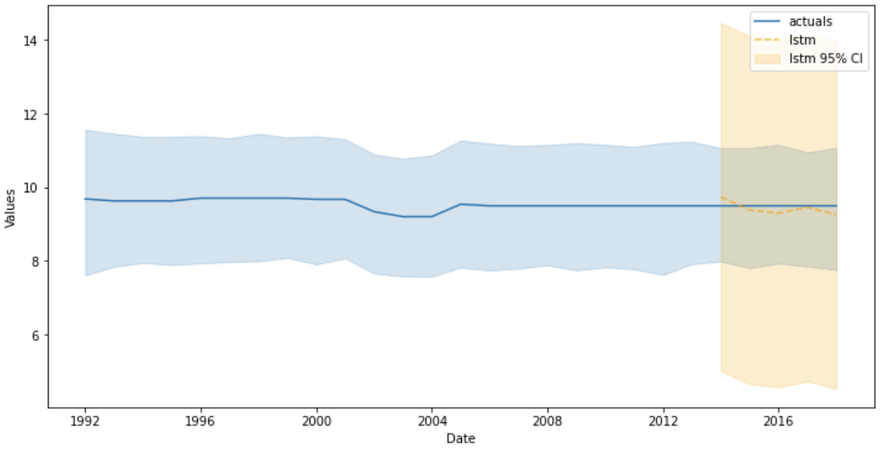
LSTM Results
All the selected features
Minus GDP, population, internet usage
Research Doc

Slide 21
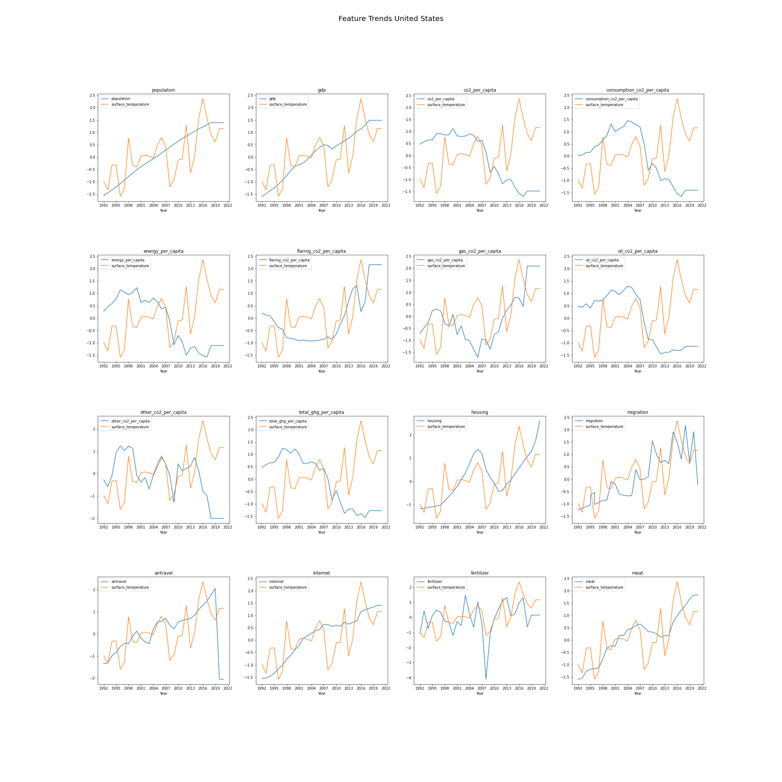
Inference
CO2 related features around 2008
Oil CO2 per capita drops abruptly from 2008 due to the 2008 economic crisis. Around the same time, the average surface temperature dropped at similar rates.
Later, even though there is a decrease in the Oil CO2 per capita, the surface temperatures started to increase due to the rise in gas CO2 per capita.
Other CO2 related features dropped during the same period.
Similar results could be inferred from feature selection steps where CO2 related features were consistently ranked higher.

Slide 22
Inference
CO2 related features around 2013
There was an abrupt decrease in the average surface temperature and the CO2 related features stayed low around that time
This could be due to the increasing usage of the electric vehicles in the market.
In 2013, Tesla sold a record of 22,477 cars and this could be an indicator for the high demand of electric vehicles.

Slide 23
Inference
Fertilizer Consumption
From 2005 whenever there is a peak in fertilizer consumption, it is observed that there is a peak in average surface temperature.
Between 2007 and 2009, there was a huge dip in fertilizer consumption, hence it is possible that the fertilizer consumption and CO2 related factors together have a significant effect on the average surface temperature.
Fertilizer consumption is also the next high ranked feature following CO2 features.

Slide 24
Inference
Migration Rate
Between 2005 and 2017, the peaks in the migration time series almost match the peaks in the average surface temperature.
Between 2010 and 2018, the peaks in average surface temperatures follow the peaks of migration, with a lag of almost one year.
This could be a good predictor in the future since the effect of migration on the average surface temperature in the current period of time is higher than the past.

Slide 25
Inference
Air Travel and Internet Usage
The number of passengers traveling by air travel increases following the peaks in average surface temperature.
It is interesting to raise a question about the reverse effect that is the possible effect of average surface temperature on air travel.
If true, it could be used as an alternative stock price predictor in the aviation industry.
Internet usage pattern does not show any observable correlation with average surface temperature.

Slide 26
Inference
Hence we can infer that the various human activities have distinctive effects on the average surface temperature.
As of 2018, only sixteen countries out of the 197 that have signed the Paris Agreement have defined a national climate action plan ambitious enough to meet their pledges.
Recently, scientists have found zombie virus that had been stranded under a lake more than 48,500 years ago in the siberian region. Scientists are warning that, with the global warming there is a high chance of melting of the glaciers and potentially expose these deadly virus.
A deeper study along these lines of human factors by the countries would be immensely useful in tackling climate change and adopting policies that would best suit their interests.

Slide 27
Conclusion
Data was collected from multiple sources for 12 kinds of human activities
Data Preprocessing – Cleaning, Imputation, Fusion
Six Feature Selection Techniques –
CO2 per capita and Other CO2 per capita showed very low variances.
Total ghg per capita feature was found to be redundant from Pearson Correlation Analysis.
ANOVA f-score showed that the variance between the features and value to be predicted (surface temperature) is greater than the variance within the features.
Univariate Linear Regression provided a good evidence of strong relationship between the features and average surface temperature.
Sequential Backward Selection resulted in high aic scores that are statistically significant for most of the features.
Mutual Information based Feature Selection was used to rank features based on mutual information score.
Time-series stationary tests –
Qualitative (Histogram plot)
Quantitative (time-series split mean and variance comparison)
Statistical (Augmented Dickey-Fuller test)
Granger Causality Analysis – no direct causal relationship
Five predictive models – Decision Tree for regression, Random Forest Regressor, Support Vector Regressor, Lasso Regression, LSTM
Decision Tree for regression, Random Forest Regressor and LSTM performed the best
Challenges and Limitations
Unavailability of reliable data for a few human activities, given the fact that different countries vary in their data collection capabilities and associated infrastructure.
Future Work
Extend the study to analyze the rate of deforestation over the period of time by employing computer vision techniques on satellite imagery
Incorporating wider ranges of data collection

