Slide 1

LITERATURE REVIEW
DEEPTI SARAVANAN

Slide 2
Collarana, Diego & Heuss, Timm & Lehmann, Jens & Lytra, Ioanna & Maheshwari, Gaurav & Nedelchev, Rostislav & Trivedi, Priyansh. (2018). A Question Answering System on Regulatory Documents. DATA: German Regulatory Document CONCEPTS: Cosine Similarity, LSTM, attention models
Q&A MODEL

Slide 3
WORK DONE | CHALLENGES | KEY TAKEAWAYS
PARAGRAPH SELECTION MODULE: FastText embedding of words n-grams(3,4,5,6) of words in each document – pseudoquery Cosine similarity – pseudoquery and actual query ANSWER SELECTION MODULE: Match LSTM – new representation of paragraphs based on the question. Final representation = new representation combined with original question vector Answer Pointer – Self-attention based mechanism – points to the exact span MODEL PERFORMANCE: Transfer Learning - improved model performance (F1 = 0.59) Synthetic Training Data Expansion - Question generation model for each sentence Precision - 67% | Limited Data for training External data used - SQuaD (non-legal domain) | Transfer Learning Different combination of n-grams Synthetic Data Generation

Slide 4
Saias, José & Quaresma, Paulo. (2020). Using NLP techniques to create legal ontologies in a logic programming based web information retrieval system. DATA: Portuguese Regulatory Document CONCEPT: OWL Ontology
Q&A MODEL

Slide 5
WORK DONE | CHALLENGES | KEY TAKEAWAYS
REGULATIONS: OWL instances into ISCO facts. QUERIES: SYNTAX: Syntactic Analyzer tool (VISL) -> Prolog facts (3 files). 1. Unique word ids in word tags 2. POS tags association 3. Parsing structure – Subject, direct object and predicate – ontology created. SEMANTICS: First Order Logic – Semantic Representation | Discourse Representation Structures Eg. Which are the documents where ﬁremen saved children? Semantics representation: document(A), ﬁreman(B), save(C), child(D), action(E), rel(E, B, C, D), rel(A, E) Discourse referents list: [ref(A),ref(B),ref(C),ref(D),ref(E)] PRAGMATICS: Query -> ISCO query (Interpretation as abduction) | Limited Query types - Docs where action A is performed - Docs where action A is performed with subject S - Docs where S is the subject of the action Hierarchical relationship between classes in the ontology. | Combine this with previous paper – classify training queries. Create automated ontology with multiple attributes for easier retrieval.

Slide 6
Quaresma, Paulo & Rodrigues, Irene. (2005). A Question Answer System for Legal Information Retrieval. 91-100. DATA: Portuguese Judicial Documents CONCEPTS: Discourse Representation Theory, Ontology
Q&A MODEL

Slide 7
WORK DONE | CHALLENGES | KEY TAKEAWAYS
Query types: Places, Dates, Definitions and Specific. Information Extraction: 1. Syntactic analysis: Portuguese Parser 2. Semantic Analysis: Discourse Representation Theory 3. Pragmatic Interpretation: Ontology and logical inference (ISCO) Query Processing: 1. Syntactic Analysis: Portuguese Parser 2. Semantic Analysis: Discourse Representation Theory 3. Pragmatic Interpretation: Map the query to KB. Model Evaluation: 25% Correct Answers (Incorrect structual analysis and Ontology, lack of synonyms) | Ontology Creation Lack of synonyms for Portuguese Language | Discourse Representation Theory

Slide 8
Desola, Vinicio & Hanna, Kevin & Nonis, Pri. (2019). FinBERT: pre-trained model on SEC filings for financial natural language tasks. 10.13140/RG.2.2.19153.89442. DATA: SEC filings (Link given) CONCEPT: Pre-training BERT
BERT

Slide 9
WORK DONE | CHALLENGES | KEY TAKEAWAYS
FinBERT Prime: Pre-training from scratch. (corpus of 630M words) FinBERT Pre2K: 1998 and 1999 datasets (change in financial language) Cosine similarity between the embeddings of analogies. FinBERT Combo: Transfer Learning Model Evaluation: FinBERT Prime performed the best with prediction accuracy of 98%. | Limited Data for training Extend to news articles and posts from financial sites. | Finance Dataset: FiQA

Slide 10
Yang, Yi, Mark Christopher Siy UY, and Allen Huang. "FinBERT: A Pretrained Language Model for Financial Communications." arXiv preprint arXiv:2006.08097 (2020). DATA: Corporate reports, Conference call transcripts and analysis reports (4.5B tokens) CONCEPT: Pre-training BERT (available for use)
BERT

Slide 11
WORK DONE | CHALLENGES | KEY TAKEAWAYS
FinVocab (SentencePiece Library) FinBERT-BaseVocab, uncased/cased and FinBERT-FinVocab, uncased/cased Model Evaluation: FinBERT-FinVocab performed the best with prediction accuracy of 87-89% (uncased) and 81-88% (cased). |  | Finance Dataset: FiQA Financial Phrase Bank AnalystTone Dataset Can use all the additional SEBI documents available

Slide 12
Multiple Interpretation, Cross-country Compliance, Legal Knowledge Graph Construction
Summary of Slides

Slide 13
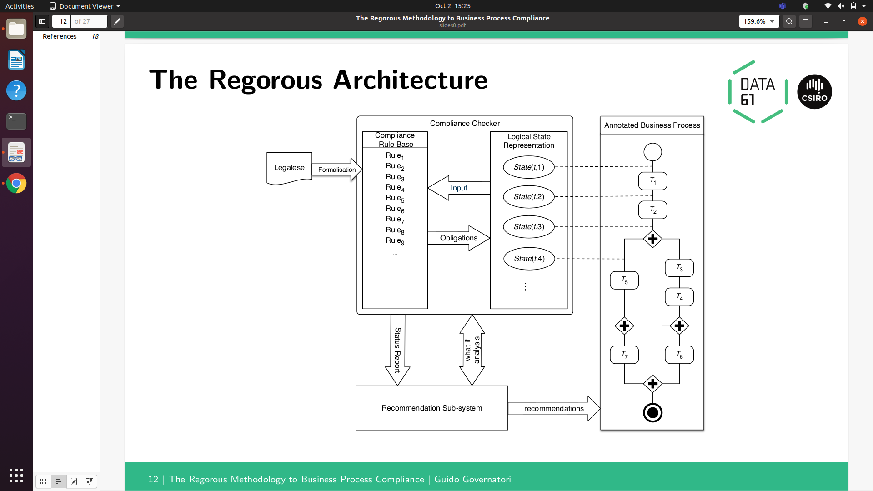
KEY TAKEAWAYS
Rules – Offence and Defense tags – Capture exceptions (Loopholes?)
Business Process Compliance – Rules violation and compensation
Disambiguation – logical forms
Neo4j representation

